Slide 1
ICE Price Data Analysis
CWG/MCWG
Suresh Pabbisetty, ERP, CQF, CSQA.
ERCOT Public
December 16, 2015

Slide 2
ICE Price Data – Preliminary Analysis
CWG/MCWG is considering using ICE Futures data as an input to determine ERCOT’s credit risk exposure.
ERCOT staff performed some preliminary analysis on ICE Futures data as detailed below:
Inputs:
ICE Futures prices pertaining to North HUB Settlement Point for Daily Peak (END) and Off-peak (NED) products are used
Data range from January 2011 through mid-November 2015
As ICE doesn’t have new pricing information available on weekends and holidays, most recent available price of the same product is substituted if a price is missing
ERCOT’s RTSPPs are used for comparison purposes
ERCOT Public

Slide 3
ICE Price Data – Preliminary Analysis
Methodology:
Moving Average Prices are calculated using “M” forward delivery days for both Peak and Off-peak Products
Forward Daily Estimated Average Price Exposure is determined using weighted average of Peak and Off-Peak hours
(16 * ICE Peak Moving Average Price + 8 * ICE Off-peak Moving Average Price) / 24
Forward Daily Actual Average Price Exposure is determined as moving average of 24 hours of ERCOT RTSPPs over the same “M” delivery days.
Comparison, correlation and R-Squared for Estimated vs Actual are performed for various seasons.
Multiple scenarios are run with different “M” values as 21, 15 and 7.
ERCOT Public

Slide 4
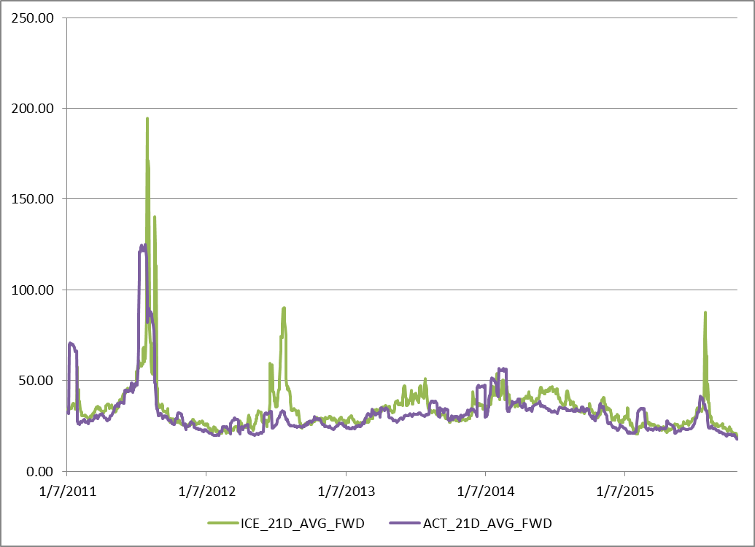
ICE Price Data – Preliminary Analysis
Moving Average Price comparison with “M” = 21:
ERCOT Public

Slide 5
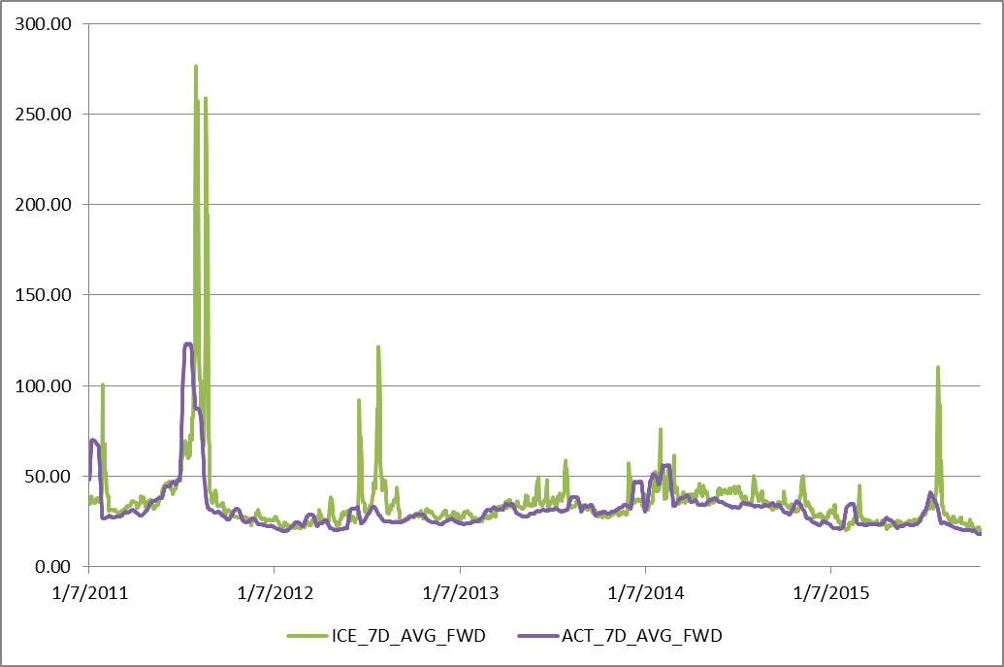
ICE Price Data – Preliminary Analysis
Moving Average Price comparison with “M” = 15:
ERCOT Public

Slide 6
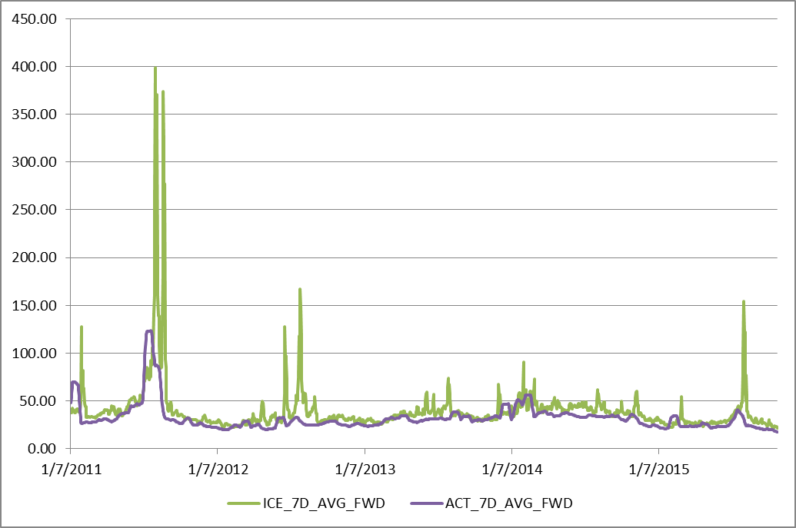
ICE Price Data – Preliminary Analysis
Moving Average Price comparison with “M” = 7:
ERCOT Public

Slide 7
ICE Price Data – Preliminary Analysis
ICE to Actual Moving Average Price correlation and R-Square:
Season | 21-Day Correlation | 21-Day R-Squared | 15-Day Correlation | 15-Day R-Squared | 7-Day Correlation | 7-Day R-Squared
Winter | 69.1% | 47.7% | 61.2% | 37.4% | 54.5% | 29.7%
Spring | 76.5% | 58.5% | 73.3% | 53.8% | 72.6% | 52.7%
Summer | 51.6% | 26.6% | 42.6% | 18.1% | 44.4% | 19.7%
Fall | 73.4% | 53.9% | 74.4% | 55.3% | 62.5% | 39.1%
Overall | 59.6% | 35.5% | 50.9% | 25.9% | 51.1% | 26.1%
ERCOT Public

Slide 8
Questions
ERCOT Public

