Slide 1
Final Update to RMS
December 9th, 2015

Slide 2
MarkeTrak TaskForce: Updates
Switch Hold Review Process
With the switch hold review process operational for a few years, the following is asked of the users:
Are the expectations clearly stated in the guides?
Retail Market Guide
MarkeTrak User’s Guide
Have we identified any gaps in the process?
What information is expected by all parties – CRs & TDSPs?
Are there any issues that need to be clarified/ resolved?

Slide 3
MarkeTrak TaskForce: Updates
Switch Hold Review Process - continued
Robust discussion led to a list of issues which will be addressed by TDTMS:
Documentation required for CSAs
Landlord scenarios and associated documentation
Consistency amongst market participants
Data / metrics on switch hold MTs
Access of TDSP evidence
Switch hold files
Training ?

Slide 4
MarkeTrak TaskForce: Updates
Service Level Agreements for MarkeTraks
Revisited the SLAs for subtypes to increase transparency in the market. ERCOT provide the following raw data for further review:
Issue Sub Type | Count Since 6/1/2015
Cancel With Approval | 18612
Inadvertent Losing | 14191
Inadvertent Gaining | 13563
Switch Hold Removal | 6962
Customer Rescission | 6354
Usage/Billing - Missing | 5124
Missing Enrollment TXNS | 4712
AMS LSE Interval Dispute | 3210
Usage/Billing - Dispute | 3017
Other | 1417

Slide 5
MarkeTrak TaskForce: Updates
Service Level Agreements for MarkeTrak
For the top MT drivers (excluding IAGs & Switch holds), the TF requested the following information:
Cancel with Approval – the # of unexecuted / # of completed MTs
For the remaining top 10, (Usage/Billing – Missing & Dispute, Missing enrollment TXNS – initiated by CR, AMS LSE Interval Dispute) a similar approach to IAGs is requested, by TDSP (anonymously):
#of unexecuted / # of completed MTs
Volume (by TDSP)
Average time for completion (by TDSP)
Results will be reviewed by TDTMS and made available to RMS.

Slide 6
VOTE Sunsetting of MarkeTrak Task Force

Slide 7
WOO HOO!!

Slide 8
MarkeTrak Documentation
http://www.ercot.com/services/client_svcs/mktrk_info/index.html
http://www.ercot.com/content/meetings/rms/keydocs/2014/0110/08.__RMS_MarkeTrak_Task_Force_20140104.ppt
http://www.ercot.com/content/meetings/rms/keydocs/2014/0603/07.__RMS_MarkeTrak_Task_Force_20140603.ppt
http://www.ercot.com/content/meetings/rms/keydocs/2014/1028/07.__RMS_MarkeTrak_Task_Force_20141028.ppt
http://www.ercot.com/content/meetings/rms/keydocs/2015/0106/09.__RMS_MarkeTrak_Task_Force_20150106.ppt
http://www.ercot.com/committees/board/tac/rms/marketraktf/index.html
http://www.ercot.com/content/committees/board/tac/rms/marketraktf/keydocs/2014/PR010_03_training_FINAL.ppt
http://www.ercot.com/content/wcm/training_courses/97/MarkeTrak_Detailed_Training_102014.ppt
http://www.ercot.com/committees/board/tac/rms/marketraktf/MarkeTrak SubTypes Quick Reference 20150510 v2
Link to IAG/Rescission training: http://www.ercot.com/committees/board/tac/rms/marketraktf/index.html/MarkeTrak IAG Training
User Guide
Bulk Insert Templates
MarkeTrak Workflows
MarkeTrak Tips and Tricks
MarkeTrak API WSDL/XSD
Also direct link from MarkeTrak tool

Slide 9
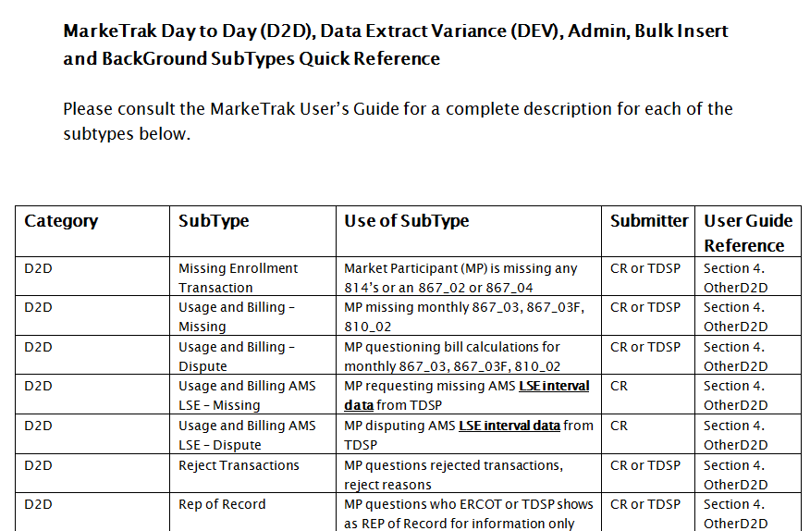
MarkeTrak Documentation
http://www.ercot.com/committees/board/tac/rms/marketraktf/MarkeTrak SubTypes Quick Reference 20150510 v2

