Slide 1
Project Update and Summary of Project Priority List (PPL) Activity
December 10, 2015

Slide 2
2015 Project Update – Agenda
  Project Portfolio Update p. 3-7
    Recent/Upcoming Project Highlights
    2015 Release Targets
    2016 Release Targets
    2015 Project Spending Update
    2016 Project Spending Forecast
  Appendix
    Project Portfolio Gantt Chart p. 8-14
Location of Project Priority List (PPL): http://www.ercot.com/services/projects/index

Slide 3
Recent / Upcoming Project Highlights
2015 December Release – Week of 12/7/2015 In Flight
  NPRR680 – Allow QSEs to Self-Arrange AS Quantities Greater Than Their AS Obligation
  NPRR686 – Changing the IRR Forecast from Next 48 Hours to Next 168 Hours
    Wind elements
  NPRR703 – Clarification of Disclosure Requirements for GINR Study Information
  NPRR718 – Correct Requirement for Posting AML Data
  PGRR044 – MIS Classification of GINR Study Information
Note: Projected Go-Live dates are subject to change.
Please watch for market notices as the effective dates approach.

Slide 4
2015 Release Targets – Board-Approved NPRRs / SCRs / xGRRs
February 2/2 – 2/12 | March 3/23 – 3/27 | June |  | September 9/7 – 9/11 | October 10/19 – 10/23 | December 12/7 – 12/11
NPRR500 SCR772 | SCR778 SCR779 | NPRR559 NPRR597 NPRR601 NPRR639 | NPRR543 NPRR626 NPRR645 NPRR665 SCR774(b) SCR775 OBD (Shadow Price Caps) | SCR771 NPRR589(b) NPRR701 | NPRR556 NPRR595 NPRR698 NPRR706 NPRR710 | NPRR680 NPRR686(a) NPRR703 NPRR718 PGRR044
2 | 2 | 11 |  | 3 | 5 | 5
6/13 (CMM)
6/22 – 6/26
E
E
September
9/21 – 9/25
Late May
2015 TBD Items (and month they became “TBD”)
Aug 2014 | Oct 2014 | Dec 2014 | Jan 2015 | Jun 2015
NOGRR084 | NPRR327 H | SCR777 H | NPRR664
Go-live dates can differ from Protocol effective dates – Please refer to market notices for more details
Red Text: New additions and target release changes
NPRR589(b) – S&B portion
NPRR686(a) – Wind portion
SCR774(b) – Addition of Comments field
Strike-Through Text: Previous target release changes
Release targets are subject to change
(a), (b), etc. indicates multiple phases
Project Status Codes: NS = Not Started, I = Initiation, P = Planning, E = Execution, H = On Hold

Slide 5
2016 Release Targets – Board-Approved NPRRs / SCRs / xGRRs
February 2/2 – 2/4 | April 4/5 – 4/7 | May 5/24 – 5/26 | July 7/19 – 7/21 | September 9/13 – 9/15 | December 12/6 – 12/8
NPRR553 NPRR588 NPRR615 NPRR686(b) | NPRR515 NPRR617 NPRR679 NPRR700 | NPRR419 RMGRR126 EMS Upgrade | NPRR495 NPRR662 | NPRR219 NPRR573 NPRR714 SCR783 | NPRR210 NPRR272 RRGRR003 RRGRR006 SCR781
4 | 3 | 2 | 2 | 4 | 5
E
E
E
E
E
P
P
P
NS
E
NS
NS
E
H
NS
E
NS
NS
NS
NS
P
Note on NPRR714
Project to automate
Manual workaround in effect since Oct 2015
CMM Bundle
Release Date TBD
EMS Upgrade “Chill”
2016 TBD Items (and month they became “TBD”)
2014 | October 2015 | November 2015
NOGRR084, NPRR327 H, SCR777 H, NPRR664 | NPRR439 I, NPRR519 I, NPRR620 I, NPRR683 I | NPRR679
Go-live dates can differ from Protocol effective dates – Please refer to market notices for more details
Red Text: New additions and target release changes
NPRR686(b) – Solar portion
Strike-Through Text: Previous target release changes
Release targets are subject to change
(a), (b), etc. indicates multiple phases
Project Status Codes: NS = Not Started, I = Initiation, P = Planning, E = Execution, H = On Hold

Slide 6
2015 Project Spending Update
2015 Project Budget = $21.65M
Any excess spending in 2015 will be offset by equal reductions in 2016 spending (ERCOT projects only)
December includes a Data Center Refresh hardware purchase that will be offset by 2016 Data Center funding

Slide 7
2016 Project Spending Forecast
“Potential Demand” includes internal ERCOT projects that have not been fully approved as well as 2015 excess project spending
2016 PPL Budget = $22.5M

Slide 8
2015 Project Update – Appendix
  Appendix
    11/30/2015 Project Gantt
      In-flight items sorted by Project End Date
      “On Hold” projects listed separately
      “Not Started” items sorted by Project Start Date

Slide 9
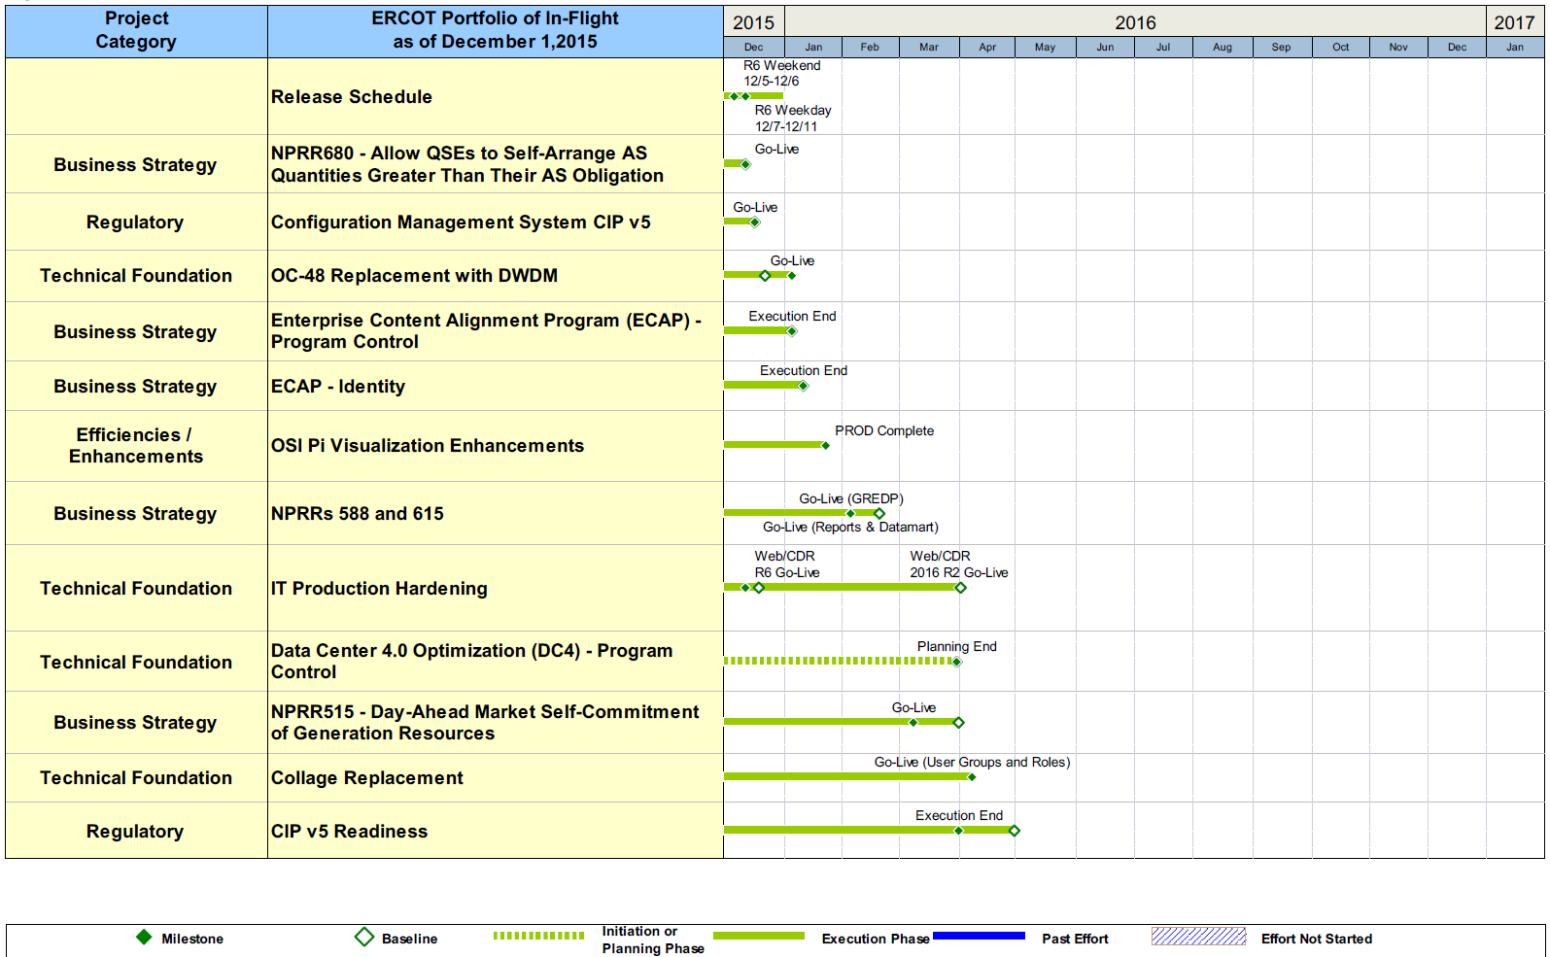
Project Portfolio Status – as of 11/30/2015

Slide 10
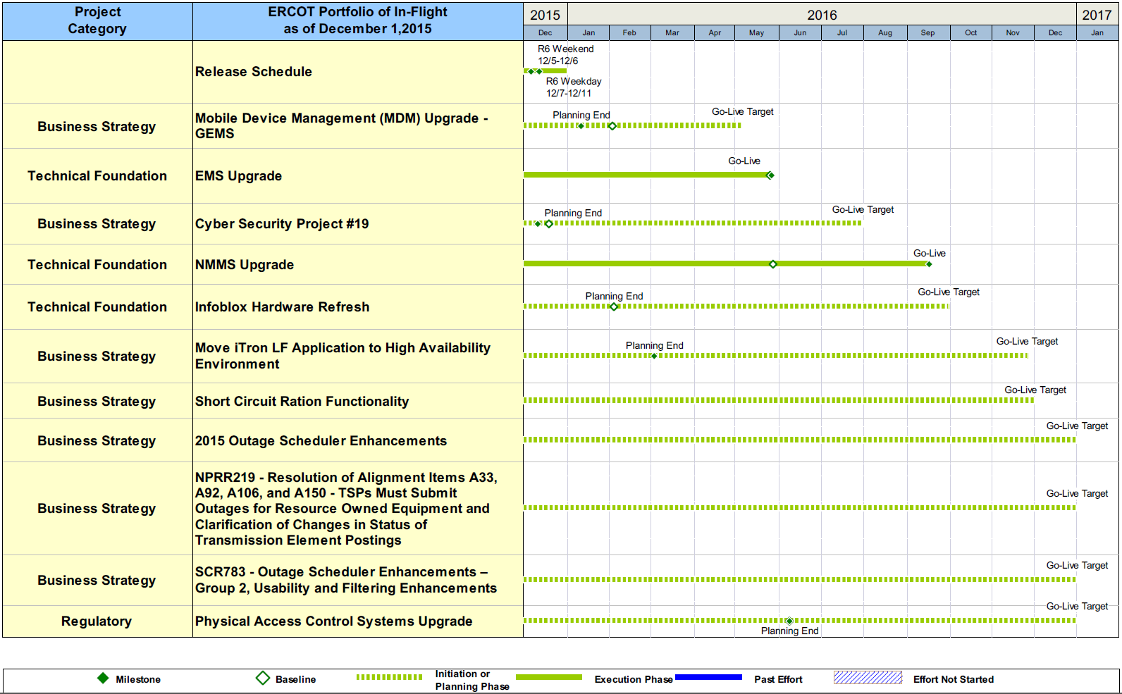
Project Portfolio Status – as of 11/30/2015

Slide 11
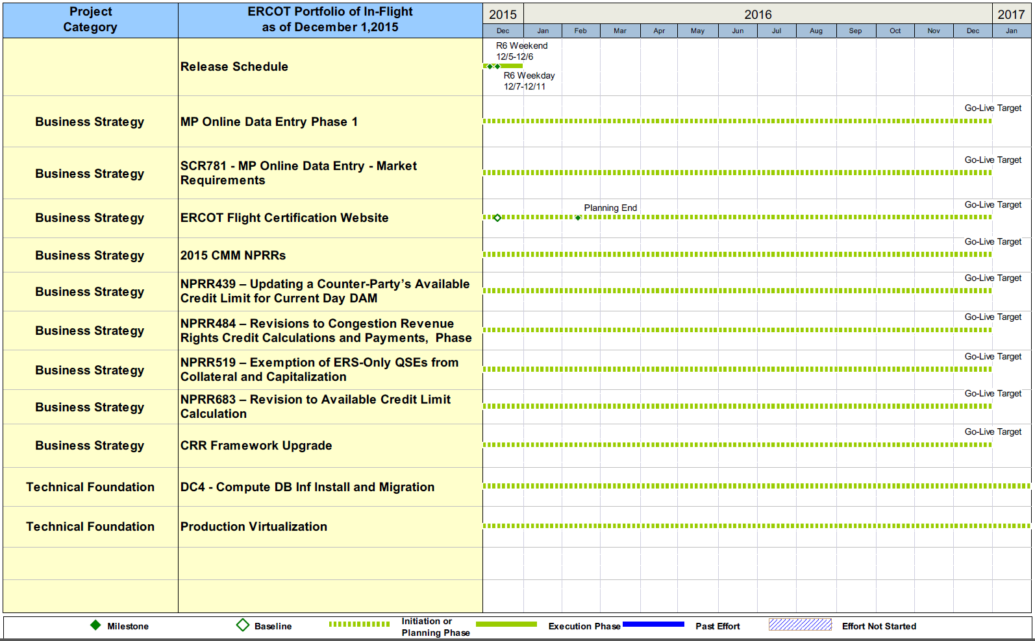
Project Portfolio Status – as of 11/30/2015

Slide 12
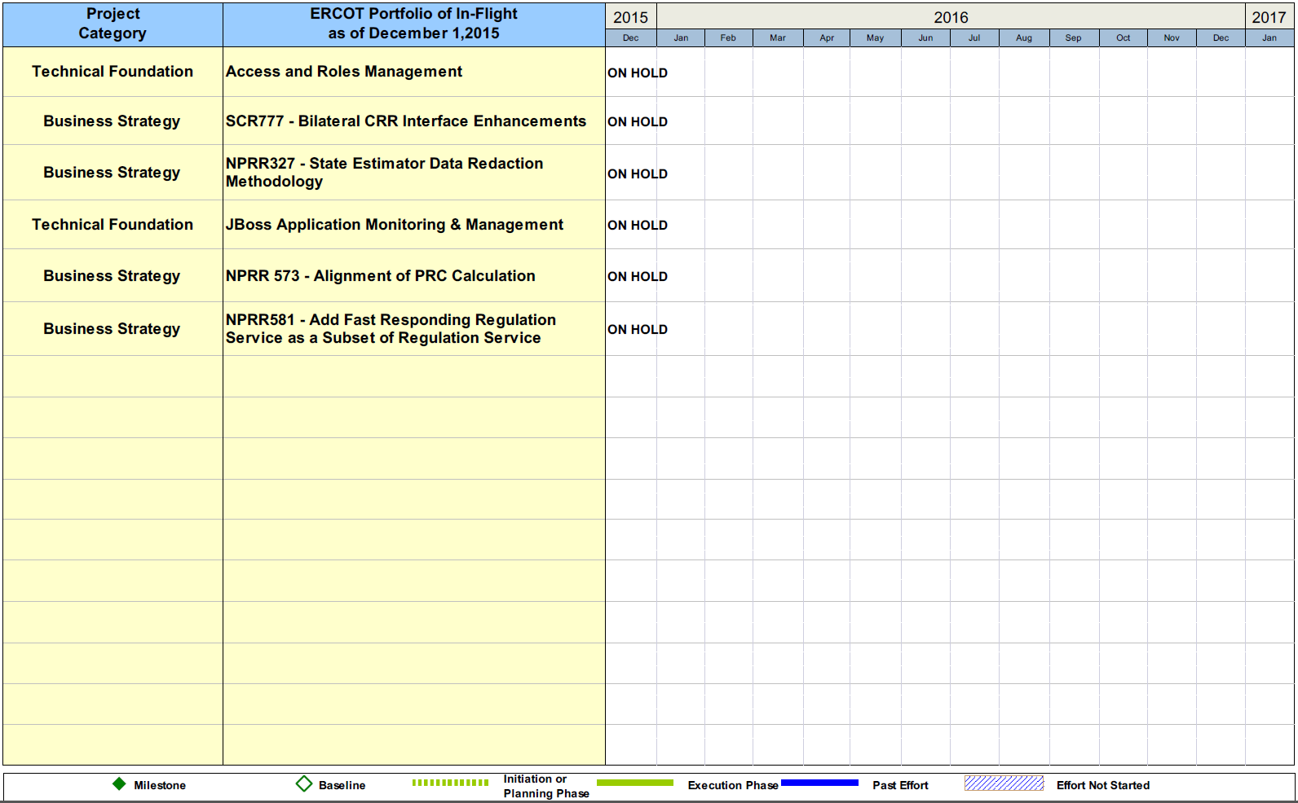
Project Portfolio Status – as of 11/30/2015

Slide 13
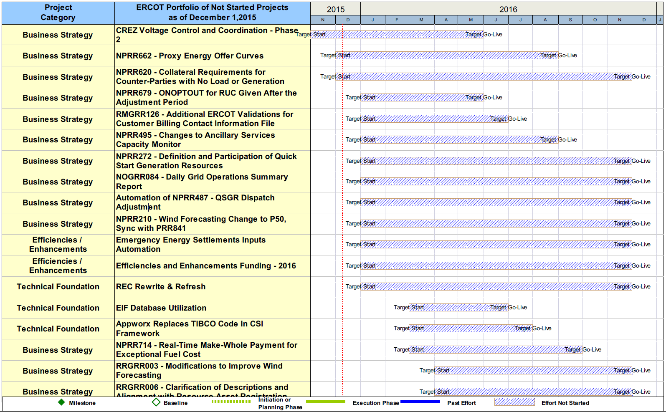
Project Portfolio Status – as of 11/30/2015

Slide 14
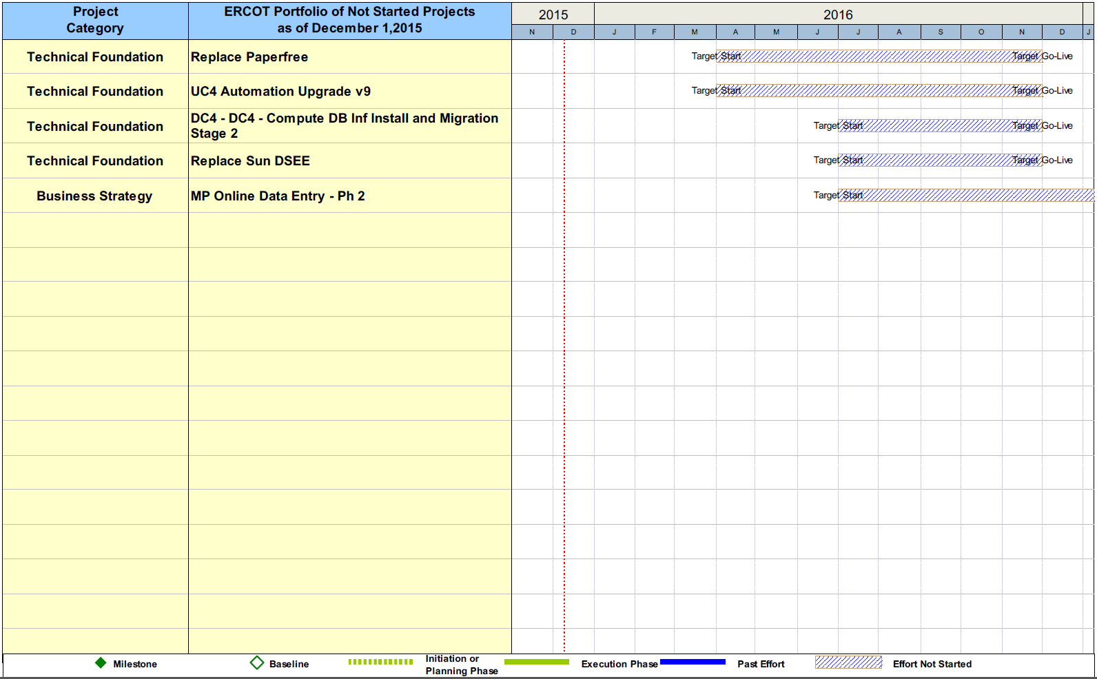
Project Portfolio Status – as of 11/30/2015

