Slide 1
SMT Update To AMWG
NOV 2015

Slide 2
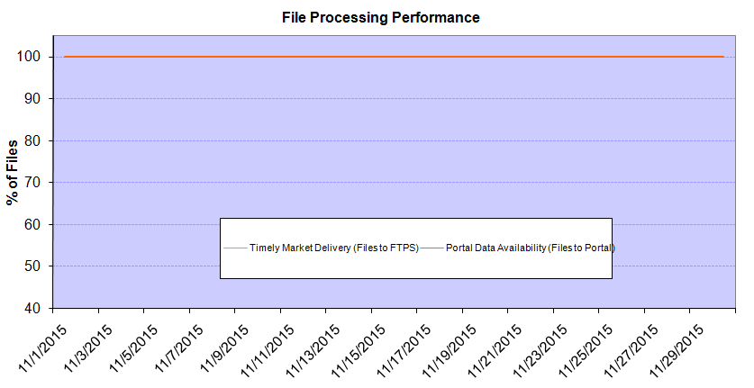
Monthly SMT Data Timelines AMWG CR 2014 002 End to End File Processing Completeness – NOV 2015
% Timely Market Delivery - % of files posted to market (FTPS) by 11:00pm out of # of files received by SMT by 11:00pm.
% Portal Data Availability - % of files loaded to the database for data availability on portal by 6:00am next day for the files received by 11:00pm
* A LSE file includes usage data for up to 50,000 ESIIDs.
Observed Anomalies:
2

Slide 3
SMT API and FTPS Services Availability – NOV 2015
The service availability is measured as a percentage of number of minutes the service was available out of the total number of minutes in a month, excluding planned outages.
Observed Anomalies:
Mar-Apr 2015: SMT outage and subsequent recovery/catch-up impacted API availability. FTPS was available for most of the part except on 03/21-03/22 for 36 hours.
26 Jul 2015: Services were unavailable for 12 hours due to Flash storage issue
Notes:
3

Slide 4
SMT Number of Accounts by Type AMWG CR 2014 009 – NOV 2015
Registered Users | ONC | CNP | AEPN | AEPC | TNMP | TOTAL
Active Residential Accounts | 33786 | 22090 | 2007 | 5305 | 2359 | 65547
Active Residential English Accounts | 33631 | 21946 | 2003 | 5196 | 2351 | 65127
Active Residential Spanish Accounts | 155 | 144 | 4 | 109 | 8 | 420
Non Active Residential Accounts | 16296 | 11474 | 1301 | 2757 | 547 | 32115
Total Residential Accounts | 50082 | 33564 | 3308 | 8062 | 2906 | 97662
TDSP User | 386 | 39 | 12 | 17 | 2 | 456
TDSP Admin | 3 | 4 | 4 | 4 | 3 | 18
Small Business User | 79 | 38 | 0 | 1 | 1 | 119
Small Business Admin | 2287 | 1223 | 71 | 247 | 75 | 4004
Total Agreements | 1622 | 1279 | 1 | 0 | 0 | 2902
Energy Data Agreements | 1527 | 984 | 1 | 0 | 0 | 2512
Han Device Agreements | 95 | 294 | 0 | 0 | 0 | 389
Han Service Agreements | 0 | 1 | 0 | 0 | 0 | 1
IN SMT
ESI IDs | 3456645 | 2379204 | 197245 | 853653 | 208665 | 7095412
Meters | 3386815 | 2379172 | 198067 | 853832 | 208404 | 7026290
HAN Devices | 4217 | 5520 | 147 | 299 | 35 | 10218
Acknowledgement | 0 | 0 | 0 | 0 | 0
Pending | 0 | 0 | 0 | 0 | 0
Meter Ready | 311 | 54 | 45 | 122 | 23
Provisioned | 3906 | 5466 | 102 | 177 | 12
HAN Messages (MTD) | 0 | 0 | 0 | 0 | 0 | 0
HAN Messages (YTD) | 31 | 33 | 0 | 0 | 0 | 64
HAN Messages (Cumulative) | 322 | 7397 | 0 | 0 | 0 | 7719
Simple Text Messages | 98 | 2922 | 0 | 0 | 0
Load Control Messages | 88 | 2658 | 0 | 0 | 0
Pricing Messages | 92 | 53 | 0 | 0 | 0
Cancellation Messages | 44 | 1764 | 0 | 0 | 0
Supplemental – (Friends)
Total Agreements | 1548 | 1235 | 72 | 82 | 56 | 2993
Accepted Agreements | 695 | 489 | 32 | 29 | 17 | 1262
Pending Agreements | 2 | 1 | 0 | 0 | 0 | 3
Revoked Agreements | 223 | 232 | 9 | 7 | 6 | 477
Expired Agreements | 602 | 486 | 29 | 46 | 33 | 1196
Terminated Agreements | 26 | 27 | 2 | 0 | 0 | 55
 | TDSPs | REP | NRC | Regulatory | Third Party
Registered Entities | 5 | 104 | 3891 | 2 | 76
Registered Users | 456 | 786 | 119 | 7 | 14
Registered Admins | 18 | 162 | 3903 | 3 | 80
HAN Messages Sent By | 312 | 7383

Slide 5
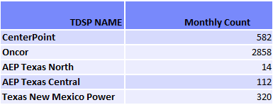
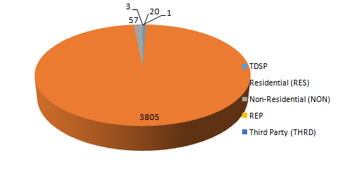
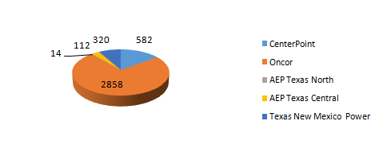
SMT ODR Details – NOV 2015
Total ODR Requests TDSP wise statistics:
Total ODR Requests User type statistics:

