Slide 1
ERCOT MARKET EDUCATION
Retail 101

Slide 2
Introductions, Roles and Responsibilities

Slide 3
Overview
Topics in this lesson . . .
Two Basic Definitions
Market Relationships
Roles and Responsibilities
ERCOT
REPs
TDSPs
PUCT

Slide 4
Two Basic Definitions Premise / ESI-ID

Slide 5
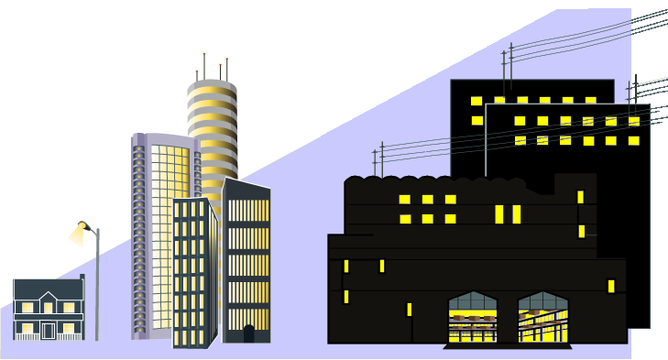
Two Basic Definitions
Premise – A Service Delivery Point or combination of Service Delivery Points that is assigned a single identifier for ERCOT settlement and registration.
Metered
Unmetered, such as
Street Lights
Traffic Lights
Billboards
Electrons R Us

Slide 6
Two Basic Definitions
ESI ID – Electric Service Identifier
The unique identifier assigned to each Premise
Used for all retail transactions in ERCOT
Enrolling Customers
Switching retail providers
Load metering
Retail Electric Provider (REP)

Slide 7
Market Relationships

Slide 8
Market Participants
Who are the ERCOT Players?
QSE
Qualified Scheduling Entities
LSE
Load Serving Entities
Transmission and/or Distribution Service Providers
TDSP
Resource
Entity
Resource Entities
Notes:
Before, we go any further, let’s introduce the players in the Market. This is a list of all of the entities who must register with ERCOT. Over the next few slides, we will look at how these players fit into the overall market structure and focus on the relationships between them.

Slide 9
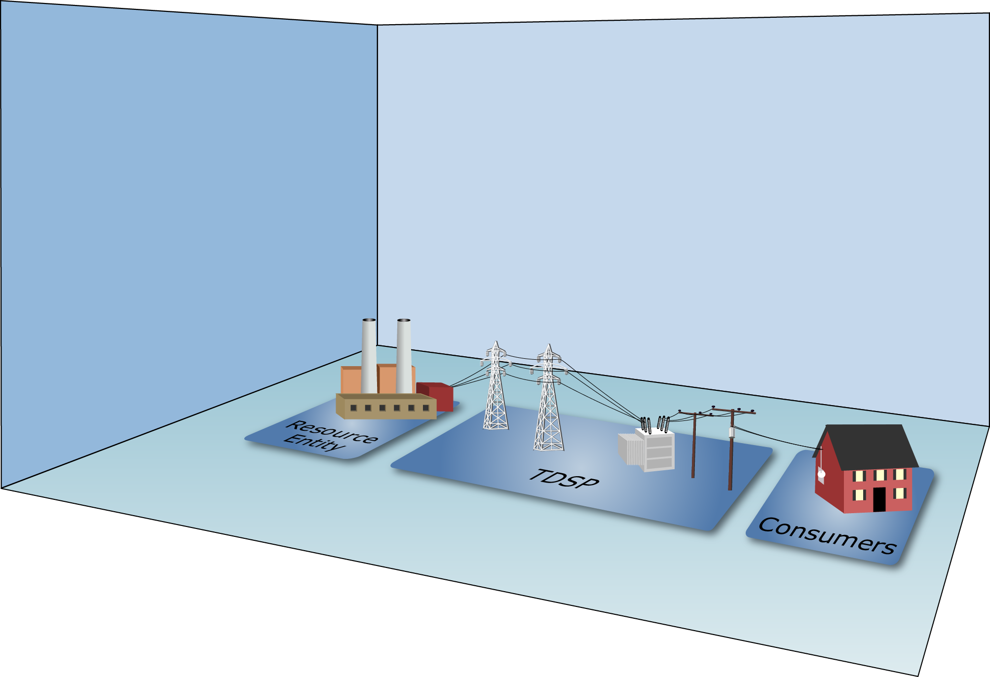
Market Relationships

Slide 10
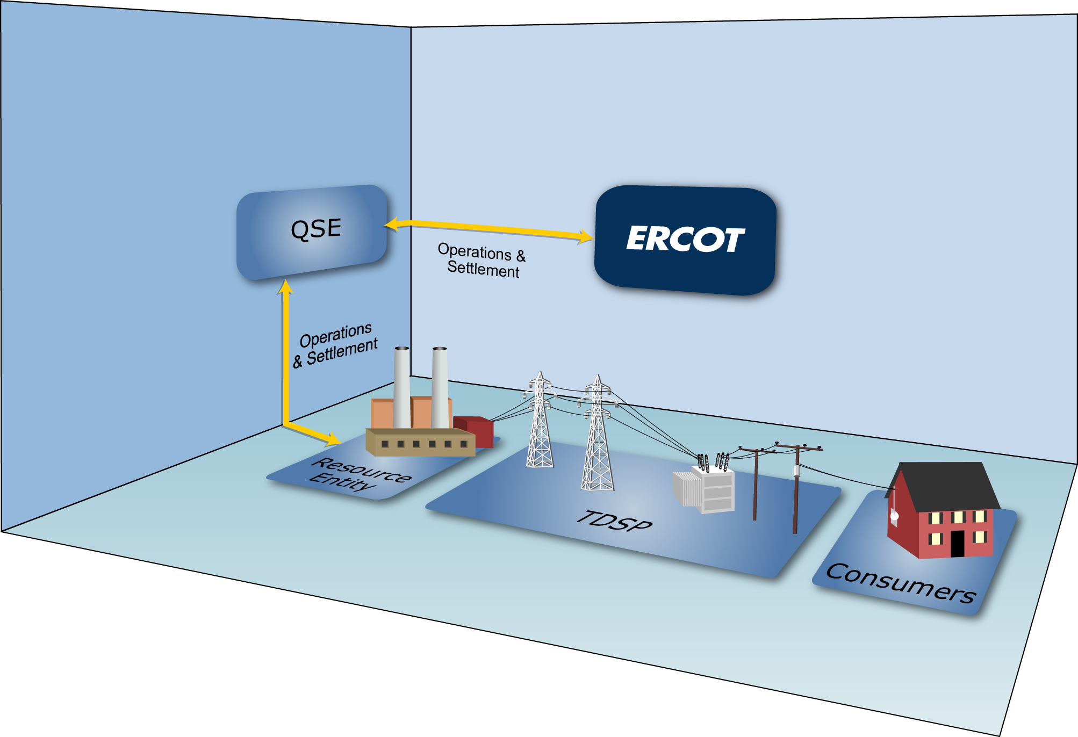
Market Relationships

Slide 11
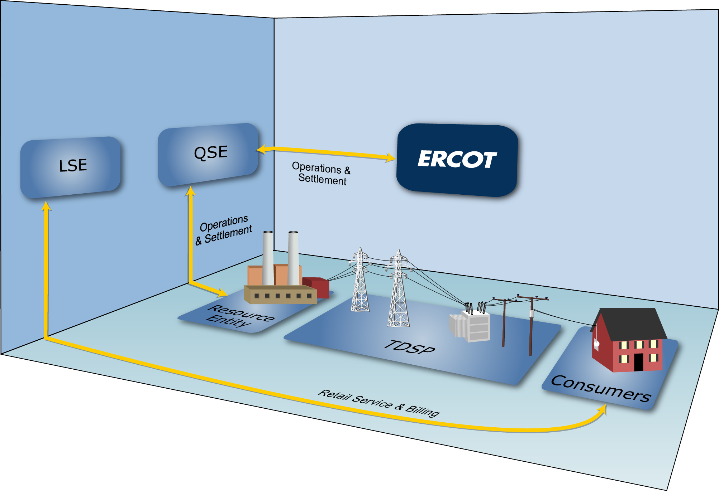
Market Relationships

Slide 12
Market Relationships

Slide 13
Market Relationships
A Load Serving Entity (LSE) provides electric service to end-use Customers
Notes:
Load serving entities (LSEs) provide electric service to end-use Customers. As mentioned in defining the audience for this course, LSEs include:
Retail Electric Providers – entities that sell electric energy to retail Customers in the areas of Texas where the sale of electricity is open to retail competition
Electrical Cooperatives – businesses owned by the people who use their services
Municipally-Owned Utilities – providers owned by the municipalities they serve

Slide 14
Market Relationships
Types of LSEs:
Retail Electric Providers
(AKA Competitive Retailers)
Electrical Cooperatives
Municipally-Owned Utilities
Notes:
LSEs include:
Retail Electric Providers – entities that sell electric energy to retail Customers in the areas of Texas where the sale of electricity is open to retail competition
Electrical Cooperatives – businesses owned by the people who use their services
Municipally-Owned Utilities – providers owned by the municipalities they serve

Slide 15
Market Relationships
Types of LSEs:
Retail Electric Providers
(AKA Competitive Retailers)
Electrical Cooperatives
Municipally-Owned Utilities

Slide 16
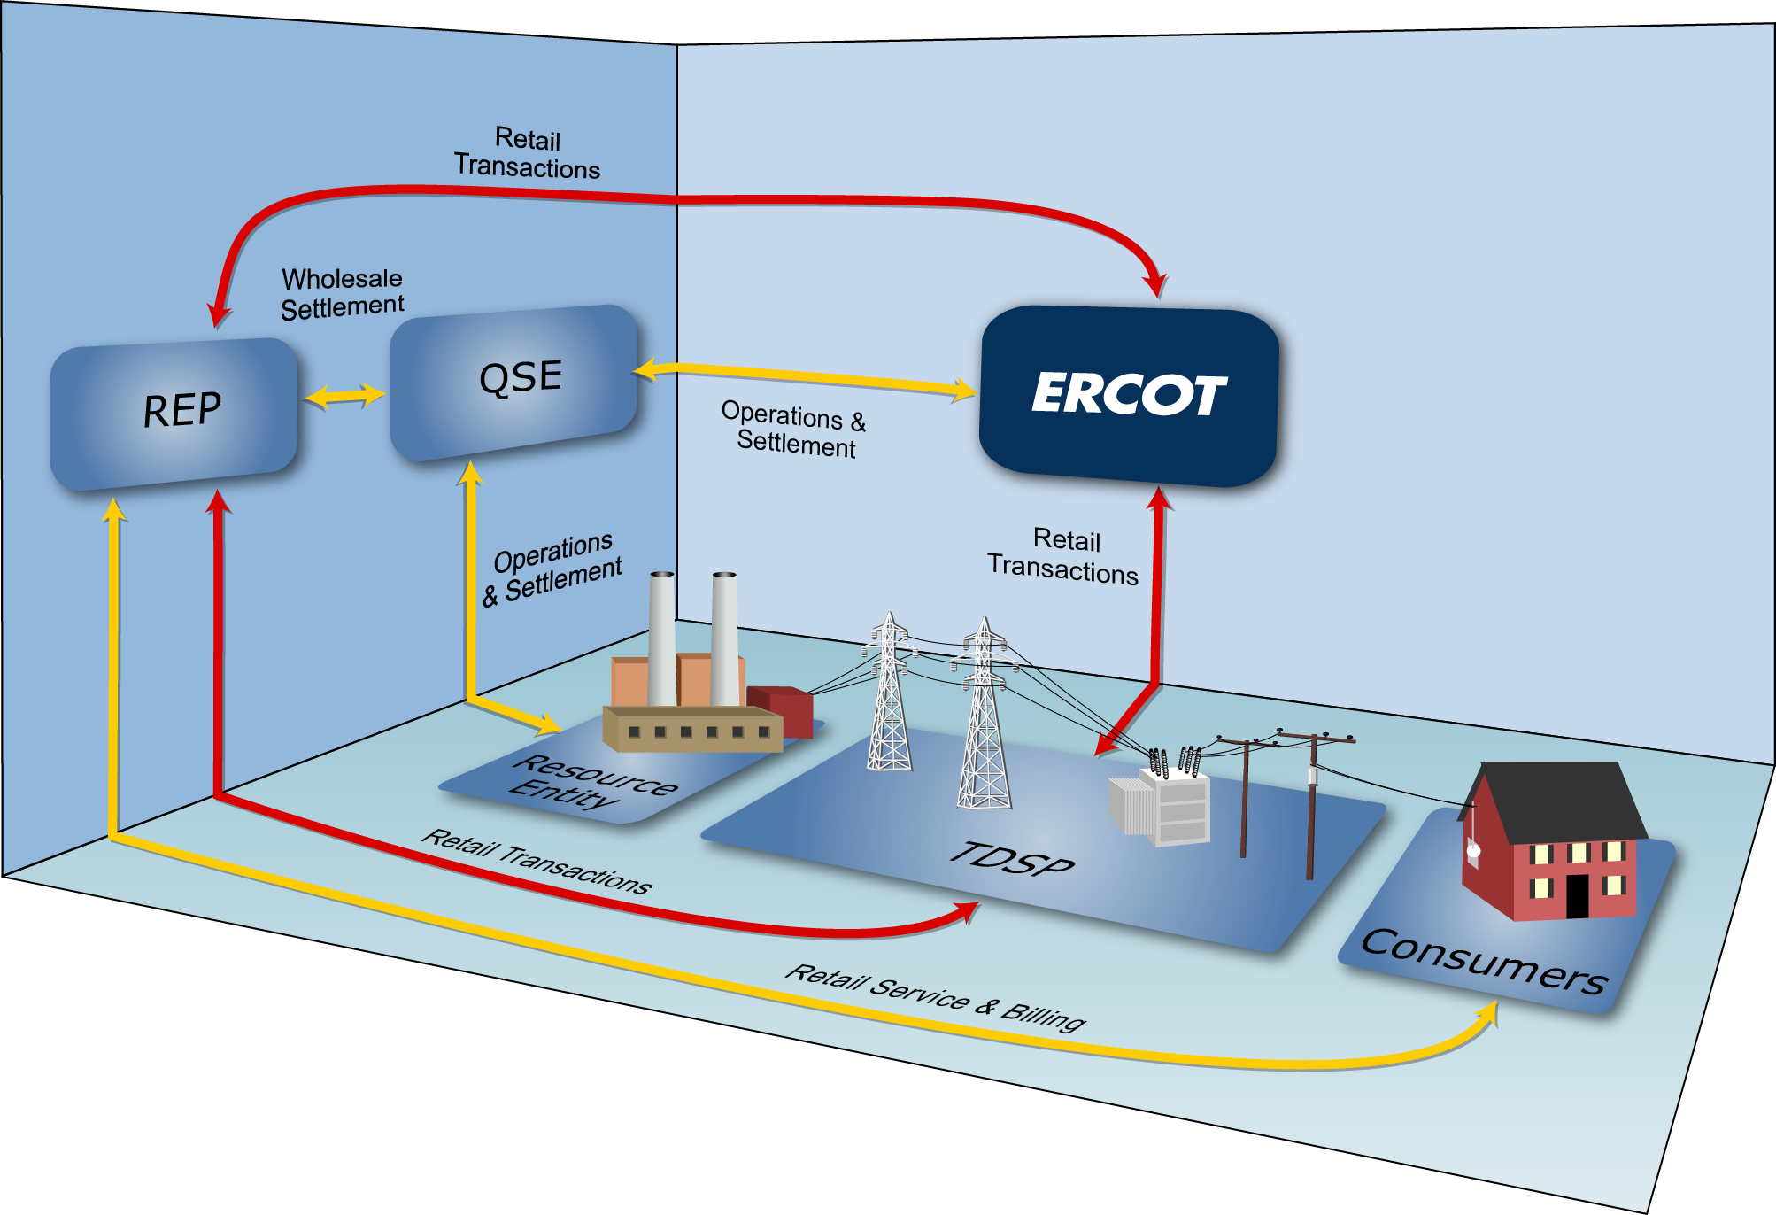
Market Relationships

Slide 17
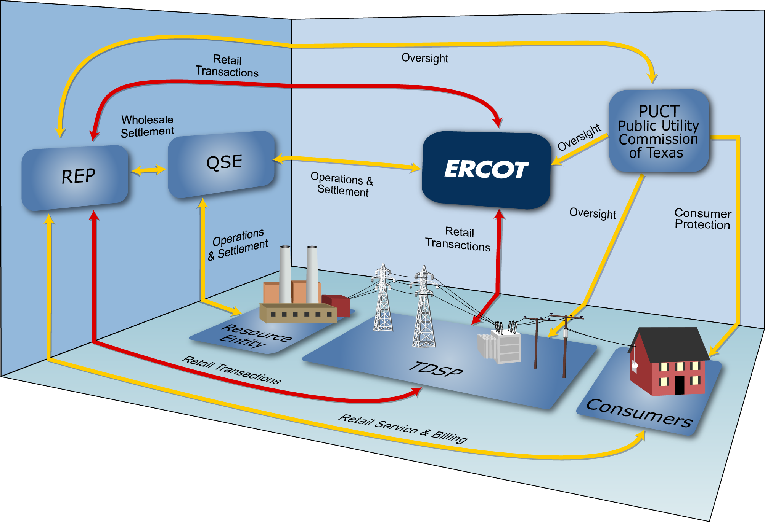
Market Relationships

Slide 18
Roles and Responsibilities

Slide 19
ERCOT Responsibilities
Maintain Reliability of the Bulk Electric System
Ensures generation meets demand
Operate transmission grid within established limits
Executes competitive markets for reliability services
Notes:
ERCOT’s primary responsibility is to ensure the day-to-day reliability of the ERCOT Transmission Grid. To achieve reliability, ERCOT must match generation output and system demand, and make sure that the transmission system is operating within its established limits.
This process requires continual dispatch of generation to meet the rise and fall in system demand.
In order to be able to perform this dispatch at the least cost, ERCOT executes competitive markets to purchase energy and capacity services needed to reliably serve the system demand.

Slide 20
ERCOT Responsibilities
Maintain Registration Database
Qualified Scheduling Entity (QSE)
ERCOT facilitates enrollment and switching of retail Customers
Retail Electric Provider (REP)

Slide 21
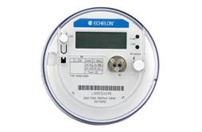
ERCOT Responsibilities
Settle the Wholesale Markets
Adjusted Metered Load (QSE)
Qualified Scheduling Entity (QSE)
Retail Electric Provider (REP)
Unaccounted For Energy (UFE)
Losses
Meter Data

Slide 22
REP Responsibilities
Service Retail Customers
Negotiate competitive contracts with retail Customers
Manage retail Customer’s ESI IDs
Act as primary contact for electric service issues

Slide 23
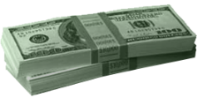
REP Responsibilities
Meet Financial Responsibilities
Pay and/or dispute invoices
Buy electricity at wholesale
Pay TDSPs for delivery costs
Invoice retail Customers for their monthly usage

Slide 24
REP Responsibilities
Investigate Customer Switching issues
Work with TDSPs and other REPs to resolve inadvertent gains and losses
REP #1
REP #2

Slide 25
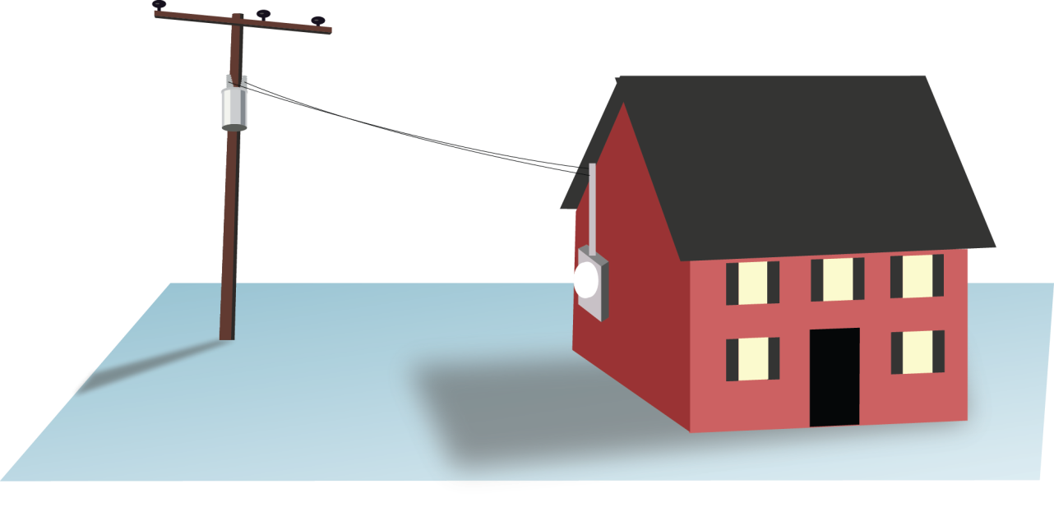
TDSP Responsibilities
Physical System Operations
Maintain reliable transmission and distribution system
Physically connect Customer Premise to ERCOT grid
Maintain metering systems at Customer Premises
Resolve power outages

Slide 26
TDSP Responsibilities
Retail System Operations
Establish ESI IDs
Facilitate Enrollments and Service Order Requests from REPs
Provide ESI ID usage data for ERCOT Settlement and REP billing
REP #1
REP #2

Slide 27
TDSP Responsibilities
The anatomy of an ESI ID
10xxxxxzzz..zz
Where:
10 Placeholder for future
xxxxx Five digit DOE code for TDSP
zzz..zz Up to 29 alphanumeric characters assigned by TDSP
Notes:
Speaking of ESI IDs, we should spend a little time looking at the basic anatomy of an ESI ID. When the TDSP sets up an ESI ID, they must follow a prescribed format defined in Protocol Section 15. Every ESI ID today will begin with “10,” originally set up as a future placeholder, but holds no physical meaning today. The next five digits (the Xs) are the most significant portion of the number for our purposes here, because they define the TDSP who set up the ESI ID in the first place. So this part of the code will tell a REP at a glance which TDSP services this premise. The remaining digits are any combination of up to 29 alphanumeric characters, used at the TDSPs discretion.

Slide 28
TDSP Responsibilities
The anatomy of an ESI ID
10xxxxxzzz..zz
XXXXX | TDSP Name
20404 | AEP TX North
03278 | AEP TX Central
08901 | CenterPoint
13830 | Nueces Electric Coop
44372 | Oncor Electric Delivery
17699 | Oncor/SESCO
03109 | Sharyland Utilities
17008 | Sharyland Utilities-McAllen
40051 | Texas New Mexico Power (TNMP)
Notes:
Speaking of ESI IDs, we should spend a little time looking at the basic anatomy of an ESI ID. When the TDSP sets up an ESI ID, they must follow a prescribed format defined in Protocol Section 15. Every ESI ID today will begin with “10,” originally set up as a future placeholder, but holds no physical meaning today. The next five digits (the Xs) are the most significant portion of the number for our purposes here, because they define the TDSP who set up the ESI ID in the first place. So this part of the code will tell a REP at a glance which TDSP services this premise. The remaining digits are any combination of up to 29 alphanumeric characters, used at the TDSPs discretion.

Slide 29
TDSP Responsibilities
Invoice REPs according to tariffs
Delivery charges based on usage
Discretionary charges
Please refer to each TDSP’s website for details

Slide 30
TDSP Responsibilities
Investigate Customer Switching issues
Work with REPs to resolve inadvertent gains and losses
MarkeTrak
MarkeTrak

Slide 31
PUCT Responsibilities
Public Utility Commission of Texas (PUCT)
Provides regulatory oversight
ERCOT operations and budget
TDSPs operations and tariffs
REP certification / oversight

Slide 32
PUCT Responsibilities
Public Utility Commission of Texas (PUCT)
Provides consumer protection
Creates Substantive Rules that govern all other Market Rules and Protocols
Maintains Power to Choose website
Receives and investigates Customer complaints

