Slide 1
Texas Competitive Market & Governance
October 4, 2015

Slide 2
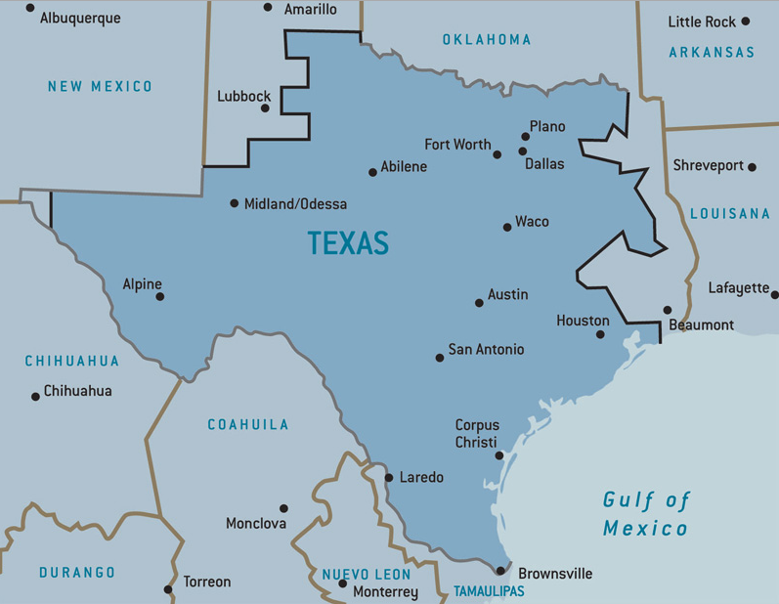
ERCOT Region

Slide 3
State of Texas Regulations
Public Utility Regulatory Act – 1999 – Texas Deregulation
  Section 39.101
    Prior to Customer Choice in 2002, these key retail customer protections were established that Entitled a Customer:
      to Privacy of customer consumption and credit information
      to Accuracy of metering and billing
Public Utility Regulatory Act - 2005 – Texas Advanced Metering
  Section 39.107
    All Meter Data, including all data generated, provided, or otherwise made available, by advanced meters and meter information networks, Shall Belong To A Customer, including data used to calculate charges for service, historical load data, and any other proprietary customer information.
    A Customer may Authorize Its Data to be provided to one or more retail electric providers under rules and charges established by the commission.

Slide 4
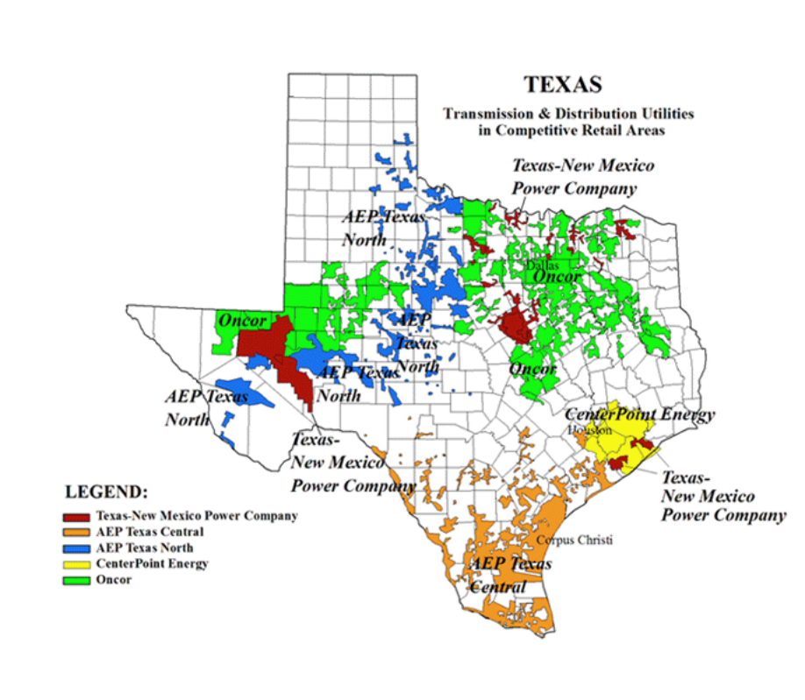
Competitive Areas w/in ERCOT

Slide 5
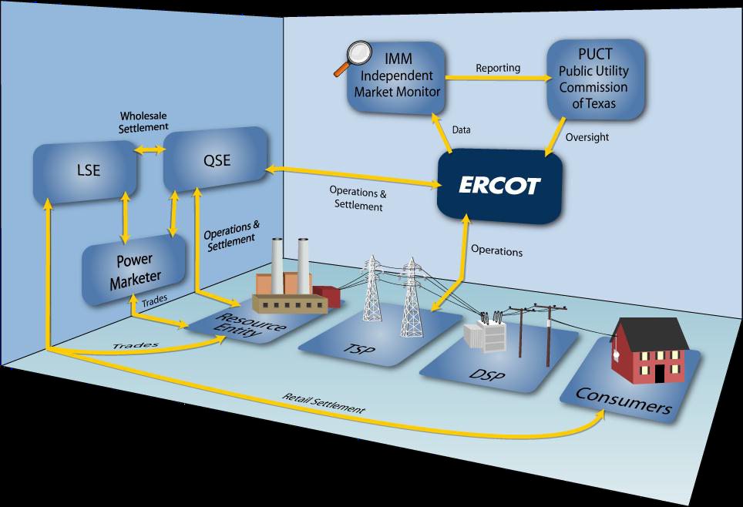
Electric Reliability Council of Texas (ERCOT) Market Design

Slide 6
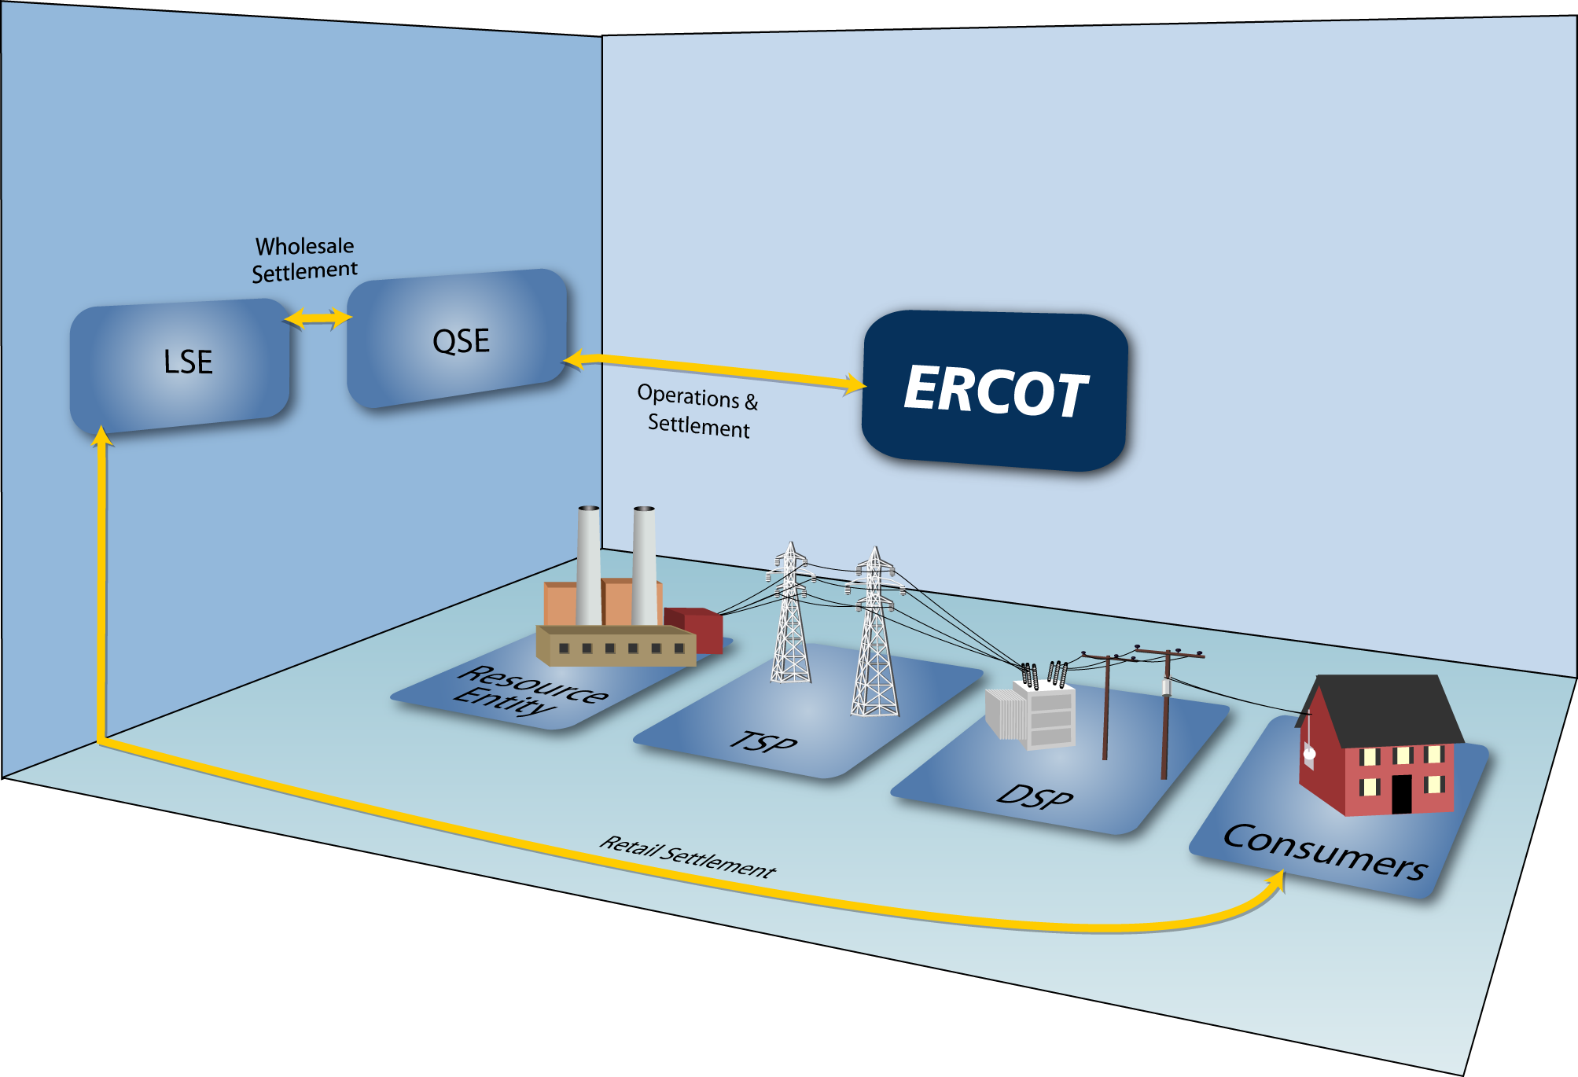
ERCOT
Market Design (Retail)
Retail Transactions
Retail Transactions
Point to Point Retail Transactions
Billing / Customer Service

Slide 7
Certified Market Participants at ERCOT
Certified REPs/CRs: Total of 173
Certified TDUs/TDSPs –Total of 7
  American Electric Power Texas Central (AEP TCC)
  American Electric Power Texas North (AEP TNC)
  CenterPoint Energy (CNP)
  Oncor
  Sharyland McAllen
  Sharyland Utilities (SU)
  Texas New Mexico Power (TNMP)
Certified MOU/EC – Total of 1
  Nueces Electric Cooperative

Slide 8





TDSPs/TDU/MOU/EC own and maintain the distribution lines and meters.
The TDSP/TDU’s are paid by the REP of Record (ROR) for their Retail Customer’s electric consumption and discretionary service charges associated to the premise.
MOU/EC payment arrangements may be different depending upon REP of Record and MOU/EC Billing Agreement(s)
Retail
Customer
Retail Electric Provider
Retail Customers’ have their Choice of over 170 certified Retail Electric Providers (REPs) in the Texas Market
Generation facilities can be owned by Qualified Scheduling (QSEs) or Load Serving Entities (LSEs)

Slide 9
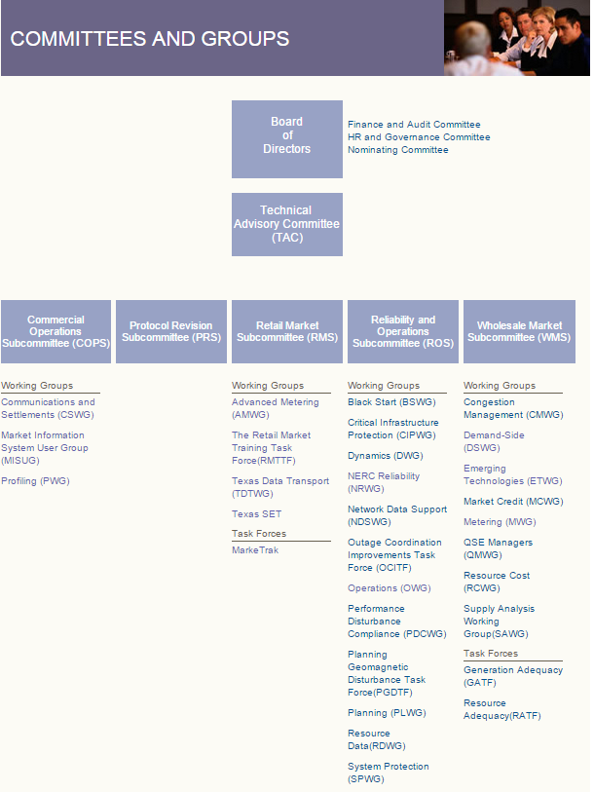
ERCOT Committees & Groups

Slide 10
Advanced Meters and
Smart Meter Texas
Roles in the Texas Market

Slide 11
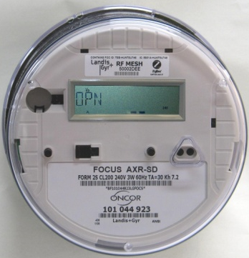
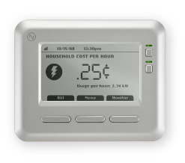
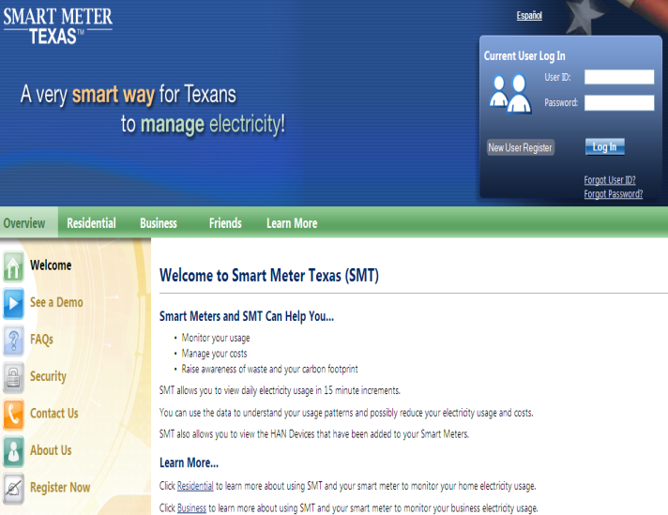
TDSP Advanced Metering System (AMS) - Requirements
Providing 15 minute VEE data to customers, REPs and ERCOT(validate, edit, estimate) data to customers, REPs, and ERCOT (for settlement)
Providing 2-way meter transactions (disconnects/reconnects, on-demand reads, etc.)
Providing secured connections and services to home area network (HAN) devices via ZigBee SEP 1.0 radio frequency interface (Up to 5 devices directly connected to the meter)
Providing a common Web Portal for REP, customers, and customer authorized 3rd parties (Graphical Interface & APIs)

Slide 12
Resulted in PUCT Project 34610 - AMIT
The Advanced Metering Implementation Team (AMIT) – a consortium of REPs, TDSPs, PUCT, ERCOT, OPC & consumer advocates developed 48 pages of bulleted requirements for this functionality.
Documentation on PUCT Project 34610 Website:
      http://www.puc.state.tx.us/electric/projects/34610/34610.cfm
Chances of all four TDSP developing anything even close to equivalent functionality was remote

Slide 13

Advanced Metering System (AMS) – The Players
Retail Electric Providers
Third-Parties
Daily 15 Minute Settlement Transactions and Market Transactions
TDSP IT System
ERCOT
( Monthly Meter Readings and Daily 15 Minute VEE Data )
Optional Path
for Retail
Electric
Provider
HAN Services
Market Transactions
Meter / HAN Services (thru Oncor system) and Daily 15 Minute VEE Meter Data
Meter / HAN Services
( Daily and 15 Minute Meter Data)
Historic Daily 15 Minute VEE Meter Data and limited Meter / HAN Services
SMART METER TEXAS
Host (IBM)
Consumers
Daily and 15 Minute Meter Data
Perform HAN Transactions
13

Slide 14

SMT Governance
AMWG
RMS
JDOA
PUCT

Slide 15
Advance Meter Working Group (AMWG)
  Reports to the Retail Market Subcommittee (RMS),
  Serves as the forum for addressing topics related to advanced metering systems in ERCOT such as data monitoring, issue identification and resolution, as well as, identifying improvement opportunities related to advanced meter data using the defined change control process.
  Created March 2013 when the Advanced Metering Implementation Team (AMIT) was sunsetted and the technology identified in original requirements for SMT was implemented (except 3rd party)
  Created to provide an avenue to follow technology advances and provide feedback on market and customer needs pertaining to Smart Meter Texas, Third Party Access, Service Level Agreements, Technological advances etc.
  2015 AMWG Co Chairs are John Schatz with TXU Energy and Esther Kent with CenterPoint Energy
  Participants include Retail Electric Providers, Transmission & Distribution Service Providers (TDSPs), Public Utility Commission of Texas (PUCT) Staff, Electric Reliability Council of Texas (ERCOT) Staff and 3rd Party Service Providers, Consumer Groups.

Slide 16
Retail Market Subcommittee (RMS)
RMS serves as a forum for issue resolution in regards to retail market matters directly affecting ERCOT and ERCOT protocols. The RMS is also responsible for monitoring Public Utility Commission (PUCT) rulings as they apply to retail markets and retail market participants
Members include Retail Electric Providers, Transmission & Distribution Service Providers (TDSPs), Electric Reliability Council of Texas (ERCOT) Staff, Consumer Groups

Slide 17
Joint Development & Operation Agreement (JDOA)
As part of AMS settlement, TDSPs were required to have a portal for customers to access meter data. A very long list of requirements was developed by the Texas Market. Collectively the TDSPs recommended a single data repository and portal, to which the Texas Market and PUC strongly supported. Thus the formation of the JDOA
Members are Donny Helm (Oncor), Jeff Stracener, Greg Filipkowski (AEP), Bobby Roberts (TNMP) and Esther Kent (CNP)
Operations Manager is Andrea O’Flaherty-Brown
Manages funding for SMT

Slide 18
Public Utility Commission (PUCT)
The Public Utility Commission of Texas regulates the state's electric, telecommunication, and water and sewer utilities, implements respective legislation, and offers customer assistance in resolving consumer complaints.
Their stated mission is ‘We protect customers, foster competition, and promote high quality infrastructure.’
http://www.puc.texas.gov/

