Slide 1
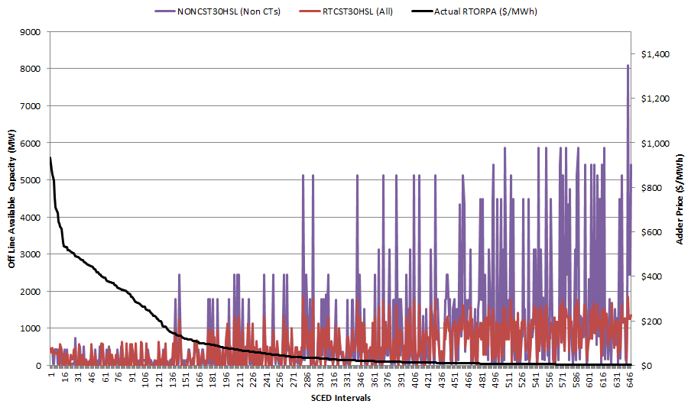
Illustration from Top 55 hours of August 2015 - Baseline
Avg SPP = $375 Avg SPP = $75
Avg ORDC Adder = $260 Avg ORDC Adder = $15

Slide 2
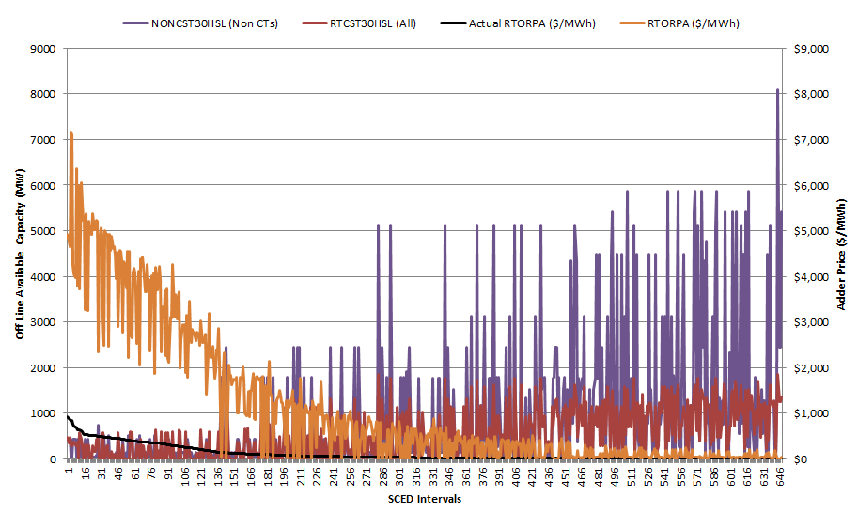
Illustration of ORDC adder sensitivity (orange) with market response parameter = $75
Avg SPP = $2,725 Avg SPP = $280
Avg ORDC Adder = $2,610 Avg ORDC Adder = $220

Slide 3
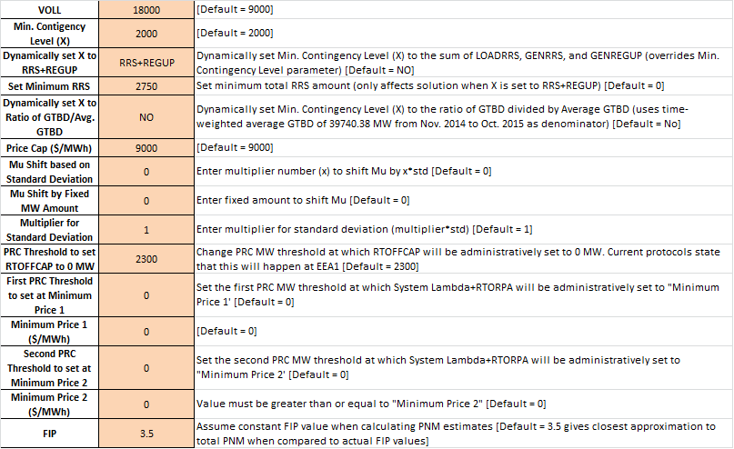

Slide 4
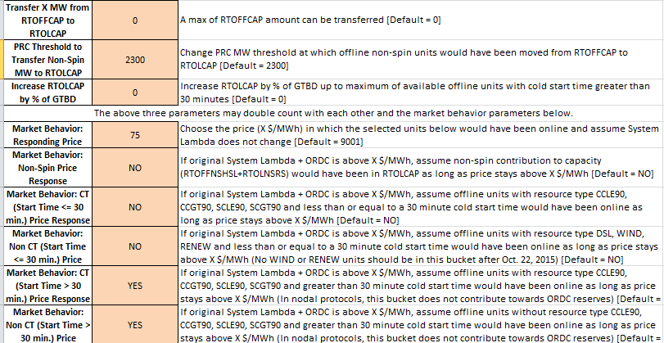
Recommended Date Range (June 1, 2014 thru October 2015 that is annualized) – needs to match the time period where ORDC was in place. Otherwise, there is a serious co-mingling of multiple moving parts (e.g. SWOC floors removed, SWOC cap changes, etc…)

