Slide 1
SAWG Update to WMS
December 2nd, 2015
Brandon Whittle

Slide 2
Report Releases
CDR December Update – Find on ERCOT Resource Adequacy Page
Housekeeping
No Items

Slide 3
MIRTM – What type of Resources?
The MIRTM study which only includes using Load Resources but some concern was expressed at SAWG that it should also include generators such as Quick Starts. No consensus at SAWG.
ERCOT is open to modifying the study.
ERCOT filed this MIRTM update at the PUCT in 41837 indicating the study will likely last through 2016. The update and description does not exclude using generators.
Possible Vote: Should ERCOT include or exclude generators from commitment in their MIRTM study?

Slide 4
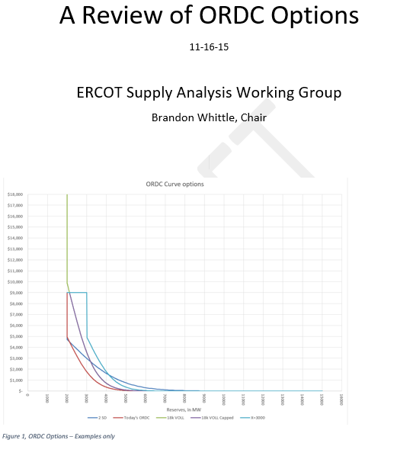
ORDC Assignment Update
The 11/19 TAC asked that WMS present the options identified in SAWG at the January 28th TAC Meeting.
SAWG will present a more complete outline of options to the January 6th WMS.
This will not be a recommendation or consensus view of SAWG. WMS is not currently expected to “Approve” or “Endorse” the options.

Slide 5
ORDC Approach – From 11/19 email
1) Nov 16 Send out the draft as an "EARLY DRAFT" <DONE - emailed 11/16>
2) Dec 2 SAWG meeting after WMS (est. 1pm to 5pm). Please send in additional recommendations and rationale for ORDC changes or be prepared to identify them at the meeting. The goal will to identify specific recommendations (Section II of current outline). We will also scope out analysis requested from ERCOT for the recommendations.
3) Dec 15 I will edit and release of updated draft which includes ERCOT's analysis
4) Dec 16 SAWG Call/Webex to review and discuss
5) Jan 4 Position papers for appendix due
6) Jan 5 SAWG (Afternoon)
7) Jan 6 WMS - Present at WMS (no vote required)
8) Jan 28 TAC - Present at TAC

Slide 6
Next Meeting – Today after WMS
Expected Agenda Item
ORDC Outline recommendations
Additional Meetings:
12/16 Webex
1/5 Met

