Slide 1
ERCOT MARKET EDUCATION
Retail 101

Slide 2
Legal Disclaimers and Admonitions
PROTOCOL DISCLAIMER
This presentation provides a general overview of the Texas Nodal Market Implementation and is not intended to be a substitute for the ERCOT Nodal Protocols (available at http://nodal.ercot.com/protocols/index.html), as amended from time to time. If any conflict exists between this presentation and the ERCOT Nodal Protocols, the ERCOT Nodal Protocols shall control in all respects.
ANTITRUST ADMONITION
ERCOT strictly prohibits Market Participants and their employees who are participating in ERCOT activities from using their participation in ERCOT activities as a forum for engaging in practices or communications that violate the antitrust laws. The ERCOT Board has approved guidelines for members of ERCOT Committees, Subcommittees and Working Groups to be reviewed and followed by each Market Participant attending ERCOT meetings. If you have not received a copy of these Guidelines, an electronic version is available at http://www.ercot.com/about/governance/index.html. Please remember your ongoing obligation to comply with all applicable laws, including the antitrust laws.

Slide 3


Housekeeping
  Restrooms
  Refreshments
  Attendance sheet
  Exam
  Questions
  Microphones
  Please turn off cell phones & other electronics
Notes:
Also cover the handouts for the course.
Have students verify their email addresses on the sign-up sheet.
Encourage students to take the exam in class.

Slide 4
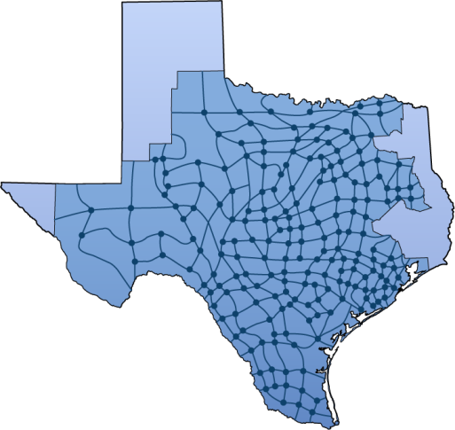
ERCOT Market Education
  Training Curriculum
    ERCOT Nodal 101
    Load Serving Entity 201
    Congestion Revenue Rights
    Settlements 301
    Basic Training Program
    Generation in RUC and Real-Time
    Generation in Day Ahead Market
    Transmission 101
    Various Workshops as needed
Placeholder
Notes:
Please visit the ERCOT website to view the training curriculum. The Nodal Market Education program offers many courses, covering a wide range of topics on system operations, market operations as well as financial settlement.

Slide 5
Course Introduction

Slide 6




Target Audience
This course is designed for Market Participants who are new to the ERCOT Competitive Retail Market or have taken on new roles in the Market.
  Includes:
    Retail Electric Providers
    Transmission and Distribution
    Providers
    PUCT Staff
    ERCOT Staff

Slide 7

Course Objectives
Upon completion of this course…
…you will be able to:
Stuff
Other stuff
More stuff
Placeholder
Notes:
The objective of this course is to provide LSEs with information about the ERCOT-facilitated Nodal Market and help them identify the impacts of its Operations on the Wholesale Market.

Slide 8
From Regulated Utilities to Current Market Design

Slide 9
Overview
Topics in this lesson . . .
  Vertically Integrated Utilities
  Market Restructuring
    Senate Bill 7
    Competition and Customer Choice
    Exemptions
    A few other mandates
  Emergence of ERCOT
    ISO
    Governance

Slide 10

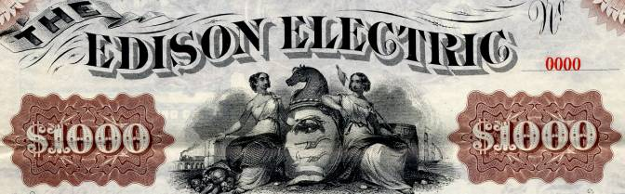
Regulated Utilities
In the beginning,
there were vertically integrated utilities. . .

Slide 11
Vertically Integrated Utilities
Reliability Coordinator
(ERCOT)
Generation
System Operations
Transmission
Utility
Distribution
Physical Power Flow
Customers
Scheduling and Dispatch

Slide 12
Vertically Integrated Utilities - Structure
Basic characteristics
  Regulated rate of return
    Regulated price for customers
    Approved through “fee case”
    Based on utility’s cost plus reasonable profit margin
  “Captive” customer base
  Multiple control areas with limited power flows between utilities

Slide 13

Mid 1990s – Restructuring
Texas Legislature amended the Public Utility Regulatory Act (PURA)
  Allowed for wholesale deregulation
  Opened the doors to competitive
  wholesale producers
  Ensured open access to
  transmission system

Slide 14
Vertically Integrated Utilities with Wholesale Deregulation
Reliability Coordinator
(ERCOT)
ISO
(ERCOT)
Generation
System Operations
Generation
Merchant Generation
Transmission
Utility
Wholesale
Marketers
Distribution
Other
Utilities
Physical Power Flow
Customers
Scheduling and Dispatch
Financial Relationships
Notes:
<Click for animation> These changes to PURA allowed the emergence of Merchant Generators who would operate generation for profit outside the traditional utility structure.
<Click for animation> These changes also brought about the need for an Independent System Operator, or ISO would facilitate open access to the transmission system for the new Merchant Generators. ERCOT, as Reliability Coordinator was ideally situated to perform this function, and in 1996, was christened as the first North American ISO.
<Click for animation> The rise of Merchant Generators also brought about the rise of Wholesale Power Marketers. These new marketers would buy power from the Merchant Generators and the traditional Utilities and sell to Utilities who needed the power.

Slide 15
Late 1990s – Restructuring
Texas Legislature passed Senate Bill 7 (SB7)
  Called for “the establishment of a
  fully competitive electric power industry”
  Ordered unbundling of Investor-Owned
  Utilities
    Generation companies sell into the
    competitive wholesale market
    Retail Electric Providers buy wholesale
    power and re-sell to retail customers
    Transmission and Distribution companies move power from generation to customer and remain regulated

Slide 16
Late 1990s – Restructuring
Texas Legislature passed Senate Bill 7 (SB7)
  Retail Market Changes
    Retail Electric Providers responsible for
    customer interaction
    Retail customers allowed to choose
    between competing providers
  System Operational Changes
    Single control area
    ERCOT responsible for grid operations

Slide 17
Retail and Wholesale Competition
System Operations
(ERCOT ISO)
Generation
Wholesale
Marketers
Transmission
Utility
Distribution
Retail Electric Providers
Physical Power Flow
Customers
Scheduling and Dispatch
Financial Relationships

Slide 18

Retail and Wholesale Competition
Not all Utilities were required to unbundle
  Not all Utilities were investor-owned
    Municipal Utilities
    Electric Cooperatives
  Exempt from unbundling
  Can choose to opt-in to Retail Deregulation
Munis and Co-ops who choose not to opt-in are called Non-Opt-In Entities, or NOIEs

Slide 19
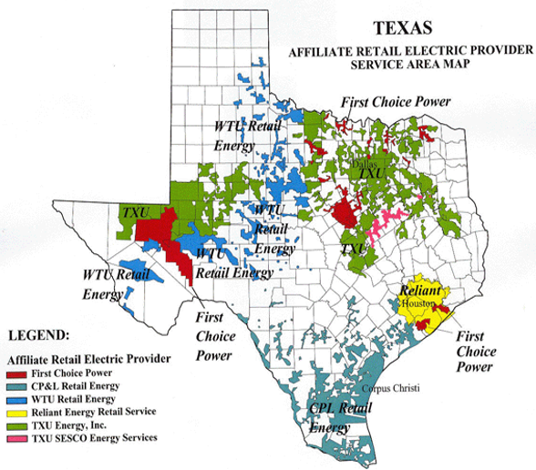
Competitive Areas
So, what areas have Retail Competition?

Slide 20
Retail and Wholesale Competition
Other provisions of Senate Bill 7
  Price to Beat
  Renewable Portfolio Standard
  Governance for ERCOT

Slide 21

Price to Beat
To foster competition, the affiliated REP of each Investor-Owned Utility had to offer a “Price-to-Beat”
  Residential and small commercial customers only
  Six percent lower than rates
  on January 1, 1999.
  Requirement expired
  January 1, 2007
Price
To
Beat

Slide 22

Renewable Portfolio Standard
SB7 established mandates for renewable generation
  Set targets for installed renewable generation capacity
  Established Renewable Energy Credits (REC) program
  Required Retail Electric Providers to purchase RECs
For more details, see Protocol Section 14

Slide 23

Governance
SB7 required ERCOT to set up a Board of Directors
  Nine representatives from Market Segments
  Five Unaffiliated Members
  ERCOT CEO
  PUCT Chair (non-voting)

Slide 24
Governance
Board Responsibilities
  Oversees ERCOT operations
  Approves budget and staffing
  Approves all changes to Market Rules

Slide 25
Governance
Board is advised by Stakeholder Groups
Board
Of
Directors
Technical Advisory
Committee
(TAC)
TAC makes policy recommendations to Board
Retail Market Subcommittee (RMS)
Reliability Operations Subcommittee (ROS)
Wholesale Market Subcommittee (WMS)
Commercial Operations Subcommittee (COPS)
Protocol Revision Subcommittee (PRS)
Subcommittees recommend changes to Market Rules and Operating Guides

