Slide 1
2016 LTSA Load Forecasts
Calvin Opheim
ERCOT
Manager, Load Forecasting & Analysis
RPG
November 20, 2015

Slide 2
Outline of Today’s Presentation
Current Trends Load Forecast
High Economic Growth Load Forecast
Environmental Mandate Load Forecast
Questions

Slide 3
Current Trends

Slide 4
Current Trends - Assumptions
2006 Weather
Typical Wind Year
Typical Load Year
Energy Efficiency/Customer Behavior DR
1.0% of the total demand in 2017
3.5% of the total demand by 2031
Rooftop PV
5% of premises to have rooftop PV
20% increase per year
Results in 683 additional MW by 2031

Slide 5
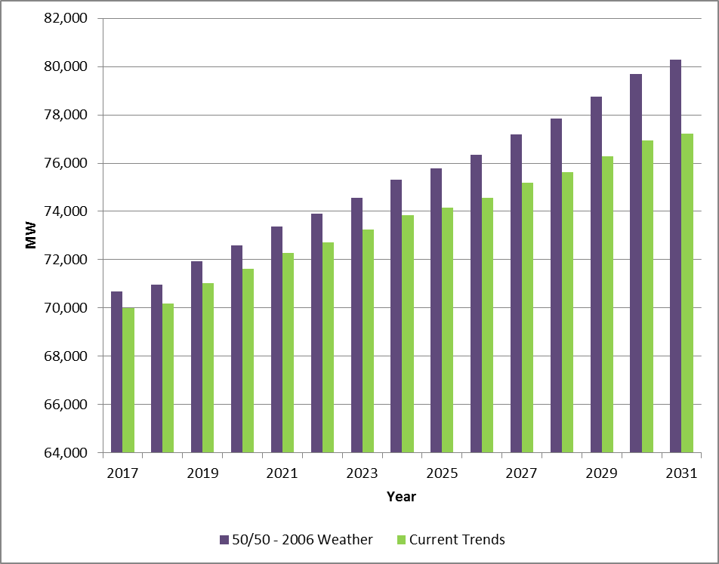
ERCOT Summer Peak Forecast Comparison

Slide 6
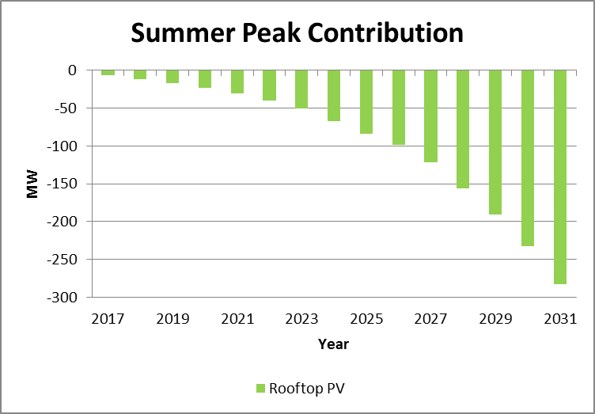
Current Trends

Slide 7
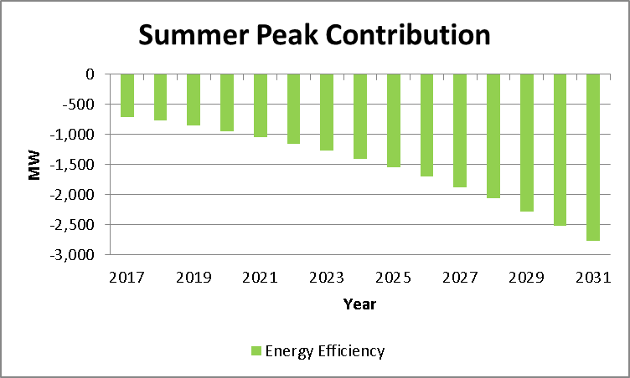
Current Trends

Slide 8
High Economic Growth

Slide 9
High Economic Growth - Assumptions
2006 Weather
Typical Wind Year
Typical Load Year
Energy Efficiency/Customer Behavior DR
1.0% of the total demand in 2017
3.5% of the total demand by 2031
Rooftop PV
5% of premises to have rooftop PV
20% increase per year
Results in 683 additional MW by 2031
Load Growth
Increased by 1% per year
Plus an additional 600 MW of LNG
Notes:
Grid to serve the 600 MW LNG. Assumed to not participate in 4 CP and to not be a price responsive load.

Slide 10
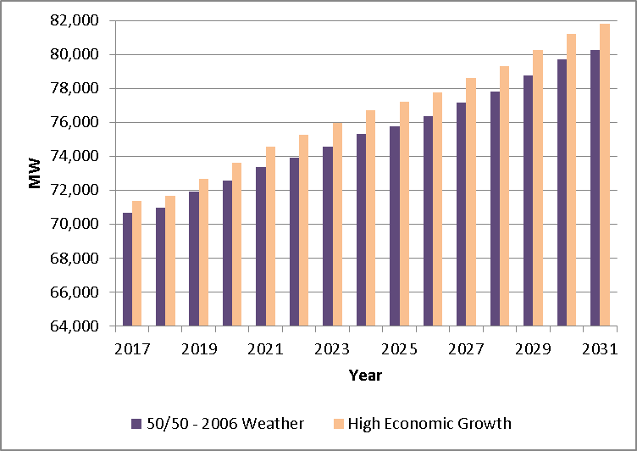
ERCOT Summer Peak Forecast Comparison

Slide 11
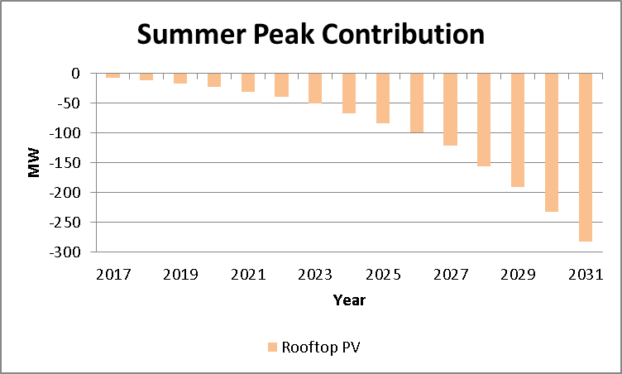
High Economic Growth

Slide 12
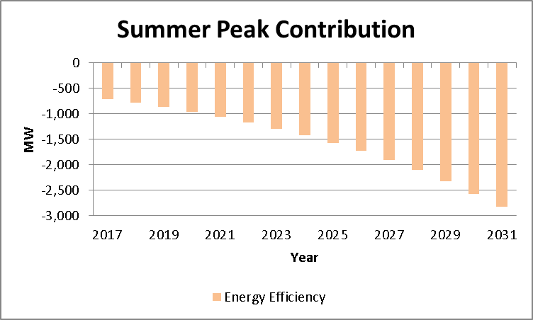
High Economic Growth

Slide 13
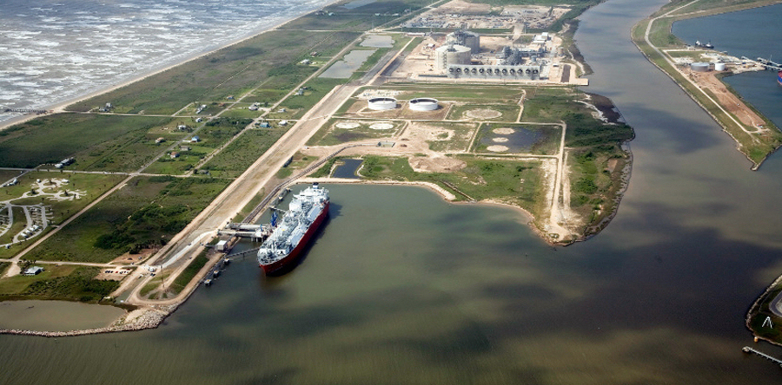
LNG – High Economic Growth
Brownsville LNG Facilities
Incremental load was added to the forecast
300 MW beginning 1/1/2020
450 MW beginning 1/1/2021
600 MW beginning
1/1/2022 on
No reduction in the
facility load was
assumed for 4 CP
and/or high price
intervals
Notes:
Texas LNG Brownsville, Annova LNG, Rio Grande LNG

Slide 14
Environmental Mandate

Slide 15
Environmental Mandate - Assumptions
2006 Weather
Typical Wind Year
Typical Load Year
Energy Efficiency/Customer Behavior DR
1.0% of the total demand in 2017
7.0% of the total demand by 2031
Rooftop PV
10% of premises to have rooftop PV
25% increase per year
Results in 1,348 additional MW by 2031

Slide 16
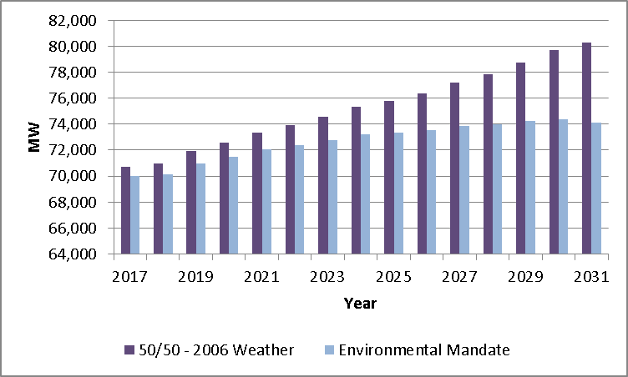
ERCOT Summer Peak Forecast Comparison

Slide 17
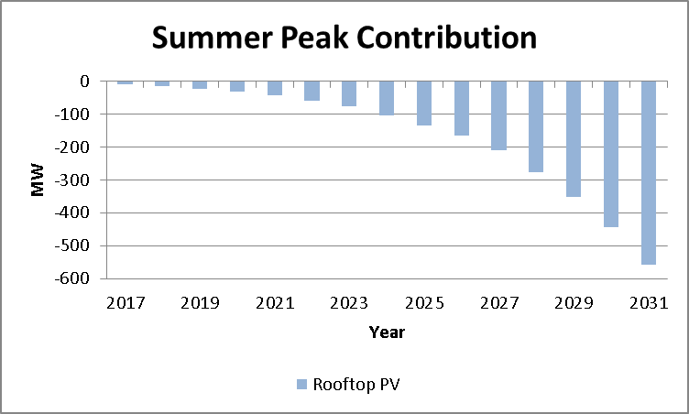
Environmental Mandate

Slide 18
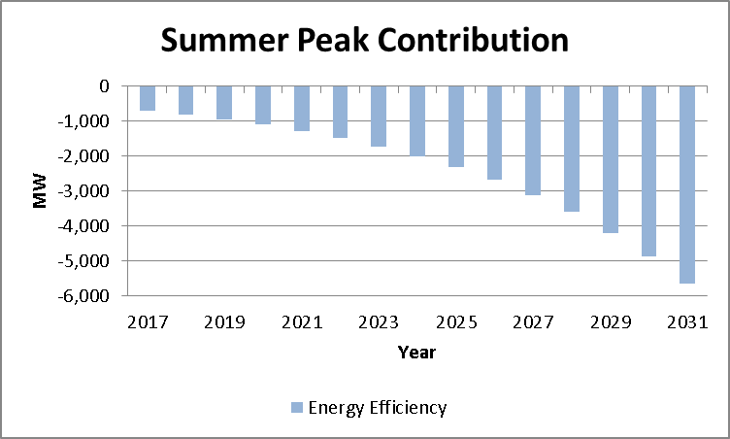
Environmental Mandate

Slide 19
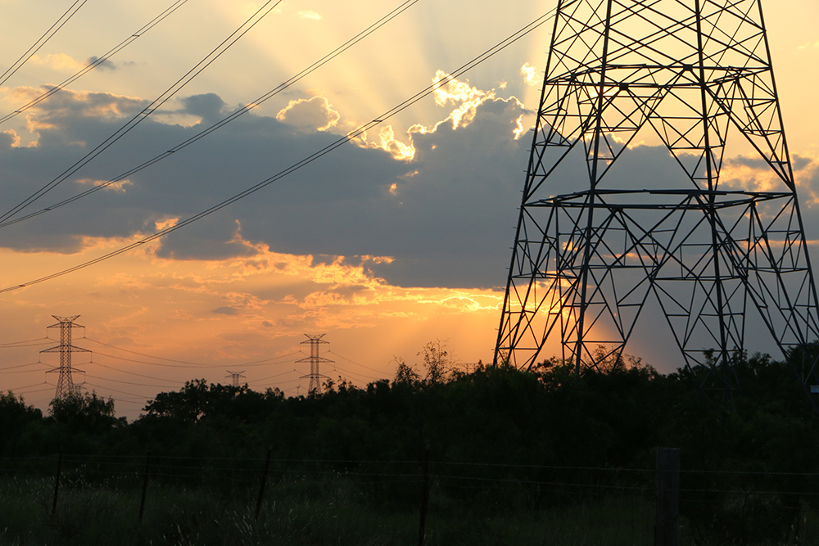
Questions?

