Slide 1
ERCOT MARKET EDUCATION
Retail 101

Slide 2
Smart Meter Technology

Slide 3
Overview
Topics in this lesson . . .
Meter Data – The Big Picture
A Few Definitions
Impacts of Smart Meter Technology on REPs

Slide 4
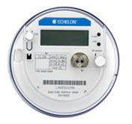
Smart Meter Technology
Meter Data – The Big Picture
Adjusted Metered Load (QSE)
Qualified Scheduling Entity (QSE)
Calculated for each 15 minute interval
Retail Electric Provider (REP)
Unaccounted For Energy (UFE)
Losses
Collected by TDSPs
Meter Data
Notes:
We saw this picture earlier in the course. <Click for animation> Load meter data is collected and sent to ERCOT by TDSPs. Ultimately, ERCOT must roll all meter data up to the QSE level in order to settle the Wholesale Markets. ERCOT adjusts the metered load data to incorporate Losses and UFE and calculates each QSE’s Adjusted Metered Load. <Click for animation> Since ERCOT settles the Wholesale Markets on a fifteen minute interval, the QSEs’ Adjusted Metered Load must be calculated for each fifteen minute interval.

Slide 5
Smart Meter Technology
Meter Data – The Big Picture
Load Related Charges
Adjusted Metered Load (QSE)
Qualified Scheduling Entity (QSE)
ERCOT settles with QSE based on Adjusted Metered Load
Energy usage
Other load-related charges

Slide 6
Smart Meter Technology
Meter Data – The Big Picture
Adjusted Metered Load (QSE)
Qualified Scheduling Entity (QSE)
Load Related Charges
QSE Settles with REP
Energy usage
Other load-related charges
Retail Electric Provider (REP)

Slide 7
Smart Meter Technology
Meter Data – The Big Picture
Adjusted Metered Load (QSE)
Qualified Scheduling Entity (QSE)
REP Bills Customers
Energy usage based on Meter Data
Other service-related charges
Retail Electric Provider (REP)

Slide 8
A Few Definitions

Slide 9
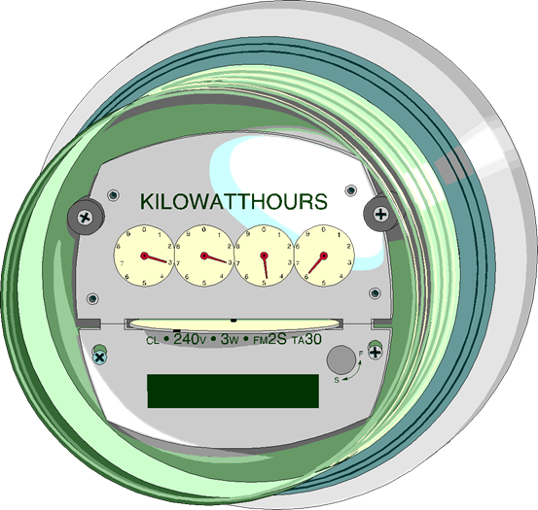
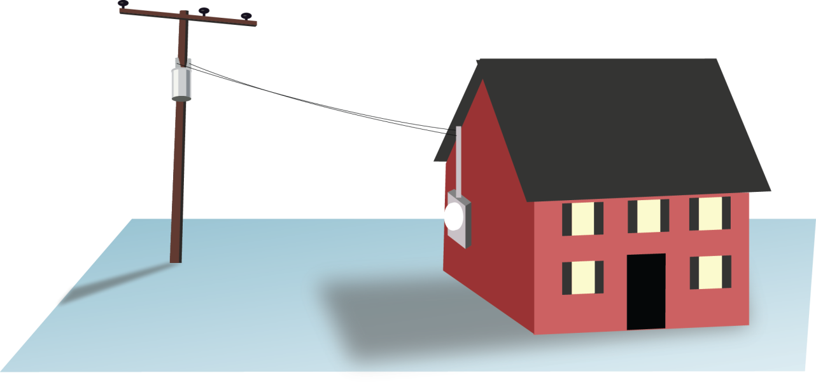
A Few Definitions
Meter – A device that measures electrical usage over some period of time
Notes:
Just so everyone is clear, when we speak of a meter, we are speaking of a device that measures electrical usage over some period of time. The time component of this definition is important, because it will help us distinguish between the various meters that are utilized in ERCOT.

Slide 10
A Few Definitions
Meters come in multiple flavors
Non-Standard
Interval Data Recorder (IDR)
Non-IDR
Standard
Advanced Meter System (AMS)

Slide 11
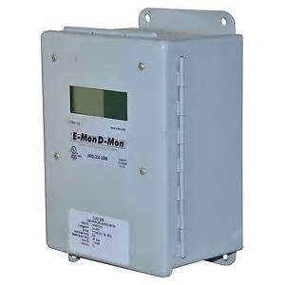
A Few Definitions
Interval Data Recorder (IDR) Meter
Usage is measured in 15-minute intervals
Data is already shaped for 15 minute Wholesale Settlement
Typically reported monthly
ERCOT Settles the Real-time Wholesale Market in 15-minute intervals

Slide 12
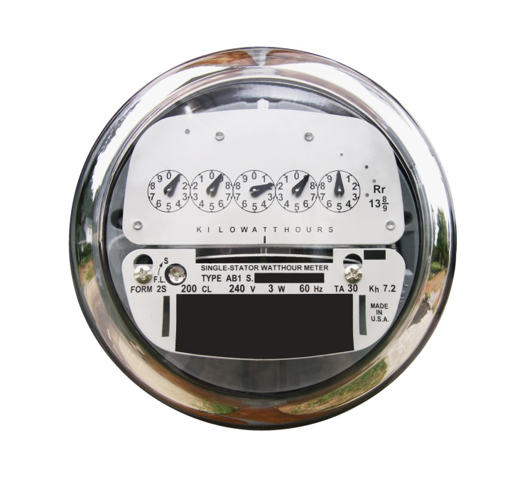
A Few Definitions
Non-IDR Meter
Traditional Meter
Usage is a scalar measurement for an entire month
Data must be shaped for 15 minute Wholesale Settlement

Slide 13
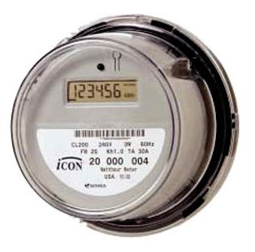
A Few Definitions
Advanced Meter System (AMS)
Usage is measured in 15 minute intervals
Data is already shaped for 15 minute Wholesale Settlement
Remote capabilities
Typically read remotely
May be disconnected and reconnected remotely
Also known as a “Smart Meter”

Slide 14
Impacts of Smart Meter Technology on the Retail Market

Slide 15
Impact of Smart Meter Technology
So, what does Smart Meter Technology mean for the Retail Market?
Meter data is more precise
Meter data is available faster
More opportunities for retail products?

Slide 16
More Precise Meter Data
Before Smart Meters
~58% of competitive load was settled with NIDR meters
Had to be shaped with Load Profile
Actual customer load pattern might have been different
Errors contributed to UFE

Slide 17
More Precise Meter Data
After Smart Meters
~98% of competitive load is now settled using interval data
REP can discover customer’s actual usage pattern
More accurate REP settlement with QSE

Slide 18
Meter Data is Available Faster
More Accurate Initial Settlement
Today, ~73% actual load data used in Initial
Before Smart Meters, ~ 39% actual load data was used in Initial
ERCOT Real-Time Settlements Timeline
Operating Day
Day 5
Day 55
Day 180
Initial Statement
Final Statement
True-Up Statement

Slide 19
Meter Data is Available Faster
Faster Execution of Retail Market Processes
Enrollment type Initiating Transaction | AMS Remote (AMSR) | AMS Manual (AMSM) | Non-AMS
Move-In 814_16 | Same Day | 2 Business Days | 2 Business Days
Standard Switch 814_01 | Same Day | Same Day | Within Next 4 Business Days
Self Selected Switch 814-01 | Same Day | Same Day | At Least 2 Business Days
Move-Out 814_24 | Same Day | Same Day | Within Next 4 Business Days

Slide 20
More Opportunities?
Does Smart Meter technology offer the promise of new Retail products?
Prepay
Demand Response
Time-of-Use Rates
Qualified Scheduling Entity (QSE)
Retail Electric Provider (REP)
Only time will tell!
Notes:
Does Smart Meter technology offer the promise of new Retail products? Does the greater timeliness of meter data allow for better prepay products, where a customer pays in advance to use a certain amount of electricity over a certain period of time? Does the greater precision and interval measure of meter data allow for enhanced demand response products? Does having interval data for most customers allow REPs to offer the long-sought time-of-use pricing?
<Click for animation> Only time will tell!

