Slide 1
ERCOT MARKET EDUCATION
Retail 101

Slide 2
Introductions, Roles and Responsibilities

Slide 3
Overview
  Topics in this lesson . . .
  Two Basic Definitions
  Market Relationships
  Roles and Responsibilities
    ERCOT
    REPs
    TDSPs
    PUCT

Slide 4
Two Basic Definitions
Premise / ESI-ID

Slide 5
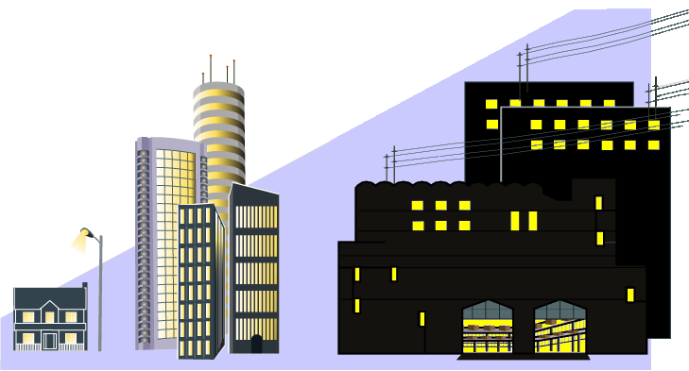
Two Basic Definitions
Premise – A Service Delivery Point or combination of Service Delivery Points that is assigned a single identifier for ERCOT settlement and registration.
  Metered
  Unmetered, such as
    Street Lights
    Traffic Lights
    Billboards
Electrons R Us

Slide 6

Two Basic Definitions
ESI ID – Electric Service Identifier
  The unique identifier assigned to each Premise
  Used for all retail transactions in ERCOT
    Enrolling Customers
    Switching retail providers
    Load metering
Retail Electric Provider (REP)

Slide 7
Market Relationships

Slide 8


Market Participants
  Who are the ERCOT Players?
QSE
  Qualified Scheduling Entities
LSE
  Load Serving Entities
  Transmission and/or Distribution Service Providers
TDSP
Resource
Entity
  Resource Entities
Notes:
Before, we go any further, let’s introduce the players in the Market. This is a list of all of the entities who must register with ERCOT. Over the next few slides, we will look at how these players fit into the overall market structure and focus on the relationships between them.

Slide 9
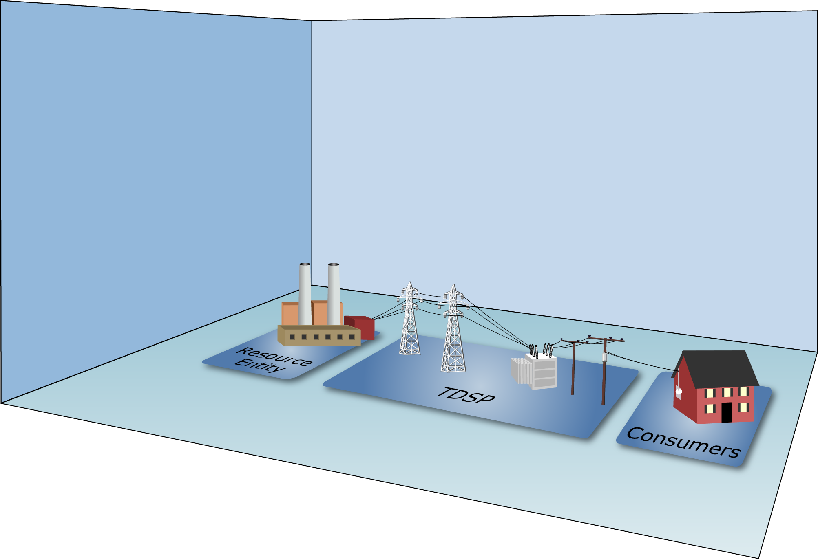
Market Relationships

Slide 10
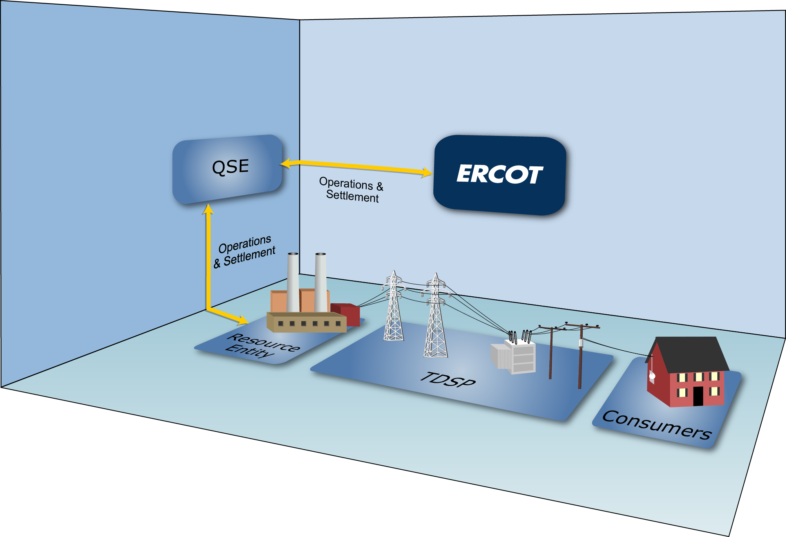
Market Relationships

Slide 11
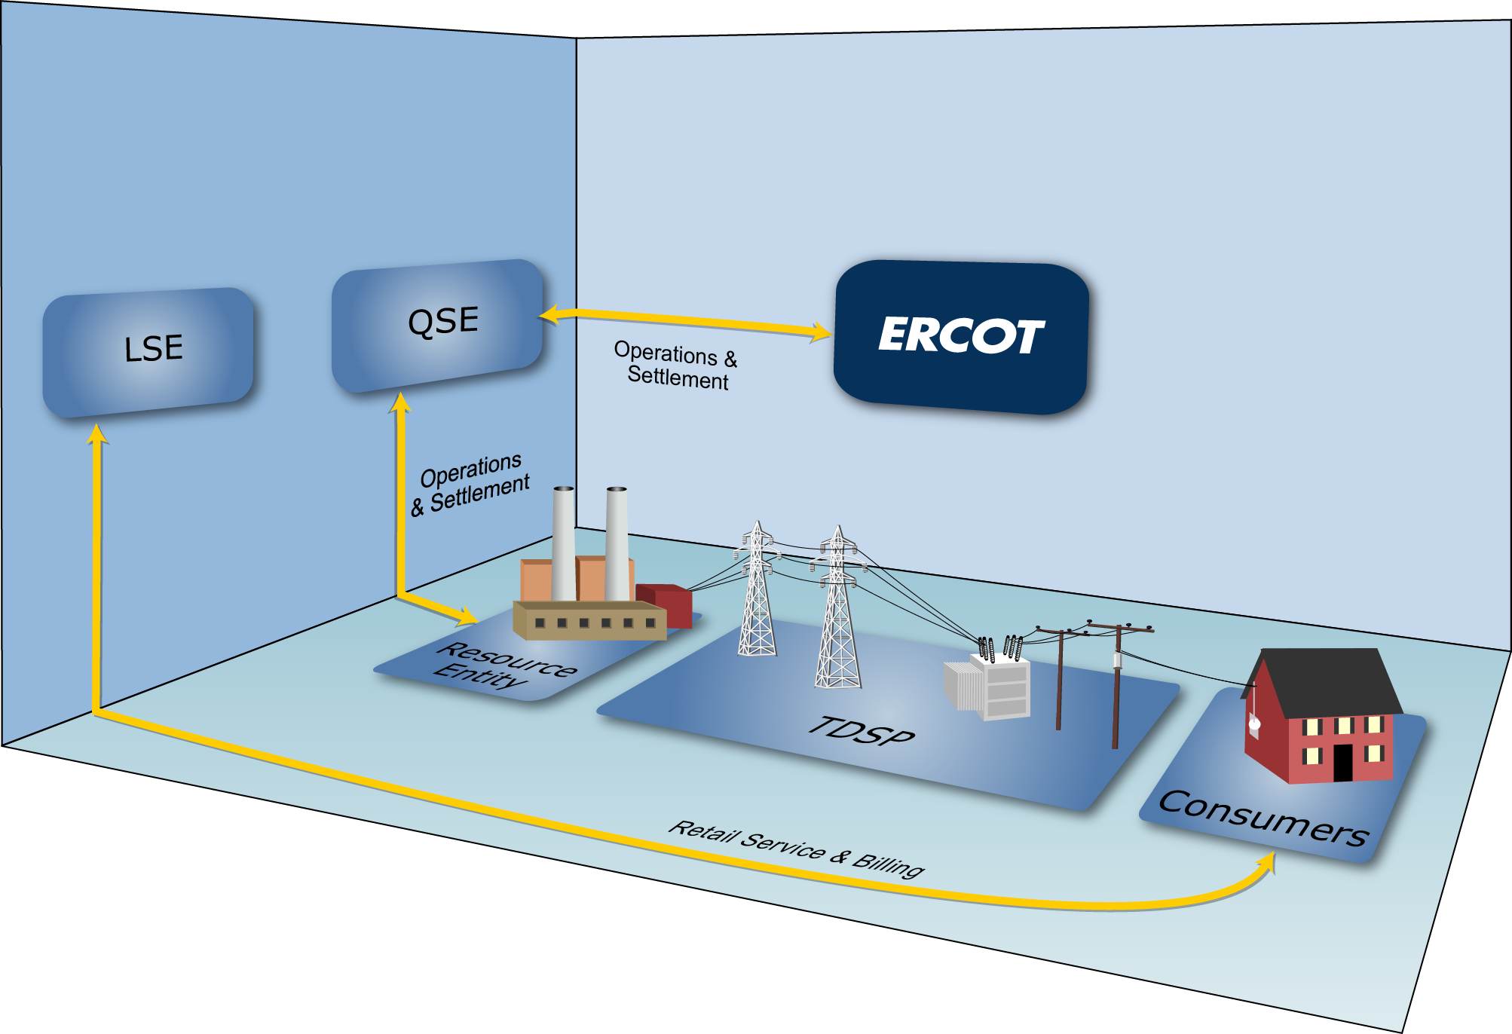
Market Relationships

Slide 12

Market Relationships

Slide 13

Market Relationships
A Load Serving Entity (LSE) provides electric service to end-use Customers
Notes:
Load serving entities (LSEs) provide electric service to end-use Customers. As mentioned in defining the audience for this course, LSEs include:
Retail Electric Providers – entities that sell electric energy to retail Customers in the areas of Texas where the sale of electricity is open to retail competition
Electrical Cooperatives – businesses owned by the people who use their services
Municipally-Owned Utilities – providers owned by the municipalities they serve

Slide 14
Market Relationships
Types of LSEs:
  Retail Electric Providers
  (AKA Competitive Retailers)
  Electrical Cooperatives
  Municipally-Owned Utilities
Notes:
LSEs include:
Retail Electric Providers – entities that sell electric energy to retail Customers in the areas of Texas where the sale of electricity is open to retail competition
Electrical Cooperatives – businesses owned by the people who use their services
Municipally-Owned Utilities – providers owned by the municipalities they serve

Slide 15


Market Relationships
Types of LSEs:
  Retail Electric Providers
  (AKA Competitive Retailers)
  Electrical Cooperatives
  Municipally-Owned Utilities

Slide 16
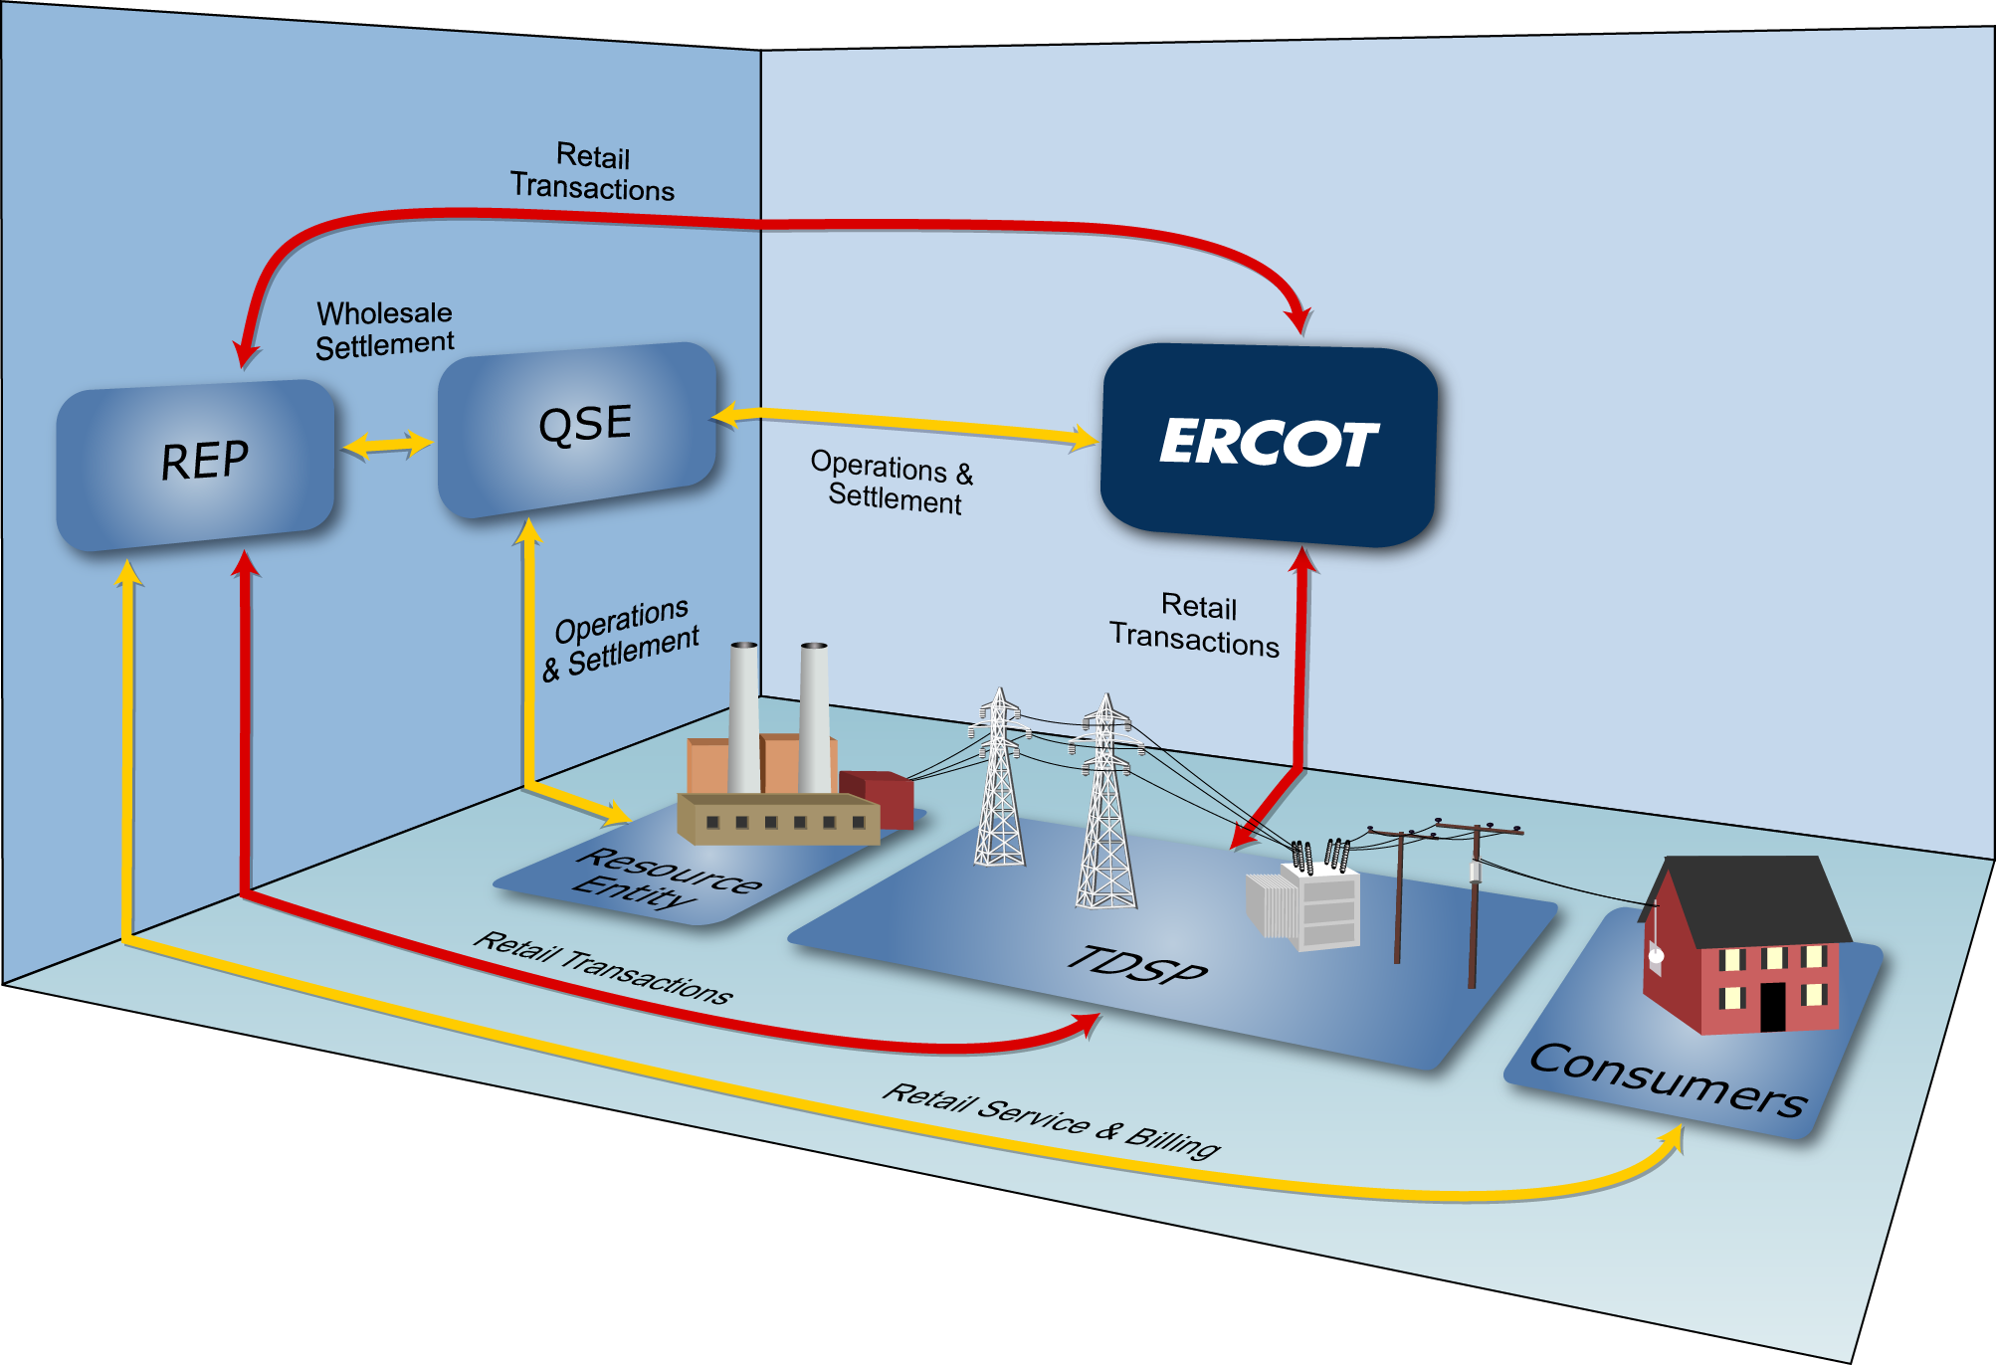
Market Relationships

Slide 17
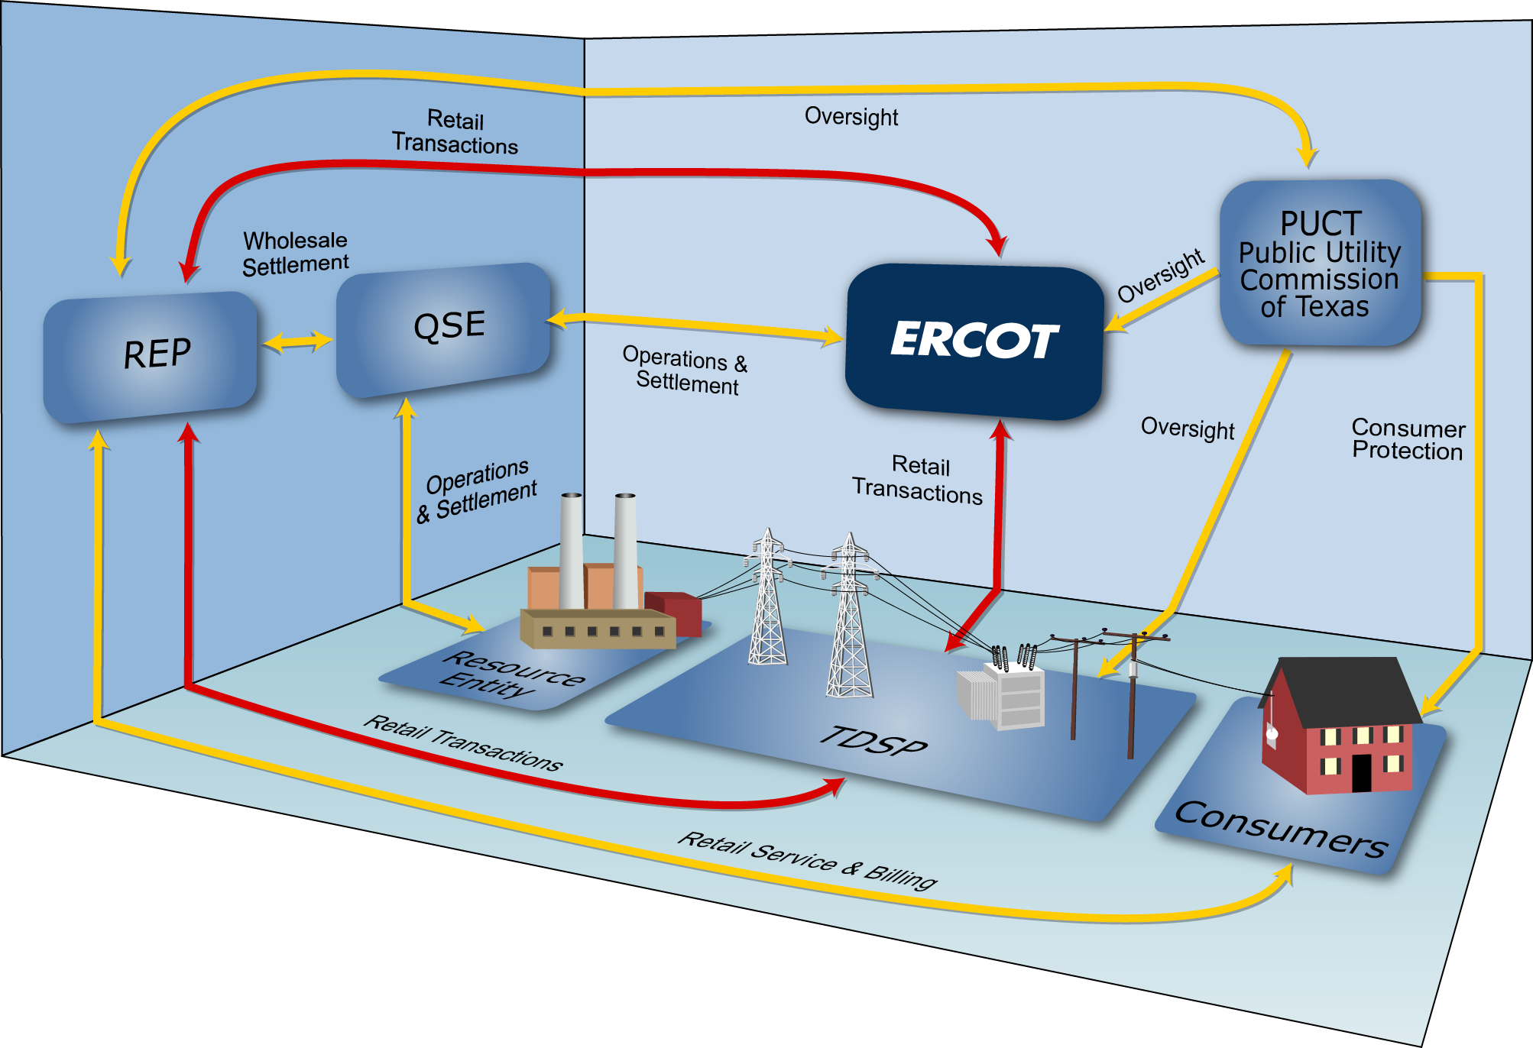
Market Relationships

Slide 18
Roles and Responsibilities

Slide 19

ERCOT Responsibilities
Maintain Reliability of the Bulk Electric System
  Ensures generation meets demand
  Operate transmission grid within established limits
Executes competitive markets for reliability services
Notes:
ERCOT’s primary responsibility is to ensure the day-to-day reliability of the ERCOT Transmission Grid. To achieve reliability, ERCOT must match generation output and system demand, and make sure that the transmission system is operating within its established limits.
This process requires continual dispatch of generation to meet the rise and fall in system demand.
In order to be able to perform this dispatch at the least cost, ERCOT executes competitive markets to purchase energy and capacity services needed to reliably serve the system demand.

Slide 20
ERCOT Responsibilities
Maintain Registration Database
Qualified Scheduling Entity (QSE)
ERCOT facilitates enrollment and switching of retail Customers
Retail Electric Provider (REP)

Slide 21
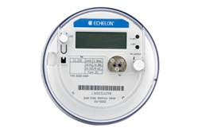
ERCOT Responsibilities
Settle the Wholesale Markets
Adjusted Metered Load (QSE)
Qualified Scheduling Entity (QSE)
Retail Electric Provider (REP)
Unaccounted For Energy (UFE)
Losses
Meter Data

Slide 22




REP Responsibilities
Service Retail Customers
  Negotiate competitive contracts with retail Customers
  Manage retail Customer’s ESI IDs
  Act as primary contact for electric service issues

Slide 23



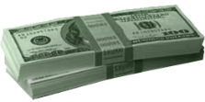

REP Responsibilities
Meet Financial Responsibilities
  Pay and/or dispute invoices
    Buy electricity at wholesale
    Pay TDSPs for delivery costs
  Invoice retail Customers for their monthly usage

Slide 24
REP Responsibilities
Investigate Customer Switching issues
  Work with TDSPs and other REPs to resolve inadvertent gains and losses
REP #1
REP #2

Slide 25
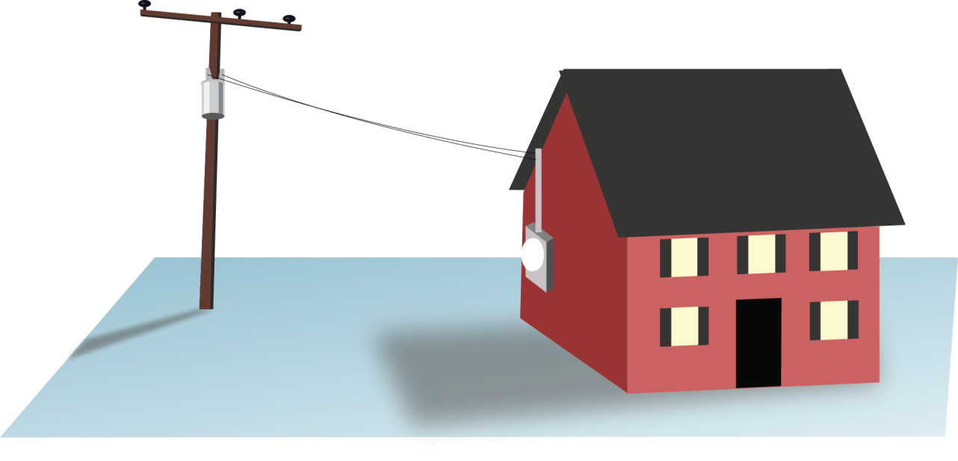

TDSP Responsibilities
Physical System Operations
  Maintain reliable transmission and distribution system
  Physically connect Customer Premise to ERCOT grid
  Maintain metering systems at Customer Premises
  Resolve power outages

Slide 26
TDSP Responsibilities
Retail System Operations
  Establish ESI IDs
  Facilitate Enrollments and Service Order Requests
  from REPs
  Provide ESI ID usage data
  for ERCOT Settlement
  and REP billing
REP #1
REP #2

Slide 27
TDSP Responsibilities
The anatomy of an ESI ID
10xxxxxzzz..zz
Where:
10 Placeholder for future
xxxxx Five digit DOE code for TDSP
zzz..zz Up to 29 alphanumeric characters assigned by TDSP
Notes:
Speaking of ESI IDs, we should spend a little time looking at the basic anatomy of an ESI ID. When the TDSP sets up an ESI ID, they must follow a prescribed format defined in Protocol Section 15. Every ESI ID today will begin with “10,” originally set up as a future placeholder, but holds no physical meaning today. The next five digits (the Xs) are the most significant portion of the number for our purposes here, because they define the TDSP who set up the ESI ID in the first place. So this part of the code will tell a REP at a glance which TDSP services this premise. The remaining digits are any combination of up to 29 alphanumeric characters, used at the TDSPs discretion.

Slide 28
TDSP Responsibilities
The anatomy of an ESI ID
10xxxxxzzz..zz
XXXXX | TDSP Name
20404 | AEP TX North
03278 | AEP TX Central
08901 | CenterPoint
13830 | Nueces Electric Coop
44372 | Oncor Electric Delivery
17699 | Oncor/SESCO
03109 | Sharyland Utilities
17008 | Sharyland Utilities-McAllen
40051 | Texas New Mexico Power (TNMP)
Notes:
Speaking of ESI IDs, we should spend a little time looking at the basic anatomy of an ESI ID. When the TDSP sets up an ESI ID, they must follow a prescribed format defined in Protocol Section 15. Every ESI ID today will begin with “10,” originally set up as a future placeholder, but holds no physical meaning today. The next five digits (the Xs) are the most significant portion of the number for our purposes here, because they define the TDSP who set up the ESI ID in the first place. So this part of the code will tell a REP at a glance which TDSP services this premise. The remaining digits are any combination of up to 29 alphanumeric characters, used at the TDSPs discretion.

Slide 29
TDSP Responsibilities
Invoice REPs according to tariffs
  Delivery charges based on usage
  Discretionary charges
Please refer to each TDSP’s website for details

Slide 30


TDSP Responsibilities
Investigate Customer Switching issues
  Work with REPs to resolve inadvertent gains and losses
MarkeTrak
MarkeTrak

Slide 31

PUCT Responsibilities
Public Utility Commission of Texas (PUCT)
  Provides regulatory oversight
    ERCOT operations and budget
    TDSPs operations and tariffs
    REP certification / oversight

Slide 32
PUCT Responsibilities
Public Utility Commission of Texas (PUCT)
  Provides consumer protection
    Creates Substantive Rules that govern
    all other Market Rules and Protocols
    Maintains Power to Choose website
    Receives and investigates Customer complaints

