Slide 1
SMT Update To AMWG
OCT 2015

Slide 2
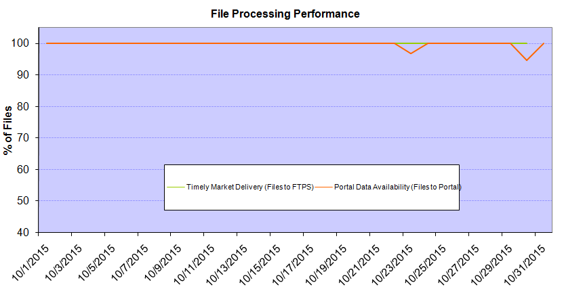
Monthly SMT Data Timelines AMWG CR 2014 002 End to End File Processing Completeness – OCT 2015
% Timely Market Delivery - % of files posted to market (FTPS) by 11:00pm out of # of files received by SMT by 11:00pm.
% Portal Data Availability - % of files loaded to the database for data availability on portal by 6:00am next day for the files received by 11:00pm
* A LSE file includes usage data for up to 50,000 ESIIDs.
Observed Anomalies:
10/23 & 10/30 – LSE file processing was delay due to SMT DR activities.
2

Slide 3
SMT API and FTPS Services Availability – OCT-2015
The service availability is measured as a percentage of number of minutes the service was available out of the total number of minutes in a month, excluding planned outages.
Observed Anomalies:
Mar-Apr 2015: SMT outage and subsequent recovery/catch-up impacted API availability. FTPS was available for most of the part except on 03/21-03/22 for 36 hours.
26 Jul 2015: Services were unavailable for 12 hours due to Flash storage issue
Notes:
3

Slide 4
SMT Number of Accounts by Type AMWG CR 2014 009 – OCT 2015
Registered Users | ONC | CNP | AEPN | AEPC | TNMP | TOTAL
Active Residential Accounts | 31937 | 20584 | 2038 | 5336 | 2268 | 62163
Active Residential English Accounts | 31785 | 20435 | 2034 | 5224 | 2260 | 61738
Active Residential Spanish Accounts | 152 | 149 | 4 | 112 | 8 | 425
Non Active Residential Accounts | 15726 | 11156 | 1260 | 2588 | 541 | 31019
Total Residential Accounts | 47663 | 31740 | 3298 | 7924 | 2809 | 93182
TDSP User | 453 | 38 | 12 | 17 | 2 | 522
TDSP Admin | 4 | 4 | 4 | 4 | 3 | 19
Small Business User | 77 | 35 | 0 | 1 | 1 | 114
Small Business Admin | 2242 | 1174 | 69 | 234 | 68 | 3877
Total Agreements | 630 | 382 | 1 | 0 | 0 | 1013
Energy Data Agreements | 537 | 85 | 1 | 0 | 0 | 623
Han Device Agreements | 93 | 296 | 0 | 0 | 0 | 389
Han Service Agreements | 0 | 1 | 0 | 0 | 0 | 1
IN SMT
ESI IDs | 3449326 | 2370610 | 197018 | 852042 | 204750 | 7073746
Meters | 3378616 | 2370578 | 197841 | 852216 | 204505 | 7003756
HAN Devices | 4171 | 5323 | 150 | 290 | 37 | 9971
Acknowledgement | 0 | 0 | 0 | 0 | 0
Pending | 0 | 7 | 0 | 0 | 0
Meter Ready | 523 | 89 | 46 | 122 | 26
Provisioned | 3648 | 5227 | 104 | 168 | 11
HAN Messages (MTD) | 0 | 0 | 0 | 0 | 0 | 0
HAN Messages (YTD) | 14 | 22 | 0 | 0 | 0 | 36
HAN Messages (Cumulative) | 305 | 7386 | 0 | 0 | 0 | 7691
Simple Text Messages | 94 | 2920 | 0 | 0 | 0
Load Control Messages | 80 | 2655 | 0 | 0 | 0
Pricing Messages | 89 | 49 | 0 | 0 | 0
Cancellation Messages | 42 | 1762 | 0 | 0 | 0
Supplemental – (Friends)
Total Agreements | 1534 | 1220 | 72 | 80 | 56 | 2962
Accepted Agreements | 693 | 477 | 32 | 28 | 17 | 1247
Pending Agreements | 1 | 1 | 0 | 0 | 1 | 3
Revoked Agreements | 219 | 231 | 9 | 7 | 6 | 472
Expired Agreements | 595 | 484 | 29 | 45 | 32 | 1185
Terminated Agreements | 26 | 27 | 2 | 0 | 0 | 55
 | TDSPs | REP | NRC | Regulatory | Third Party
Registered Entities | 5 | 101 | 3775 | 2 | 64
Registered Users | 522 | 847 | 114 | 7 | 7
Registered Admins | 19 | 159 | 3787 | 3 | 67
HAN Messages Sent By | 296 | 7383

Slide 5
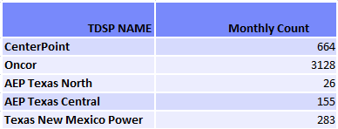
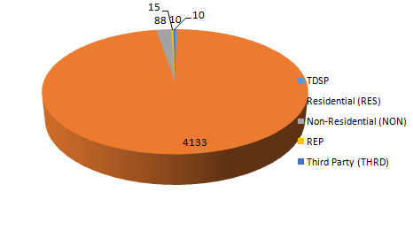
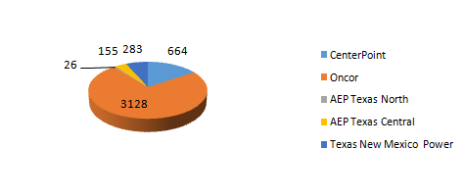
SMT ODR Details – OCT 2015
Total ODR Requests TDSP wise statistics:
Total ODR Requests User type statistics:

