Slide 1
ERCOT MARKET EDUCATION
Retail 101

Slide 2
Retail Transaction Processing

Slide 3
Overview
Topics in this lesson . . .
Introduction to Texas SET Retail Transactions
Systems used by ERCOT, REPs and TDSPs for processing Retail Transactions
Market Processes that use Retail Transactions

Slide 4
An Important Definition
Retail Transaction:
A Communication that enables and facilitates retail business processes in the deregulated Texas Electrical Market
Involves REPs, TDSPs and ERCOT
Electronic Data Interchange (EDI) format, based on ANSI ASC X12 Standards

Slide 5
Texas Standard Electronic Transactions (TX SET)
Retail Transactions are defined by TX SET
Developed and maintained by TX SET Working Group
High level description in Protocol Section 19
Detailed Implementation Guides posted on ERCOT.com

Slide 6
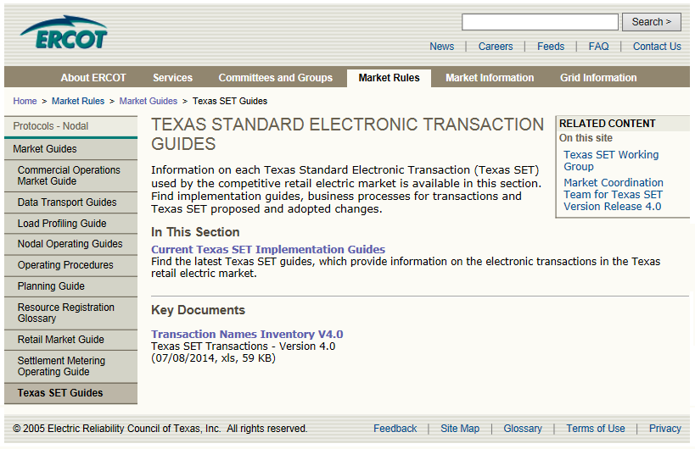
Texas Standard Electronic Transactions (TX SET)
Transaction Names Inventory and Pocket Card
Notes:
But for quick reference, there is also a Transaction Name Inventory posted on ERCOT.com, complete with a handy pocket card. We printed and laminated pocket cards to give you here today. We hope that you will find them as useful as we do. We also hope that you will use them in the upcoming class scenarios!

Slide 7
Texas Standard Electronic Transactions (TX SET)
Many transactions involve ERCOT
Transaction Type | Use
814’s – ESI ID info and Relationships (Many flavors) | Enrollments; Switch Requests; Move-Ins; Move-Outs; ESI ID Maintenance
867’s – Premise Usage | Initial Meter Read; Historical / Monthly Usage
824’s – Reject Notification | Notice of Invoice / Usage Rejection
Notes:
Instructor should point students to the pocket card for this discussion. Point out how many different 814’s there are.

Slide 8
Texas Standard Electronic Transactions (TX SET)
Some transactions do not involve ERCOT
Transaction Type | Use
810’s – Invoice | Bills for Charges between Market Participants
820’s – Payments | Payments between Market Participants
650’s – Service Order Requests | Disconnects for Non-Pay; Reconnects Switch Hold and Switch Hold Removal; Planned Outage Notification
824’s – Reject Notification | Invoice or Usage Rejection
These are called Point-to-Point Transactions

Slide 9
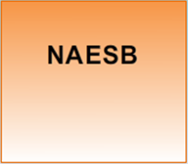
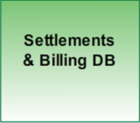
ERCOT Involved Transactions
What are the systems?
North American Energy Standards Board
Electronic Delivery Mechanism
Standards for data delivery
Allows standardized communication
System of Record for Relationships
Currently Siebel
System of Record for ESI ID data
System of Record for usage
ERCOT-developed system
Notes:
Let’s spend some time looking at the transactions involving ERCOT. We want to start by looking at the systems that are involved in these transactions.

Slide 10
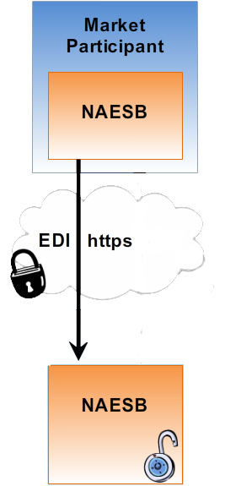
Systems for ERCOT Involved Transactions
Transaction is initiated by Market Participant
Market Participant NAESB Server initiates secure communication over Secured Socket Layer (SSL)
Market Participant sends encrypted EDI package
ERCOT NAESB Server identifies and decrypts EDI files
ERCOT Systems

Slide 11
Systems for ERCOT Involved Transactions
Data is validated and forwarded
Validated against TX SET and ANSI X12
Reformatted for other ERCOT systems
ERCOT Systems

Slide 12
Systems for ERCOT Involved Transactions
Registration Database (Siebel)
Stores REP registration information
Manages ESI ID to REP relationships
ERCOT Systems

Slide 13
Systems for ERCOT Involved Transactions
Settlements and Billing Database
Stores all ESI ID characteristics
Receives ESI ID to REP relationships through daily batch process
Incorporates relationship data into Service History for use in the settlement process
ERCOT Systems

Slide 14
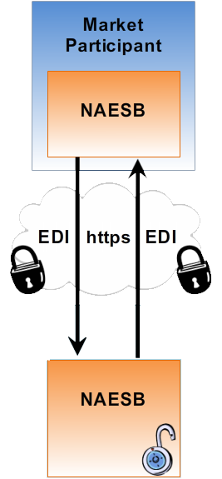
Systems for ERCOT Involved Transactions
Some transactions are initiated by ERCOT
ERCOT NAESB Server initiates secure communication over Secured Socket Layer (SSL)
ERCOT sends encrypted EDI package
Market Participant NAESB Server identifies and decrypts EDI files
ERCOT Systems

Slide 15
Another Definition
Market Process:
A pre-defined package of retail transactions that must occur in a particular sequence
Developed and maintained by ERCOT and the TX SET Working Group
REP
814_16
ERCOT
814_03
TDSP
814_04

Slide 16
ERCOT Involved Transactions
Typical Retail Market Processes
Move-In
Move-Out
Switch Request
REP #1
REP #2
These processes are typically initiated by customer request

Slide 17
Customer Move-In
From
To
Transaction Type
ERCOT
TDSP
REP
ERCOT
TDSP
REP
Move In Request
814_16
Enrollment
Notification Request
814_03
Enrollment
Notification Response
814_04
CR Enrollment
Notification Response
814_05
Historical Usage
(If requested by REP)
867_02
2
1
1
2
Initial Meter
Read
867_04
2
1
1
2
Notes:
The following set of scenarios illustrate three major market processes that utilize ERCOT-Involved transactions. Important: Learners must have their pocket cards (handed out earlier) to participate in this activity. These scenarios allow the instructor to walk the class through these processes step by step and encourage students to use the pocket card to begin speaking the transaction lingo.
As we can see here, the move-in process involves multiple transactions. In fact, the Move-In market process is a pre-defined package of transactions that must occur in a particular sequence. Notice that the sequence is initiated with the Move-In Request transaction. What follows is an ERCOT-facilitated exchange of information between ERCOT, a Competitive Retailer (REP), and the TDSP that physically connects the retail premise to the grid. Each transaction has a code number as specified in Texas SET. A transaction will always flow between at least two parties.
[Instructor should facilitate this classroom exercise as follows:]
As we have said, a Move-In Request is used to begin the Customer enrollment process for a Move-in. Using the reference cards that we handed out earlier, can someone tell me the transaction number?
Great! <Click to display number> And what parties does the transaction flow from and to?
Great! <Click to display dots> The Move-In Request is sent from the REP to ERCOT
The next transaction is the Enrollment Notification Request. What’s the number for that one? <Click to display> Who sends and receives it? <Click to display>
Great! This transaction notifies the TDSP of a Move-In, so that they can schedule meter reads.
The next transaction is the Enrollment Notification Response. What’s the number for that one? <Click to display> Who sends and receives it? <Click to display>
Great! With this transaction, the TDSP acknowledges the enrollment request and provides the Scheduled Meter Read Date.
The next transaction is the CR Enrollment Notification Response. What’s the number for that one? <Click to display> Who sends and receives it? <Click to display>
Perfect! This transaction passes the TDSP acknowledgement back to the REP, so that they will also know the Scheduled Meter Read Date. This is important because it effectively marks the beginning of the REP’s service history with this customer.
The Historical Usage, if requested through the Move-in Request, provides the REP with up to 12 months of historical metered consumption at the premise. This data provides the REP with a starting point for estimating energy consumption for this customer, so that they can adequately prepare for it at the wholesale level. What’s the number for this transaction? <Click to display> Who sends and receives it? <Click to display> [Two clicks this time. Instructor may need to facilitate the two steps here]
Perfect! This transaction actually requires two steps. First the TDSP provides the Historical Usage to ERCOT, and then ERCOT passes the data on to the REP.
Lastly, the Initial Meter Read also occurs in two steps. What’s the number for this transaction? <Click to display> Who sends and receives it? <Click to display> [Two clicks again]. Great! The TDSP provides the Initial Meter Read to ERCOT, and then ERCOT passes the data on to the REP. This meter read forms the starting point for the REP’s service history with the customer. ERCOT will also use this information as the starting point for calculating wholesale energy consumption at the QSE level.

Slide 18
Customer Move-In Summary
Transaction Type |  | Purpose
Move-in Request | 814_16 | Initiating Transaction
Enrollment Notification Request | 814_03 | Notifies TDSP to schedule meter reads
Enrollment Notification Response | 814_04 | TDSP Provides the scheduled meter read dates
CR Enrollment Notification Response | 814_05 | Communicates scheduled meter read date to REP
Historical Usage (If requested in 814_16) | 867_02 | Provides REP a starting point for estimating future usage by customer
Initial Meter Read | 867_04 | Forms the starting point for REP’s service history with customer

Slide 19
Switch Request
From
To
Transaction Type
ERCOT
Old REP
TDSP
New REP
ERCOT
Old REP
TDSP
New REP
Switch Request
814_01
Enrollment
Notification Request
814_03
Enrollment
Notification Response
814_04
CR Enrollment
Notification Response
814_05
Loss Notification
814_06
Final Usage
867_03
2
1
1
2
Initial Meter Read
867_04
2
1
1
2
Notes:
The next scenario, a Switch Request, becomes more complicated. Notice that there are simply more transactions. Plus, this type Service Order Request involves two REPs!
[Instructor should facilitate as in previous scenarios]

Slide 20
Switch Request Summary
Placeholder

Slide 21
Customer Move-Out
From
To
Transaction Type
ERCOT
TDSP
REP
ERCOT
TDSP
REP
Move Out Request
814_24
2
1
1
2
Move Out Response
814_25
2
1
1
2
Final Meter Read
867_03
2
1
1
2
Others illustrated at http://www.ercot.com/mktrules/guides/txset/sw/index
Notes:
Our next scenario, the Move-Out Business, is a little bit simpler.
[Instructor should facilitate as in previous scenario]

Slide 22
Customer Move-Out Summary
Placeholder

Slide 23
The Swimlanes!
Notes:
<Instructor should ask,> Has anyone heard of the Texas SET Swimlanes?”
If you have heard that they are scary, don’t worry, they are simply the detailed illustrations of retail market processes like the three we just covered . We’re not going to dive down to that level of detail right now; however, it is important that you know where to find the Swimlanes for future reference and further exploration.

Slide 24
Common Transaction Timelines
Enrollment type Initiating Transaction | AMS Remote (AMSR) | AMS Manual (AMSM) | Non-AMS
Move-In 814_16 | Same Day | 2 Business Days | 2 Business Days
Standard Switch 814_01 | Same Day | Same Day | Within Next 4 Business Days
Self Selected Switch 814-01 | Same Day | Same Day | At Least 2 Business Days
Move-Out 814_24 | Same Day | Same Day | Within Next 4 Business Days
For purposes of determining these minimum timelines, business hours end at 1700
Notes:
Please note the different turnaround times for AMS and Non-AMS meters. Also AMS meters with remote connect/disconnect capabilities also have different turnaround times for Move-ins (and Disconnects for non-payment, as we shall see later)

Slide 25
Systems for Point-to-Point Transactions
Transaction is initiated by one Market Participant
Market Participant NAESB Server initiates secure communication and sends encrypted EDI package
Receiving Market Participant NAESB Server decrypts EDI files
Data is validated and routed to back-office systems
Market Participant
Back-office systems may vary by Market Participant
Back-Office
Systems

Slide 26
Disconnect/Reconnect for Non-Payment
From
To
Transaction Type
TDSP
REP
TDSP
REP
Service Order: Request for DNP/RNP
650_01
Service Order: Response for completion of DNP/RNP
650_02
Timing requirements vary depending on circumstances. Details in PUCT Substantive Rules and Retail Market Guide

Slide 27
Billing and Payment
From
To
Transaction Type
ERCOT
TDSP
REP
ERCOT
TDSP
REP
Monthly Usage
867_03
2
1
1
2

Slide 28
Billing and Payment
From
To
Transaction Type
TDSP
REP
TDSP
REP
REP combines 810_02 with 867_03 (and QSE charges) to bill Customer
Invoice (Wires Charges)
810_02
REP Pays TDSP through HACHA/Wire Transfer
Remittance Detail
820_02

