Slide 1
SAWG Update to WMS
November 4th, 2015
Brandon Whittle

Slide 2
Report Releases
Presentation for 2016 Long Term Load Forecast, data to be posted in December.
Housekeeping
Meeting for November 13th added to the calendar

Slide 3
NERC LTRA / CDR
NERC LTRA- Undergoing review by NERC Planning committee. ERCOT highlighting that Reserve Margins will naturally tail off after a few years due to market design.
CDR – List is forming for a 2016 review of CDR inputs.
Switchable Resources – A similar approach to the PUN or the DC Tie Methodology?
Solar Resources – Capacity contribution
DC Ties - Do we need a new methodology for new DC Ties where historical data is not available?

Slide 4
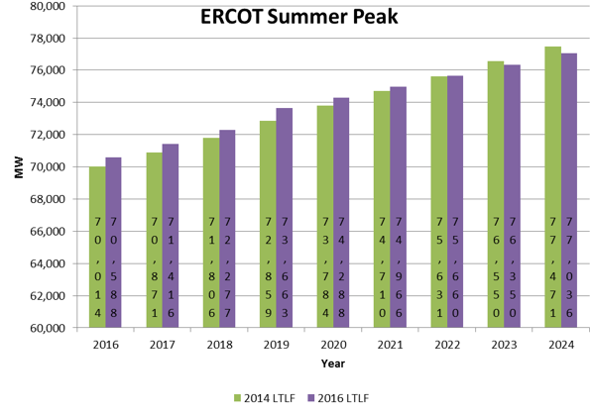
Load Forecasting
Long Term
Addition of Freeport LNG 2019
No adjustments made for efficiency, DG, 4CP, etc as it is all baked into the forecast.
Short Term Forecast is in testing but due to EMS upgrade it is not expected in production until Q3 2016.

Slide 5
RT Co-op General Plan
ERCOT provide Concept Paper
Get written comments on concept paper
ERCOT and MPs discuss the Concept Paper and comments received and make policy cuts at focused SAWG meetings
ERCOT write draft NPRRs and provide updated Cost estimate.
a. RT Co-optimization
b. Multi-Interval SCED
5) ERCOT will bring specific issues to SAWG when needed to proceed with NPRR and Cost Estimates.
6) Market Participants provide comments on draft NPRRs
8) ERCOT provide numbered NPRRs with preliminary Impact Analysis
PAUSE?

Slide 6
Multi-Interval RTM
No Change
Readiness Study is under review at ERCOT, Resources have begun to assemble and prepare for the study
No significant progress expected until 2016

Slide 7
Next Meeting – November 13th, 2015
Expected Agenda Items
Multi Interval Real Time Market – Update
WMS Assignments

