Slide 1
AMWG CR Recommended for Prioritization
Presented to RMS – November 3, 2015
Change Request # | Description | ROM
2015-033 | Provide user i/d and p/w rules up front on UI registration page | $0 - $20K

Slide 2
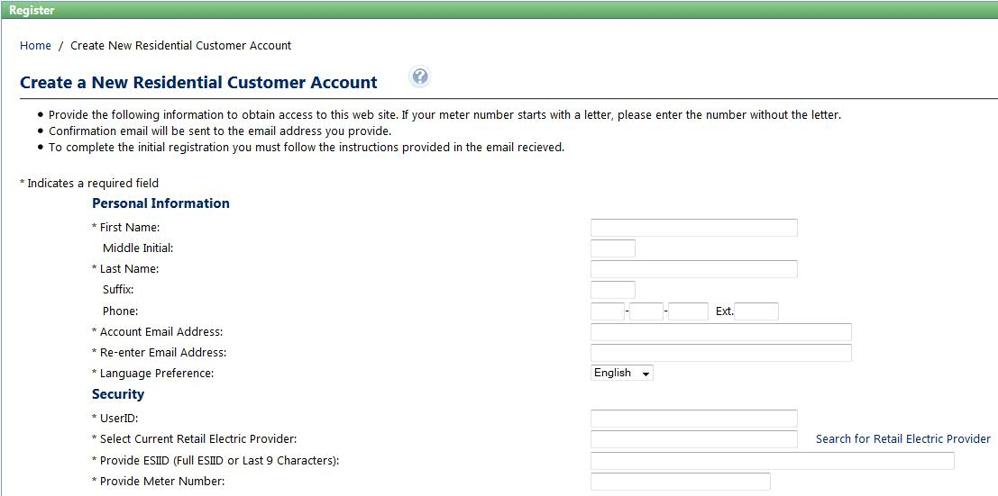
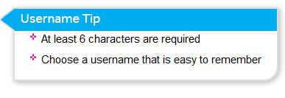
AMWG CR 2015-33 Customer account set-up process
Complexity: Minor
Business Requirement
Specific requirements / rules about user name and password do not appear intuitively. Example: the use of special characters is not allowed, but the error message displayed does not provide sufficient information / direction to correct.
Proposed Solution: Tooltip with rules will appear in the screen when the cursor will be in the User-ID field.

Slide 3
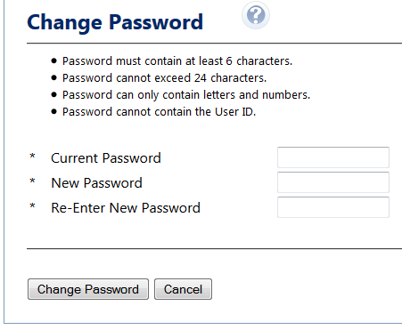
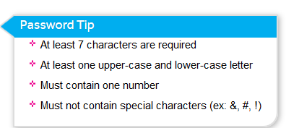
AMWG CR 2015-33 Customer account set-up process
Complexity: Minor
Business Requirement
(cont)
Password requirement Tool-tip
Proposed Solution: Tooltip with rules will appear in the screen when the cursor will be in the All-Password fields

