Slide 1
2016 Long-Term Load Forecast
Calvin Opheim
ERCOT
Manager, Forecasting & Analysis
SAWG
October 28, 2015

Slide 2
Outline of Today’s Presentation
Summary of Results
Comparison to 2014 Long-Term Load Forecast
Forecasting Framework / Model Data Input
Normal Weather (50/50) Forecast
Assumptions and Challenges
Active Models

Slide 3
Summary

Slide 4
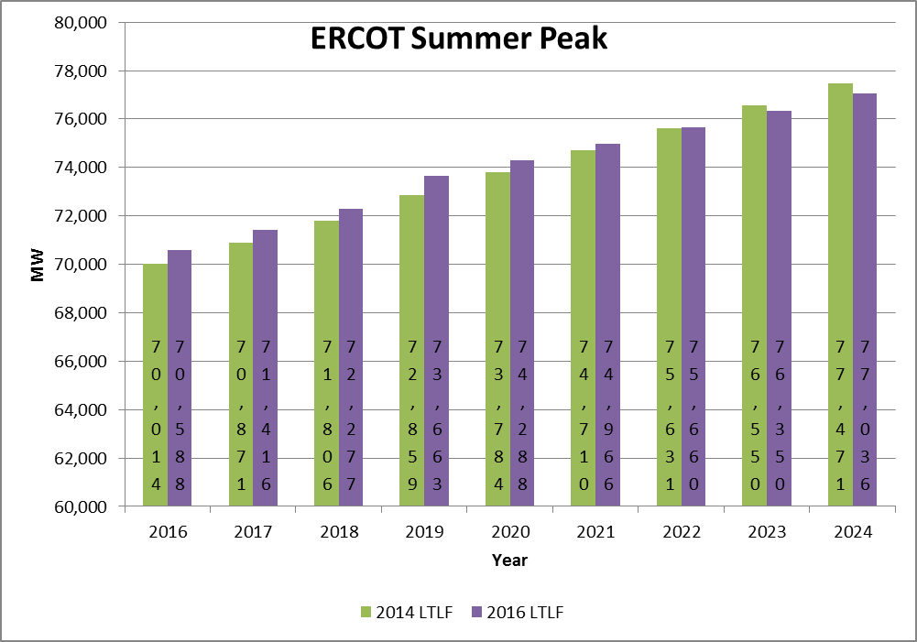
ERCOT Summer Peak Forecast

Slide 5
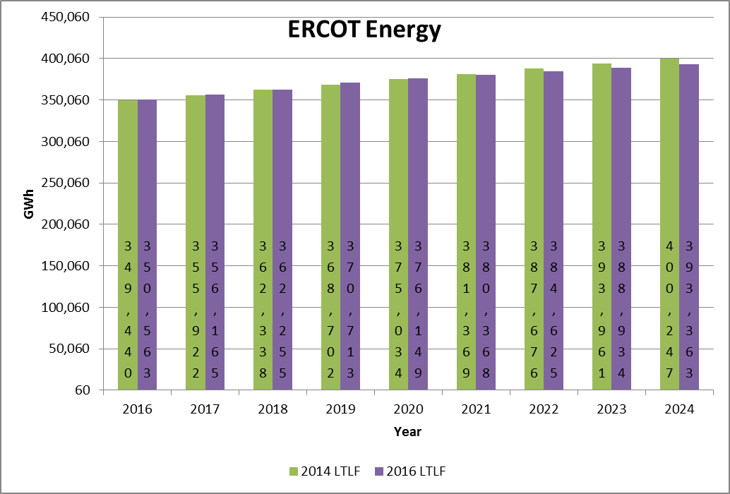
ERCOT Annual Energy Forecast

Slide 6
Forecast Adjustments
Freeport LNG Facility
Incremental load of 655 MW was added to the forecast
Timeline for the load addition was from Freeport’s website
(http://www.freeportlng.com/Project_Status.asp)
This load was not
included in the
previous forecast
No reduction in the
facility load was
assumed for 4 CP
and/or high price
intervals

Slide 7
Summary
Summer Peak Forecast
Consistent with the previous forecast (within ~ 1%)
Slower growth in the outer years (2023 on)
Forecasted growth rate is 1.1% (2016 – 2025)
Previous forecast growth rate was 1.3% (2014 – 2023)
Energy Forecast
Consistent with the previous forecast (within ~ 1%)
except for 2024
The energy forecast is less than the previous forecast after 2020

Slide 8
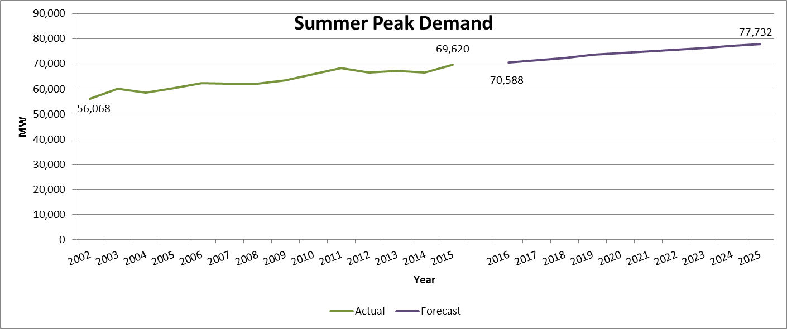
Historical and Forecasted Summer Peak Demand

Slide 9
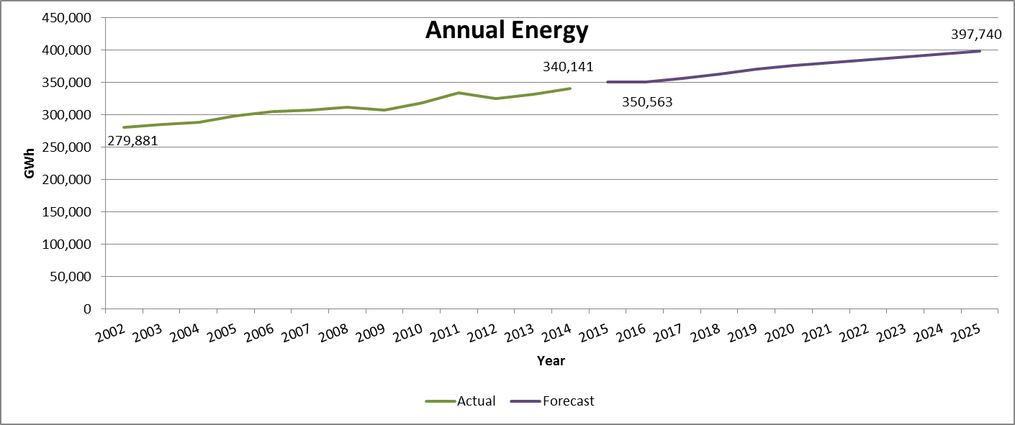
Historical and Forecasted Energy

Slide 10
Forecasting Framework

Slide 11
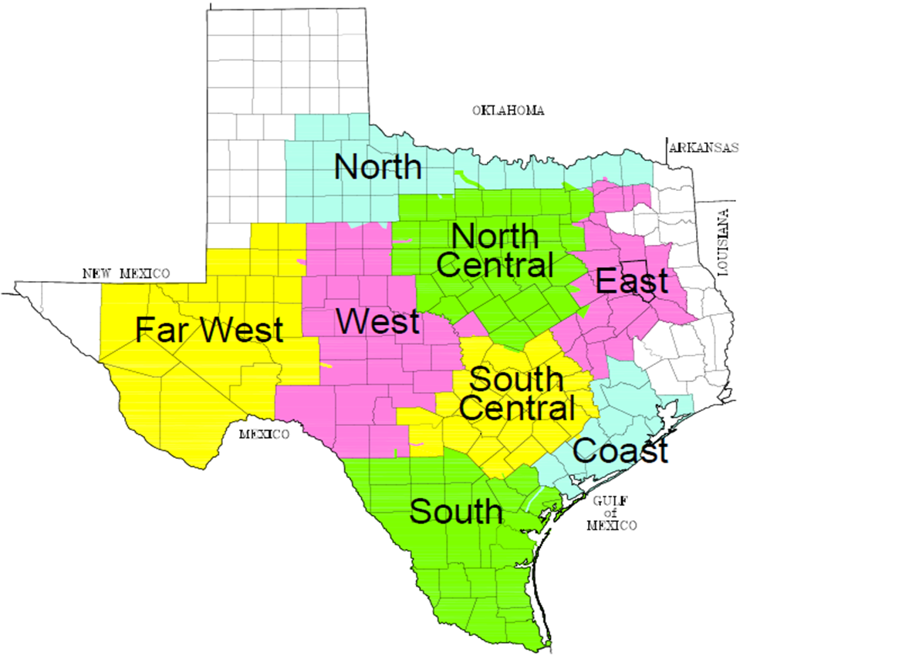
Weather Zones
Premise models and load models are developed for each weather zone

Slide 12
Forecasting Premises
Premise Models
Forecasted premise counts are used as the driver of future demand/energy growth in the majority of weather zones
Economic variables were used as input in the premise forecast models
Variables used include population, non-farm employment, and housing stock
Also included error correction term

Slide 13
Forecasting Premises
Monthly Economic Measures
Non-farm employment
Population
Housing stock
Moody’s base scenario was used for economic forecasts
Data Availability
County level
Counties are mapped into a weather zone
Growth Driver in Premise Models

Slide 14
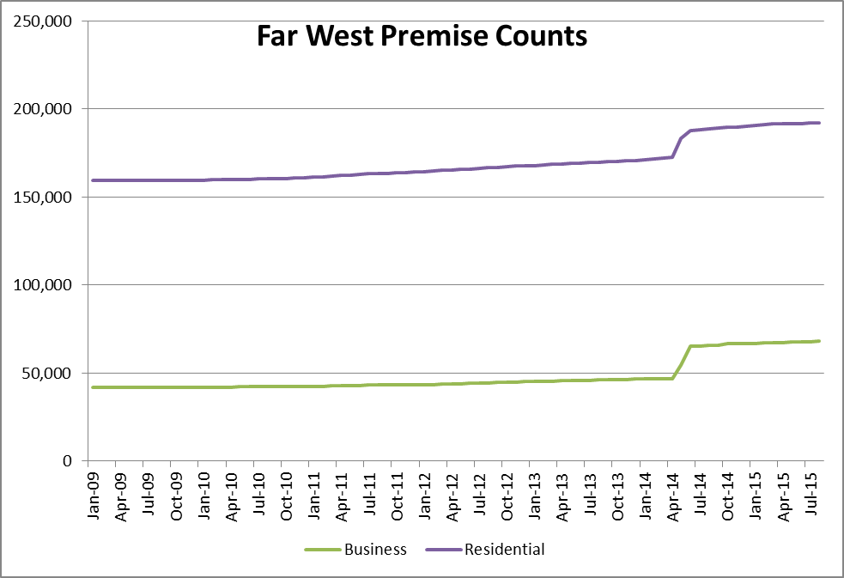
Forecasting Premises – Challenges
Premise counts were increased significantly via opt-in
Forecasting premises is problematic

Slide 15
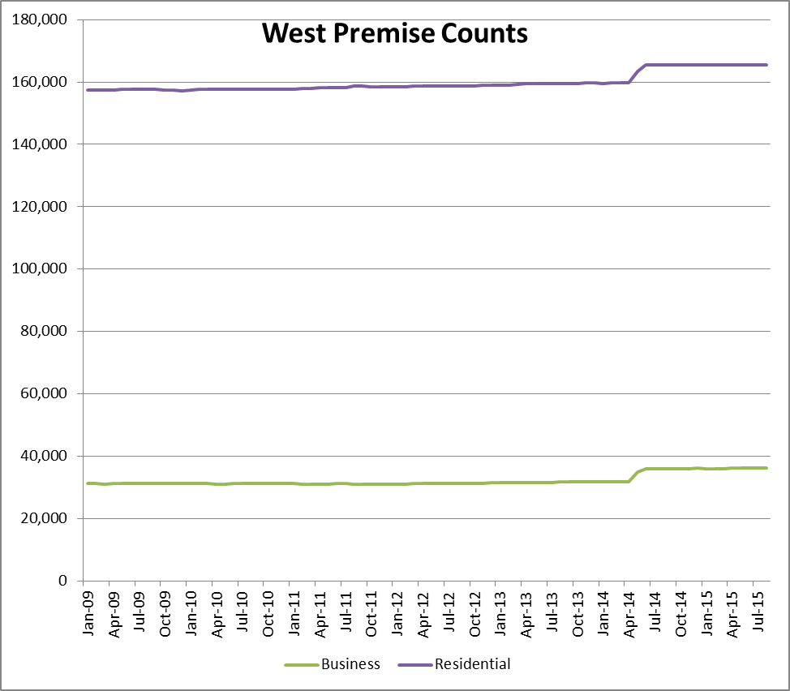
Forecasting Premises – Challenges
Premise counts were increased significantly via opt-in
Forecasting premises is problematic

Slide 16
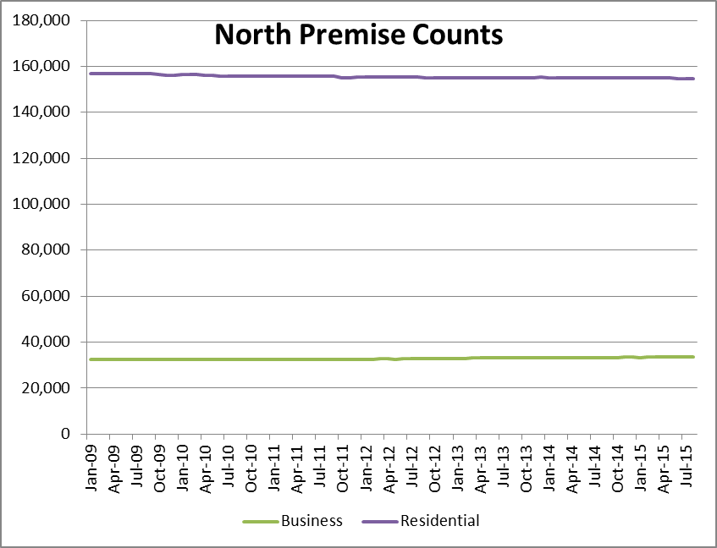
Forecasting Premises – Challenges
Premise counts are relatively flat
No significant benefit in forecasting premises

Slide 17
Forecasting Premises – Challenges
Premise Models - Exceptions
Unable to forecast premise counts in three weather zones
Impacted by an entity opting-in (Far West and West)
Flat premise growth (North)
Modeling Solution
These three weather zones required traditional economic variables (population and non-farm employment) as the driver of future demand/energy growth in the hourly models

Slide 18
Load Forecasting Models
Hourly Models
Hourly models were created for each weather zone
Over 48,000 hourly observations including load, weather data, and calendar variables (day-of-week, holidays, etc.)
Historical data from January, 2010 through August, 2015 was used to create the models
Rationale
Typically use 5 years of historical data in model development
Allows for a more recent snapshot of appliance stock, energy efficiency impacts, demand response impacts, price responsive load, etc.

Slide 19
Load Forecasting Models - Data Input
Weather Data
Temperature, Temperature Squared
Cooling Degree Days/Hours
Heating Degree Days/Hours
Cloud Cover
Wind Speed
May also include values from a previous day(s)
Two or three weather stations located in each weather zone

Slide 20
Load Forecasting Models - Data Input
Calendar
Month
Day of the week
Holidays
Hour
Interact Hour with Day of the week
Interactions
May interact weather variables with calendar variables
Example: Temperature with Hour

Slide 21
Load Forecasting Models - Data Input
Monthly Premise Count by Customer Class
Instead of using economic measures as the driver of future load growth, use the actual number of premises for each customer class
Customer class is determined by the load profile assignment
Three classes
Residential (includes lighting)
Commercial
Industrial

Slide 22
Load Forecasting Models - Data Input
Monthly Economic Data
For the three weather zones without a premise forecast (Far West, West, and North), use population and non-farm employment as the driver of future load growth
Moody’s Base Scenario

Slide 23
Normal Weather Forecast

Slide 24
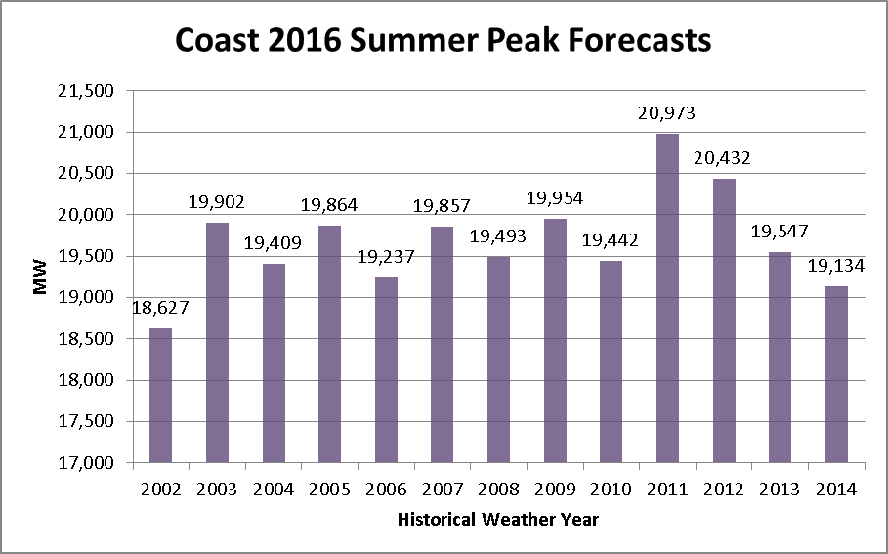
Normal Weather (50/50) Forecast
Performed at the Weather Zone Level
Historical weather from calendar years 2002 – 2014 is used as input into each hourly weather zone forecast model

Slide 25
Normal Weather (50/50) Forecast
Performed at the Weather Zone Level
Forecasted values are sorted from high to low for each year
The sorted values are averaged by rank
Example:
Below are the top 5 peak values for Coast for 2016

Slide 26
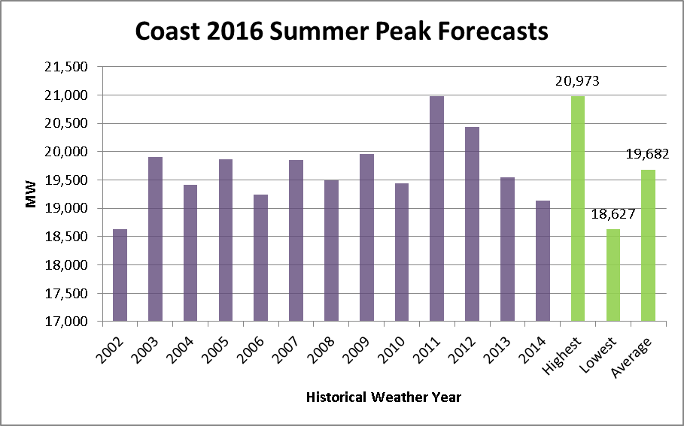
Normal Weather (50/50) Forecast
Performed at the Weather Zone Level

Slide 27
Normal Weather (50/50) Forecast
Performed at the Weather Zone Level
This process is completed for every weather zone, for each forecasted year (2016 – 2025)
ERCOT (50/50) Forecast
After the weather zone (50/50) hourly load forecasts are completed, the results are mapped into a representative historical calendar by rank
The 2003 calendar was selected (as has been our convention in the past)

Slide 28
Assumptions and Challenges

Slide 29
Load Forecasting Assumptions
Current Modeling Framework Assumes:
Inherent levels from the input data for
Appliance stock / energy efficiency
Demand Response, 4 CP Impact, behind-the-meter DG, Price Responsive Load
Electric Vehicles
No increase in territory to be served by ERCOT
No discrete increase for additional LNG facilities (except for Freeport)
No discrete increase in load for a Tesla plant or other large unanticipated load
No incremental adjustments (positive or negative) to the load forecast have been applied for the above

Slide 30
Load Forecasting Challenges
Weather Volatility:
Extreme weather events (record heat and cold, drought, flood, etc.) seem to occur fairly frequently
Economic Uncertainty
Accuracy of economic forecasts
Recession has occurred every decade since the 60s
Policy Impacts
Behind the meter DG growth
Energy Efficiency growth
Increased price caps
Loads in SCED

Slide 31
Active Models

Slide 32
Modeling Structure
ERCOT maintains an ensemble of load forecast models
Neural Network models based on a single linear node
Linear Regression model representation of the single linear node Neural Network model
Uses the exact same variables, relationships as the single linear node Neural Network model
Is easier to share the model form with Market Participants (i.e., the variables are easier to interpret than those from the Neural Network model)
Results are very close to the Neural Network model
Neural Network models based on linear and higher order nodes
Models are maintained for daily energy forecasting, hourly energy forecasting, and a combination

Slide 33
Appendix

Slide 34
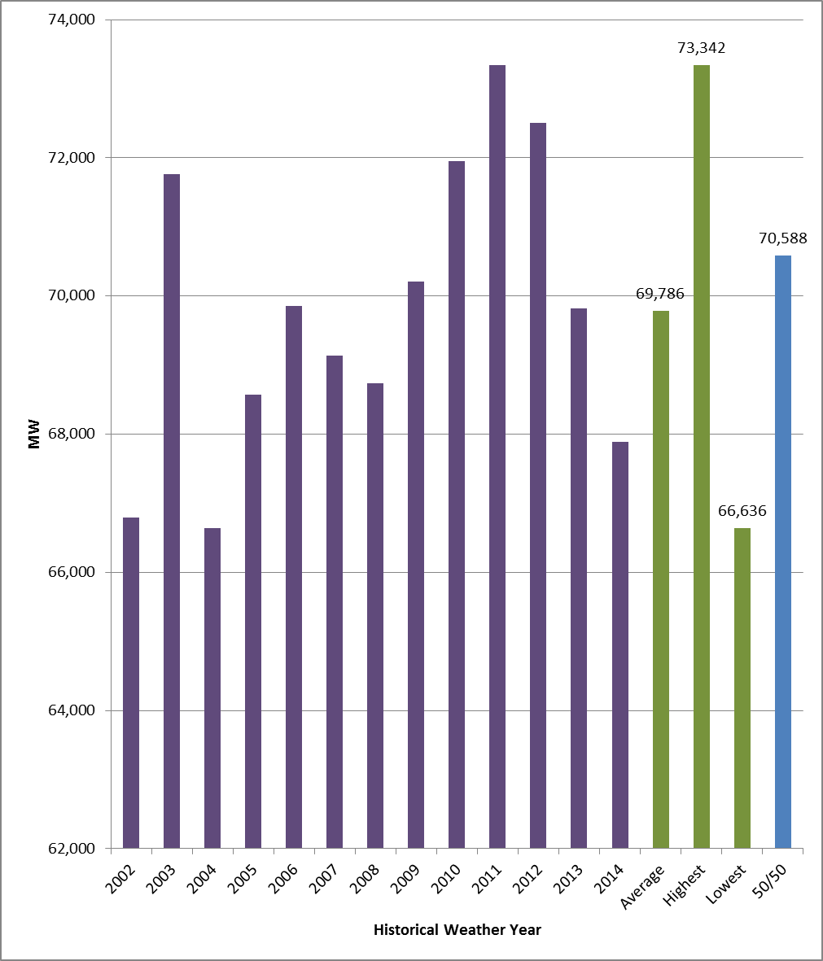
ERCOT 2016 Forecasts

Slide 35
Weather Zone 2016 Forecasts

Slide 36
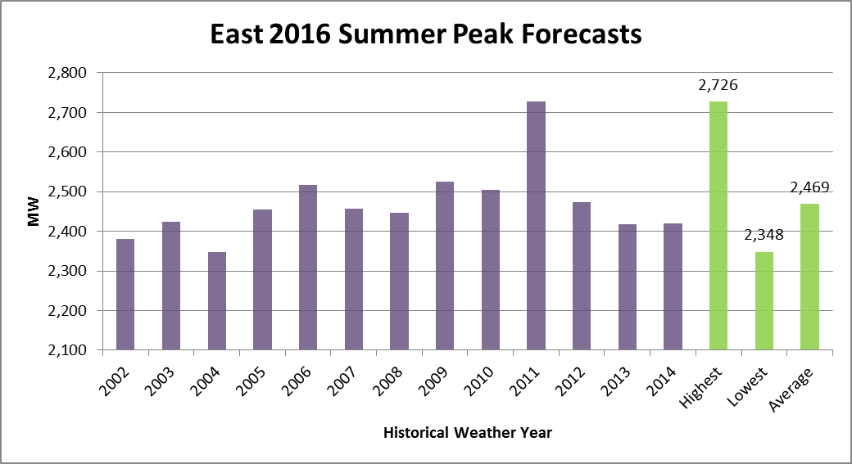
Weather Zone 2016 Forecasts

Slide 37
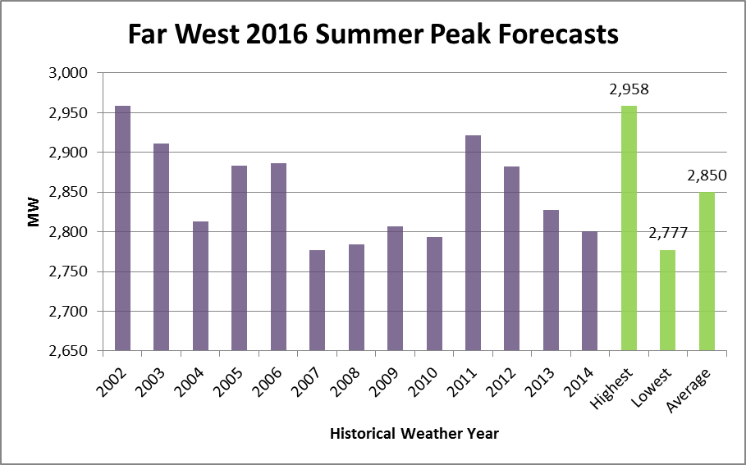
Weather Zone 2016 Forecasts

Slide 38
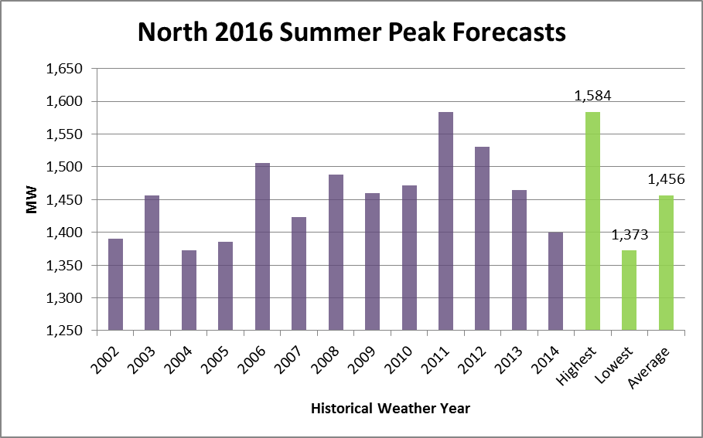
Weather Zone 2016 Forecasts

Slide 39
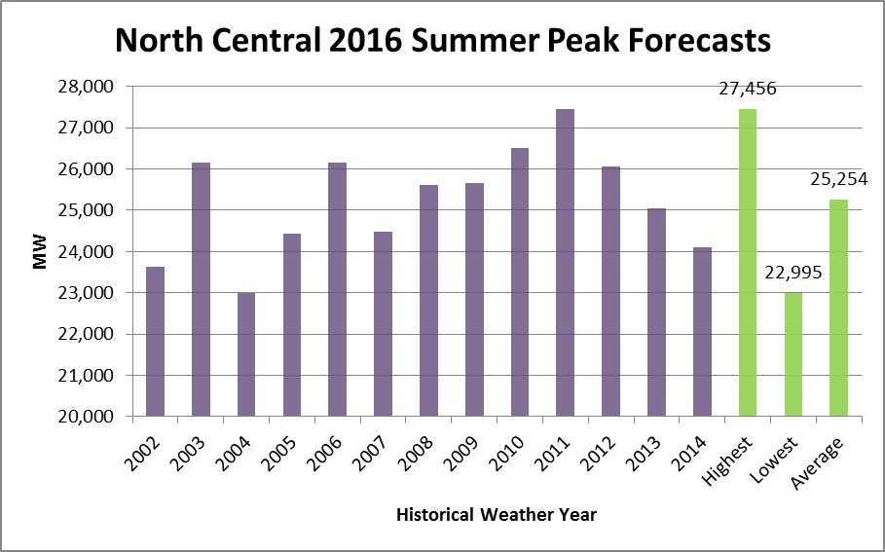
Weather Zone 2016 Forecasts

Slide 40
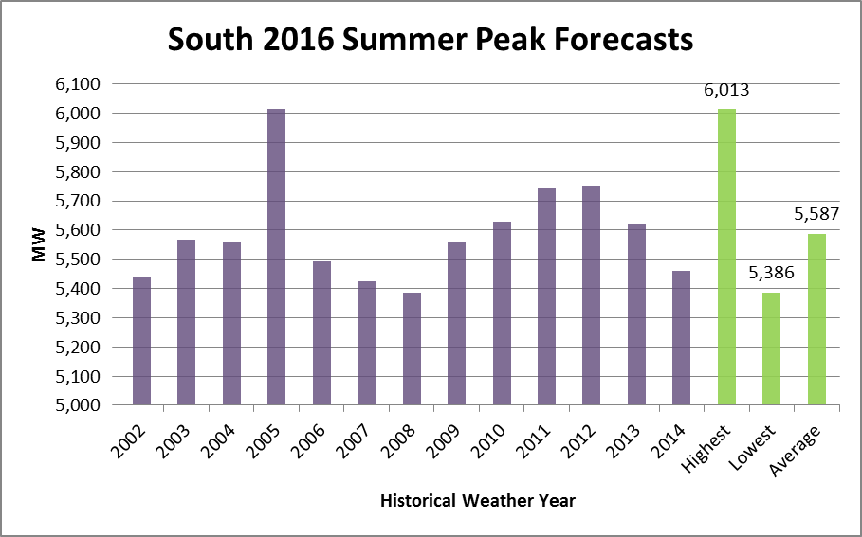
Weather Zone 2016 Forecasts

Slide 41
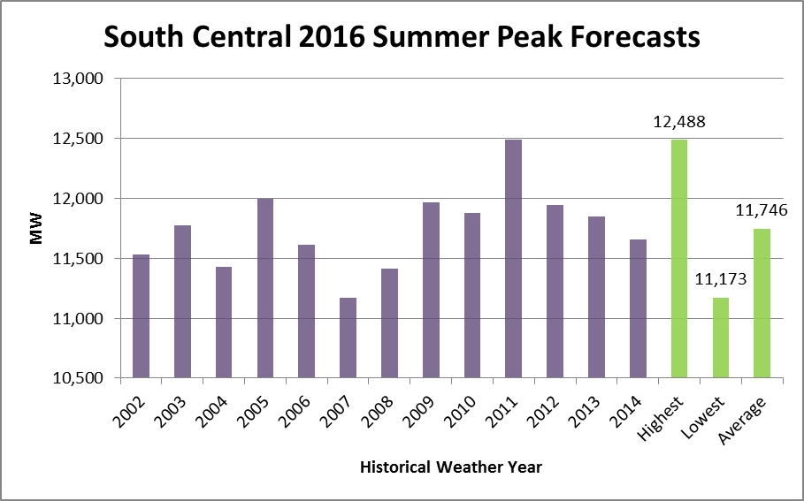
Weather Zone 2016 Forecasts

Slide 42
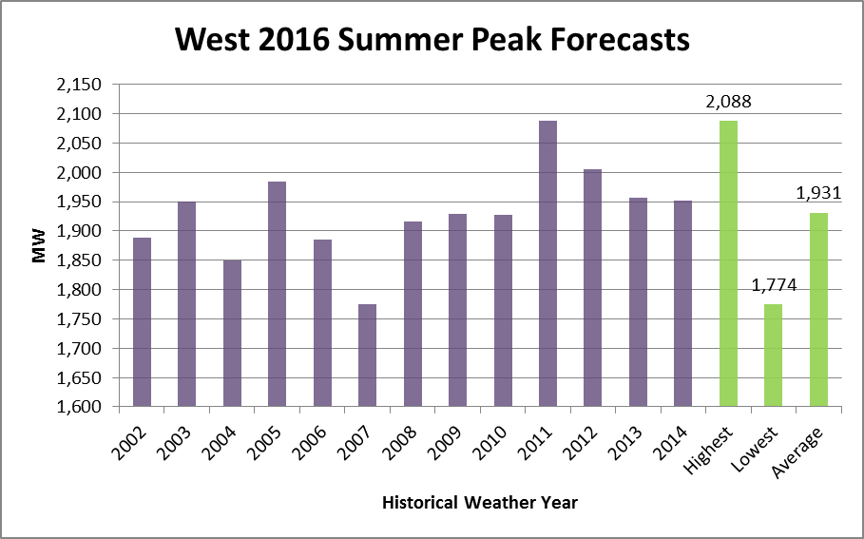
Weather Zone 2016 Forecasts

Slide 43
Questions?

