Slide 1
Review of August 13, 2015
Resmi Surendran
TAC 10/29/2015

Slide 2
Case Study: August 13th
Notes:
In this graph RTOLCAP = (RTOLCAP – RRS)+ RTNCLRRRS+ GEN RRS
Of the 2300 MWs of RRS, Load Resources were obligated to provide 1150MW. ERCOT had 929 MWs of ERS obligated from 1 to 4 pm and 881 MWs obligated from 4 to 8 pm. When ERCOT is in an emergency condition, we can request the TDSPs to deploy the loads contracted under their Load Management Programs which is about 183 MWs. There were no deployments of RRS or ERS during the scarcity condition notices during the week of Aug 10th.

Slide 3
PRC Vs ORDC
EEA1 is called based on PRC <2300 to enable the use of Resource that are only available in emergency in a series of steps to avoid load shedding. PRC only considers frequency responsive capacity (max 20%HSL)
ORDC is based on LOLP of reserves falling below 2000. ORDC reserve (RTOLCAP) includes capacity that is considered in PRC up to 100% HSL and it also includes QSGR, capacity from WGRs which are curtailed and NFRC. i.e. ORDC reserves include all the remaining reserves in the system.
PRC drops much faster than ORDC because PRC only considers a fraction of the available online capacity.
Since EEA is based on PRC, ORDC reserves could be high and price adder could be low when we are near EEA unless ORDC converges to PRC
As we approach scarcity PRC will be around 2500 and ORDC will gradually approach PRC as prices increase causing QSGRs to come online, resources to put their duct firing online and SCED to move resources to the top making the remaining capacity within 20%HSL. However, since minimum RRS level is 2300MW there could be situations where PRC stays just above 2300MW for a long time and could drop below 2300 when we still have lot of quick starts physically offline but available to SCED.

Slide 4
Non-Spin of QSGR
Notes:
Maximum 393.2MW Non-Spin was deployed from 8/13/2015 15:06 to 8/13/2015 18:05 due to low available capacity

Slide 5
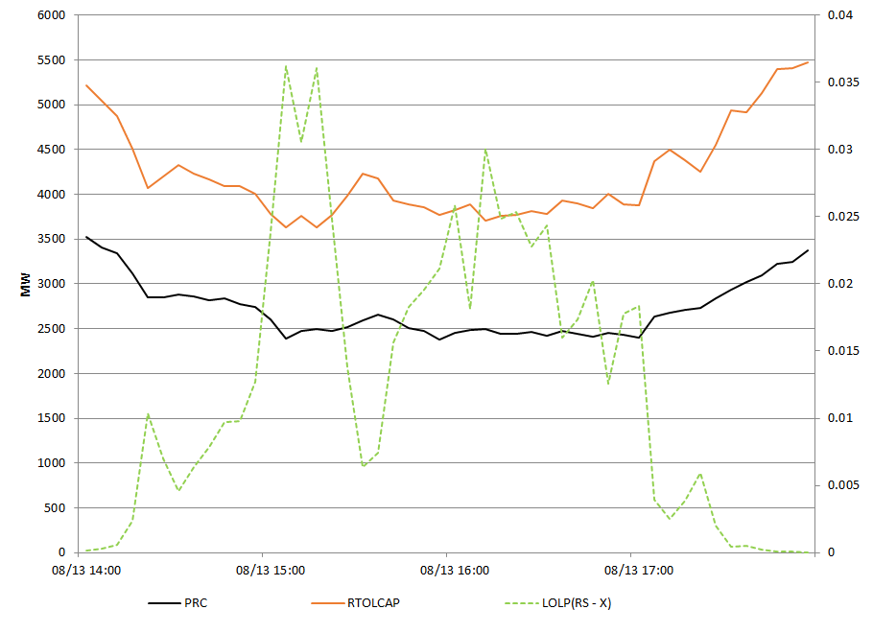
LOLP Vs Emergency Alerts
Notes:
LOLP reflects the N-0 loss of load probability. PRC is maintained to prevent f drop under N-1

Slide 6
Appendix
August 10, 2015 – August 13, 2015
Hour Ending 15-17

Slide 7
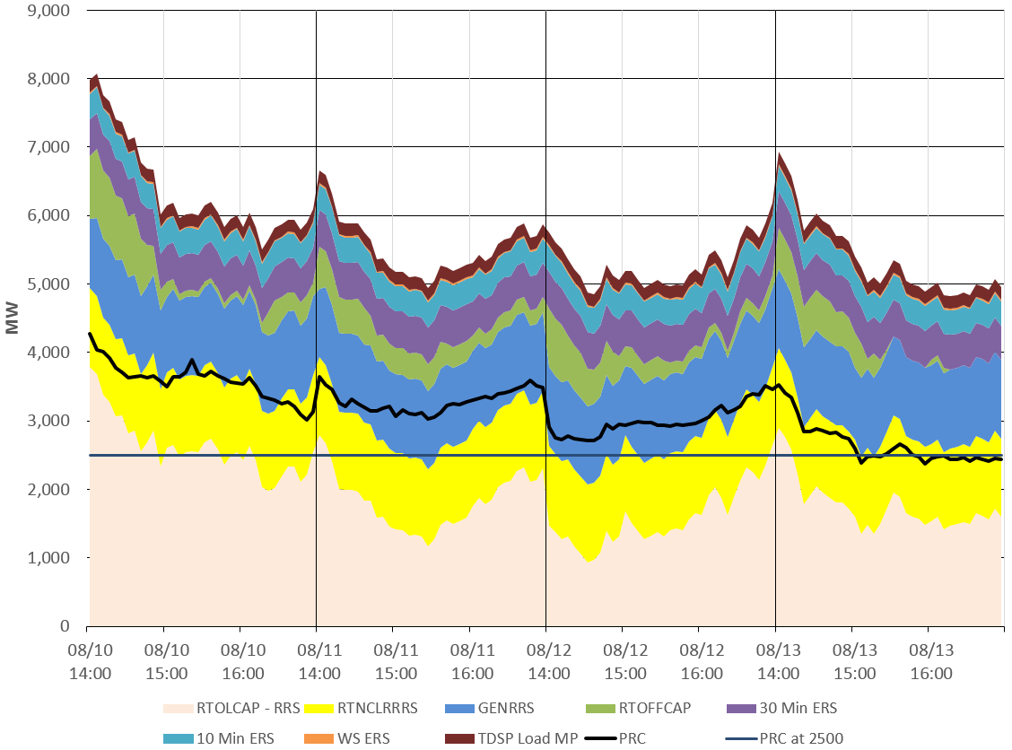
All Reserves
Notes:
In this graph RTOLCAP = (RTOLCAP – RRS)+ RTNCLRRRS+ GEN RRS
Of the 2300 MWs of RRS, Load Resources were obligated to provide 1150MW. ERCOT had 929 MWs of ERS obligated from 1 to 4 pm and 881 MWs obligated from 4 to 8 pm. When ERCOT is in an emergency condition, we can request the TDSPs to deploy the loads contracted under their Load Management Programs which is about 183 MWs. There were no deployments of RRS or ERS during the scarcity condition notices during the week of Aug 10th.

Slide 8
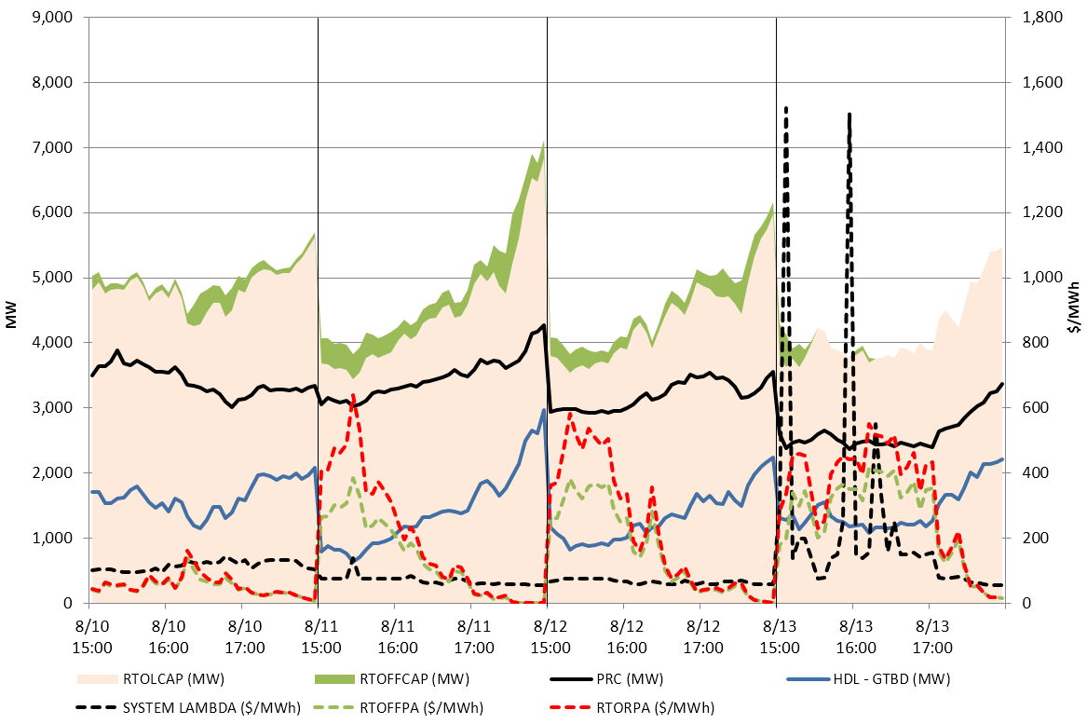
Reserves and Prices

Slide 9
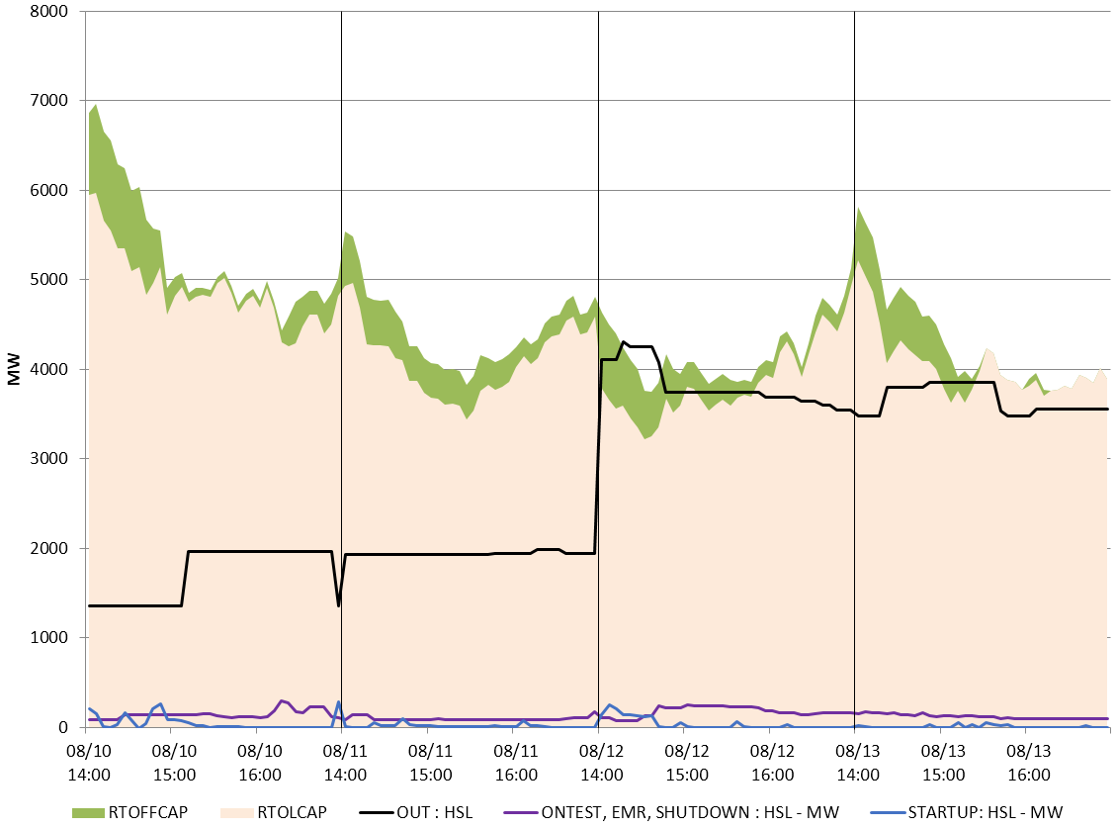
Reserves and Outages

Slide 10
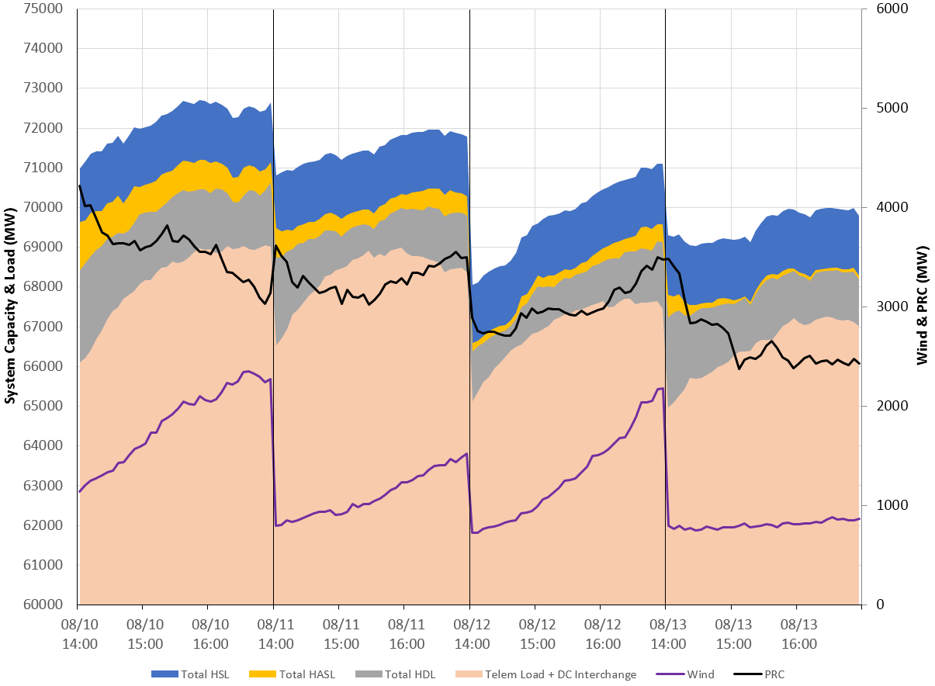
System Capacity
Notes:
System capacity and load were very similar between 8/12 and 8/13. However PRC was lower on 8/13 primarily due to lower wind over peak, and probably more units dispatched above 80% of HSL

Slide 11
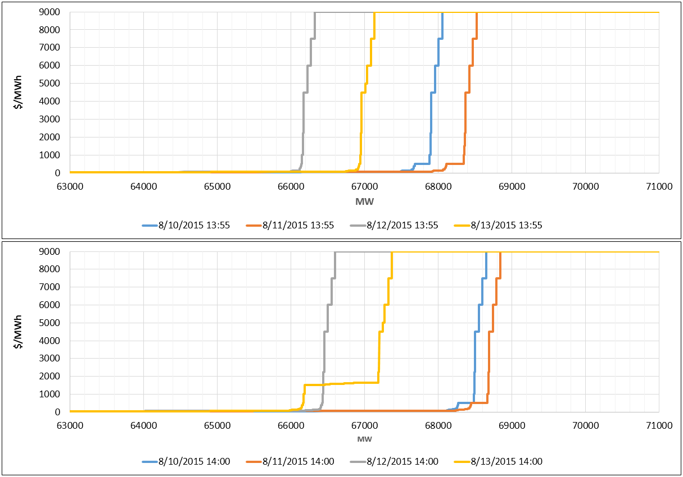
Aggregate HDL Offer Curves
Notes:
On 8/13 ~1000MW of quick-starts were priced at $1500-$1650 Vs $75 on 8/12 over peak.

Slide 12
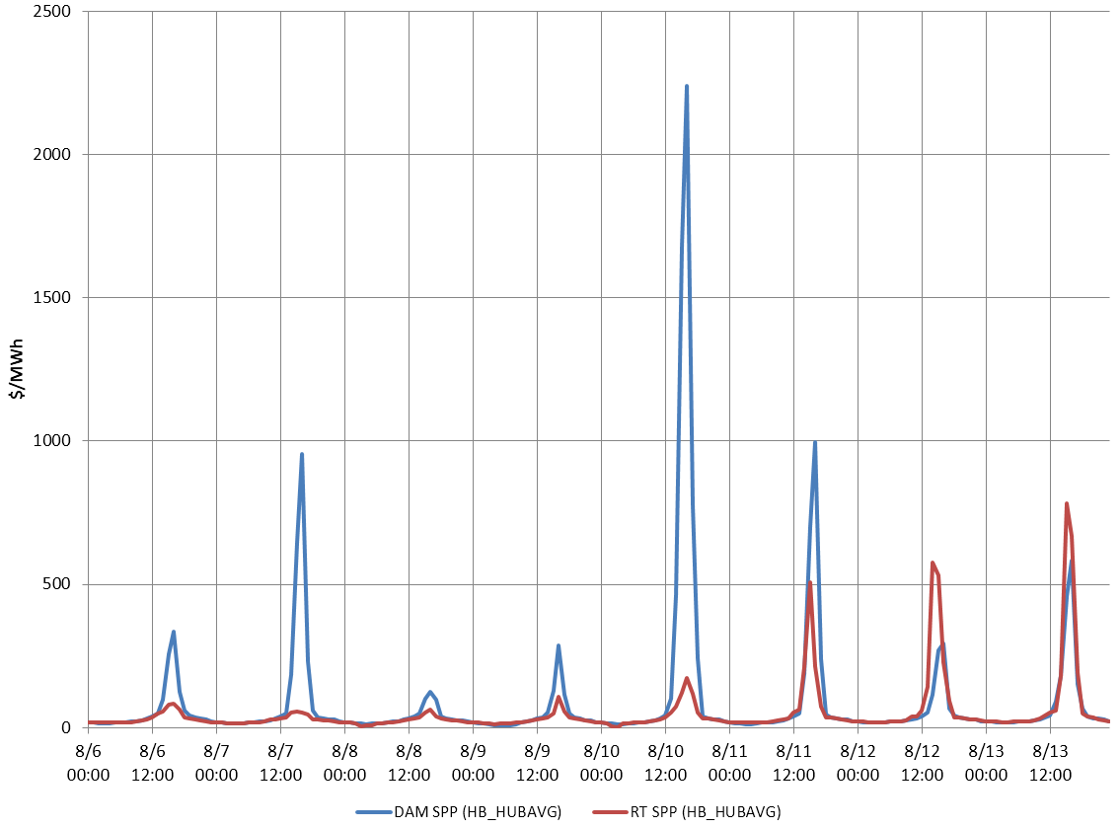
DAM vs. RTM Price Convergence

Slide 13
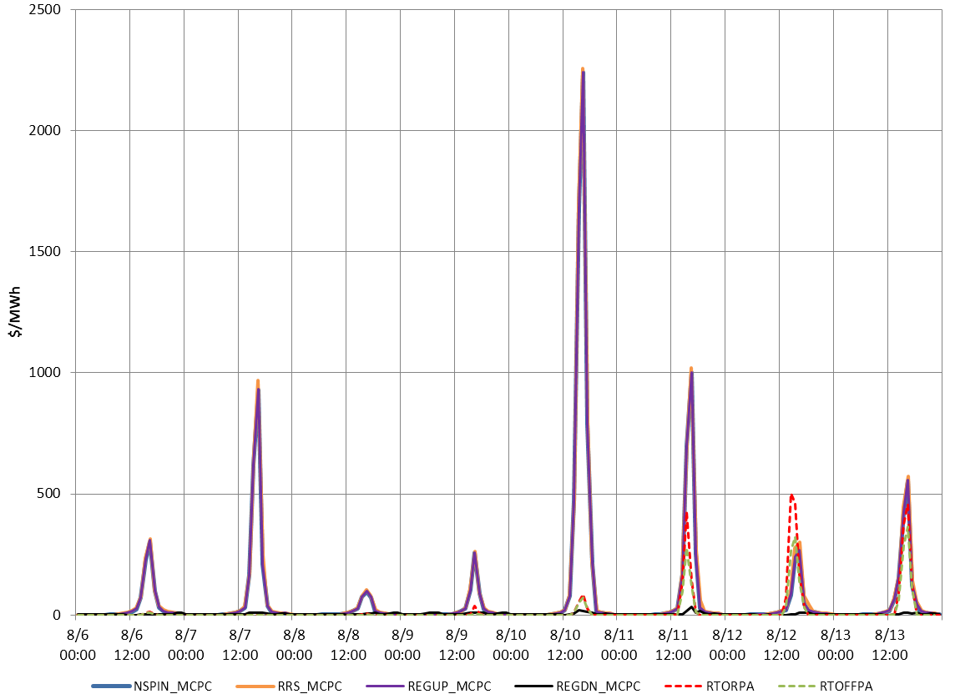
MCPC vs. ORDC Price Adder Convergence

Slide 14
Appendix
August 6, 2015 – August 13, 2015
All Hours

Slide 15
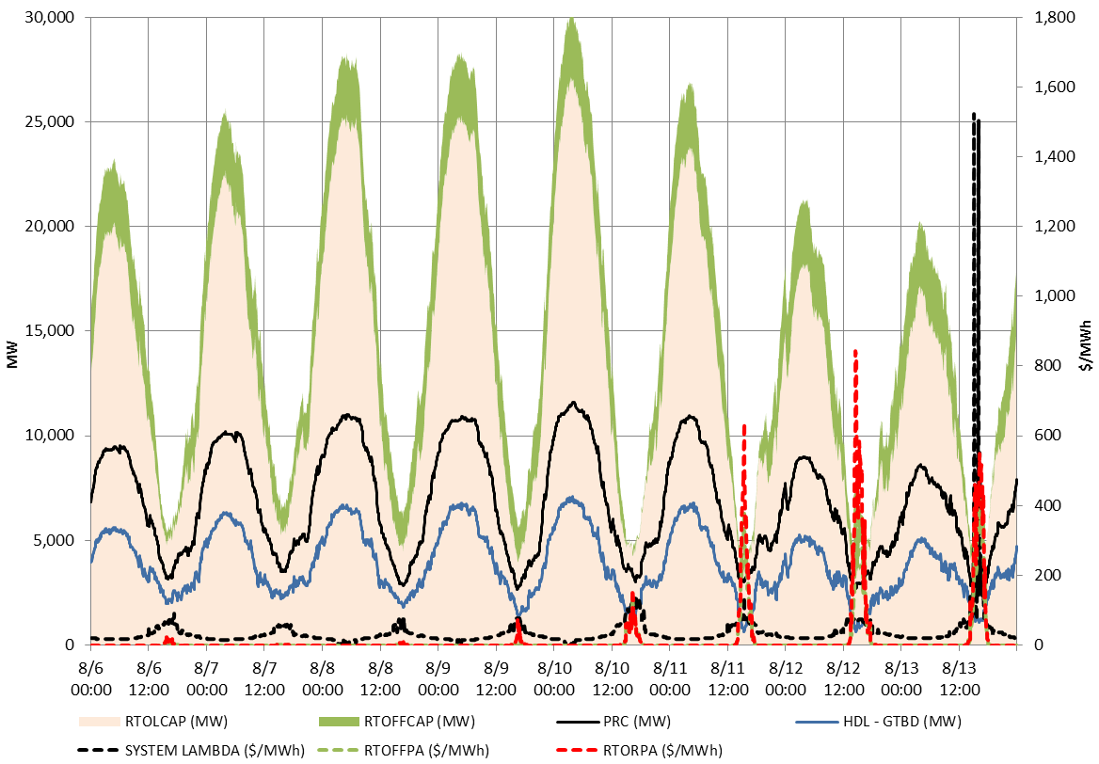
Reserves

Slide 16
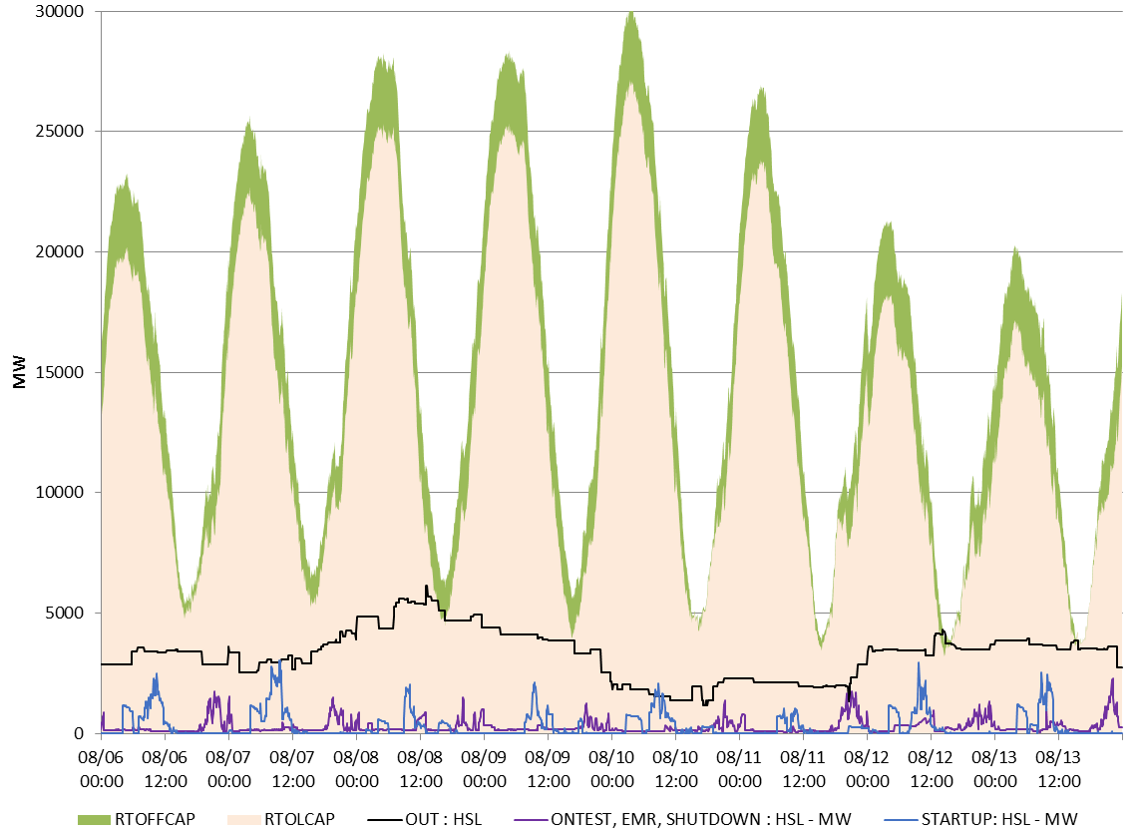
Reserves and Outages

Slide 17
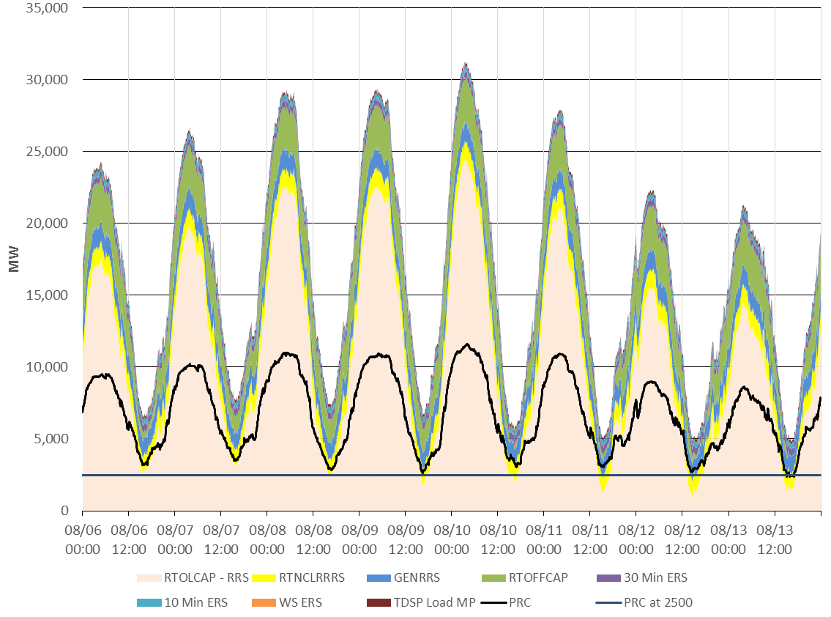
All Reserves and Prices

Slide 18
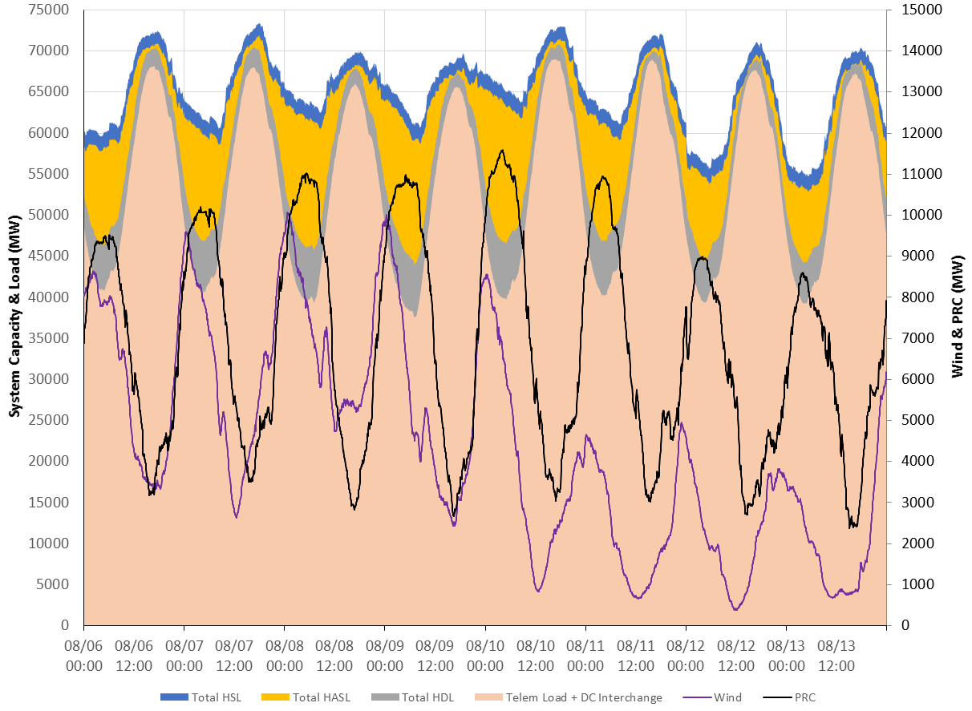
System Capacity

