Slide 1
SMT Update To AMWG
October 21, 2015

Slide 2
Update on SMT Disaster Recovery Exercise

Slide 3
SMT October 2015 Disaster Recovery Exercise
Friday October 23, 2015 8:00 P.M. CST until Saturday October 24, 2015 12:00 P.M. CST outage of all SMT services.
Saturday October 24, 2015 12:01 A.M. CST ROR and Third Party FTPS Folders for LSE interval data will become available for download utilizing the SMT Disaster Recovery environment.
Saturday October 24, 2015 12:01 P.M. CST until Friday October 30, 2015 7:59 P.M. CST all SMT services are available utilizing SMT Disaster Recovery environment.
Friday October 30, 2015 8:00 P.M. CST until Saturday October 31, 2015 12:00 P.M. CST outage of all SMT services.
Saturday October 31, 2015 12:01 A.M. CST ROR and Third Party FTPS Folders for LSE interval data will become available for download utilizing the SMT Production environment.
Saturday October 31, 2015 12:01 P.M. CST all SMT services are available utilizing SMT Production environment.

Slide 4
Update on SMT Minor Release to Correct Deficiencies and Usability Defects

Slide 5
SMT Minor Release to Correct Deficiencies and Usability Defects Saturday October 17, 2015
Planned Release Completed on Saturday October 17, 2015 SMT included the following:
Provide the capability for Third Party energy data agreements to be renewed after completing one year of duration.
Energy data agreements are no longer held to only 1 year of duration
Energy data agreements can continue to be extended over one year for 1, 3, 6, 9 or 12 month lengths
Improvement to the SMT website browser to prevent website users from having to clear their cache to re-login in scenarios where the user does not follow expected logout procedures
SMT users no longer have to clear their cache to log back into SMT
If a user has SMT open in two different tabs in the same browser, when they close one tab both tabs will be logged out
Disable the login button after one click so that users cannot click it multiple times causing an invalid request error on the website

Slide 6
SMT Minor Release to Correct Deficiencies and Usability Defects December, 2015
Planned Release for December 2015 SMT to include the following:
Invalid Request - Display message box after Log In action until the landing page is displayed
ROR validation simplification with friendly company name inputs from ERCOT
Third Party scheduled report expiry alignment with agreement
ESIID field in CSV/excel export showing up as scientific exponential value

Slide 7
Status Update of AMWG Change Requests

Slide 8
Status of AMWG Change Requests
Delivered | To Be Delivered Zero $$ | Approved Awaiting Project Packaging | AMWG Reporting Options Under Review | RMS Approved Awaiting Categorization | JDOA Estimated Awaiting AMWG Review | Tabled RMS | AMWG Delayed | RMS Remanded back to AMWG | Pushed Back as Defect
2013 002 | 2013 014 | 2013 015 | 2013 001 |  | 2015 033 | 2014 018 | 2015 029 |  | 2015 022
2013 005 |  | 2015 019 | 2013 003 |  |  |  | 2015 030
2013 006 |  | 2015 020 | 2013 004 |  |  |  | 2015 031
2013 007 |  | 2015 023 | 2013 008 |  |  |  | 2015 032
2013 009 |  | 2015 025 | 2013 010 |  |  |  | 2015 034
2013 012 |  | 2015 026 | 2013 011 |  |  |  | 2015 038
2013 013 |  | 2015 027 |  |  |  |  | 2015 040
2013 016 |  | 2015 028 |  |  |  |  | 2015 041
2013 017 |  | 2015 035
2015 024 |  | 2015 036
 |  | 2015 037
 |  | 2015 039
 |  | 2015 021
 |  | 2015 042
Total 9 | Total 2 | Total 14 | Total 6 | Total 0 | Total 1 | Total 1 | Total 7 | Total 1 | Total 1

Slide 9
AMWG Change Requests
AMWG Change Request | AMWG CR Document | Status | Categorization and Estimated Delivery Date | Estimated Cost
AMWG CR 2013 001 – Report for AMWG Data Monitoring – Data Completeness Measurements |  | Estimate Complete & RMS Approved 3/3/15 | Reporting Options Under Review | Small (20-40)
AMWG CR 2013 002 – Reports for AMWG Data Monitoring – Data Timeliness Measurements |  | Implemented | Q2 2014 Delivered | Included in Maintenance Contract
AMWG CR 2013 003 – Reports for AMWG Data Monitoring – Measurement of Percentage of Actual Meter Reads |  | Estimate Complete & RMS Approved 3/3/15 | Reporting Options Under Review | Small (20-40)
AMWG CR 2013 004 – Reports for AMWG Data Monitoring – Measurement of Estimates |  | Estimate Complete & RMS Approved 3/3/15 | Reporting Options Under Review | Medium (40-60)
AMWG CR 2013 005 – Reports for AMWG Data Monitoring – Number of SMT Help Desk Tickets Monthly by Ticket Type |  | Implemented | Q2 2014 Delivered | Included in Maintenance Contract
AMWG CR 2013 006 – Reports for AMWG Data Monitoring – Availability of SMT API |  | Implemented | Q2 2014 Delivered | Included in Maintenance Contract
AMWG CR 2013 007 – Reports for AMWG Data Monitoring – Availability of SMT FTPS |  | Implemented | Q2 2014 Delivered | Included in Maintenance Contract
AMWG CR 2013 008 – Reports for AMWG Data Monitoring – Average Time to Deliver HAN Messages |  | Estimate Complete & RMS Approved 3/3/15 | Reporting Options Under Review | Small (20-40)
AMWG CR 2013 009 – Reports for AMWG Data Monitoring – Number of Accounts by Type |  | Implemented | Q2 2014 Delivered | Included in Maintenance Contract
AMWG CR 2013 010 – Reports for AMWG Data Monitoring – Number of Reports Requested by GUI (Portal) and Number of FTPS Accesses |  | Estimate Complete & RMS Approved 5/6/15 | Reporting Options Under Review | Medium (40-60)

Slide 10
AMWG Change Requests (Cont.)
AMWG Change Request | AMWG CR Document | Status | Categorization and Estimated Delivery Date | Estimated Cost
AMWG CR 2013 011 – Average Time from HAN Provision Request to Meter Ready Status |  | Estimate Complete & RMS Approved 3/3/15 | Reporting Options Under Review | Small (20-40)
AMWG CR 2013 012 – Bypass redundant screen for Users with only one meter when accessing HAN device information |  | Implemented | Q4 2014 Delivered | Included in Third-Party
AMWG CR 2013 013 – Timeout on SMT takes user to “incorrect login” screen |  | Implemented | Q4 2014 Delivered | Included in Third-Party
AMWG CR 2013 014 – Allow SMT user to toggle between 15-Minute Reads and Daily Reads without having to reset the date range |  | Designed | 2015 Next Release | Included in Usability
AMWG CR 2013 015 – Expand Daily Usage Graph to show 35 days of daily usage on the SMT GUI |  | Estimate Complete & RMS Approved 3/3/15 | 2 Important Awaiting Packaging | Medium (40-60)
AMWG CR 2013 016 – Capability for RORs to grant access to vendors on their behalf to the ROR’s customers via API (energy usage, HAN messaging , and HAN provisioning) and FTPS files |  | Implemented | Q3 2014 Delivered | Included in Maintenance Contract
AMWG CR 2013 017 – REP API for Energy Usage on SMT (Backfill of Historical Usage Data for Existing Customers- “Interim”) | See Below CR 2013 017 Permanent | Implemented Interim | Q4 2013 Delivered | Included in SMT Work In Process
AMWG CR 2013 017 – REP API for Energy Usage on SMT (Subscription for New Customer Historical Usage – “Interim”) | See Below CR 2013 017 Permanent | Implemented Interim | Q2 2014 Delivered | Included in Maintenance Contract
AMWG CR 2013 017 – REP API for Energy Usage on SMT – Permanent Solution to Replace Interim Solution |  | Confirmed Delivery of Requirements Based on New SMT Environment Performance Statistics | Q2 2015 Delivered | Delivered 2015
AMWG CR 2014 018 – Add Generation Data to the SMT Portal View |  | JDOA Estimate Completed | RMS Tabled 6/2/15 RMS Tabled 8/4/15 | Medium (40-60) Graph and Table Small (20-40) Table Only

Slide 11
AMWG Change Requests (Cont.)
AMWG Change Request | AMWG CR Document | Status | Categorization and Estimated Delivery Date | Estimated Cost
AMWG CR 2015 019 – Relocate Various SMT User Guides from the Authenticated Site to the Unauthenticated Site |  | JDOA Estimate Completed | 2 Important Awaiting Packaging | Small (20-40)
AMWG CR 2015 020 – Add Customer Type in the Customer Information Section in the View / Edit Agreement Page |  | JDOA Estimate Completed | 3 Nice to Have Awaiting Packaging | Medium (40-60)
AMWG CR 2015 021 – Improve REP of Record Search Criteria During the Customer Registration Process |  | Estimate Complete & RMS Approved 5/6/15 | 1 Critical Awaiting Packaging | Medium,(40-60)
AMWG CR 2015 022 – Keep Selected ROR Visible During Customer Registration |  | JDOA Estimate Completed | Push Back as Defect | Small (20-40)
AMWG CR 2015 023 – Allow Entry of Multiple ESIIDs During Customer Registration Process |  | JDOA Estimate Completed | 3 Nice to Have Awaiting Packaging | High (60-120)
AMWG CR 2015 024 – Third Party Access Renew Energy Data Agreement After One Year |  | JDOA Estimate Completed | 1 Critical Awaiting Delivery in 2015 | 0 Dollar
AMWG CR 2015 025 – Third Party User Experience Add Identifying Data Fields in the Report Request Status Page |  | JDOA Estimate Completed | 2 Important Awaiting Packaging | High (60-120)
AMWG CR 2015 026 – SMT Functionality Display Portal Message when Report Can Not be Displayed in the SMT Portal Page |  | JDOA Estimate Completed | 2 Important Awaiting Packaging | Minor (0-20)
AMWG CR 2015 027 – SMT Functionality Allow Specific Date Entry on the Export Report Screen |  | JDOA Estimate Completed | 3 Nice to Have Awaiting Packaging | Small (20-40)
AMWG CR 2015 028 – SMT Functionality Allow ESIIDs to be Copied and Pasted into the ESIID Box on the Usage Page |  | JDOA Estimate Completed | 3 Nice to Have Awaiting Packaging | Minor (0-20)
AMWG CR 2015 029 – This Party Allow Third Parties to Utilize an API for On Demand Data Requests |  | Estimate Complete & RMS Approved | AMWG Delayed | High (60-120)

Slide 12
AMWG Change Requests (Cont.)
AMWG Change Request | AMWG CR Document | Status | Categorization and Estimated Delivery Date | Estimated Cost
AMWG CR 2015 030 – Support multiple RORs during CSV file meter upload |  | JDOA Estimate Completed | AMWG Delayed | High (60-120)
AMWG CR 2015 031 – Allow only current ROR for account registration validation and meter add validation |  | JDOA Estimate Completed | AMWG Delayed | High (60-120)
AMWG CR 2015 032 – Support SFTP protocol for SMT integration |  | Investigation Complete | AMWG Delayed | High (60-120)
AMWG CR 2015 033 – Provide user id and password rules up front on UI registration page |  | JDOA Estimate Completed | Re-estimated Awaiting Categorization | Minor (0-20)
AMWG CR 2015 034 – Display the day of the week in addition to the date on usage reports |  | JDOA Estimate Completed | AMWG Delayed | Medium (40-60)
AMWG CR 2015 035 - Provide a customer-selected option to receive a monthly usage report via email |  | Estimate Complete & RMS Approved | 2 Important Awaiting Packaging | Medium (40-60)
AMWG CR 2015 036 – Rename Overview tab to Home |  | Estimate Complete & RMS Approved | 2 Important Awaiting Packaging | Minor (0-20)
AMWG CR 2015 037 – Remove SMT Demo from Private Site for REPs, TDSPs, and Third Parties |  | Estimate Complete & RMS Approved | 2 Important Awaiting Packaging | Minor (0-20)
AMWG CR 2015 038 – Provide a “Hold” capability on Third Party accounts to reactivate usage until the Third Party has integrated with FTPS and API |  | JDOA Estimate Completed | AMWG Delayed | High (60-120)
AMWG CR 2015 039 – Provide more detail for Third Party Agreement Invitation Error Messages |  | Estimate Complete & RMS Approved | 2 Important Awaiting Packaging | Medium (40-60)
AMWG CR 2015 040 – Improve SMT Administration Functionality for TDSPs, RORs, Third Parties, and Businesses |  | JDOA Estimate Completed | AMWG Delayed | 5 Functions Small, Small, Zero, Medium, High

Slide 13
AMWG Change Requests (Cont.)
AMWG Change Request | AMWG CR Document | Status | Categorization and Estimated Delivery Date | Estimated Cost
AMWG CR 2015 041 – Allow Enrollment for New Customer 12 Month History for Third Parties |  | RMS Remanded back to AMWG for Further Discussion | Review Functionality | Medium (40-60)
AMWG CR 2015 042 – Automate Machine to Machine Consumption of Third Party Agreement Information |  | RMS Approved 8/4/15 | 2 Important Awaiting Packaging | Med / High (80)

Slide 14
Rough Order Of Magnitude (ROM) Estimate of Effort Classification
Change Type | ROM
MINOR | 0 – 20 K
SMALL | 20 – 40 K
MEDUIM | 40 – 60 K
HIGH | 60 – 120 K
VERY HIGH | Over 120 K
These are rough order of magnitudes and do not include project ramp-up and testing effort (SIT & UAT) and only assumes unit testing.
Actual estimates could vary significantly depending on requirements.
Ramp-up and testing would be 20 to 40% of the overall effort
Overall project cost will vary based on efficiency gains from packaging like functionality

Slide 15
Revised Storyboard AMWG CR 2015-033

Slide 16
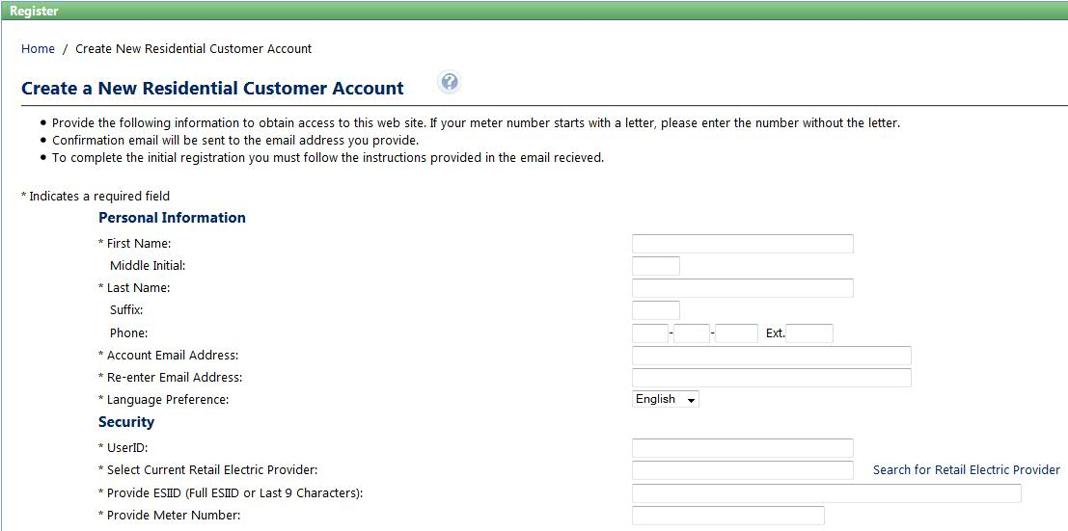
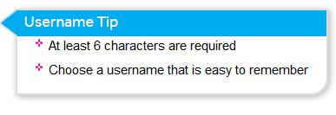
AMWG CR 2015-33 Customer account set-up process
Complexity: Minor
Business Requirement
Specific requirements / rules about user name and password do not appear intuitively. Example: the use of special characters is not allowed, but the error message displayed does not provide sufficient information / direction to correct.
Proposed Solution: Tooltip with rules will appear in the screen when the cursor will be in the User-ID field.

Slide 17
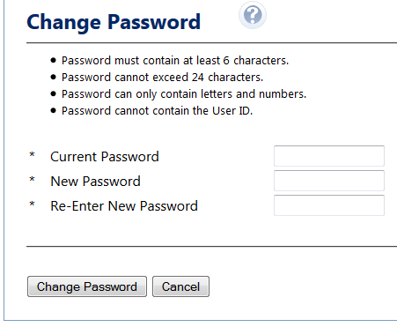
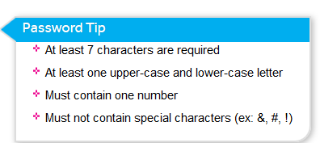
AMWG CR 2015-33 Customer account set-up process
Complexity: Minor
Business Requirement
(cont)
Password requirement Tool-tip
Proposed Solution: Tooltip with rules will appear in the screen when the cursor will be in the All-Password fields

Slide 18
Completion Summary of AMWG CR 2013-017

Slide 19
Completion Summary of AMWG CR 2013-017
Historical Usage of Daily Enrollments Functionality
Q2 2014 Implemented Interim Solution
This solution is for REPs of Record
A request form can be found on the AMWG website or requested through the SMT help desk
REPs fill out the request form and submit it through the SMT help desk
The requesting REP is subscribed to the new customer enrollment history functionality
The subscribed REP receives 12 months of history for each new customer enrollment on a daily basis within 24 hours of the switch being received at SMT
This interim solution could not meet the enrollment volumes as described in the AMWG CR 2013-017 of 7,500 ESIIDs per day
Q2 2015 Final Solution Complete
The SMT new infrastructure was implemented in May of 2015 and enables SMT to handle > 7,500 ESIIDS per day

Slide 20
Completion Summary of AMWG CR 2013-017
Historical Backfill of Data Functionality
Q4 2013 Implemented Interim Solution
This solution is for REPs of Record
A request form can be found on the AMWG website or requested through the SMT help desk
REPs fill out the request form and submit it through the SMT help desk
The requesting REP is provided historical data for the requested DUNS or subset of ESIIDs
The REP may request the data to be provided in interval, daily or monthly format
This interim solution could not meet the requested volumes as described in the AMWG CR 2013-017 tables on pages 2 and 3
Q2 2015 Final Solution Complete
The SMT new infrastructure was implemented in May of 2015 and enables SMT to handle the requested volumes as described in the AMWG CR 2013-017 on pages 2 and 3

Slide 21
Q&A Monthly SMT Reports to AMWG Data Through August 2015

