Slide 1
Potential New Equipment Modeling Workshop
Discussion for NDSWG 10/20/15
Stephen Solis

Slide 2
Why a New Equipment Modeling Workshop
ERCOT continues to see new equipment entering the network model outside of expected timelines and without outage schedules
Potential for real time confusion between ERCOT and TO system operators relative to new equipment modeling
ERCOT continues to have some uninitialized telemetry with new equipment
Communicate the impacts of not adhering to timelines
Understand challenges from the Market Participant perspective

Slide 3
Objective
Understanding the expectations regarding modeling of new equipment (and retirement of old if appropriate) and Approval to Energize process
Understanding of the impact when expectations are not met
Understanding of the challenges faced by ERCOT and Market Participants in implementing the processes
Discussions of potential solutions in hopes of identifying some actionable next steps

Slide 4
Draft Agenda November 18th, 2015
Agenda: 9:30 AM to 3:00 PM.
  Introductions: 10 min
  Intro/Overview Presentation: 50 min (ERCOT)
  Break: 15 min
  Symposium 1: Modeling Expectations, Challenges, and Solutions: 60 min
    ERCOT’s Perspective: 30 min
    TSP Perspective: 30 min
  QA Session 1: 15 min
  Lunch: 60 min
  Symposium 2: Energization Process Expectations, Challenges, and Solutions: 60 min
    ERCOT’s Perspective: 30 min
    TSP Perspective: 30 min
  QA Session 2: 30 min
  Closing Remarks: 30 min

Slide 5
Seeking Volunteers
Symposium 1 Modeling Expectations, Challenges, and Solutions
  TSP(s) willing to present on challenges relative to meeting expectations regarding new equipment (or retirement) modeling and potential solutions.
  TSP(s) willing to share successes in overcoming previous challenges.
Symposium 2 Energization Expectations, Challenges, and Solutions
  Energization would encompass Approval to Energize process
  TSP(s) willing to present on challenges relative to meeting expectations regarding energization and potential solutions.
  TSP(s) willing to share successes in overcoming previous challenges.

Slide 6
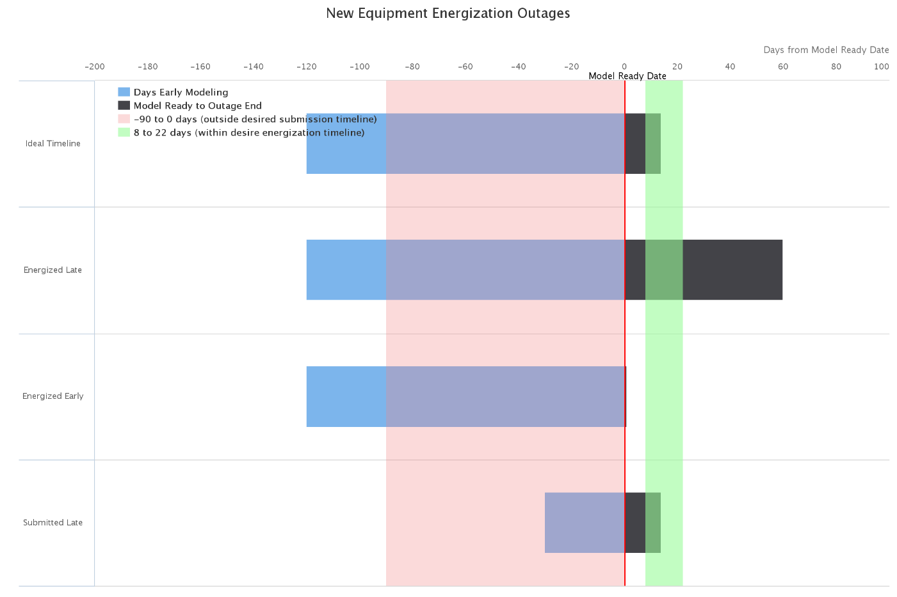
Example

