Slide 1
Material for 10/23/2015 PGDTF Meeting
Michael Juricek
Notes:
1

Slide 2
Outline
GMD Model
GMD Assessment Process
Transmission System
Transformer Thermal Assessment

Slide 3
GIC Data File Contents
Required Data
Geographic location of substations (longitude and latitude)
Grounding resistance data for substations
DC resistance of transformer windings
Identification of GIC blocking device in the grounding connection
Transformer vector group
Optional Data for Transformers
Number of cores
K Factor

Slide 4
GIC Data File Contents
Three group records, with each group containing a particular type of data
Substation Data
Bus Substation Data
Transformer Data

Slide 5
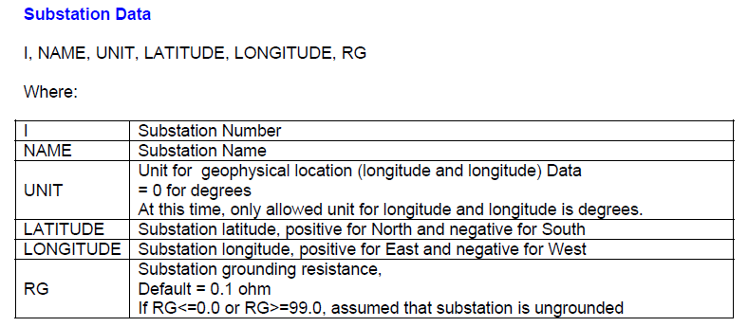
Substation Data

Slide 6
Substation Data Example

Slide 7
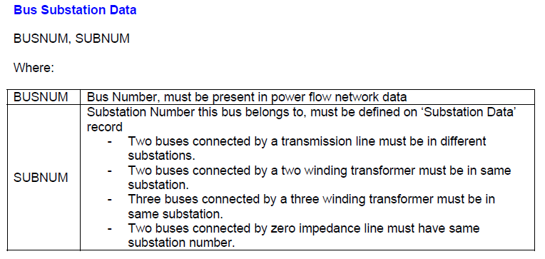
Bus Substation Data

Slide 8
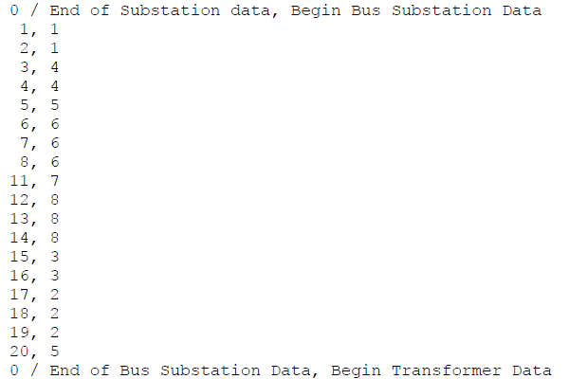
Bus Substation Data Example

Slide 9
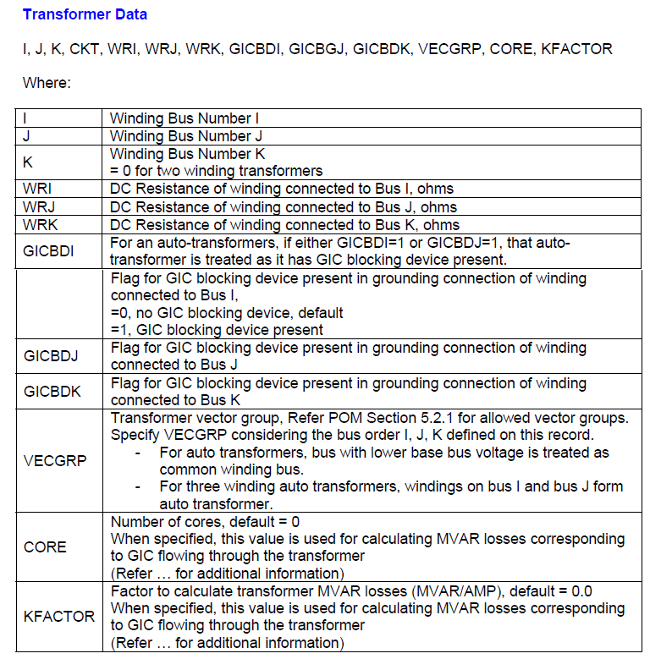
Transformer Data
Notes:
DC resistances, if left blank, will be calculated based on power flow data
User can choose to enter, CORE, KFACTOR, or enter “0” for both and k-factor will be determined based on base kV of transformer windings (as shown on next slide)

Slide 10
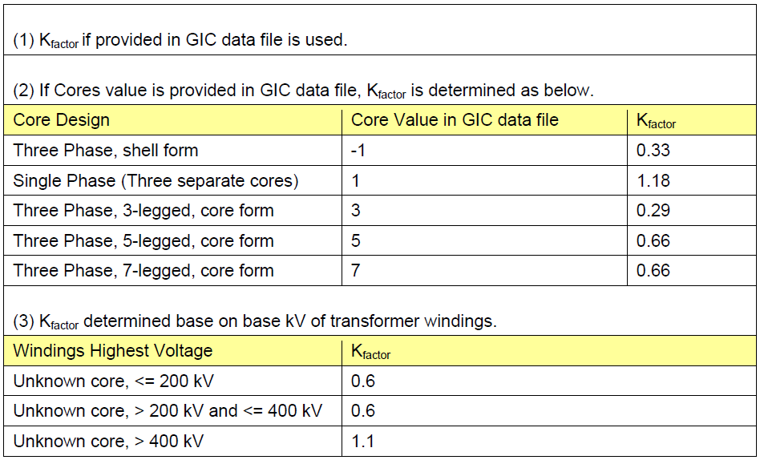
Transformer MVAR Scaling Factors

Slide 11
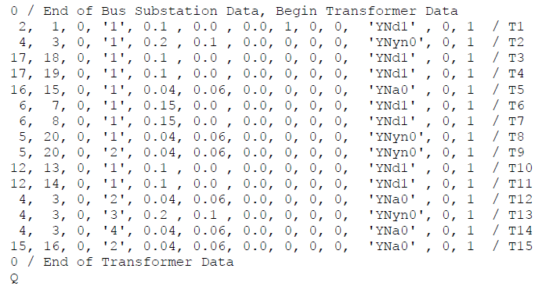
Transformer Data Example

Slide 12
Outline
GMD Model
GMD Assessment Process
Transmission System
Transformer Thermal Assessment

Slide 13
GMD Assessment Process Overview
GMD-specific Planning Steps
Assemble model and equipment data
Create dc model of the system
Calculate GIC for each transformer
Calculate transformer reactive losses
Conduct transformer thermal assessment
Standard TPL Planning
Investigate mitigation options
Identify voltage and system issues
Run ac power flow w/ reactive losses included

Slide 14
Outline
GMD Model
GMD Assessment Process
Transmission System
Transformer Thermal Assessment

Slide 15
TPL-007-1 Summary
R6 requires a Transformer Thermal Impact Assessment to ensure high-side, wye grounded BES transformers connected at 200kV or higher will not overheat based on the benchmark event
Applies to transformers where effective GIC identified in GIC studies 75 A per phase or greater (not 75 A continuous). Effective 75 A per phase is a conservative screening criterion
Approaches for conducting the assessment are presented in the Transformer Thermal Impact Assessment white paper posted on the project page http://www.nerc.com/pa/Stand/Pages/Project-2013-03-Geomagnetic-Disturbance-Mitigation.aspx
Performed once every five years with GMD Vulnerability Assessment
Applicability: Generator Owners, Transmission Owners

