Slide 1
Congestion Revenue Rights Activity Calendar Update
Donald House
CMWG
October 23, 2015

Slide 2
Summary
Protocol section 7.5.1(4)(b)(iii), CRR Auctions, requires ERCOT to maintain and publish a calendar of key milestone dates for the Congestion Revenue Right (CRR) auctions
The “CRR Activity Calendar” is posted on the ERCOT public site and has all activity scheduled out through 2016
ERCOT is proposing to update the calendar to cover CRR activity through 2017
ERCOT would like to review the draft calendar with CMWG and ask for their endorsement of the proposed changes

Slide 3
Description of Changes - Overview
Current calendar
Dates from the currently approved calendar remain unchanged
Added dates to cover CRR activity through 2017
The same patterns were applied to 2017 to maintain Protocol requirements and consistency
The last long-term auction sequence (LTAS) covered by the proposed calendar is the initial auctioning of July through December 2019
The last monthly auction covered by the proposed calendar is the February 2018 monthly auction

Slide 4
Description of Changes - Overview
Avoided overlapping bid windows
Where necessary to avoid overlapping bid windows with monthly auctions, two Seq3 LTAS auctions and one Seq4 LTAS auction were pushed back by one week
2018.2nd6.AnnualAuction.Seq3
2019.1st6.AnnualAuction.Seq4
2019.1st6.AnnualAuction.Seq3

Slide 5
Description of Changes – Column Headings
The credit release and Invoice posting columns were combined:
Column heading is now “Auction Invoice Posted and Credit Released On or Before This Date”
The dates for both are always the same
Removes extra column, making the calendar easier to read
Reminder: ERCOT will send a Market Notice one Business Day prior to posting any auction results before the posted calendar date

Slide 6
Description of Changes – Holiday Conflicts
No substantial holiday conflicts observed
2018.1st6.AnnualAuction.Seq3 only moved back by 1 week to avoid overlapping bid window with 2017.JAN.Monthly.Auction
Biggest potential conflict is opening the bid window for the 2019.2nd6.AnnualAuction.Seq4 auction on 1/2/2018
Falls in line with the typical Tuesday through Thursday bid window

Slide 7
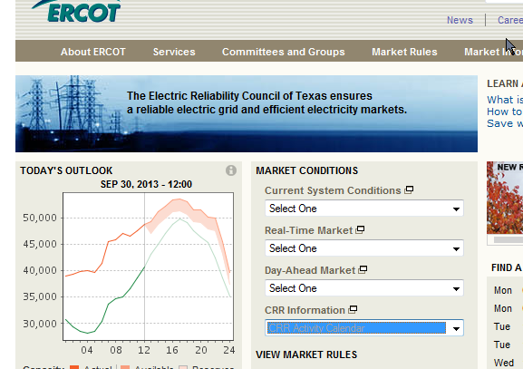
Next Steps
ERCOT is seeking endorsement today from CMWG
Take to WMS for endorsement on November 4, 2015 and to TAC for final approval on November 19, 2015
Once approved, the new version of the calendar will be posted on the ERCOT public site

