Slide 1
SMT Update To AMWG
SEP 2015

Slide 2
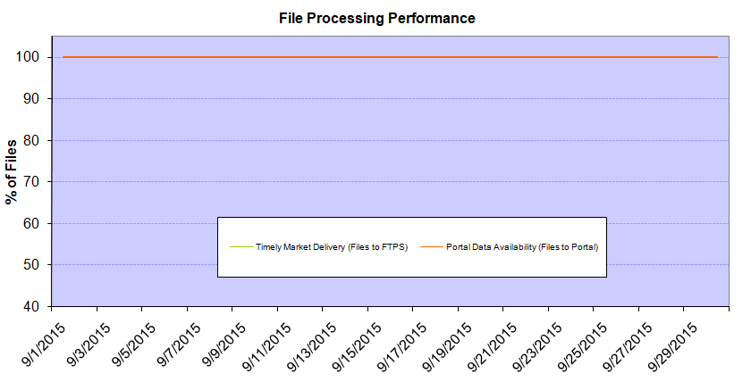
Monthly SMT Data Timelines AMWG CR 2014 002 End to End File Processing Completeness – SEP 2015
% Timely Market Delivery - % of files posted to market (FTPS) by 11:00pm out of # of files received by SMT by 11:00pm.
% Portal Data Availability - % of files loaded to the database for data availability on portal by 6:00am next day for the files received by 11:00pm
* A LSE file includes usage data for up to 50,000 ESIIDs.
Observed Anomalies:
Did not experience any issues in September with LSE file processing. Every day in September the files were posted to FTPS before 11:00pm and loaded to database before 6:00am next day.
2

Slide 3
SMT API and FTPS Services Availability – SEP-2015
The service availability is measured as a percentage of number of minutes the service was available out of the total number of minutes in a month, excluding planned outages.
Observed Anomalies:
Mar-Apr 2015: SMT outage and subsequent recovery/catch-up impacted API availability. FTPS was available for most of the part except on 03/21-03/22 for 36 hours.
26 Jul 2015: Services were unavailable for 12 hours due to Flash storage issue
Notes:
3

Slide 4
SMT Number of Accounts by Type AMWG CR 2014 009 – SEP 2015
Registered Users | ONC | CNP | AEPN | AEPC | TNMP | TOTAL
Active Residential Accounts | 31937 | 20539 | 2039 | 5316 | 2263 | 62094
Active Residential English Accounts | 31785 | 20392 | 2035 | 5205 | 2255 | 61672
Active Residential Spanish Accounts | 152 | 146 | 4 | 111 | 8 | 421
Non Active Residential Accounts | 15589 | 11103 | 1254 | 2565 | 539 | 30800
Total Residential Accounts | 47526 | 31642 | 3293 | 7881 | 2802 | 92894
TDSP User | 453 | 38 | 11 | 16 | 2 | 520
TDSP Admin | 4 | 4 | 4 | 4 | 3 | 19
Small Business User | 77 | 35 | 0 | 1 | 1 | 114
Small Business Admin | 2238 | 1167 | 69 | 232 | 68 | 3864
Total Agreements | 982 | 759 | 1 | 0 | 0 | 1742
Energy Data Agreements | 889 | 464 | 1 | 0 | 0 | 1354
Han Device Agreements | 93 | 294 | 0 | 0 | 0 | 387
Han Service Agreements | 0 | 1 | 0 | 0 | 0 | 1
IN SMT
ESI IDs | 3447321 | 2369530 | 196989 | 851837 | 205527 | 7071204
Meters | 3376518 | 2369462 | 197814 | 852011 | 205280 | 7001085
HAN Devices | 4107 | 5299 | 150 | 259 | 36 | 9851
Acknowledgement | 0 | 0 | 0 | 0 | 0
Pending | 0 | 3 | 0 | 0 | 0
Meter Ready | 473 | 78 | 46 | 115 | 25
Provisioned | 3634 | 5218 | 104 | 144 | 11
HAN Messages (MTD) | 0 | 1 | 0 | 0 | 0 | 1
HAN Messages (YTD) | 14 | 22 | 0 | 0 | 0 | 36
HAN Messages (Cumulative) | 305 | 7386 | 0 | 0 | 0 | 7691
Simple Text Messages | 94 | 2920 | 0 | 0 | 0
Load Control Messages | 80 | 2655 | 0 | 0 | 0
Pricing Messages | 89 | 49 | 0 | 0 | 0
Cancellation Messages | 42 | 1762 | 0 | 0 | 0
Supplemental – (Friends)
Total Agreements | 1532 | 1220 | 72 | 80 | 56 | 2960
Accepted Agreements | 691 | 477 | 32 | 28 | 17 | 1245
Pending Agreements | 2 | 1 | 0 | 0 | 1 | 4
Revoked Agreements | 219 | 231 | 9 | 7 | 6 | 472
Expired Agreements | 594 | 484 | 29 | 45 | 32 | 1184
Terminated Agreements | 26 | 27 | 2 | 0 | 0 | 55
 | TDSPs | REP | NRC | Regulatory | Third Party
Registered Entities | 5 | 101 | 3762 | 2 | 62
Registered Users | 520 | 853 | 114 | 7 | 7
Registered Admins | 19 | 159 | 3774 | 3 | 64
HAN Messages Sent By | 296 | 7383

Slide 5
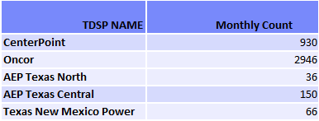
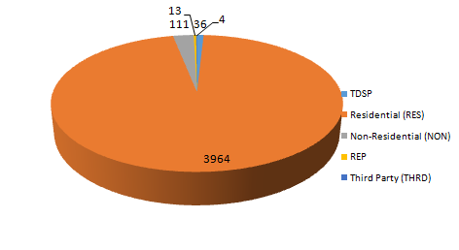
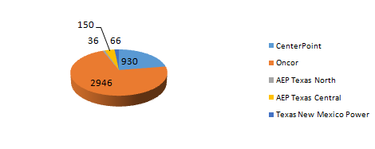
SMT ODR Details – SEP 2015
Total ODR Requests TDSP wise statistics:
Total ODR Requests User type statistics:

