Slide 1
Federated Identity Management and Access
Andres Carvallo
Dwight Moore
CMG Consulting, LLC
October 2015

Slide 2
Who is CMG?
CMG is a strategy consulting and advisory company focus on enabling smarter Cities, Enterprises, Utilities, Vendors, and Startups. CMG’s mission is to help define and accelerate the digitalization and transformation of the energy industry. CMG builds ecosystems for its clients.
Our consulting services include the development of Strategy, White Papers, Reports, Assessments, Gap Analysis, Benchmarking, Designs, Architectures, Road Maps, Business Models, Business Cases, Go-to-Market Plans, IT/OT Management, Product Innovation, Funding, and M&A.
We are experts in Energy, Telecommunications and Software.
http://www.512cmg.com

Slide 3
What is FIM?
Federated Identity Management is the methodology for linking a person's electronic identity and attributes which can be stored across multiple distinct identity management systems.
A key element of delivering federated identity management is single sign-on (SSO), in which a user's single authentication ticket, or token, is trusted across multiple IT systems or even organizations. SSO is an authentication technology and methodology enabling technical interoperability of customer credentials and ultimately allowing controlled access to a desired destination.

Slide 4
How Does FIM Work?
Federated Identity Management (FIM) refers to where the user stores their credentials. Alternatively, FIM can be viewed as a way to connect Identity Management systems together. In FIM, a user's credentials are always stored with the "home" organization (the "identity provider"). When the user logs into a service, instead of providing credentials to the service provider, the service provider trusts the identity provider to validate the credentials. So the user never provides credentials directly to anybody but the identity provider.
Single Sign-on (SSO) allows users to access multiple services with a single login. SSO can mean that the user only has to provide credentials a single time per session, and then gains access to multiple services without having to sign in again during that session. But it can also mean that the same credentials are used for multiple services.

Slide 5
FIM Technologies
Some of the technologies used for Federated Identity Management include:
SAML (Security Assertion Markup Language)
OAuth
OpenID
Security Tokens (Simple Web Tokens, JSON Web Tokens, and SAML Tokens)
Web Service Specifications
Microsoft Azure Cloud Services (Windows Identity Foundation)

Slide 6
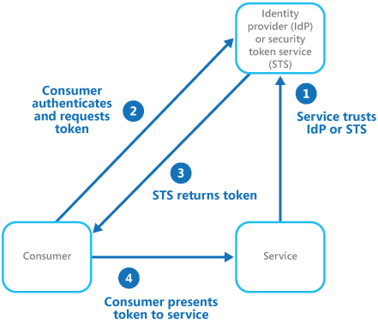
FIM Example
A client application needs to access a service that requires authentication. The authentication is performed by an identity provider (IdP), which works in concert with a security token service (STS). The IdP issues security tokens that assert information about the authenticated user. This information, includes the user’s identity, and may also include other information such as role membership and more granular access rights.

Slide 7
Why FIM?
There are many Digital identity platforms that allow users to log onto third-party websites, applications, mobile devices and gaming systems with their existing identity to simplify customer authentication while maintaining robust security.
One example would to enable social login.
In many cases there is also the possibility to exchange profile information about the user with the third-party site.
For example name, address, email, photo, etc.
Nowadays there are 3rd party service providers that have simplified the implementation of customer login. Along with customer login, they provide additional features like Single Sign-on and others.

Slide 8
Example of Identity Providers
The trusted identity providers may include:
Corporate Directories: Microsoft Active Directory, Open LDAP
On-Premises Federation Services: IBM, Intel, CA, Oracle, SAP, EMC (RSA), Radiant Logic, OpenAM, Verizon
Cloud/SaaS Federation Services: Axway, OneLogin, OpenID, OpenLogic, Capterra, Networkworld, Ping Identity, Gigya, Janrain or Loginradius
Financial Services providers: Paypal, Square, Intuit, others
Social Identity providers that can authenticate users: AOL, Amazon, Microsoft, Google, Linkedin, Yahoo!, Twitter, Facebook, others. User is required to have provider user ID and password.

Slide 9
CMG Contact
CMG is headquartered in Austin, Texas and has partner offices in Boston, Chicago, Denver, Durham, Kansas City, Minneapolis, New York City, Seattle, and Toronto.
Website: http://www.512cmg.com
Andres Carvallo, CEO & Founder, CMG
Email: andres@512cmg.com
Tel: 512-215-9080

