Slide 1
Customer Data Access -The New Ground Floor
Christopher Irwin
US Department of Energy – Office of Electricity
Oct 16, 2015

Slide 2
Quick Background
Project Officer - $1.5B in Smart Grid Investment Grant grid modernization projects
Texas: CenterPoint Energy, CoServ Electric, Golden Spread Electric Cooperative
DOE founding member of the Green Button Initiative – an industry standard advanced under a public brand

Slide 3
The New Ground Floor
Customers have a right to their consumption data
Data must be easily human and machine accessible, and easy to share with whomever the customer trusts (think GPS)
Organizations who operate in the public trust have an obligation to maximize public benefit and the efficiency with which it is delivered

Slide 4
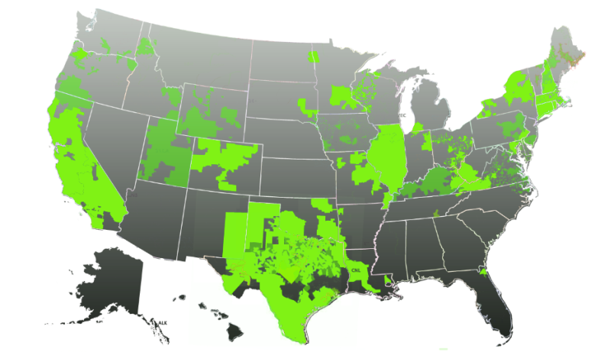
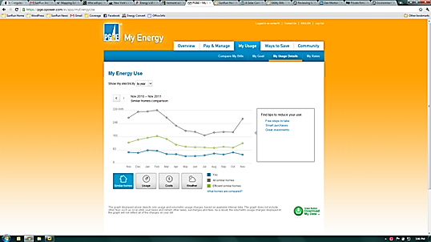
Green Button Initiative Overview
Common-sense idea that electricity customers should be able to download and transmit their own energy usage information in a standard consumer- and computer-friendly format
Brings energy data closer to the “App Economy” and software developers
US: Available to 60+ million customers based on utility commitments
CANADA: 2.6 million+
Result of collaboration among White House, NIST, DOE, state regulators, utilities, vendors, Smart Grid Interoperability Panel, and North American Energy Standards Board
Two options: Green Button Download My Data and Green Button Connect My Data
Map of US Green Button Commitments

Slide 5
“An Overnight Success”
White House Call to Action
Connect My Data Beta Deployments
American Energy Data Challenge
Green Button
CMD Certifications
9/2011
NAESB ESPI Standard Ratified
12/2012
11/2013
4Q 2014
HEY (EPA) Update w/Green Button
Presidential Memorandum to Federal Agencies
10/2011
First DMD
Available
1/2012
DMD Certifications
Green Button CMD Rollouts
Nationally
DOE Apps for Energy
4/2013
12/2013
2H/2014
5/2012
1H/2015
2011
2012
2014
2013
2015
0 Customers
(Download My Data)
12 Million Customer Accounts
26 Million Customer
Accounts
42 Million Customer
Accounts
60 Million Customer
Accounts

Slide 6
Typical Data Exchange
Data Custodian
Third Party
Third Party Registration
Web Service Provider
Web Service Consumer
Automated Transfer
Web Portal
One-time Authorization
Web Portal
Retail Customer
User (agent)

Slide 7
Green Button Supports Innovation in New Applications
Insight: entrepreneur-created web portals analyze energy usage and provide actionable tips;
Heating and Cooling: customized heating and cooling activities for savings and comfort;
Education: community and student energy efficiency competitions;
Retrofits: improved decision-support tools to facilitate energy efficiency retrofits, Virtual Energy Audits;
Verification: measurement of energy efficiency investments;
Real Estate: provide energy costs for tenants and/or new home purchasers; and
Solar: optimize the size and cost-effectiveness of rooftop solar panels.
www.greenbuttondata.org
Notes:
7

Slide 8
Recent Success – Com Ed
Implemented Green Button Connect My Data for C&I
Central to their Smart Grid Exchange – with entrepreneurs, start-up, universities and customers
Elmhurst Hospital was an early user, saving energy through analytics on their campus

Slide 9
Thank You
Christopher Irwin
Office of Electricity Delivery and Energy Reliability
Advanced Grid Integration
Christopher.Irwin@hq.doe.gov

