Slide 1
Integration Experience
Lisa Schmidt
Home Energy Analytics
President and CEO, HEA
lisa@hea.com
October 23, 2015

Slide 2
HEA – What we do
Analyze interval and billing data to create energy profiles for residences
Continually update the profile each month
Coach residents on cost-effective energy reduction steps
Track energy use changes

Slide 3
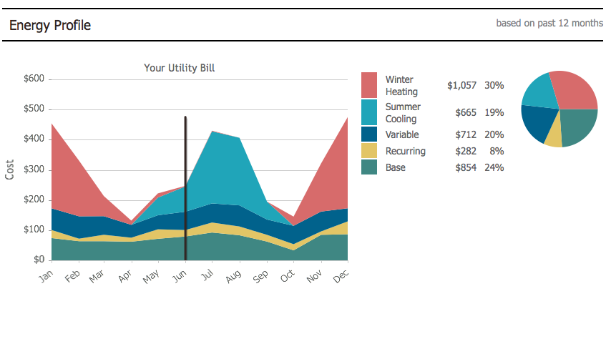
Two Products
Home Energy Profile- ongoing access to utility site for data
$3570/year

Slide 4
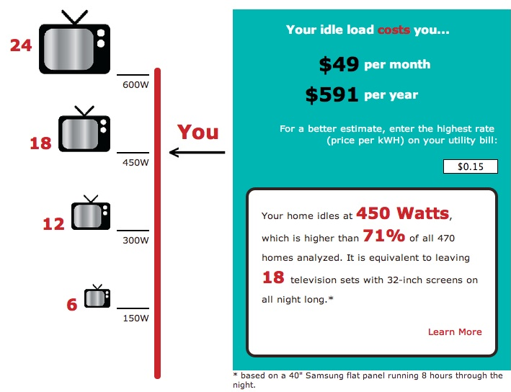
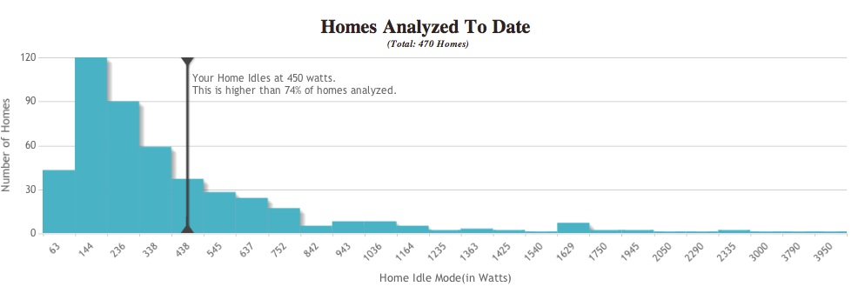
Two Products
UnPlugStuff - one time or ongoing access

Slide 5
Ease of Integration and Use
Integration | Utility | Status | For User | For HEA | For Utility | Data Transfer Method
HEP-Elec&NG | PG&E | Active | Easy | Painful | Easy | Web scraping & CSV downloads
HEP-Water | PHWD | Replaced | Easy | Ok | Painful | Emailed CSVs
UnplugStuff (UPS) | Any | Active | Painful | Easy | Easy | File download & upload in browser
UPS-GBC | PG&E | Replaced | Ok | Easy | Painful | Machine to Machine (Green Button Connect My Data)
HEP-ElecOnly | VEIC | Enabled | Easy | Ok | Painful | Manual SFTP file transfers
UPS-SDG&E | SDG&E | Active | Easy | Easy | Easy | SFTP Transfers (Green Button Connect)
UPS-Ontario | OntarioPwr | Active | Easy | Easy | Easy | Machine to Machine (Green Button Connect)
HEP-Batch | PG&E | Active | n/a | Painful | Easy | Web scraping & CSV downloads
UPS-SMD | PG&E | Active | Easy | Easy | Easy | Machine to Machine (Green Button Share My Data)
UPS-SMT | SMT | Inc | ? | Painful | Painful | Machine to Machine (Green Button Connect)
HEP-CalWater | CalWater | Active | Easy | Ok | Easy | Web scraping
HEP-PHWD2 | PHWD | Active | Easy | Easy | Ok | One time batch file transfer plus emailed updates
HEP-PHWD-SM | PHWD | Active | Easy | Ok | Easy | Web scraping & CSV downloads (hourly data)
HEP-SCE | SCE | Testing | Easy | Painful | Easy | Web scraping & CSV downloads
UPS-SCE | SCE | Inc | Easy | Ok | Painful | Machine to Machine (Green Button Connect)
HEP-SoCalGas | SoCalGas | Testing | Easy | Painful | Easy | Web scraping & CSV downloads

Slide 6
Recommendations
# 1- Customer ease-of-use
#1.5 - Stable system

