Slide 1
Third Party-Led Authorizations
Michael Murray
Chief Technology Strategist
Oct 16, 2015

Slide 2
Who is Mission:data?
33 companies
Data-driven energy management services
Residential and commercial/industrial
“Backhaul” data and Home Area Network
$1.0 billion/yr in North America

Slide 3
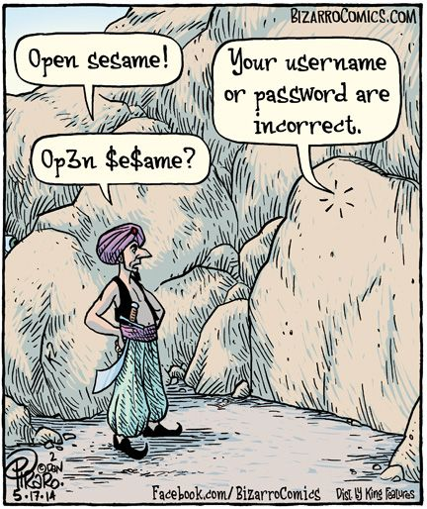
Authentication vs. Authorization
Authorization without authentication is dangerous.
Authentication without authorization is useless.
Notes:
“Principles” of ODAF include:
Convenient customer access to energy and cost data
Data format & transmission must be standards-based
Third parties receive 24-months historical data upon authorization
Backhaul access and Home Area Network
Free of charge

Slide 4
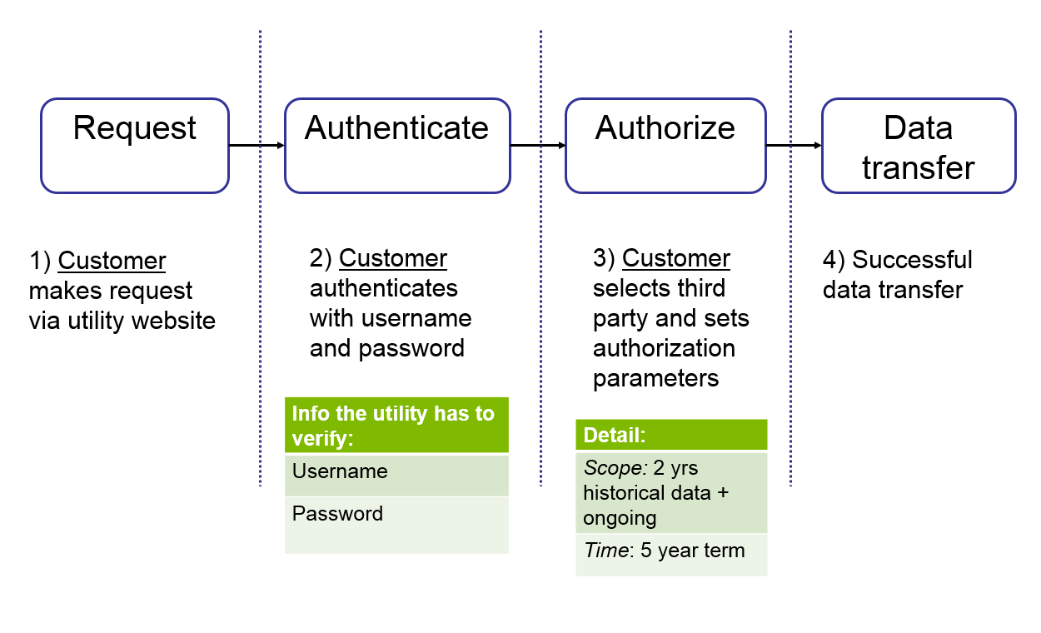
Generic customer-led authorization process

Slide 5
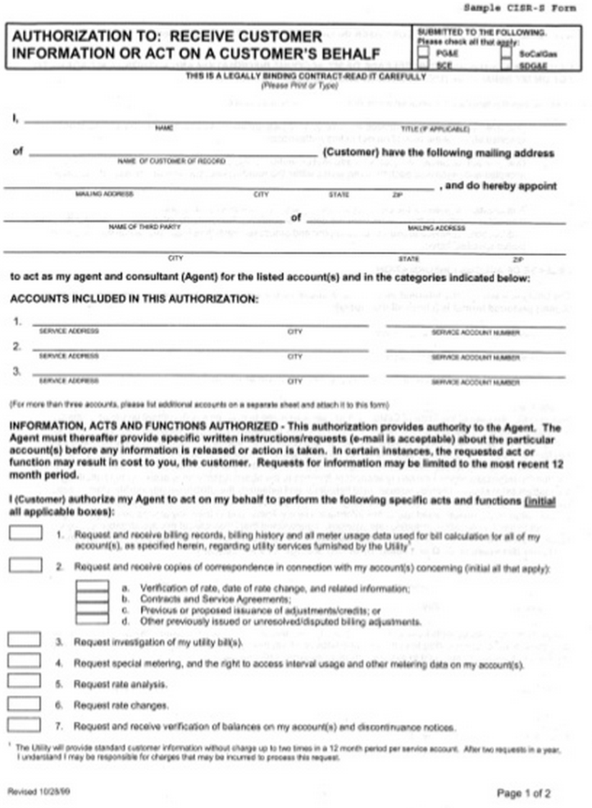
Start simple: paper form
Identity information
Name, service address, account number
Signature
Authorization length
Hold harmless clause
Authority declaration

Slide 6
What establishes identity?
Reasonable certainty, not perfect certainty
Stakeholders need to decide what is reasonable
Info could include:
Name
Account number
Service address
Meter number
Hand-written signature
Birthday, birth location, first pet’s name…

Slide 7
Retailers (and 3rd Parties) in Illinois
“Checkbox” or “warrant” process:
3rd Party enters customer account number, no other information required
3rd Party affirms “express permission to access” with each request
Interval meter data transmitted
Seamless, entirely led by retailers
May change in ongoing docket #15-0073

Slide 8
Retailers in Pennsylvania
Like IL, access is granted to third parties
But:
3rd Parties must be licensed by PA PUC
Subject to audit
Cost is $350 per year, $10k bond required
3P must provide 2 yrs audited financials, bank statements, tax returns
3P must vouch for its financial and technical “fitness”
Access is seamless, entirely led by retailers
Cons:
Uses EDI, not green button, expensive for third parties
PUC requirements discriminate against startups

Slide 9
Some Considerations
PUC jurisdiction over 3rd Parties needs resolution
If data access is 3P-led, is consent “informed”? Might require:
Separate document
Description of data, how revealing it could be
Revocation instructions
Redress methods

Slide 10
Considerations continued
Considerations for Third Party Eligibility
Registration with contact information
Agreement to Commission rules
Primary vs. secondary purposes?
Prohibitions on selling data
Technical interoperability
Not banned by PUC

Slide 11
Generic customer-led authorization process

Slide 12
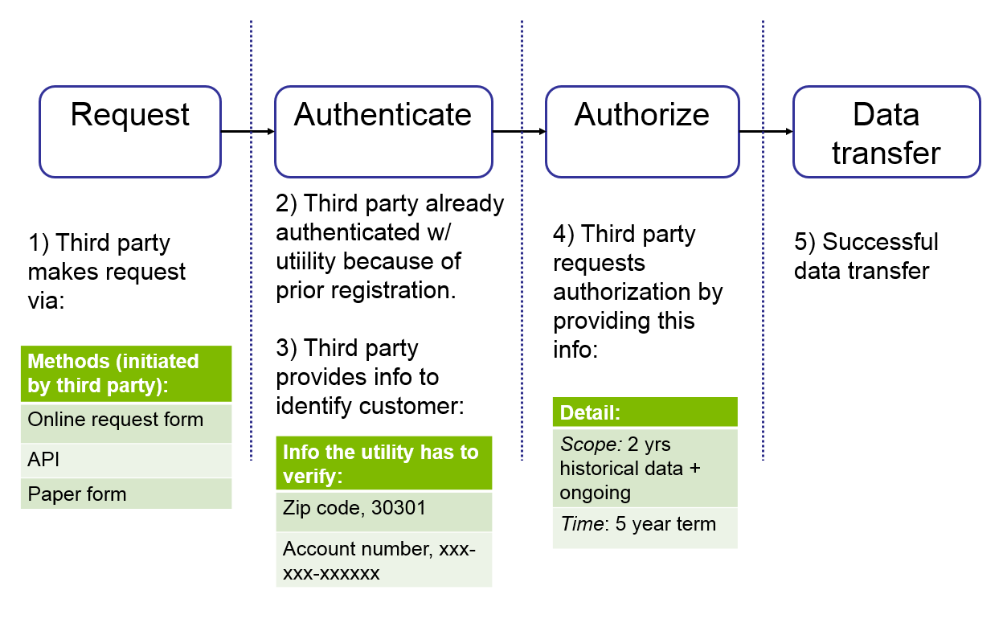
Third party-led

Slide 13
Thank You
Michael Murray
Chief Technology Strategist
michael@missiondata.org
510-910-2281

