Slide 1

Settlement Stability
2015 Q3 Update to COPS
Austin J. Rosel
ERCOT
COPS
10/14/2015

Slide 2
8.2(c)(i) Track number of price changes
Reporting Period: 2015 Q3
Operating Day | # of Corrected Settlement Point Prices |  |  |  | # of Intervals Affected
 | DASPP | RTSPP | RTRMPR | ORDC Adders | DASPP | RTSPP | RTRMPR | ORDC Adders
6/4/2015 | - | 1206 | 982 | 4 | - | 2 | 2 | 2
6/6/2015 | - | 7236 | 5892 | 12 | - | 12 | 12 | 12
6/7/2015 | - | 11457 | 9329 | 29 | - | 19 | 19 | 19
6/8/2015 | - | 15075 | 12275 | 40 | - | 25 | 25 | 25
6/9/2015 | - | 7236 | 5892 | 21 | - | 12 | 12 | 12
6/10/2015 | - | 10854 | 8838 | 29 | - | 18 | 18 | 18
6/11/2015 | - | 8442 | 6874 | 24 | - | 14 | 14 | 14
6/12/2015 | - | 12663 | 10311 | 25 | - | 21 | 21 | 21
6/13/2015 | - | 19296 | 15712 | 45 | - | 32 | 32 | 32
6/14/2015 | - | 3618 | 2946 | 6 | - | 6 | 6 | 6
6/15/2015 | - | 18693 | 15221 | 55 | - | 31 | 31 | 31
7/31/2015 | 14 | - | - | - | 14 | - | - | -
8/5/2015 | - | 1211 | 963 | - | - | 3 | 3 | -
Notes:
Price corrections for OD between 06/04/2015 and 06/23/2015 due to data error (mean and standard deviation). Approved for Resettlement at 8/11/2015 Board. The remaining corrections (6/16-19,6/23) will be executed in Q4.
Price corrections for OD 7/31/2015 corrected HE1-14 for PENA_ALL Settlement Point.
Price corrections for OD 8/5/2015 were due to a system issue.
Notes:

Slide 3
8.2(c)(ii) Track number and types of disputes submitted
YEAR | 2015
QUARTER | Q1-Q3
Row Labels | Denied | Granted | Granted w/Exc. | Open | Total Submitted
Congestion Revenue Rights-RTM | 1 |  |  | 3 | 4
Energy-DAM | 1 |  |  |  | 1
Energy-RTM | 15 | 9 |  |  | 24
Emergency Operations-RTM | 9 | 7 | 1 |  | 17
Ancillary Services-RTM | 3 |  |  | 1 | 4
Grand Total | 29 | 16 | 1 | 4 | 50

Slide 4
8.2(c)(iii) Compliance with timeliness of response to disputes
YEAR | 2015
QUARTER | Q1-Q3
Row Labels | Final | TRUE-UP | Grand Total
Congestion Revenue Rights-RTM |  | 100% | 100%
Energy-DAM |  | 100% | 100%
Energy-RTM | 100% | 100% | 100%
Emergency Operations-RTM |  | 100% | 100%
Ancillary Services-RTM |  | 100% | 100%
Grand Total | 100% | 100% | 100%

Slide 5
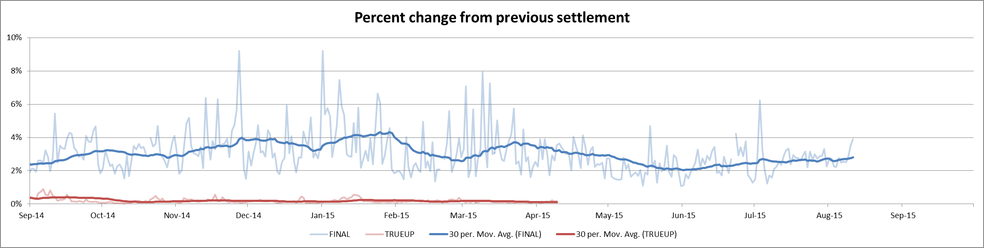
8.2(c)(iv) Other Settlement metrics
NOTE: ERS Final settlement OD data is not represented in graph.
Average percent change per year
Year | Final | True Up
2011 | 3.65% | 0.42%
2012 | 2.56% | 0.41%
2013 | 2.83% | 0.34%
2014 | 3.18% | 0.32%
2015 | 2.92% | 0.17%

Slide 6
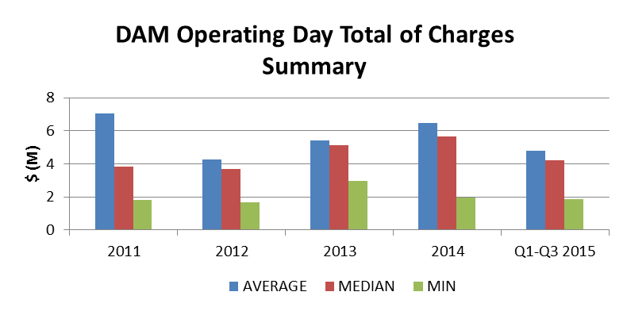
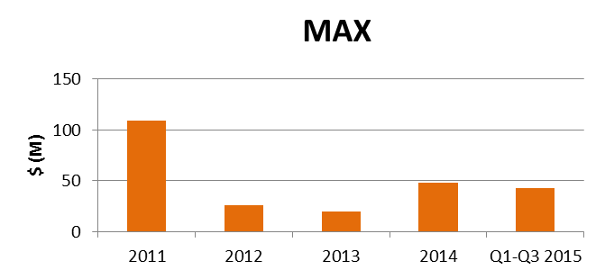
8.2(c)(iv) Other Settlement metrics
 | 2011 | 2012 | 2013 | 2014 | 2015 Q1-Q3
AVERAGE | $7.06 | $4.29 | $5.41 | $6.46 | $4.79
MEDIAN | $3.85 | $3.67 | $5.11 | $5.66 | $4.20
MIN | $1.81 | $1.70 | $2.96 | $1.96 | $1.86
MAX | $108.69 | $26.21 | $19.45 | $47.93 | $42.34
NOTE: “Total of Charges” represents the sum of statements that are a net charge to the Market Participant (i.e., the amount due to ERCOT)

Slide 7
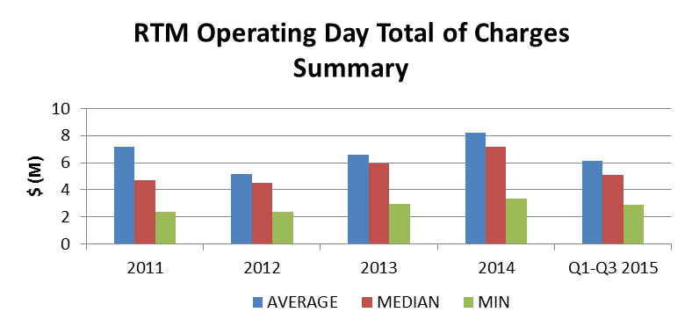
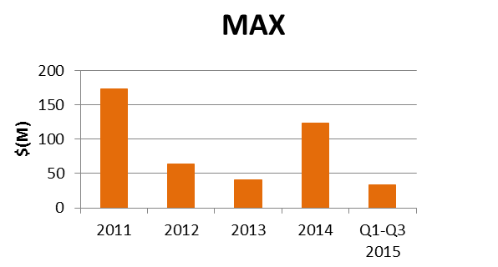
8.2(c)(iv) Other Settlement metrics
 | 2011 | 2012 | 2013 | 2014 | 2015 Q1-Q3
AVERAGE | $7.19 | $5.19 | $6.61 | $8.21 | $6.14
MEDIAN | $4.69 | $4.51 | $5.97 | $7.15 | $5.13
MIN | $2.38 | $2.34 | $2.98 | $3.32 | $2.90
MAX | $173.66 | $63.34 | $40.52 | $123.68 | $33.61
NOTE: “Total of Charges” represents the sum of statements that are a net charge to the Market Participant (i.e., the amount due to ERCOT)

Slide 8
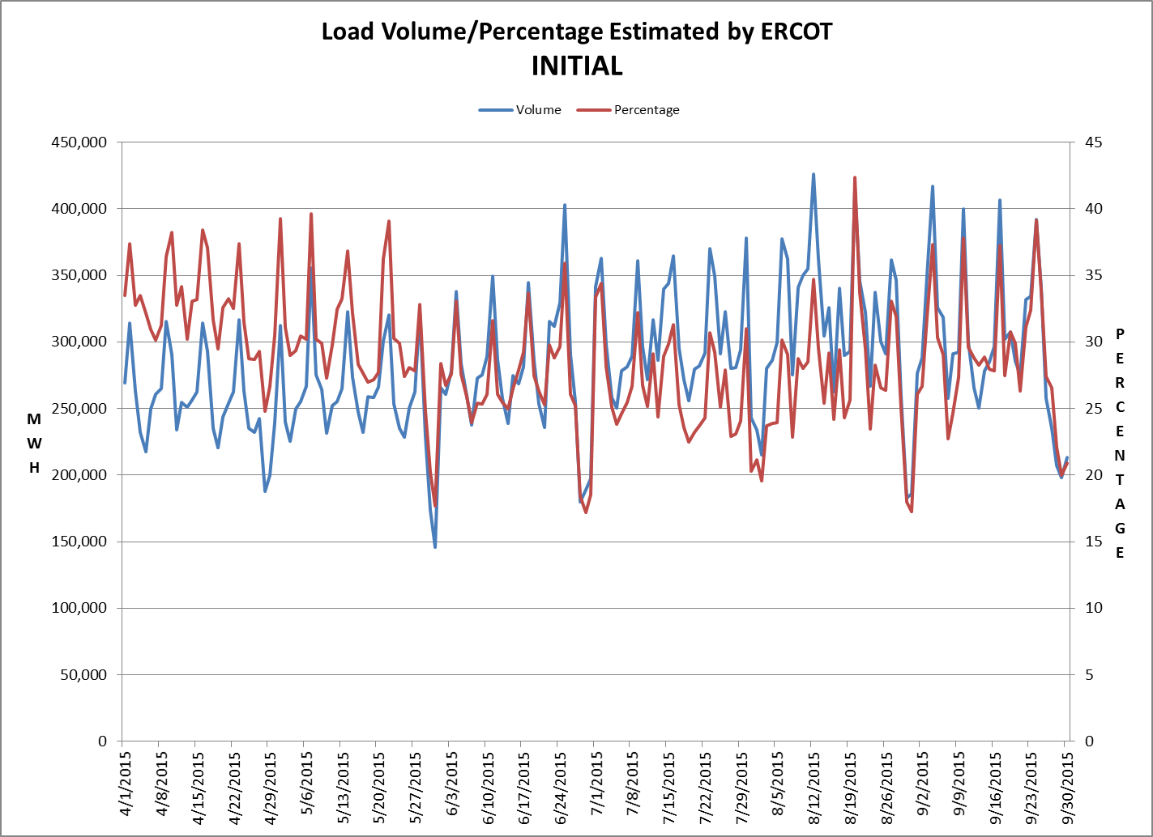
8.2(c)(v) Availability of ESIID consumption data

Slide 9
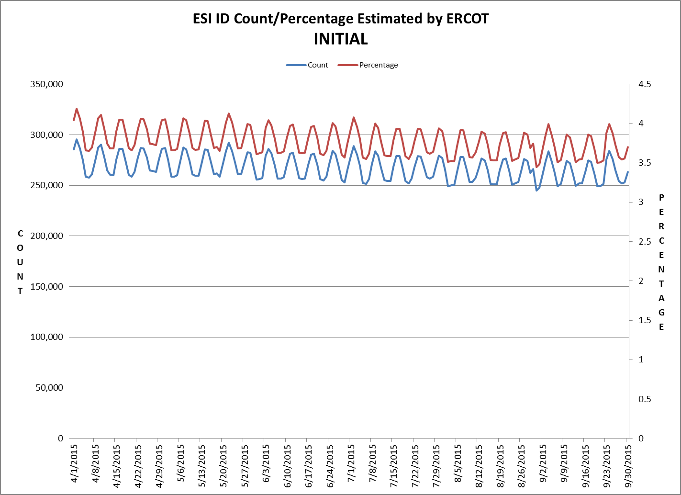
8.2(c)(v) Availability of ESIID consumption data

Slide 10
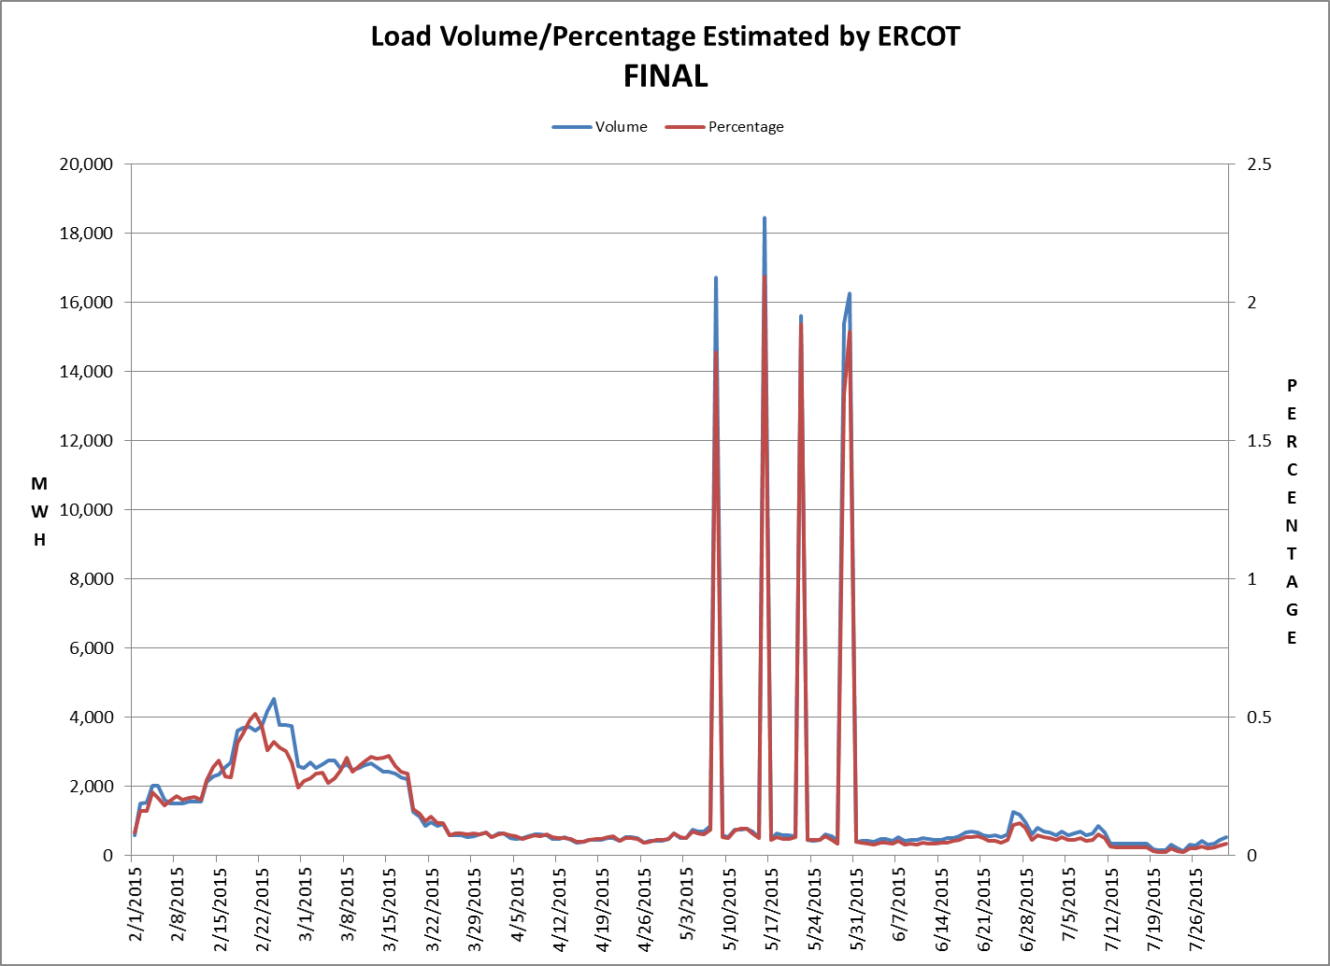
8.2(c)(v) Availability of ESIID consumption data

Slide 11
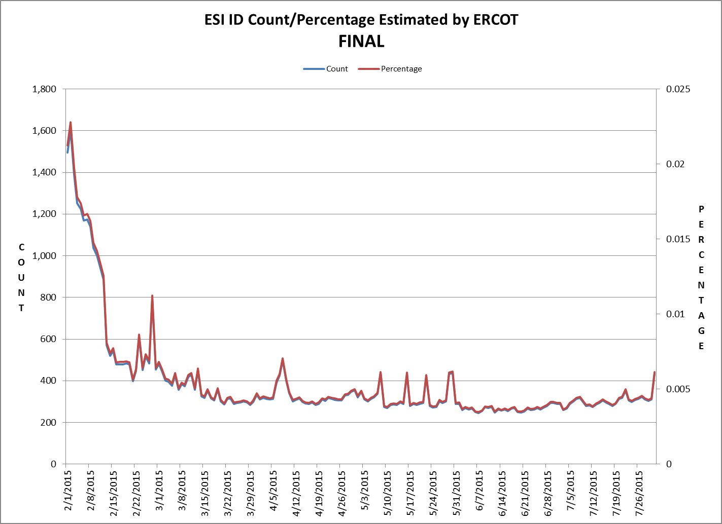
8.2(c)(v) Availability of ESIID consumption data

Slide 12
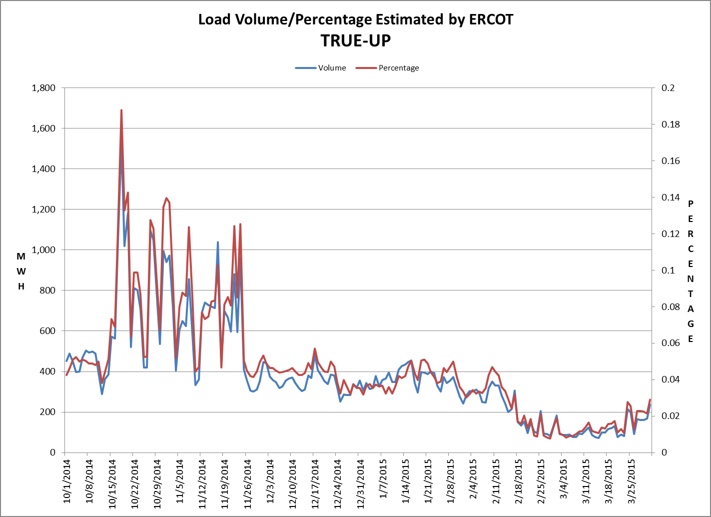
8.2(c)(v) Availability of ESIID consumption data

Slide 13
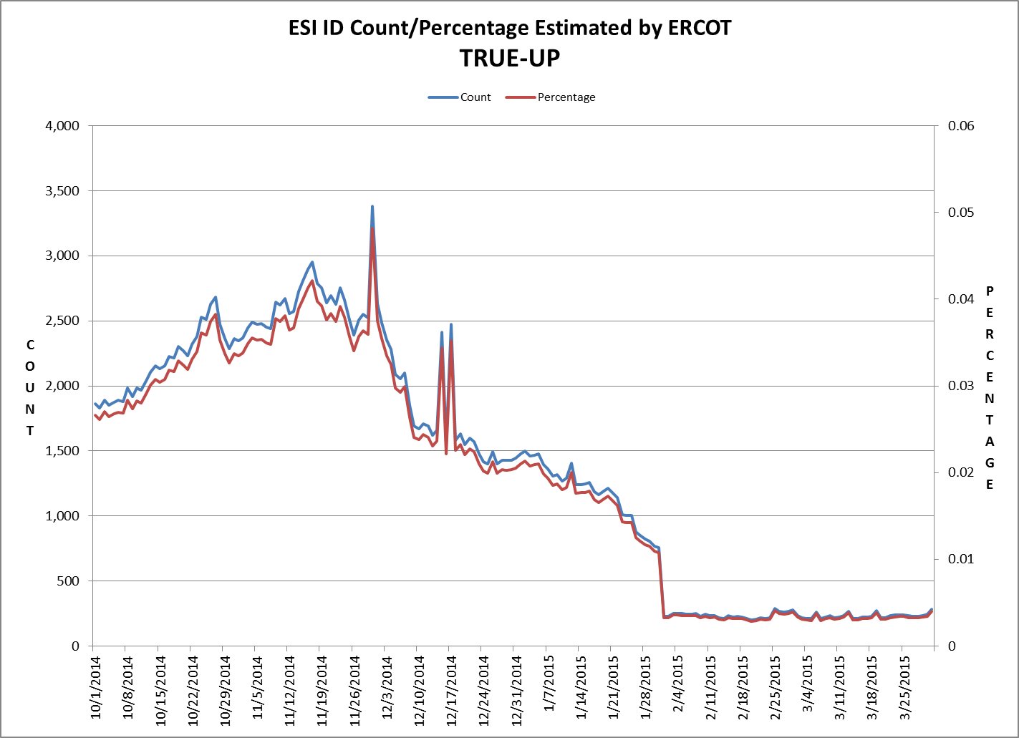
8.2(c)(v) Availability of ESIID consumption data

Slide 14
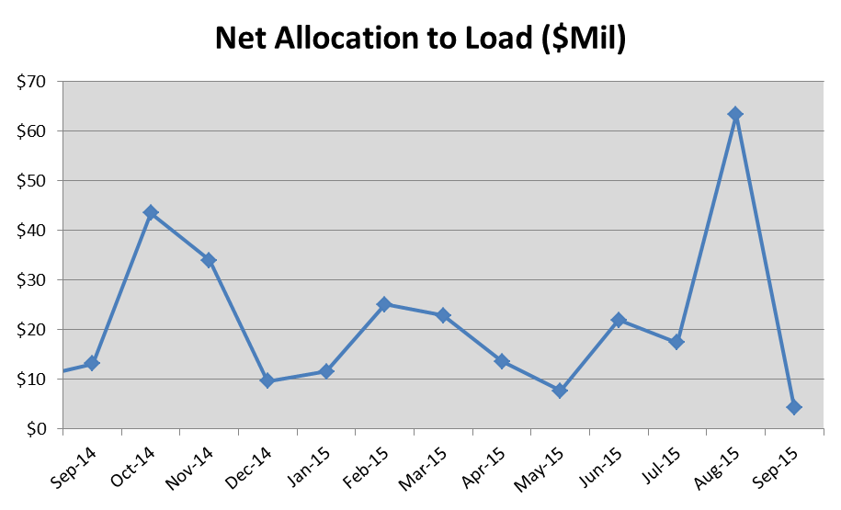
8.2(g) Net Allocation to Load

