Slide 1

Market Update
ERCOT Market Analysis
QSE Managers Working Group
10/9/2015

Slide 2
Supplemental Ancillary Services Market (SASM) Update
  SASM sufficient; offers were made in 30-minute window
Notes:
Non-reconfiguration SASMs

Slide 3
Manual Overrides
  None

Slide 4
June 3, 2015 Valley RUC
  Reason for RUC is
  SL_FLA_8 / LA_PAL_VCAVAZ1_1
    Loss of Los Fresnos to Loma Alt 138kV overloads La Palma to Villa Carazos 138kV
    Long-term outage of MV_RIOHO to MV_CNTRA
  HRUC of SILASRAY_10 for HE15-18
  @ 6/3 12:00
  Resource chose ONOPTOUT; no RUC settlements

Slide 5
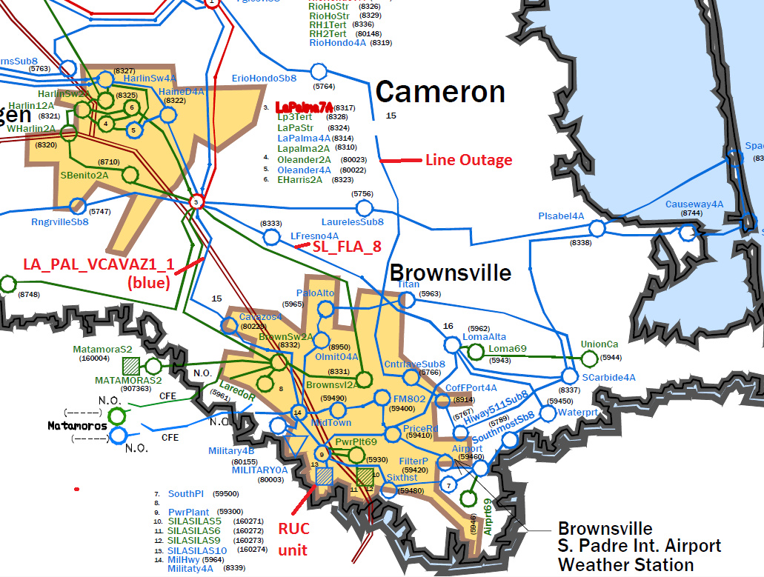
June 3, 2015 Valley RUC

Slide 6
June 3, 2015 Valley RUC
  Shift Factors
    DAM - Settlement Points
      SILAS 5,6,9,10,CC1 -0.64
      LZ_SOUTH -.03
    SCED - Resources
      SILAS CC1, 10 -0.62
      All other Resources .00335
  Shadow Prices
    DAM $84 - $234
    SCED $3500 before RUC hours; $10-$15 after

Slide 7
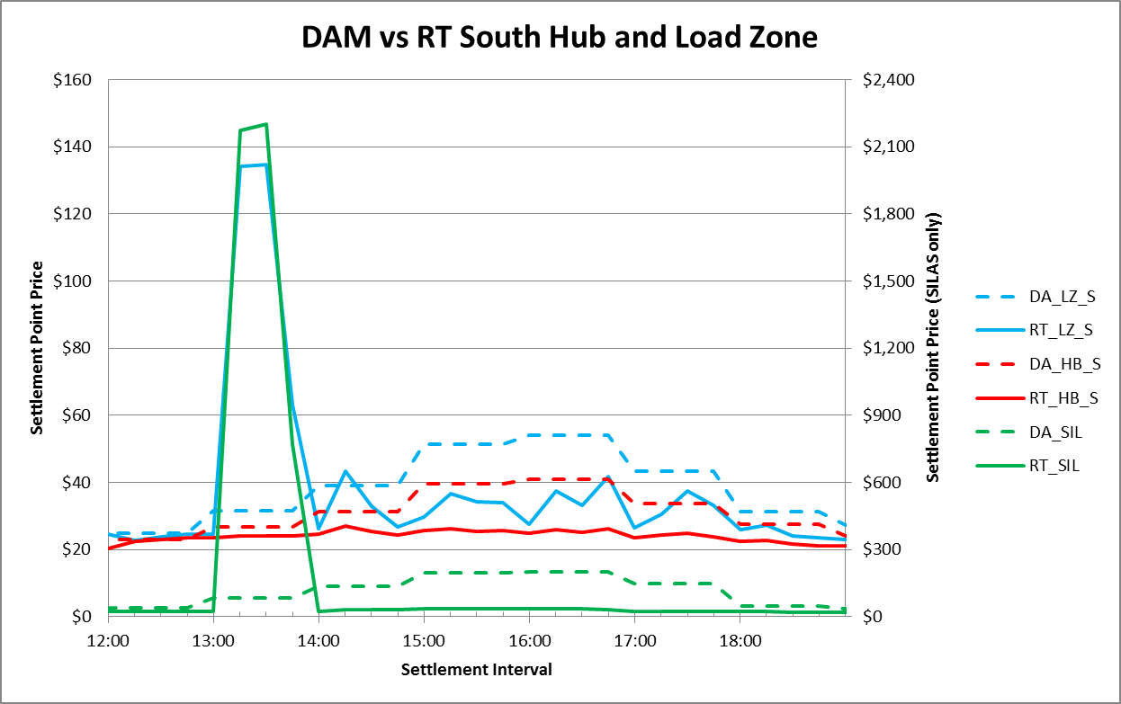
June 3, 2015 Valley RUC

Slide 8
June 3, 2015 Valley RUC
  Real-Time Events
    12:00 HRUC RUCs SILAS_10 for HE15-18
    12:28 SILAS_10 updates COP to ONOPTOUT
    13:15 Constraint activated
    13:15-13:45 Constraint irresolvable (SP = $3500)
    13:50 SILAS_10 comes online w/BP at LSL
    14:15 SILAS_10 BP are marginal
    17:00 SILAS_10 BP at LSL
    18:00 RUC period ends
    19:00 SILAS_10 goes offline

Slide 9
June 3, 2015 Valley RUC
  SCED study re-execution
    13:30 If SILAS online, LMP drops to $24
      Resource would have resolved congestion
    17:30 If SILAS offline, LMP jumps to $2,200
      Resource was still needed to resolve congestion
    18:30 If SILAS offline, LMP stays the same
      Resource was NOT needed to resolve congestion,
      BUT it was no longer in a RUC-committed hour

Slide 10
June 3, 2015 Valley RUC
  Area Unit COP Status
    SILAS_CC1 OUT
    SILAS_10 OFF (then ONOPTOUT after RUC)
    Other Valley Resources (which do not resolve constraint)
      DUKE_CC1_2 ON
      FRONTERA CCs OUT
      NEDIN_CC1_1 ON
      NEDIN_CC1_2 OUT

Slide 11
QUESTIONS / COMMENTS???

