Slide 1
PDCWG Report to ROS
Chair: Mike Noth, LCRA
Vice Chair: Stewart Rake, Luminant
ROS
October 8th, 2015

Slide 2
Meeting Minutes
PDCWG Meeting 9/22/15
  BAL-001-TRE-1 & MOD-025-2 Updates
    As of October 1st, ERCOT is planning to update Generator maximum Dead-band and Droop settings for use in the BAL-001-TRE-1 PFR calculations.
  GREDP Performance Analysis
  GTBD Analysis
    ERCOT is in the process of analyzing the benefit of adding ACE Integral component to the existing GTBD calculation.
    ERCOT is preparing to update the current GTBD tuning parameters (K3 & K4) in preparation for shoulder months and bi-diurnal season.
  Non-Frequency Responsive Capacity Telemetry
    ERCOT is preparing a RFI to be sent out to applicable Generation Resources to understand the different types of PA Capacity currently being used as well as the methodology of computing the NFRC telemetry.
  Methodology to Determine Fast Responding Regulation Service (FRRS) Limit and Equivalency Ratio
  Reviewed 4 ERCOT Frequency Disturbances
    082715 @ 2111
    082515 @ 1618
    091715 @ 0745
    091705 @ 2220

Slide 3
Frequency Measurable Events Performance

Slide 4
Frequency Measurable Events
There were 2 FMEs during the month of September.
  9/17/2015 7:45:02
    Loss of 815 MW
    18 of 66 Generation Resources had less than 75% of their expected Initial Primary Frequency Response.
    7 of 66 Generation Resources had less than 75% of their expected Sustained Primary Frequency Response.
  9/17/2015 22:20:14
    Loss of 643 MW
    9 of 53 Generation Resources had less than 75% of their expected Initial Primary Frequency Response.
    6 of 53 Generation Resources had less than 75% of their expected Sustained Primary Frequency Response.

Slide 5
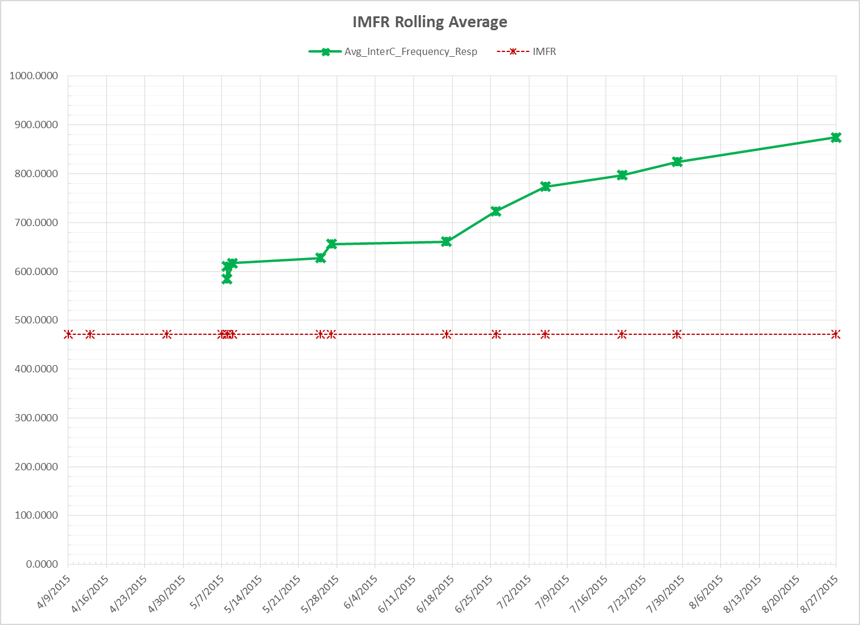
Interconnection Minimum Frequency Response (IMFR) Performance

Slide 6
Frequency Control Report
September 2015

Slide 7
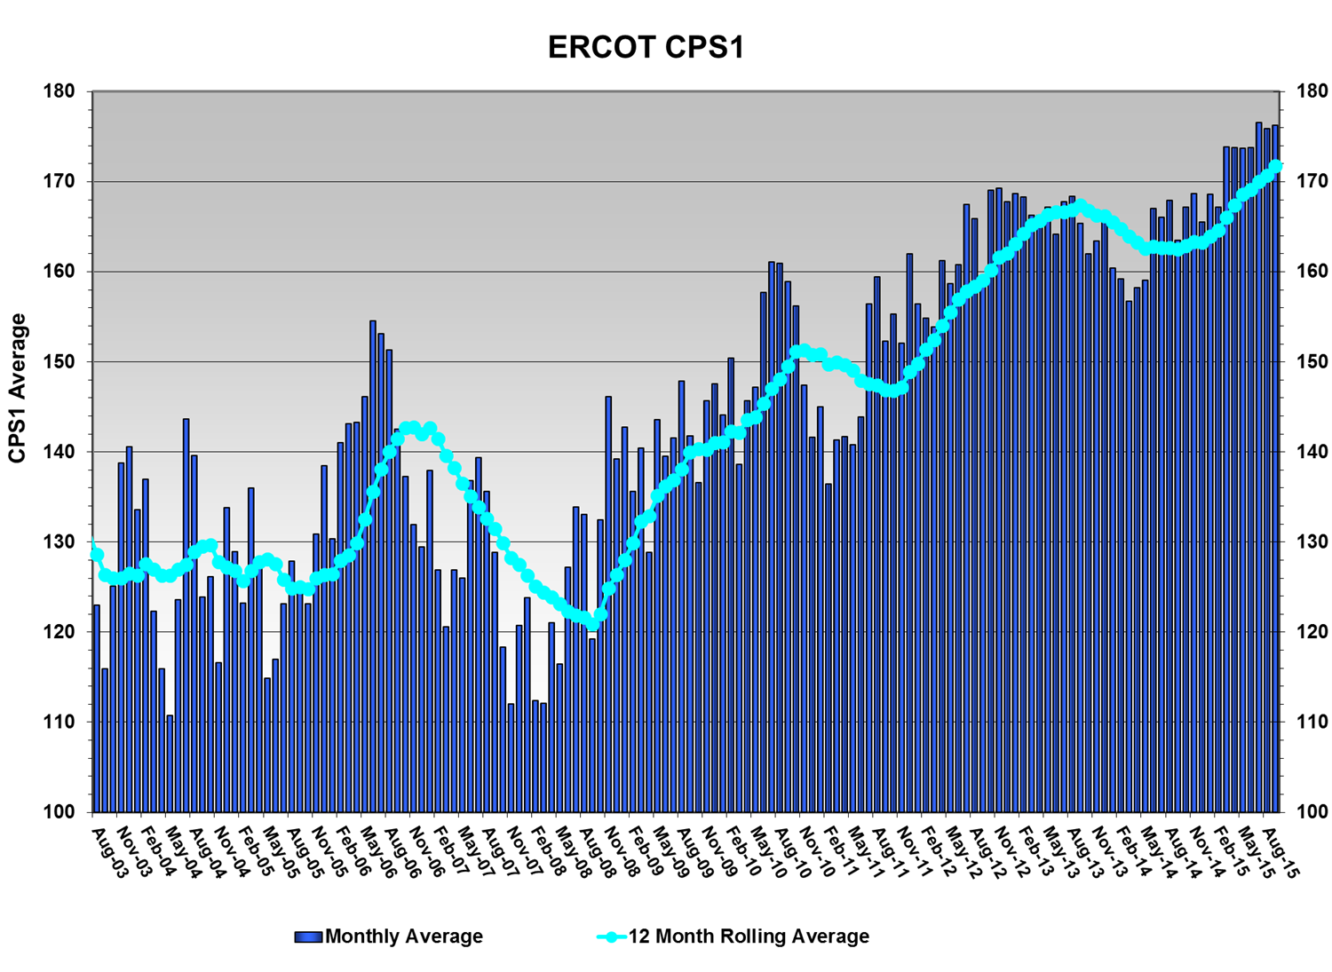
CPS1 Performance
CPS1 12 Month Rolling Average = 171.75

Slide 8
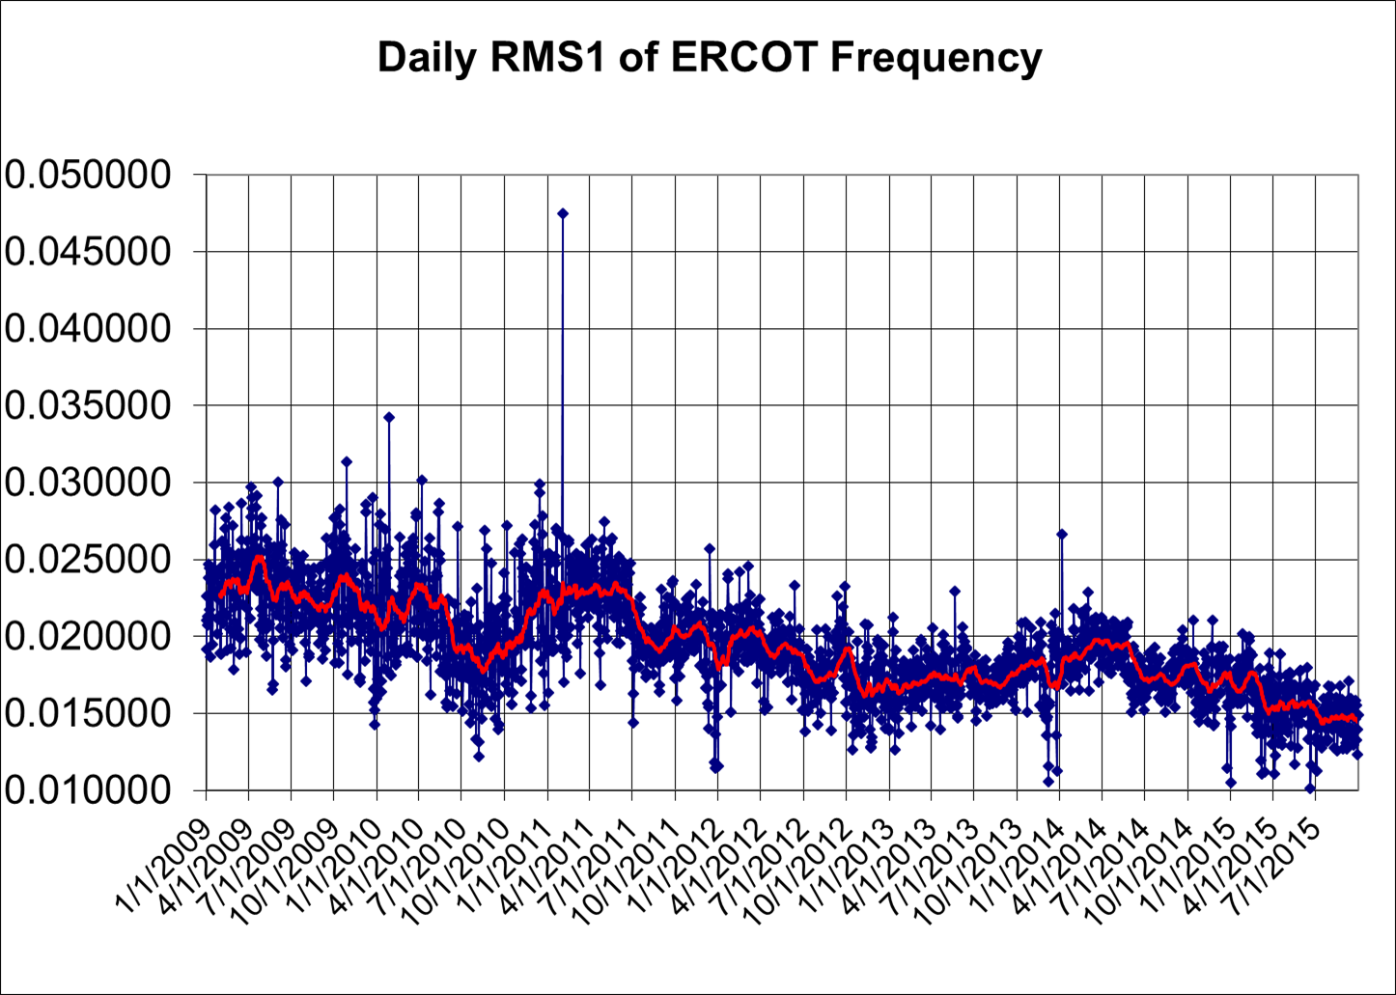
RMS1 Performance of ERCOT Frequency

Slide 9
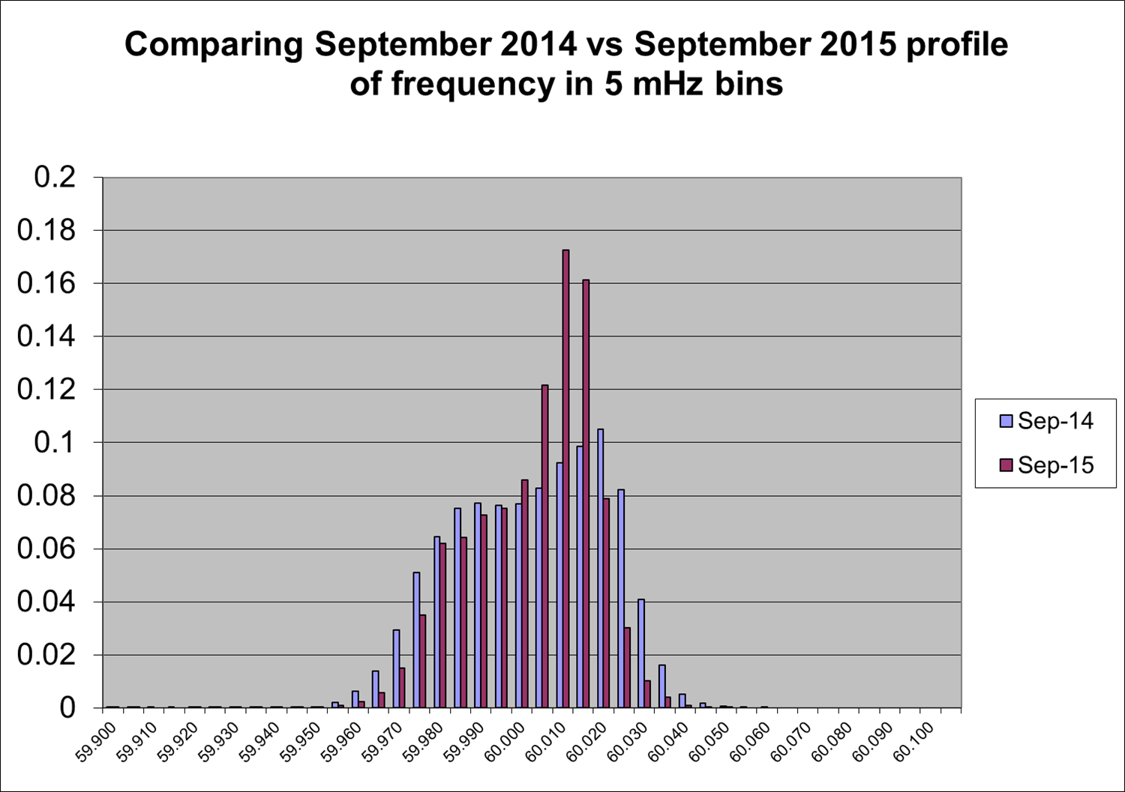
Frequency Profile Analysis

Slide 10
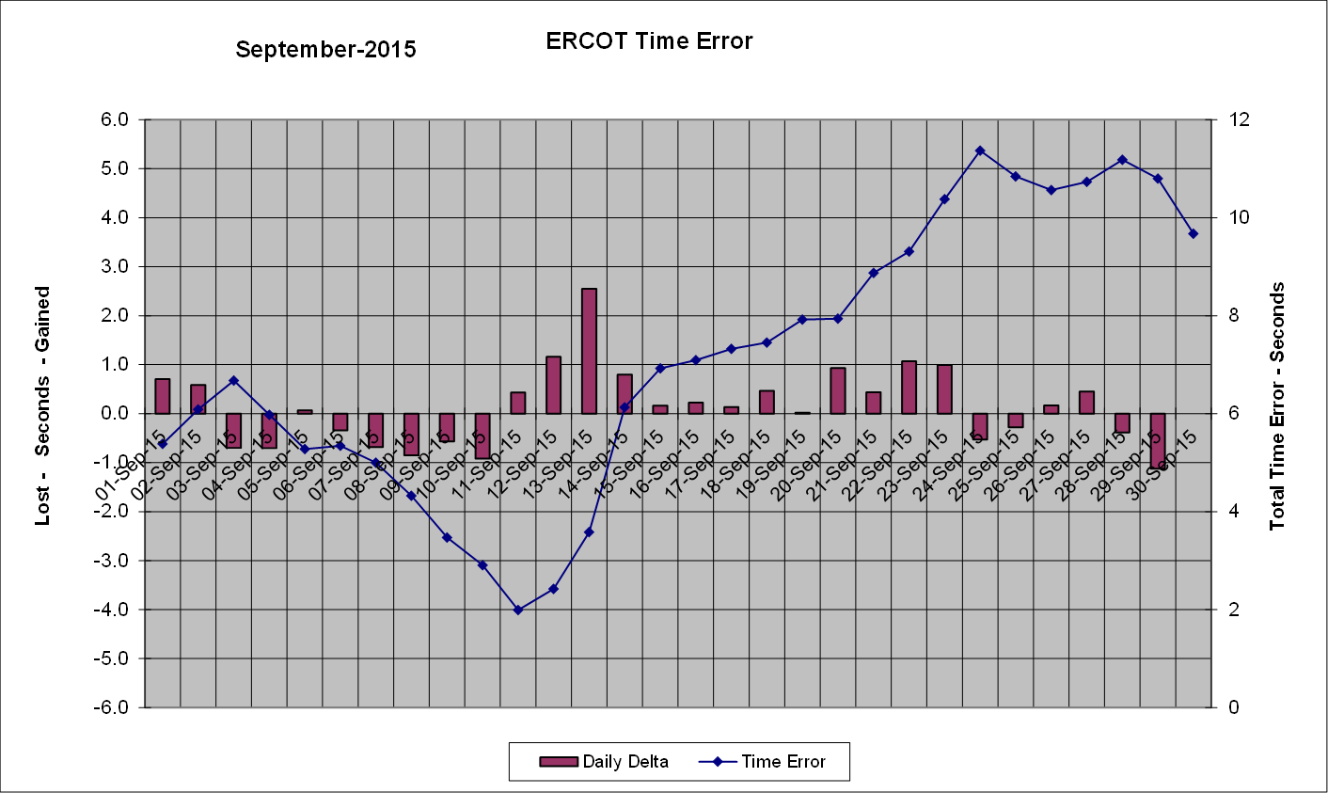
Time Error Corrections
There were no Time Error Corrections (TEC) in September. The last TEC was on May 18th, 2015.

Slide 11
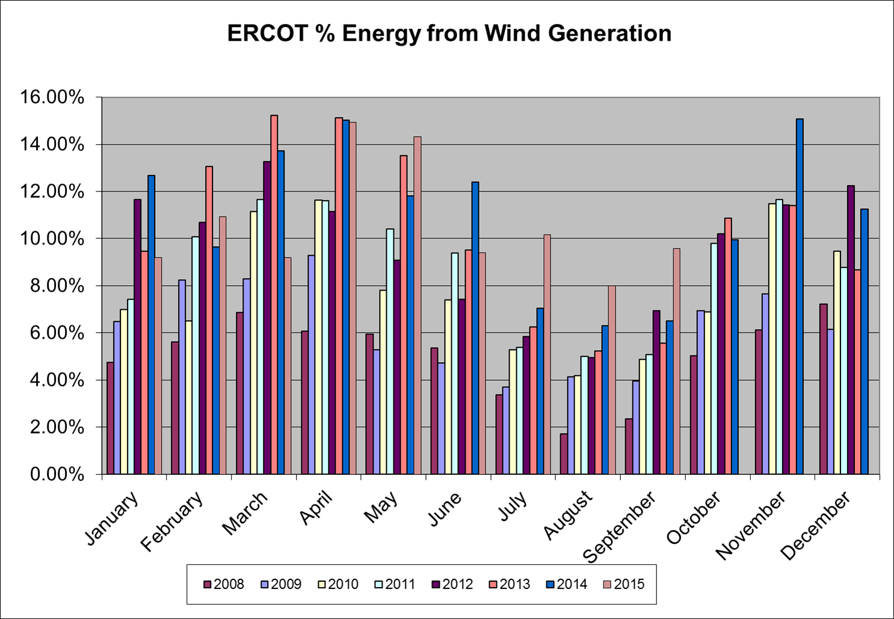
Wind Generation Performance

Slide 12
Questions?

