Slide 1

2015 Internal Control Evaluation at ERCOT
Yvette Landin and Matt Stout
September 17, 2015
NERC Reliability Working Group (NRWG)

Slide 2
  Outline of discussion
  Building Controls
  Assessing Controls
  Preparing for Audits
  2015 Audit Experience

Slide 3
Building Controls

Slide 4

Implementation Alert Roadmap
2Q2014
3Q2014
4Q2014
1Q2015
Initial NERC 693 & Protocols for System Operations and Planning Effort
Quality check
Close gaps
6 week mapping window for each business unit
Complete NERC
self-certification
Maintain update standards/protocols
Maintain with changes to requirements
NERC CIP Requirements
Develop CIP v5
ICMP Activities via surveys
Executing BrightLine
Audit with some reporting
functionality
Enhanced reports from Alert
Considering shift in framework in 2015 to COBIT

Slide 5
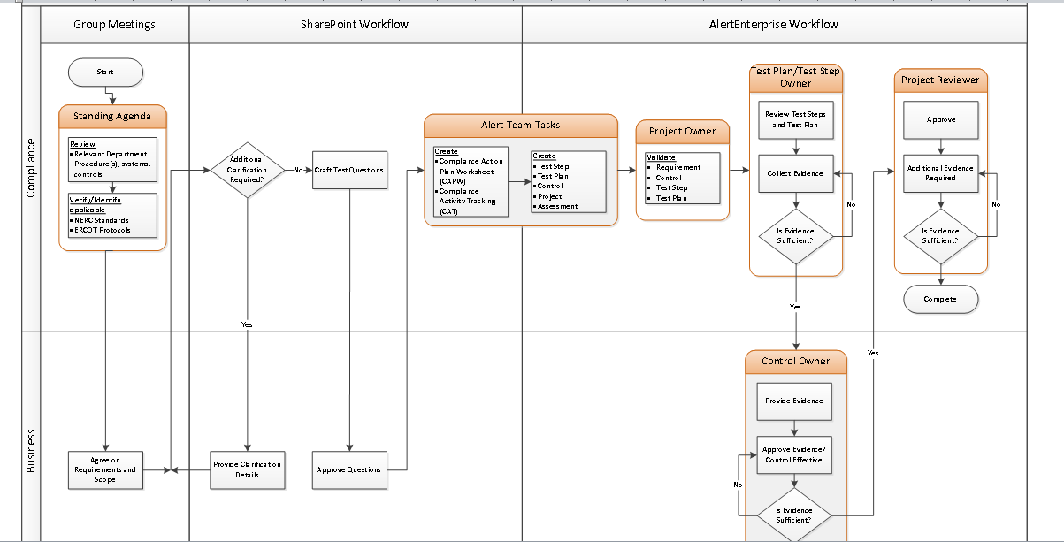
Partnering with Business Groups
EXAMPLE ONLY

Slide 6
Assessing controls

Slide 7
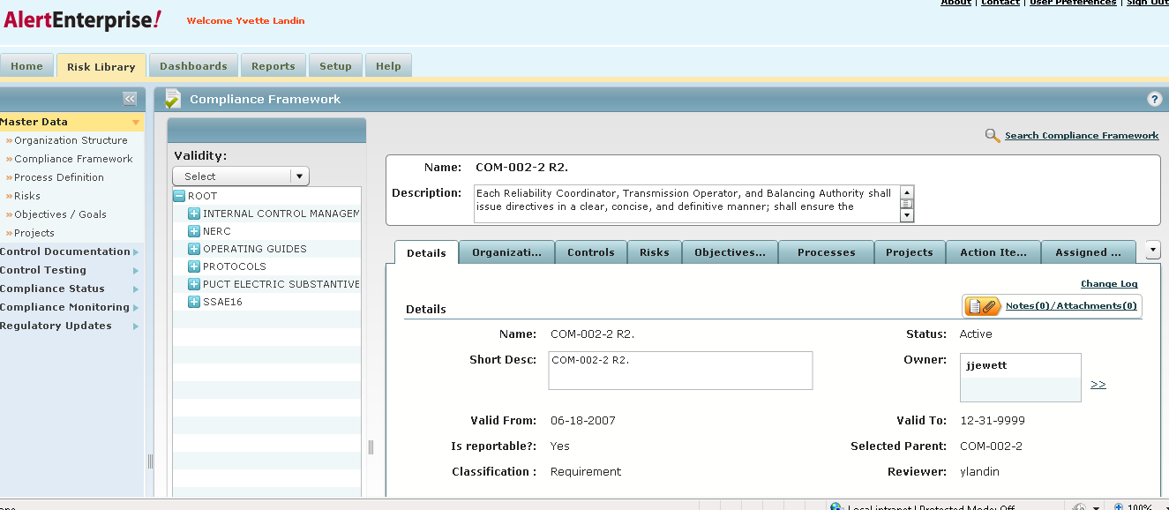
Compliance system – Requirement screenshot
EXAMPLE ONLY

Slide 8
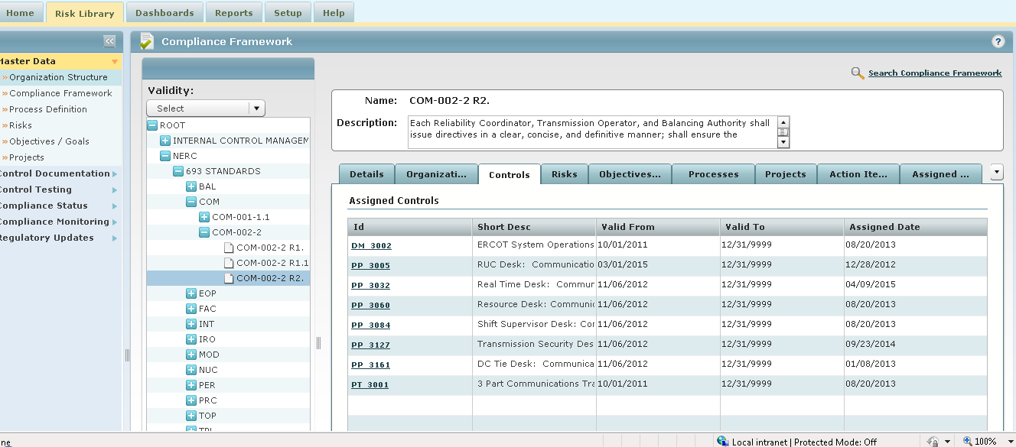
Compliance Requirement mapped to multiple Internal Controls
EXAMPLE ONLY

Slide 9
Internal Controls Assessments
ERCOT performs periodic “assessments” to verify controls are effective.
  Assessments are performed based on risk
ERCOT evaluates changes to requirements to ensure processes and controls are consistent with the changes.
ERCOT’s goal is to assess all NERC–related controls at least once per year.

Slide 10





Control Assessment Life Cycle
Business Analyst(s)
Reviews assessment questions and gathers evidence.
Compliance
Initiates changes and execution of assessments.
Business
Owner/Manager
Reviews and approves assessment and evidence.
Compliance
Final review, update in system as completed and effective.
Effective with Date

Slide 11
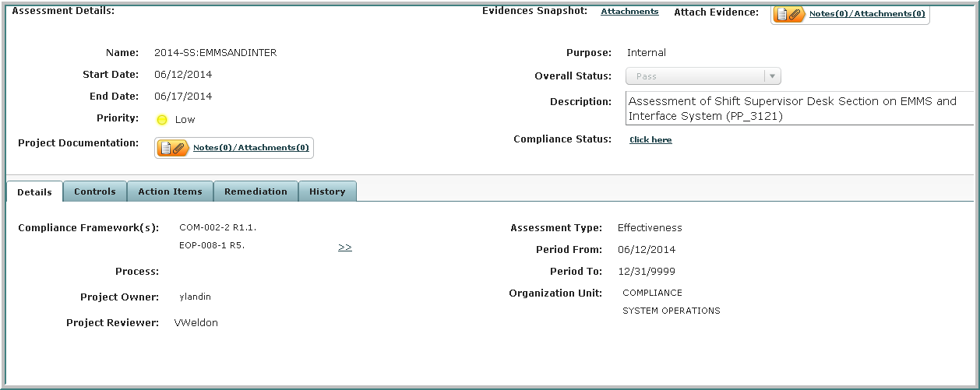
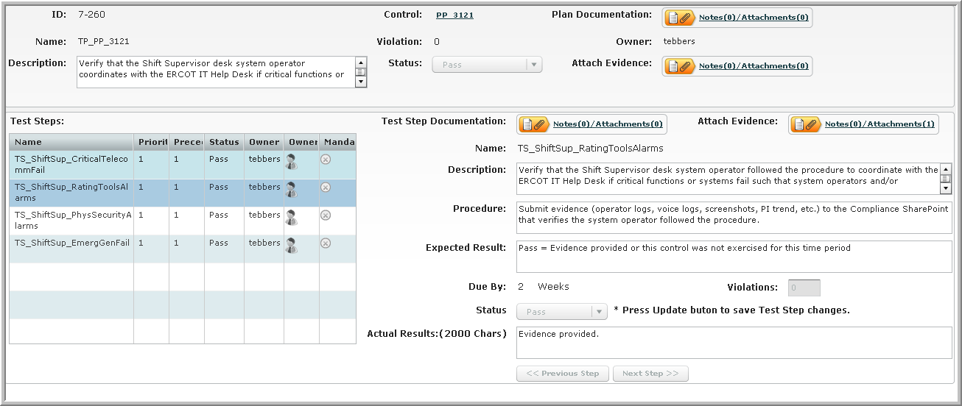
Example – Control Assessment
The screenshots below provide assessment details including the start date and the overall status and example of test questions to help determine if control is effective.
Control/procedure is verified, evidence attached, and “passed”

Slide 12
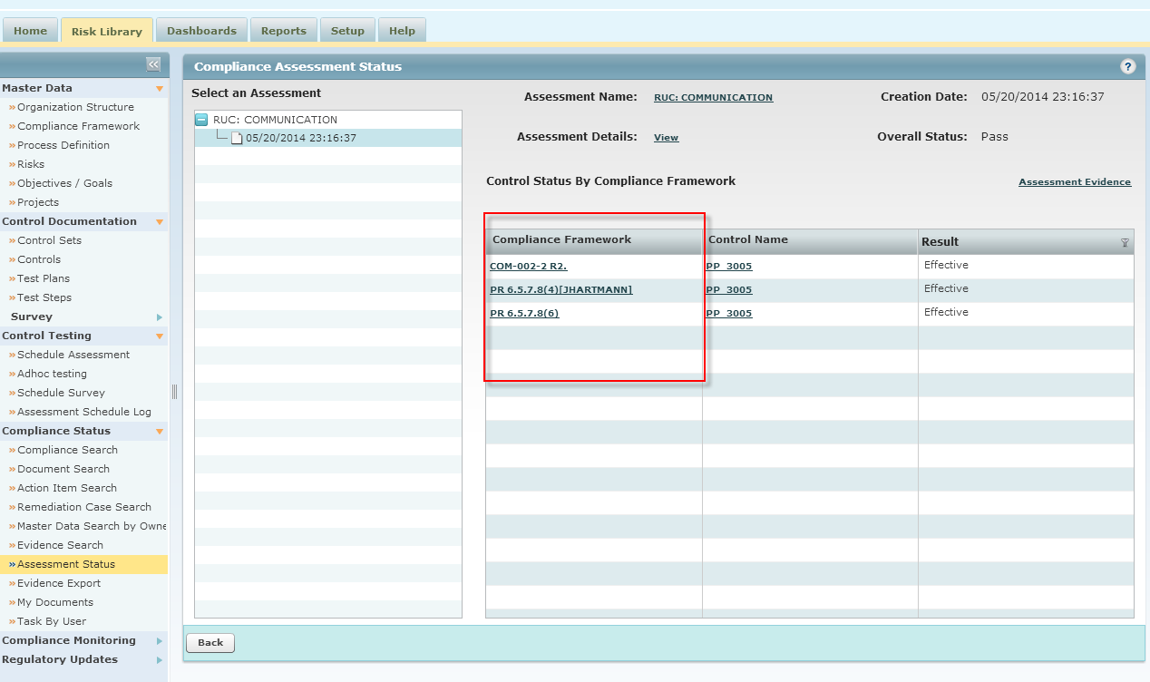
Example of Assessment of Control to Multiple Requirements
By testing this RUC procedure, you can assess/pass 3 requirements

Slide 13
Preparing for auditS

Slide 14
Compliance Risk Methodology and Results
Reqt Risk Factor
NERC CMEP
Audit History
4 Risk Levels
Self-Report
Critical - 163
High - 117
Med - 257
Low - 389

Slide 15
Risk Methodology and Results
Subset of NERC Requirements
Subset of
ERCOT Controls
ERCOT Compliance Risks
Controls inventory to prioritize and assess

Slide 16
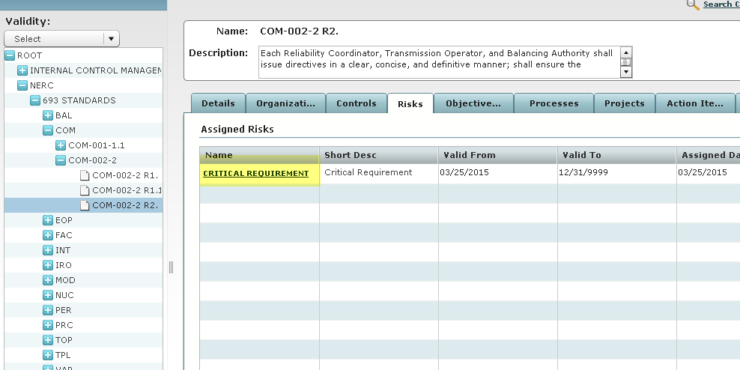
Critical Requirement (Focus on Risks)

Slide 17
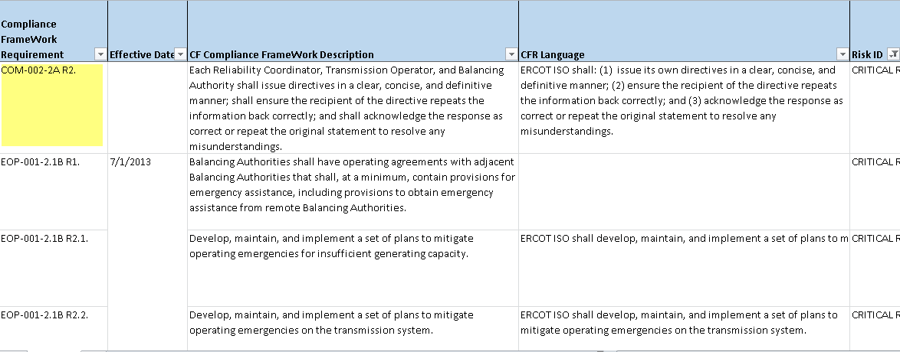
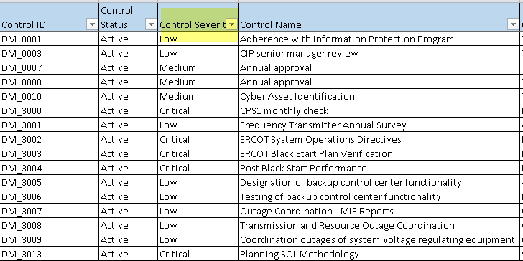
Reports of Critical Requirements and Controls

Slide 18
2015 Audit experience

Slide 19
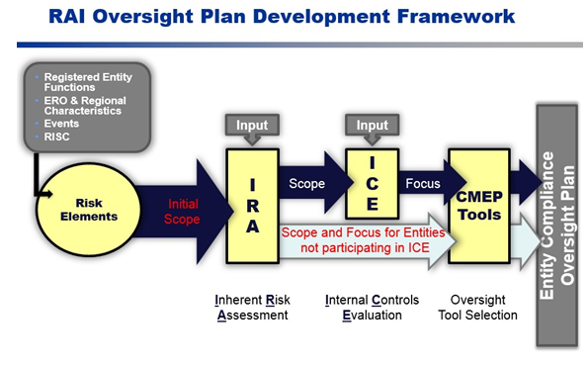
NERC changes in auditing
ERCOT 2015 Audit Scope
~1000 Requirements → IRA 26 requirements → ICE 20 requirements
Auditors will be off-site Sep 14-18 and on-site Sep 21-25

Slide 20
Audit timeline and details
January 2015 – RE advised ERCOT of being scheduled for Sept audit engagement.
Early May 2015 – RE advised ERCOT that IRA was complete and invited ERCOT to engage in ICE.
No interaction between ERCOT and RE during IRA evaluation
Audit scope was unknown at this point, but told it would be “focused”
ERCOT accepted voluntary ICE invitation
May 11, 2015 – ERCOT received ICE notice.
  18 weeks before audit
ICE scope for 26 requirements supporting 2 risk themes (represented the current scope of the forthcoming audit)
2-week deadline to respond with controls (provided powerpoint overview of controls program, applicable procedures/controls for each requirement, and listing of dates controls last assessed)
Three deliveries

Slide 21
Audit timeline and details (cont.)
June 5, 2015 – ERCOT received formal audit notice.
14 weeks before audit
Due date for RSAWs – July 16 (6-week turnaround time)
June 22, 2015 – ERCOT received formal audit scope reduction notice.
12 weeks before audit (3.5 weeks remaining until RSAWs due)
Output (benefit) of ICE was that 6 of 26 requirements were removed from scope of audit.
Received two round of questions (1-week turnaround time).
July 30
August 20
Did not receive third round of questions

Slide 22
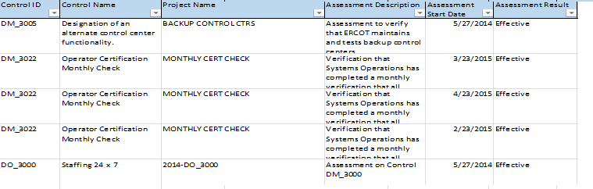
Specific to TexasRE ICE
Controls for ICE
ERCOT submitted the inventory of key controls mapped to requirements.
Assessments for ICE
In its submission package ERCOT included a summary of the assessment history for the related controls.
Overview of Internal Controls at ERCOT
GRC System, terminology, goals

Slide 23
Q & A
Yvette.Landin@ercot.com
Matt.Stout@ercot.com

