Slide 1

Ancillary Services Methodology Changes for 2016
Bill Blevins
Manager Operations Planning
WMS
07-OCTOBER-2015

Slide 2
Items for discussion
  Schedule
  Proposed changes to Regulation Service
  Proposed changes to Non-Spin Reserve Service (NSRS)
  Postings of AS Requirements

Slide 3
Schedule for discussion with Stakeholders
4-Sept | QMWG
17-Sept | OWG
7-Oct | WMS
8-Oct | ROS
29-Oct | TAC
08-Dec | BOD
Notes:
3.16 Standards for Determining Ancillary Service Quantities
The ERCOT Board shall review and approve ERCOT's methodology for determining the minimum Ancillary Service requirements, the monthly percentage of Load Resources, Controllable Load Resources and DC Ties allowed to provide RRS, and the maximum amount of Reg-Up and Reg-Down that can be provided by Resources providing FRRS-Up and FRRS-Down.
Last done by BOD Dec 2014.

Slide 4
Discussions at QMWG/OWG on Reg-Service
  Members were in general agreement with the proposed changes to Regulation Service
  Some members requested additional data which has been posted to the September 4th QMWG meeting page.

Slide 5
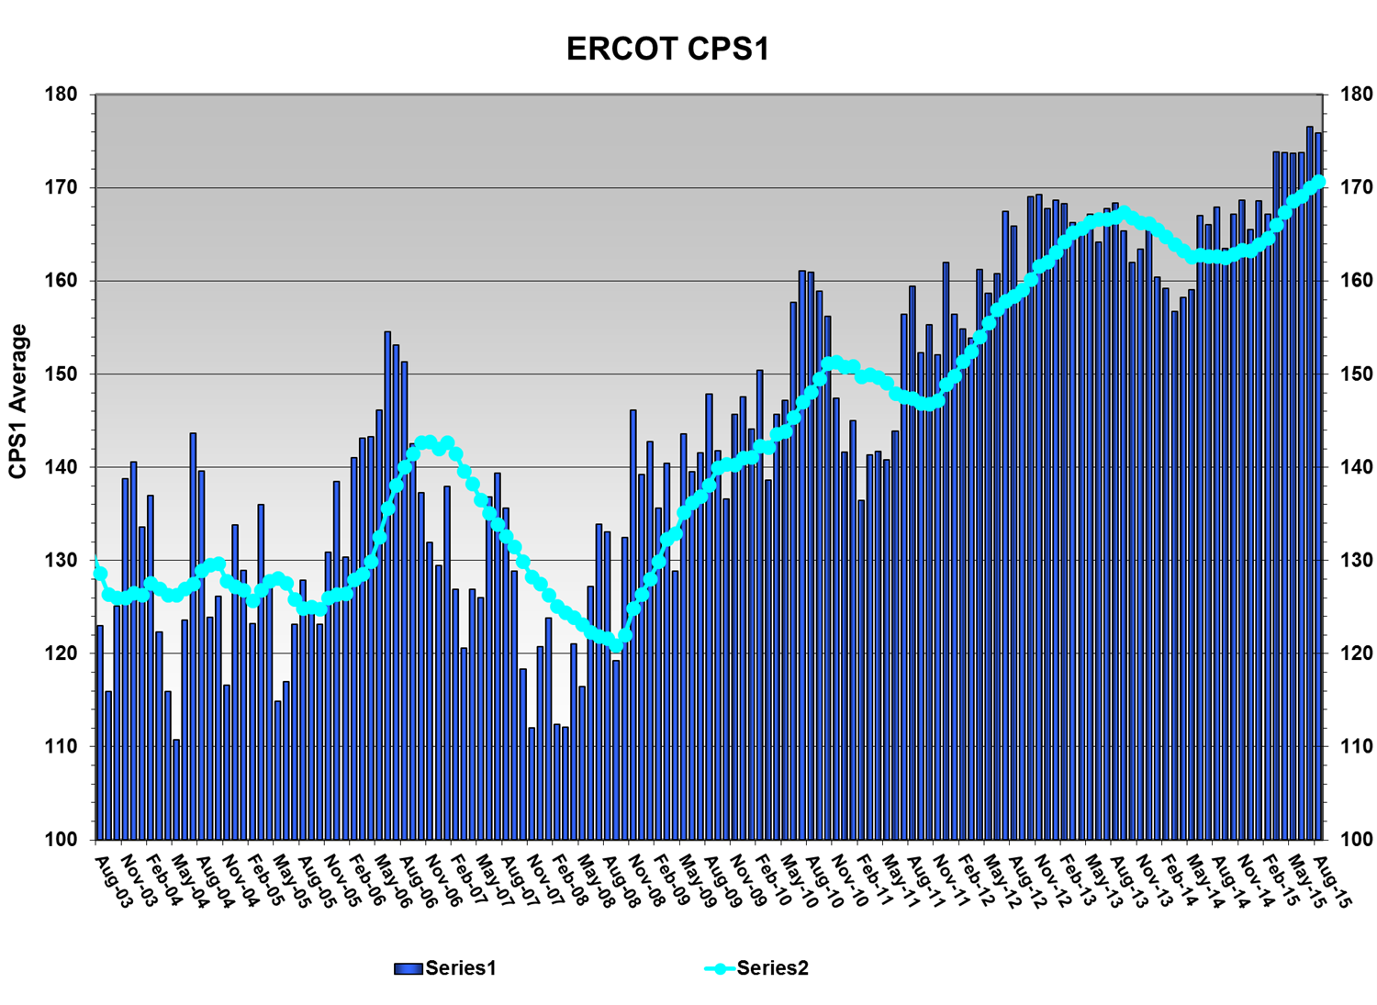
Regulation Performance-CPS1 Score
ERCOT has to maintain rolling 12 months average CPS1 Score above 100% Per NERC standard BAL-001-1

Slide 6
Drivers for changes to Regulation Requirements
CPS1 is significantly higher than required and on an increasing trend.
By using last 30 days, transition months tend to drive requirements for the following month. (e.g. April is used to set quantity for June)
Extreme events tend to drive over-procurement for a particular hour in subsequent months, even though the event is unlikely to repeat.
Significant changes in regulation requirements from one hour to the next, which may not be necessary.

Slide 7
Possible Changes to Regulation Service
  Remove consideration of the last 30 days from Regulation Analysis and instead use the Regulation data using same month of the previous two years. (e.g. April 2014 and April 2015 to calculate April 2016 requirements)
  Use five minute average instead of one minute average regulation deployment for exhaustion rate.
  Use 95th percentile of 5 minute net-load/deployments instead of 98.8th percentile.
  Update the GE Tables
  Increase CPS1 trigger to 140% instead of 100%
Notes:
Item D. is a metric so that using the 95th percentile will not decrease regulation if CPS1 scores significantly . This adjustment will be applied to the month that scored below 140% unless the rolling average goes below 140% and then it will be applied to the next month until the rolling 12 month CPS1 average increases above 140%.

Slide 8
Reg-Up Requirement for Jan. 2015
A: Use data from the same month of last 2 years
B: 5-min exhaustion rate
C: 95th percentile

Slide 9
Reg-Up Requirement for Apr. 2015
A: Use data from the same month of last 2 years
B: 5-min exhaustion rate
C: 95th percentile

Slide 10
Reg-Up Requirement for June 2015
A: Use data from the same month of last 2 years
B: 5-min exhaustion rate
C: 95th percentile

Slide 11
Proposed Regulation-Up Requirement
A: Use data from the same month of last 2 years
B: 5-min exhaustion rate
C: 95th percentile

Slide 12
Proposed Regulation-Down Requirement
A: Use data from the same month of last 2 years
B: 5-min exhaustion rate
C: 95th percentile

Slide 13
Discussion at QMWG/OWG on Non-Spin Service
  Members had more questions on Non-Spin Reserve service and in general they covered the below topics;
    Whether or not there is a need for NSRS due to ORDC payments
    Effect of changing the forecast error to 3-hours ahead instead of current 6-hours ahead
    Number of units that can be started 6-hours ahead compared to 3-hours ahead
    Wanted to see the incremental effect of each of the proposed changes to NSRS
    Additional data requested has been posted to the September 4th QMWG meeting page.

Slide 14
Drivers for NSRS Changes
Feedback we received last year to revisit NSRS Methodology
Incorporate effects of net load ramps

Slide 15
Suggested Changes to Non-Spin Service
  Remove last 30 days from NSRS Analysis and instead use the same month for previous three years
  Use the 3-hour ahead net forecast error instead of 6-hour ahead
  Use net forecast error only on the under-forecast
  Use dynamic percentile between 70th and 95th percentile based on the risk of net load ramp

Slide 16
Possible Changes to Non-Spin Reserve Service(NSRS)
 | Current Methodology | Proposed Methodology
Data Used
Forecast | 6hour-ahead Net Load Error | 3hour-ahead Net Load Error
Over & Under Forecast | Both | Under Forecast
Percentile | 95th | Dynamically determined based on risk of net load ramp
Cap | 2000MW | No Cap
Floor | 1375 MW (Peak Hours) | 1375 MW (Peak Hours)
15 days
Not considered
Same Period
Previous Year
30
Same Period
Previous 3 Years
30
30
30
30
15
30
30
30days prior to study
Target Period
Target Period

Slide 17
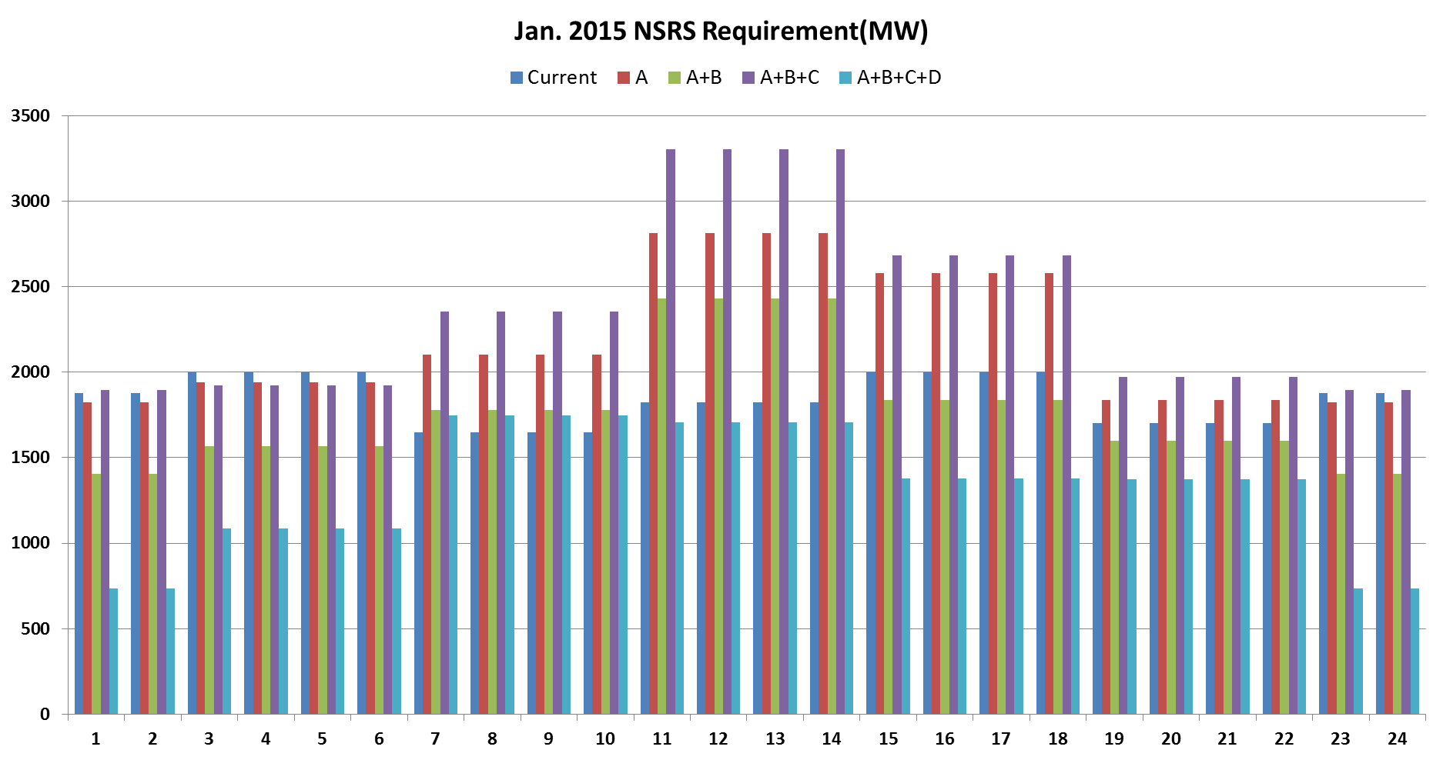
Proposed NSRS Requirement
A: Same month of last 3 years
B: Use 3-hour ahead forecast error C: Use net under-forecast only D: Use dynamically determined percentile based on risk of net load ramp

Slide 18
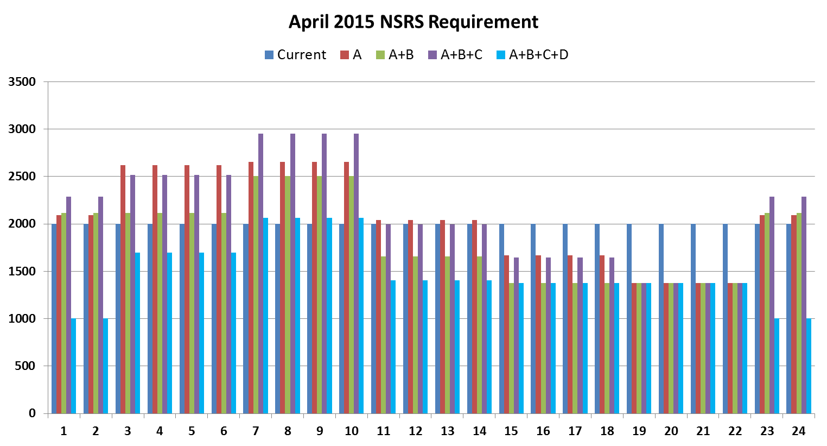
Proposed NSRS Requirement
A: Same month of last 3 years
B: Use 3-hour ahead forecast error C: Use net under-forecast only D: Use dynamically determined percentile based on risk of net load ramp

Slide 19
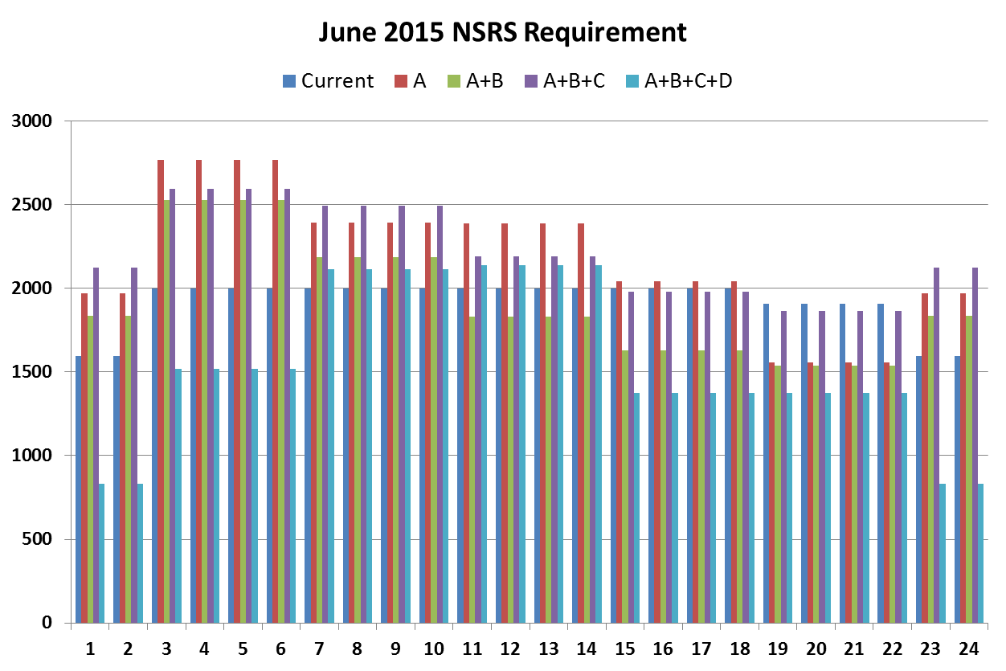
Proposed NSRS Requirement
A: Same month of last 3 years
B: Use 3-hour ahead forecast error C: Use net under-forecast only D: Use dynamically determined percentile based on risk of net load ramp

Slide 20
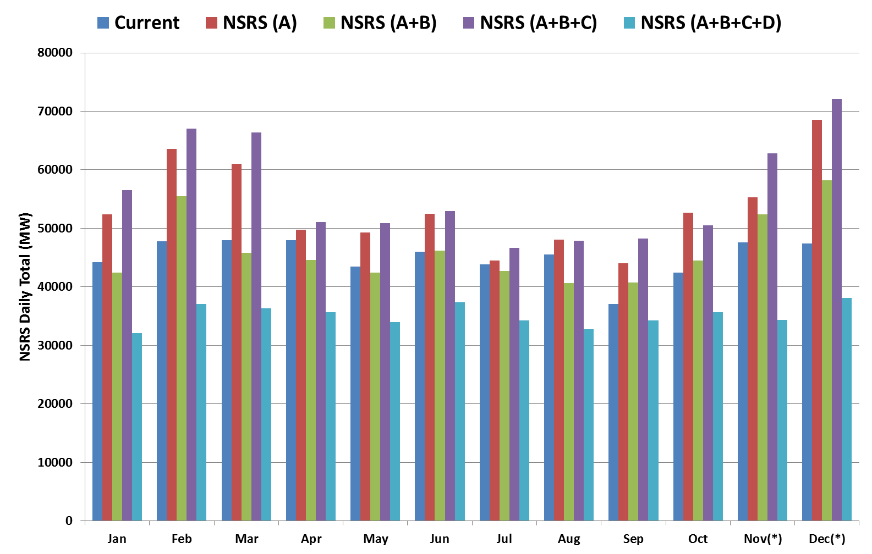
Proposed NSRS Requirement

Slide 21
Comparison NSRS Procurement change
Current Methodology
Proposed Methodology
Notes:
Font sizes should be increased if possible

Slide 22
Posting of AS Requirements
  Responsive Reserve is already posted in December for the next year.
  Regulation for each month can be posted for the next year in December.
  NSRS for each month can be posted for the next year in December.
Notes:
Font sizes should be increased if possible

Slide 23
Discussion

Slide 24


NSRS Net Load Ramp – Up and Risk Factor
Net Load Ramp-Up is the increase in Net Load over an hour.
$$Net Load Ramp−Up Risk Factor= \frac{Net Load Ramp−Up}{Seasonal Ramp−Up Peak}$$
The Net Load Ramp–Up Risk Factor is calculated by normalizing hourly ramp-up values by seasonal peak value
The Net Load Ramp-Up Risk Factor is averaged over 4 hour blocks.

Slide 25
How is Risk Factor Used
Higher Risk Factor corresponds to a higher Percentile value for the Net Load Forecast Error.
Notes:
Give example
Select one high risk
One low risk

