Slide 1
Update to RMS
October 6th, 2015

Slide 2
RMGRR129 – Revision to Customer Rescission Completion Timeline – REMINDER
Timely execution of a customer rescission after completion of a switch transaction.
Gaining CR submits timely Rescission MT
Losing CR is provided two (2) Business Days to ‘agree’ and transition the Rescission MT
Losing CR shall submit the appropriate back-dated Move-In transaction (BDMVI) within another (2) days of the TDSP updating the MT status to “ready to receive”
Effective date was October 1st

Slide 3
RMGRR 133 – Clarification of Inadvertent Gain Valid/Invalid Reject Reasons - VOTE
Minimize confusion of valid reject reasons to improve the resolution time for Inadvertent Gain MarkeTraks.
Propose to strike the current language for valid reject/unexecutable reason (c) “Losing CR has confirmed Customer’s intent to change REPs” where CRs are interpreting and rejecting MTs

Slide 4
RMGRR 133 – Clarification of Inadvertent Gain Valid/Invalid Reject Reasons - VOTE
IMPACTS
This leads to various MTs being rejected and the gaining CR with balances for which they may not be able to collect
Proposed changes will minimize “bad actor” behavior and “gaming” of the system by customers.
SUGGESTIONS
Since the losing CR has the authority to hold the occupant of the premise responsible, it is suggested a ‘current occupant’ process be followed if the losing CR’s customer indicates their REP of choice is not the losing CR. The customer always has the right to select another provider.

Slide 5
RMGRR 133 – Clarification of Inadvertent Gain Valid/Invalid Reject Reasons - VOTE
Minimize confusion of valid reject reasons to improve the resolution time for Inadvertent Gain MarkeTraks.
Proposed language for the gaining CR has also been clarified to read “The gaining CR has confirmed with the customer that the customer’s REP of choice is the gaining CR”
The intent is for the Gaining CR to reach out to their customer informing them of the IAS and have the customer confirm their REP of choice

Slide 6
MarkeTrask TaskForce: Updates
Inadvertent Gain Reporting – Impact by REP
Reviewed proposed reporting metrics as developed by ERCOT and market participants
With the proposed format, all CRs will be represented on a single sheet, either
in the top bar graph depicting CRs whose percentage is >1%
tallied in the matrix below within a respective % bucket <1%
1% represents slightly below the market average % to serve as a GOAL
ERCOT will provide monthly reporting until the end of 2015. At that time, it will be evaluated if reporting will be effective on a quarterly basis

Slide 7
June 2015 – IAG/IAL % Greater Than 1% of Enrollments
1,485 Total IAG+IAL
# of Enrollments
Gaining REP by total IAG+IAL count (Low to High)
IAG/IAL % Less Than 1% of Enrollments - 1,837 Total IAG+IAL
Retail Electric Provider Counts
 | Percent of Enrollments Resulting in IAG/IAL
Enrollment Total | .00% to .25% | .26% to .50% | .51% to .75% | .76% to 1.00%
<= 500 | 2 | 2 | 5 | 3
> 500 and <= 2500 | 3 | 1 | 2 | 5
> 2500 | 1 | 5 | 6 | 8

Slide 8
MarkeTrak Documentation
http://www.ercot.com/services/client_svcs/mktrk_info/index.html
http://www.ercot.com/content/meetings/rms/keydocs/2014/0110/08.__RMS_MarkeTrak_Task_Force_20140104.ppt
http://www.ercot.com/content/meetings/rms/keydocs/2014/0603/07.__RMS_MarkeTrak_Task_Force_20140603.ppt
http://www.ercot.com/content/meetings/rms/keydocs/2014/1028/07.__RMS_MarkeTrak_Task_Force_20141028.ppt
http://www.ercot.com/content/meetings/rms/keydocs/2015/0106/09.__RMS_MarkeTrak_Task_Force_20150106.ppt
http://www.ercot.com/committees/board/tac/rms/marketraktf/index.html
http://www.ercot.com/content/committees/board/tac/rms/marketraktf/keydocs/2014/PR010_03_training_FINAL.ppt
http://www.ercot.com/content/wcm/training_courses/97/MarkeTrak_Detailed_Training_102014.ppt
http://www.ercot.com/committees/board/tac/rms/marketraktf/MarkeTrak SubTypes Quick Reference 20150510 v2
Link to IAG/Rescission training: http://www.ercot.com/committees/board/tac/rms/marketraktf/index.html/MarkeTrak IAG Training
User Guide
Bulk Insert Templates
MarkeTrak Workflows
MarkeTrak Tips and Tricks
MarkeTrak API WSDL/XSD
Also direct link from MarkeTrak tool

Slide 9
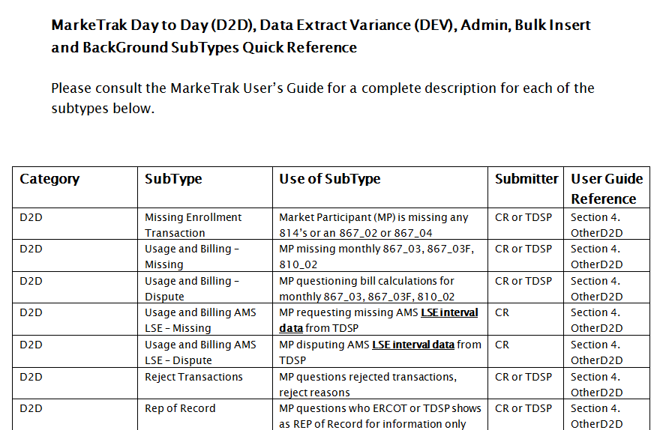
MarkeTrak Documentation
http://www.ercot.com/committees/board/tac/rms/marketraktf/MarkeTrak SubTypes Quick Reference 20150510 v2

Slide 10
Questions
Next Meeting:
Will be scheduled on an as-needed basis

