Slide 1
Advanced Metering Working Group (AMWG)
Update to RMS
October 6, 2015

Slide 2
Noteworthy September Meeting Items
SMT performing maintenance on the 1st and 3rd Sunday/month (includes patching)
Reviewed initial revisions to the AMWG CR processes
Additional revisions/comments to be reviewed at October AMWG
Disaster recovery exercise occurred 8/21-8/22 and 8/28-8/29…no issues, but some challenges
Next DR exercise is October 23 & 24, October 30 & 31

Slide 3
Improving 3rd Party Access to SMT Workshop II
October 16th @ ERCOT Met Center Room 206
Room 206 9:30 a.m. – 1:00 p.m.
Agenda preparations continue

Slide 4
Change Request Update
CR 2015-033: revised cost estimate in progress
CR 2015-041: delayed at AMWG, needs scope and cost revisions
CR2013-017: deemed complete, previous status was interim

Slide 5
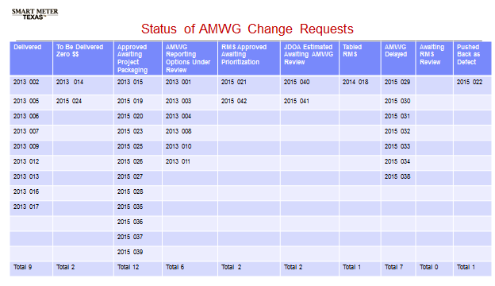
Change Requests (CRs)

Slide 6
Selected SMT Statistics - August
SMT Help Desk Calls 714 (-257)
SMT Help Desk Tickets 695 (-170)
Residential = 623(-145)
GUI access issues = 221 (-71)
Registration issues = 244 (-24)
SMT Registered Users (Res) 61,176 (+1,111)
ESIs in SMT 7,060,198 (+11,216)
Active Meters in SMT 6,990,921 (+12,957)

Slide 7
August Stats – Cont.
Energy Data Agreements 337 (+88)
AEPN = 1; CNP = 79; Oncor = 257
HAN Device Agreements 389 (NC)
HAN Devices 9,651 (+183)
3rd Parties Registered @ SMT 59 (-7)
REPs Registered @ SMT 98 (NC)
On Demand Reads
Customers 4,803
REPs 21
3rd Party 2

Slide 8
2015 Meetings
Monthly, alternating between in-person and WebEx
Next meeting is October 21nd, 9:00 – 3:30
WebEx only
Remaining meetings for 2015:
November 17th – Room 209 at ERCOT
December 15th – WebEx only

Slide 9
Questions?

