Slide 1
AEPSC Live Oak County Transmission Project – ERCOT Independent Review
TAC
September 24, 2015

Slide 2
Project Background
Load growth in Live Oak and Bee Counties has created the need for transmission improvements in the area
With the present transmission system, it is difficult to schedule maintenance even during off-peak seasonal conditions
In October 2013, approximately 80 MW of load was lost across seventeen substations due to a single contingency during a maintenance outage
AEPSC submitted a project for Regional Planning Group review and comment in March 2015

Slide 3
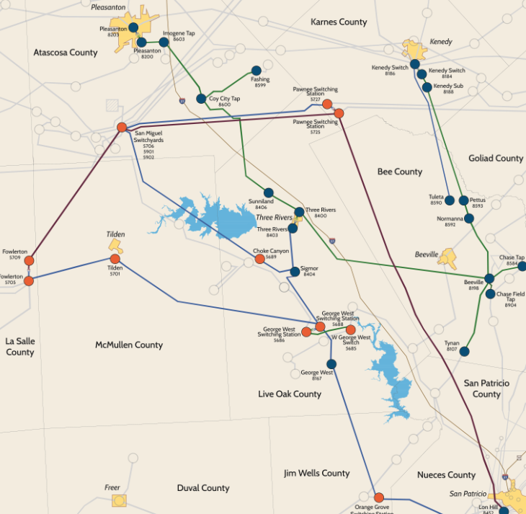
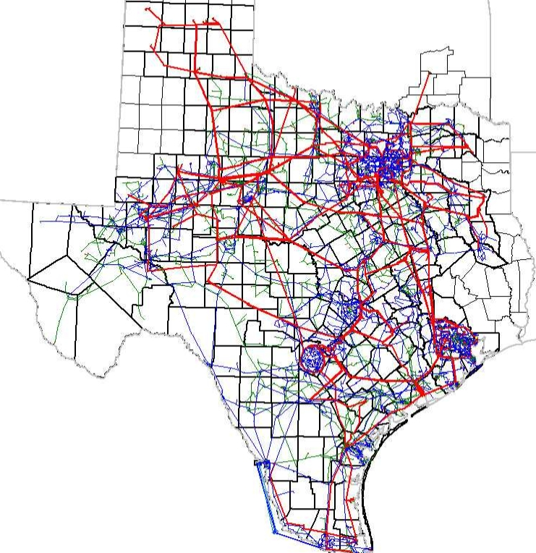

Slide 4
ERCOT Independent Review Reliability Analysis
G-1 N-1 Contingency Results (summer peak cases)
N-1-1 Contingency Results (2017 minimum load case)
Branch | Loading in 2018 | Loading in 2021
San Miguel – Choke Canyon 138 kV | 107% | 113%
Choke Canyon – Sigmor 138 kV | 103% | 109%
Normanna - Pettus 69 kV | 100% | 103%
Normanna - Beeville 69 kV | 99% | 103%
Branch | Worst Contingency Loading
Pleasant – Imogene Tap 69 kV | 102%
Coy City – Imogene Tap 69 kV | 102%
Bus Name | Bus Voltage
Choke Canyon 138 kV | 0.88
Three Rivers 138 kV | 0.88
Sigmor 138 kV | 0.88

Slide 5
ERCOT Recommendation
ERCOT evaluated five options to solve the reliability criteria violations
ERCOT will seek Board endorsement of Option 4:
Construct a new 138 kV Beeville Substation near to the existing Beeville 69 kV Substation
Install a new 138/69 kV transformer at the new Beeville 138 kV Substation
Construct a new 138/69 kV double circuit transmission line from Tuleta to Beeville. Utilize the existing Right of Way of the Pettus – Normanna – Beeville 69 kV transmission line where possible
Using existing Right of Way where possible, rebuild and convert the existing Beeville – Three Rivers 69 kV transmission line to 138 kV
The cost estimate is $74.5 million

