Slide 1
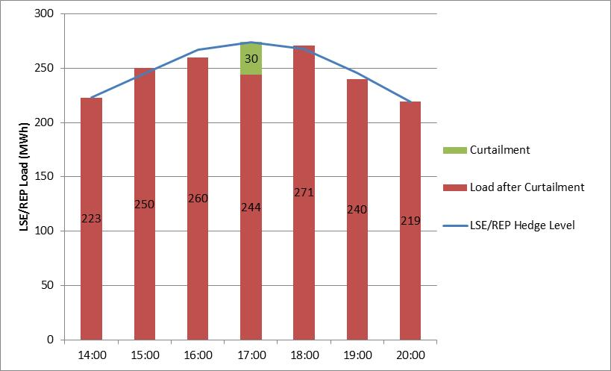
How would LMP-Proxy $G work?
HEDGED
ERCOT Settlement for HE17
ERCOT charges LSE/REP RTEIAMT based on 274MWh
RTEIAMT settlement is $0 due to hedges
ERCOT credits LSE/REP 30MWh x Proxy $G
ERCOT credits CSP 30MWh x $920 (RTSPP – Proxy $G)
Proxy $G = $105/MWh
(POLR)
RTSPP = $1,025/MWh
CSP is settled for the curtailment quantity at LMP-Proxy $G
LSE/REP is settled like they served the load at the POLR rate

Slide 2
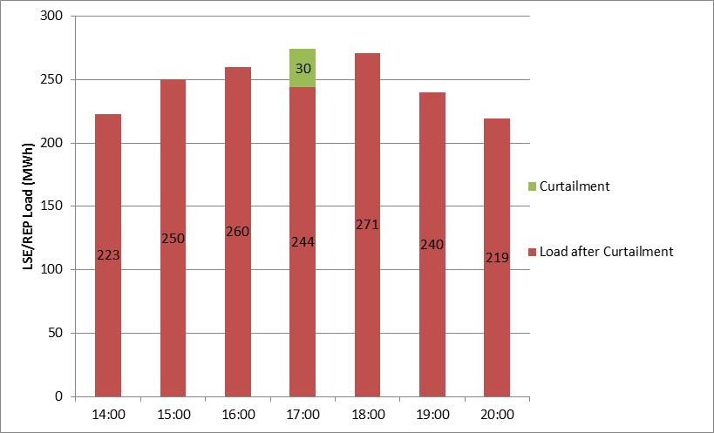
How would LMP-Proxy $G work?
UNHEDGED
ERCOT Settlement for HE17
ERCOT charges LSE/REP RTEIAMT based on 274MWh
RTEIAMT settlement charge is 274MWh x $1,025/MWh
ERCOT credits LSE/REP 30MWh x Proxy $G
ERCOT credits CSP 30MWh x $920 (RTSPP – Proxy $G)
Proxy $G = $105/MWh
(POLR)
RTSPP = $1,025/MWh
CSP is settled for the curtailment quantity at LMP-Proxy $G
LSE/REP is settled like they served the load at the POLR rate

