Slide 1
ERCOT MARKET EDUCATION
Retail 101

Slide 2
Overview
  Topics in this lesson . . .
  Two Basic Definitions
  Market Relationships
  Roles and Responsibilities
    ERCOT
    REPs
    TDSPs
    PUCT

Slide 3
Two Basic Definitions

Slide 4
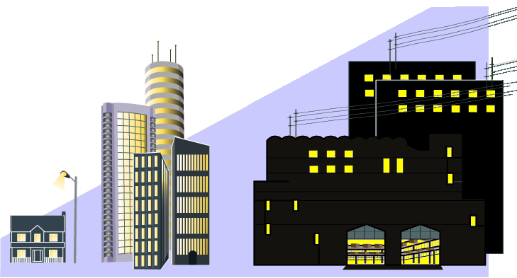
Two Basic Definitions
Premise – A Service Delivery Point or combination of Service Delivery Points that is assigned a single identifier for Settlement and registration.
  Typically metered
  Might be unmetered
    Street Lights
    Traffic Lights
    Billboards

Slide 5

Two Basic Definitions
ESI ID – The unique identifier assigned to each Premise.
Used for all Retail Communications in ERCOT
  Enrolling customers
  Switching Retail Providers
  Load Metering
Retail Electric Provider (REP)

Slide 6
Market Relationships

Slide 7

Market Participants
  Who are the Players?
QSE
  Qualified Scheduling Entities
LSE
  Load Serving Entities
  Transmission and/or Distribution Service Providers
TDSP
Resource
Entity
  Resource Entities
Notes:
Before, we go any further, let’s introduce the players in the Market. This is a list of all of the entities who must register with ERCOT. Over the next few slides, we will look at how these players fit into the overall market structure and focus on the relationships between them.

Slide 8
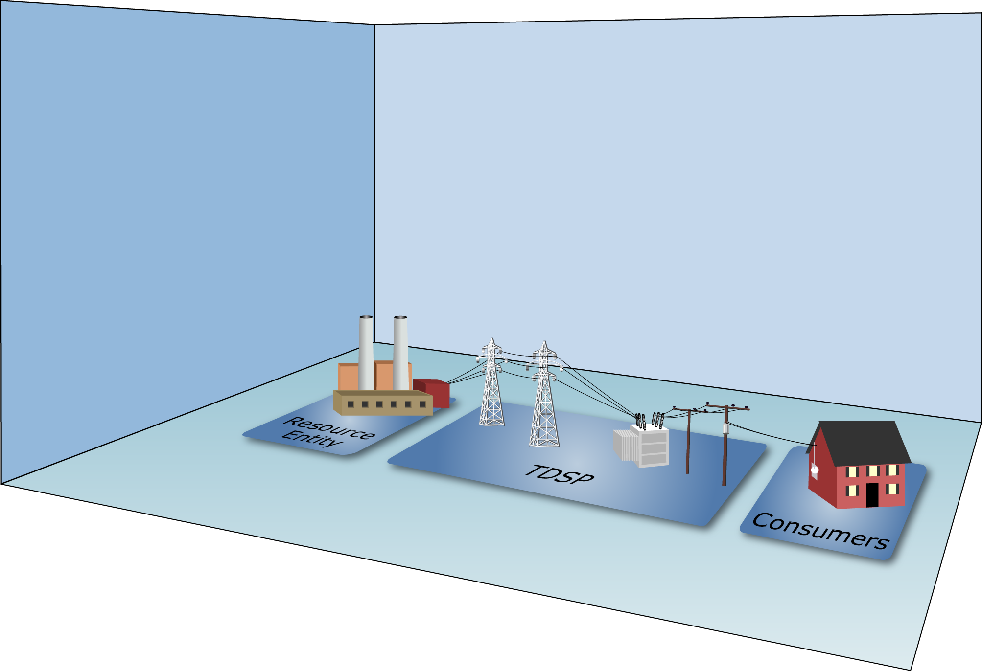
Market Relationships

Slide 9
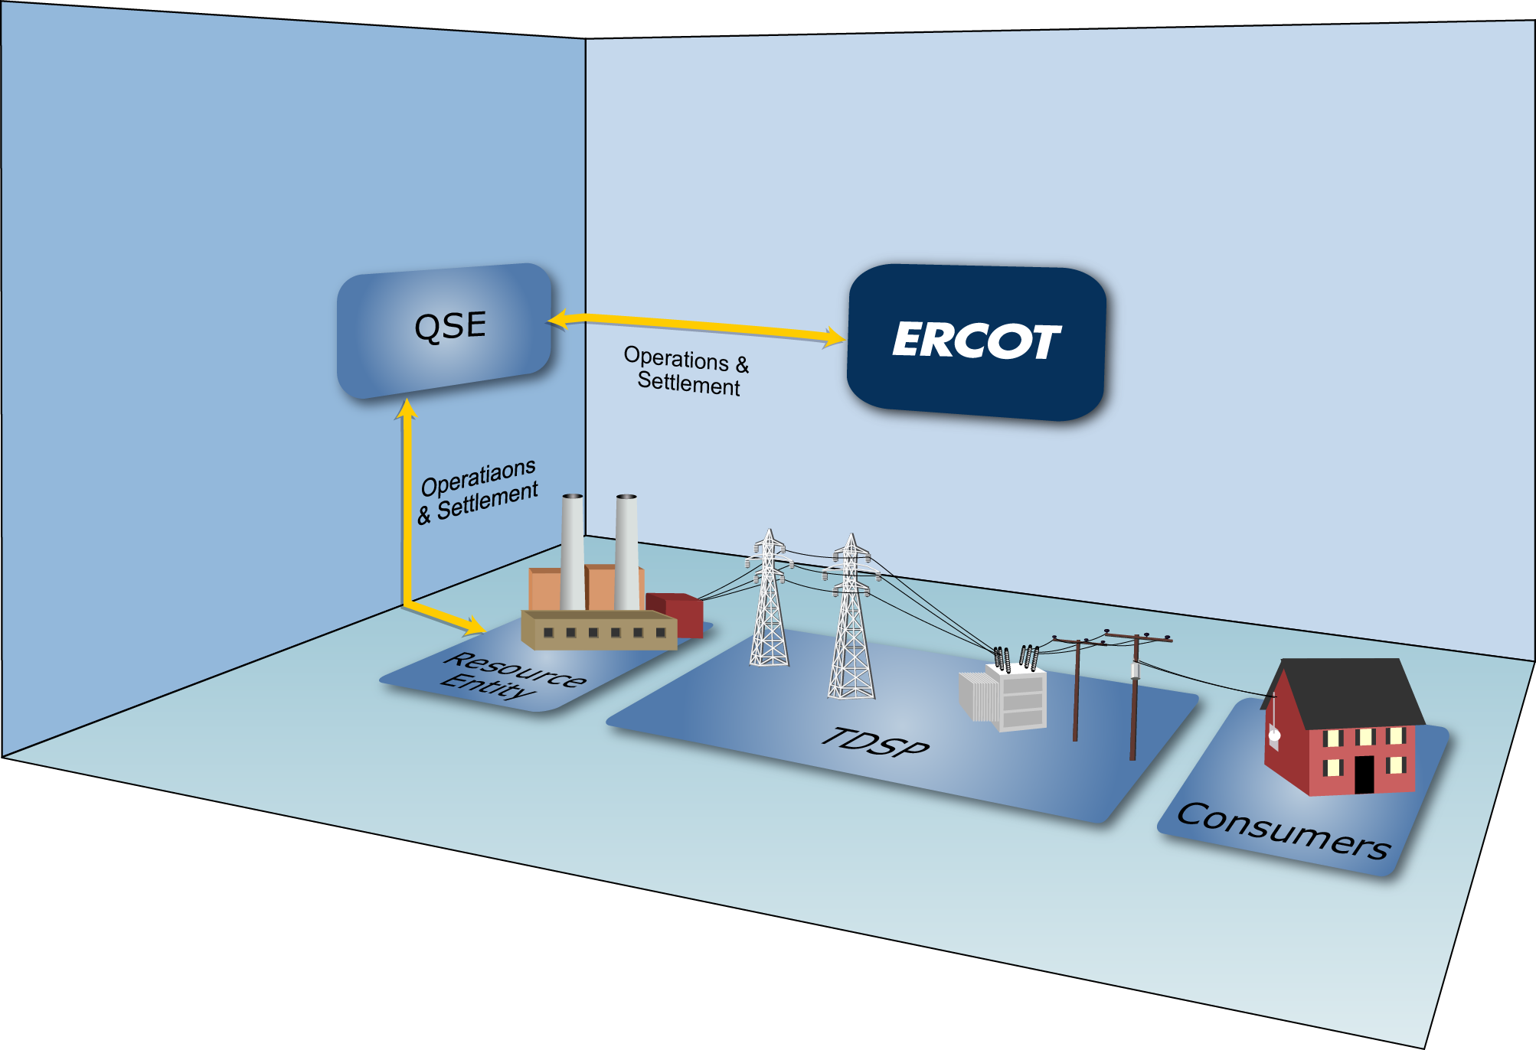
Market Relationships

Slide 10
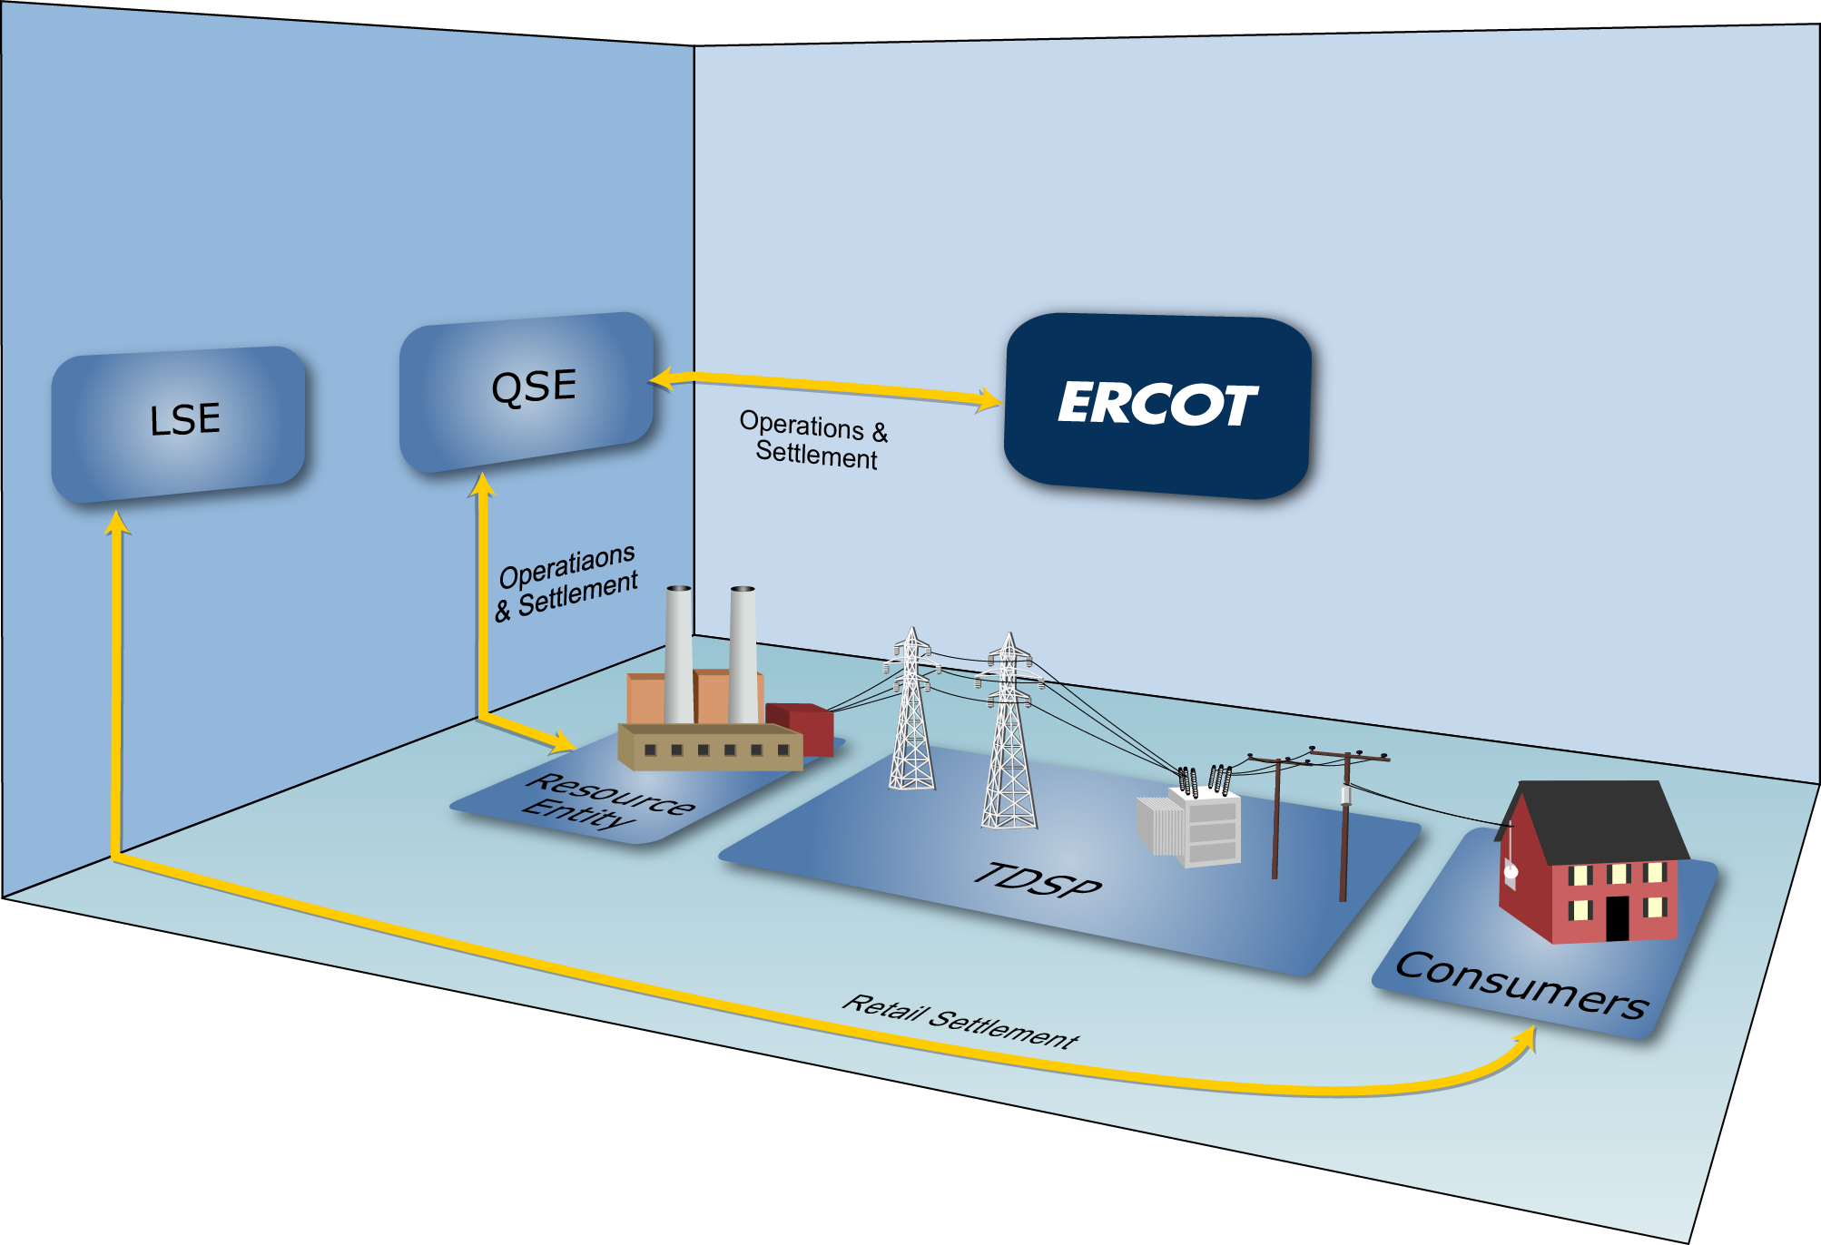
Market Relationships

Slide 11

Market Relationships

Slide 12
Market Relationships
A Load Serving Entity (LSE) provides electrical service to end-use customers
Notes:
Load serving entities (LSEs) provide electric service to end-use customers. As mentioned in defining the audience for this course, LSEs include:
Retail Electric Providers – entities that sell electric energy to retail customers in the areas of Texas where the sale of electricity is open to retail competition
Electrical Cooperatives – businesses owned by the people who use their services
Municipally-Owned Utilities – providers owned by the municipalities they serve

Slide 13

Market Relationships
Types of LSEs:
  Retail Electric Providers
  Electrical Cooperatives
  Municipally-Owned Utilities
Notes:
LSEs include:
Retail Electric Providers – entities that sell electric energy to retail customers in the areas of Texas where the sale of electricity is open to retail competition
Electrical Cooperatives – businesses owned by the people who use their services
Municipally-Owned Utilities – providers owned by the municipalities they serve

Slide 14


Market Relationships
Types of LSEs:
  Retail Electric Providers
  Electrical Cooperatives
  Municipally-Owned Utilities

Slide 15
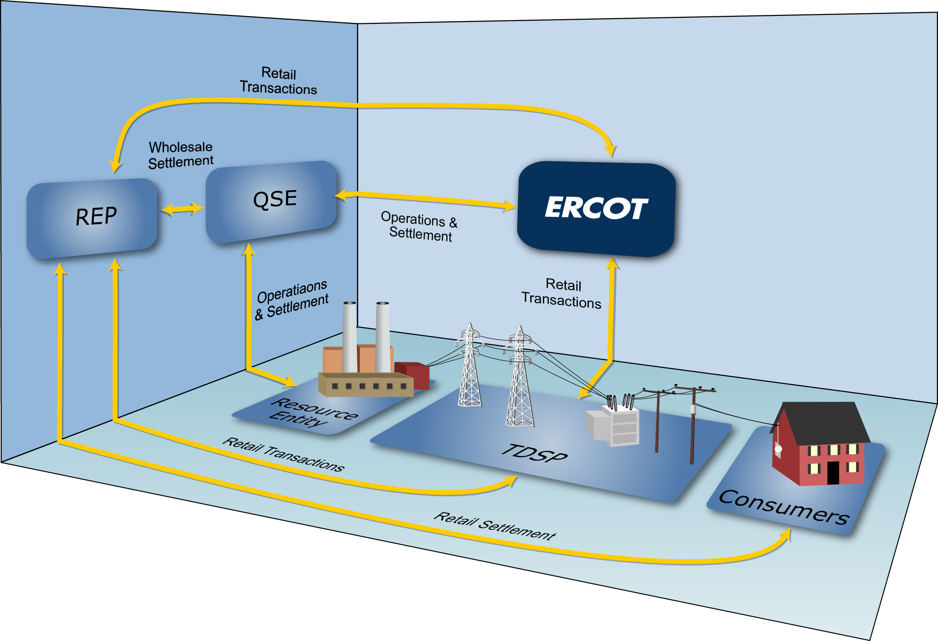
Market Relationships

Slide 16
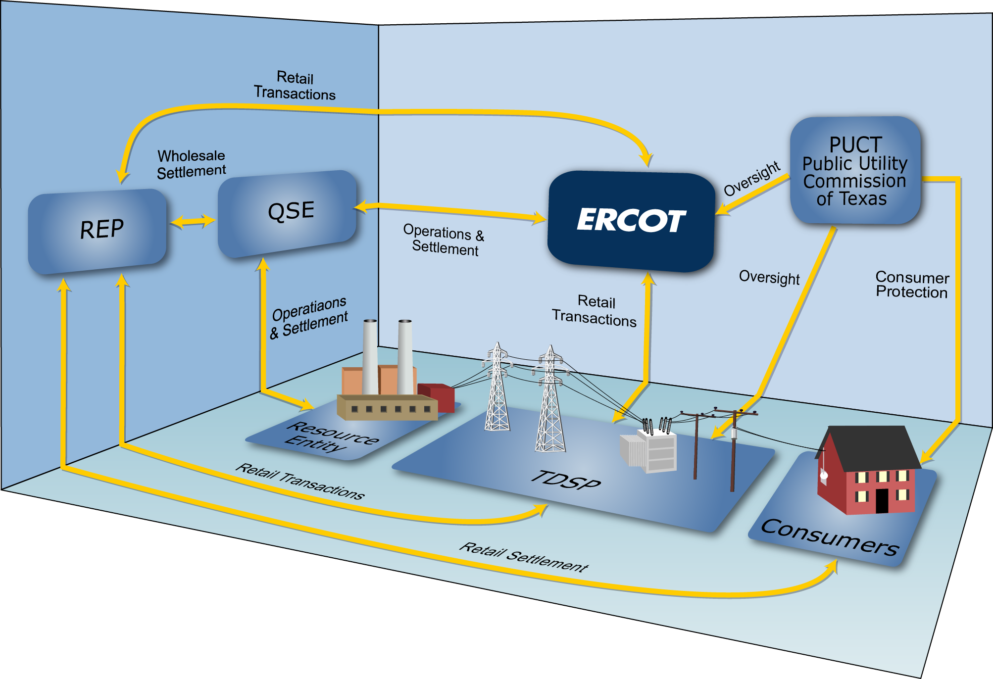
Market Relationships

Slide 17
Roles and Responsibilities

Slide 18

ERCOT Responsibilities
ERCOT’s Primary Responsibility is Reliability
Match generation with demand
Operate transmission system within established limits
Execute competitive markets for reliability services
Notes:
ERCOT’s primary responsibility is to ensure the day-to-day reliability of the ERCOT Transmission Grid. To achieve reliability, ERCOT must match generation output and system demand, and make sure that the transmission system is operating within its established limits.
This process requires continual dispatch of generation to meet the rise and fall in system demand.
In order to be able to perform this dispatch at the least cost, ERCOT executes competitive markets to purchase energy and capacity services needed to reliably serve the system demand.

Slide 19
ERCOT Responsibilities
Customer Registration
Qualified Scheduling Entity (QSE)
ERCOT facilitates registration and switching of Retail Customers
Retail Electric Provider (REP)

Slide 20
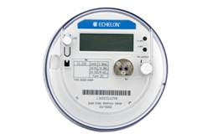
ERCOT Responsibilities
Wholesale Market Settlement
Adjusted Metered Load (QSE)
Qualified Scheduling Entity (QSE)
Retail Electric Provider (REP)
Unaccounted For Energy (UFE)
Losses
Meter Data

Slide 21




REP Responsibilities
Maintain Retail Customers
Negotiate competitive contracts with Retail Customers
Manage Retail Customer’s ESI IDs
Provide Retail Customer contact information to TDSP

Slide 22





REP Responsibilities
Financial Responsibilities
Pay and/or Dispute invoices
  QSE for wholesale power costs
  TDSPs for wires costs
Invoice Retail Customers for their monthly usage

Slide 23
REP Responsibilities
Forensic Responsibilities
Work with TDSPs and other REPs to resolve Inadvertent Gains and Losses
REP #1
REP #2

Slide 24
TDSP Responsibilities
Physical Operational Responsibilities
Physically connect customer premise to ERCOT grid
Maintain metering systems at customer Premises
Resolve Power Outages

Slide 25
TDSP Responsibilities
Retail Operational Responsibilities
Establish ESI IDs
Execute Enrollments and Service Order Requests
from REPs
Provide ESI ID usage data
for ERCOT Settlements
and REP Billing
REP #1
REP #2

Slide 26
TDSP Responsibilities
The anatomy of an ESI ID
10xxxxxyyy..yy
Where:
10 Placeholder for future
xxxxx Five digit TDSP Code
yyy..yy Up to 29 alphanumeric characters assigned by TDSP
Notes:
Speaking of ESI IDs, we should spend a little time looking at the basic anatomy of an ESI ID. When the TDSP sets up an ESI ID, they must follow a prescribed format defined in Protocol Section 15. Every ESI ID today will begin with “10,” originally set up as a future placeholder, but holds no physical meaning today. The next five digits (the Xs) are the most significant portion of the number for our purposes here, because they define the TDSP who set up the ESI ID in the first place. So this part of the code will tell a REP at a glance which TDSP services this premise. The remaining digits are any combination of up to 29 alphanumeric characters, used at the TDSPs discretion.

Slide 27
TDSP Responsibilities
Financial Responsibilities
Invoice REPs for wires costs
Wires cost based on share across Four Coincident Peaks (4CP)

Slide 28
TDSP Responsibilities
Forensic Responsibilities
Work with REPs to resolve Inadvertent Gains and Losses
REP #1
REP #2

Slide 29

PUCT Responsibilities
Public Utility Commission of Texas (PUCT)
Provides Regulatory Oversight
  ERCOT operations and budget
  TDSPs operations and tariffs
Provides Consumer protection
  Creates Substantive Rules that govern all other
  Market Rules and Protocols
  Maintains Power to Choose website
  Receives and investigates customer complaints

