Slide 1
ERCOT Energy Storage Markets & Policy: Past, Present & Future
Emerging Technology Working Group, September 17th, 2015
Cyrus Reed, Lone Star Chapter, Sierra Club

Slide 2
How did we get here ? Letting the days go by….
Past Issues
Present Issues & Current Trends
Future Issues

Slide 3
PAST ERCOT/PUC Storage Issues
LEGISLATURE
SB 943: Texas Legislature enacted legislation (Utility Code 35.151-152) in 2011 that clarifies that energy storage facilities are “generation assets” that must register with PUCT
Entitles such Energy Storage facilities to interconnection, to obtaining transmission service and participating in wholesale energy market
2009 and 2013 Separate legislation created new fund as part of TERP –Texas Emissions Reduction Plan – that allow grants for storage projects connected to renewables in air quality affected counties
Funded one round in 2014-2015; Another round coming up

Slide 4
The Past
PUC
  Project no. 39917
    (1) PUC Substantive Rule 25.192
      Wholesale storage is exempt from transmission service rates and wholesales storage load is excluded from ERCOT’s 4CP demand calculations
      (2) PUC Substantive Rule 25.501 (m)
      Defines Wholesale Storage –and states that the wholesale storage is wholesale load
      Treated as other generation facilities in the sale of energy and ancillary services at wholesale
      Energy acquired to charge a storage facility is wholesale – not subject to retail tariffs, rates or fees or with other ERCOT charges and credits because of ancillary obligations or load share ratios
      Settlement prices at the Node if transmission-connected, and at the nearest electrical bus node if distribution level connected
      If wanting to go between ERCOT and another ISO need FERC statement that will not impact ERCOT independence

Slide 5
PUC & ERCOT Past Continued
Project No. 40150
  Allows ERCOT to conduct pilot projects and grant temporary exceptions from ERCOT rules
  ERCOT
    NPRR No. 410 (2011) – Definition of ESR (Energy Storage Resource) and Creation of an Energy Storage Load Zone for Each ESR of 1 MW or more in a way similar to DC ties
      This NPRR did not move forward due to some opposition and the belief that separate PUC rule had dealt with issue
    NPRR No. 461 (2012)– Implements PUC Rulemaking by allowing batteries, flywheels, CAES, pumped hydro and capacitors to enjoy Wholesale Storage Load provisions
    NPRR 560 (2013) -- created a definition of Energy Storage Resource and specifies values for the various caps and floors used in the mitigation and make-whole calculation processes for such Resources.
    NPRR 581 (2013) – Created a new ancillary service subset of Regulation Service known as Fast Responding Regulation Service

Slide 6
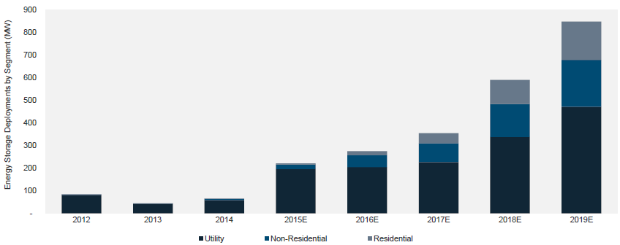
Current trends in the US market
Annual installation expected to reach 850 MWs by 2019. 2nd Quarter 2015 highest ever; in Texas – AEP and Duke projects make up most of capacity
Source: Energy Storage Association

Slide 7
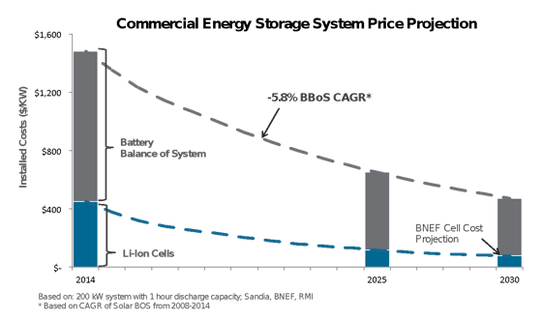
Costs expected to continue falling
Navigant: 4-hr battery install cost as low as $700/kWh by 2020
Oncor: $350/kWh install cost by 2020
Morgan Stanley: battery-only costs as low as $125/kWh to come
Tesla: Li-ion battery-only cost $110/kWh already
Source: Energy Storage Association, 2015
Notes:
And as installations continue and technologies mature, costs will continue to decline. A recent article in the journal Nature found that energy storage costs declined faster 2007-2014 than expert projections.
With installs increasing and costs declining, how will your state deal with energy storage?

Slide 8
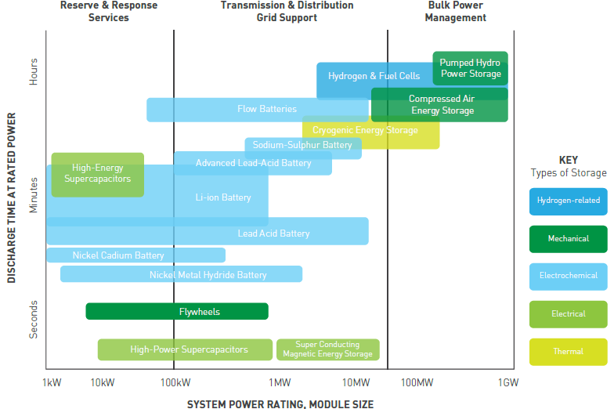
Energy storage CAN BE many things
Notes:
Energy storage is not one thing, just like “generation” is not one thing. Different technologies have different characteristics and fit different applications.

Slide 9
Numerous Applications on the Grid
Source: DOE/EPRI Handbook
Notes:
So energy storage has many applications—in bulk and ancillary services, in T&D infrastructure, and in end use. For you all today, I imagine the yellow highlighted applications are of particular note.

Slide 10
Current discussion on Storage in ERCOT
FAST: NPRR 667
  Potentially opens new space for use of Storage to participate in ancillary services in 2018-2019 period
    Could it include Pay for Performance as has been adopted or proposed in most other regions (SPP, New York, PJM, ISO New England)?
    FERC Order 755 pay for performance for frequency regulation does not apply in Texas, but..
    Current proposal instead would dictate the amount of certain more flexible resources, but not pay them more
    Other Issues within NPRR 667?

Slide 11
DREAM (Distributed Energy Resource and ancillarIES market) On!
Distributed level storage resources could participate more fully in DER-Light or DER-Heavy Scheme under ERCOT White Paper Proposal Significant work needed but storage has particular issues potentially with settlement
  Particular focus could be extent to which EV could be integrated into a DER ancillary or energy market offer
  Aggregation of storage and other resources like solar
  While there is separate task force, the ETWG could spend time on assuring that storage issues are covered

Slide 12
The Oncor Dilemna
Oncor/Brattle proposal suggested Oncor could build and implement batteries on its transmission system – earning ROI – as a reliability investment, while contracting out the use of the energy for other wholesale market values for third-parties
Clearly current law does not allow T & D utilities to own generation assets, and unclear in ERCOT market whether T & D utilities can even use storage for reliability purposes. AEP Presidio battery of 4 MW was a narrow exception and did not set precedent for including storage in TCOS
AEP can not capture the value of battery for ancillary or energy markets
See August 21, 2015 White Paper by James Boyd brings up many of these issues
However, there still may be room for reliability ownership or contracting of storage devices by T & D

Slide 13
How can we capture value of storage for T & D benefits?
Distributed electric storage as smart grid support? Dealing with distributed generation resources and plug-in Evs
Distributed electric storage or thermal storage as a peak shaver to lower demand on a specific distribution circuit and defer transmission upgrades and protect against outage
Bulk larger storage to avoid new transmission lines altogether
Allow third-parties to sell reliability value to customers or REPs or even T & Ds?
Can it go in TCOS or rate base?

Slide 14
Future Issues
Should storage acting as wires resource be eligible for rate-base cost recovery? Can the T & D own it as a reliability infrastructure in the same way they own wires?
Can we change our transmission planning model and allow storage as a capacity resource looked at in transmission planning (see FERC Order 1000 for Non-Transmission Alternatives)? Could we require this for certain ERCOT RPG process?
Rather than ownership could third parties be allowed to contract with utilities to provide energy storage with cost-recovery for utility – no ownership just a service?
Will we allow Pay for Performance in ERCOT for Ancillary Services?
Will DREAM allow distributed storage to monetize its value in wholesale market?
How will DREAM deal with aggregated storage and integration of EVs?
Could Clean Power Plan lead to a state plan that emphasized storage?
  Inlet cooling as an efficiency measure to reduce CO2
  Integration with renewables
  Heat rate improvements at coal and gas facilities

Slide 15
ETWG work list
TBD

