Slide 1
Capacity Forecast Report
Sean Chang
Market Analysis and Design
Suresh Pabbisetty CQF, ERP, CSQA
Credit
CWG/MCWG
September 16, 2015
ERCOT Public

Slide 2
Capacity Forecast Model - History
ERCOT began posting of the Capacity Forecast Model results starting from February 24^{tth} 2015.
The report shows:
Hourly forecast MW excess reserves for OD+1 through OD+6, with partial day forecast for OD+7.
For OD-1 through OD-7,
Hourly MW forecast for the Operating Day generated on the OD-1 relative to that day (the most recent capacity forecast for that day)
Actual MW excess reserves for that hour
HUBBUSAVG price for the hour
Posted forecast values are P₅₀.
ERCOT Public

Slide 3
Capacity Forecast Model – Model recap
The idea is that Reserve Forecast could help to identify potential scarcity events during the forward week.
With the implementation of the Operating Reserve Demand Curve (ORDC), we expect an increased correlation between reserves and prices.
Reserves forecast calculation:
Expected Reserves =
+ Non-Wind Resource HSL
+ AWS Wind Forecast
+ Load Resource RRS
– Resource Outages
– Load Forecast
± Load Forecast Error

Slide 4
Capacity Forecast Model – Model recap
Model Run:
Capacity Forecast Model was run at 8 AM for Operating Days March 1, 2015 through August 31, 2015 with P₅₀, and P₉₀ exceedance confidence intervals.
Definitions:
Exceedance Confidence Interval, P_{xx} is xx% confidence that actual excess reserves will exceed modeled excess reserves
Model Error = Modeled estimated reserves - actual reserves
OFF_{n} indicates forecast model run “n” days in advance of Operating Date.
Interpretation:
Positive model error indicates failure to predict while negative model error indicates false positive.

Slide 5
Correlation of
Capacity Forecast Reserves to Actual Reserves
ERCOT Public

Slide 6
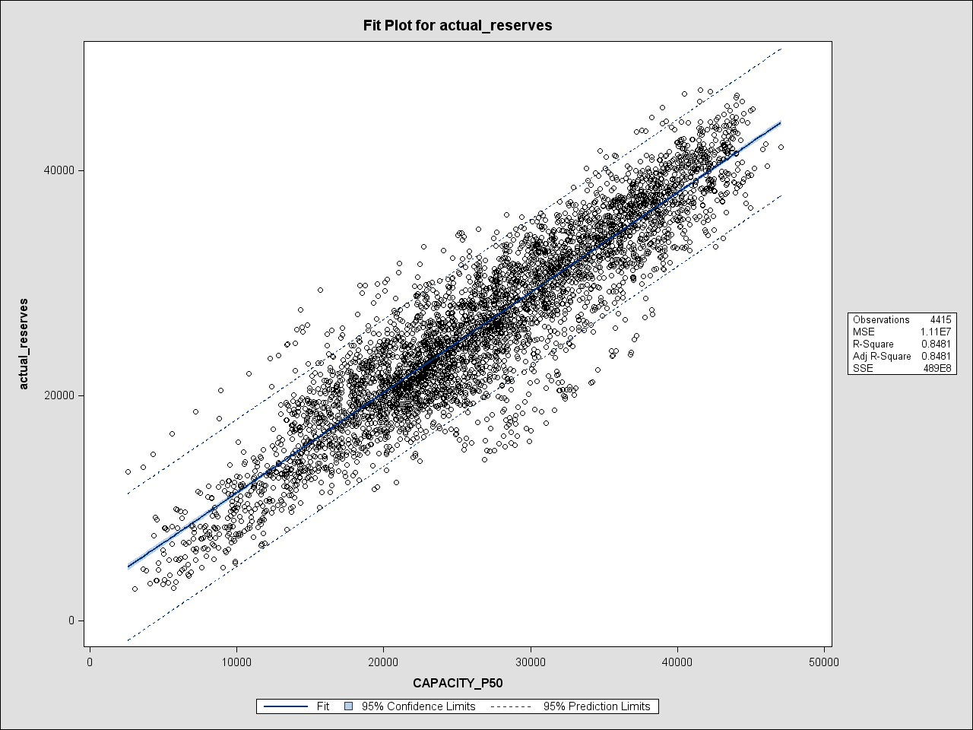
OFF4 P50 vs. Actual Reserves Correlation (MAR 2015-AUG 2015)

Slide 7
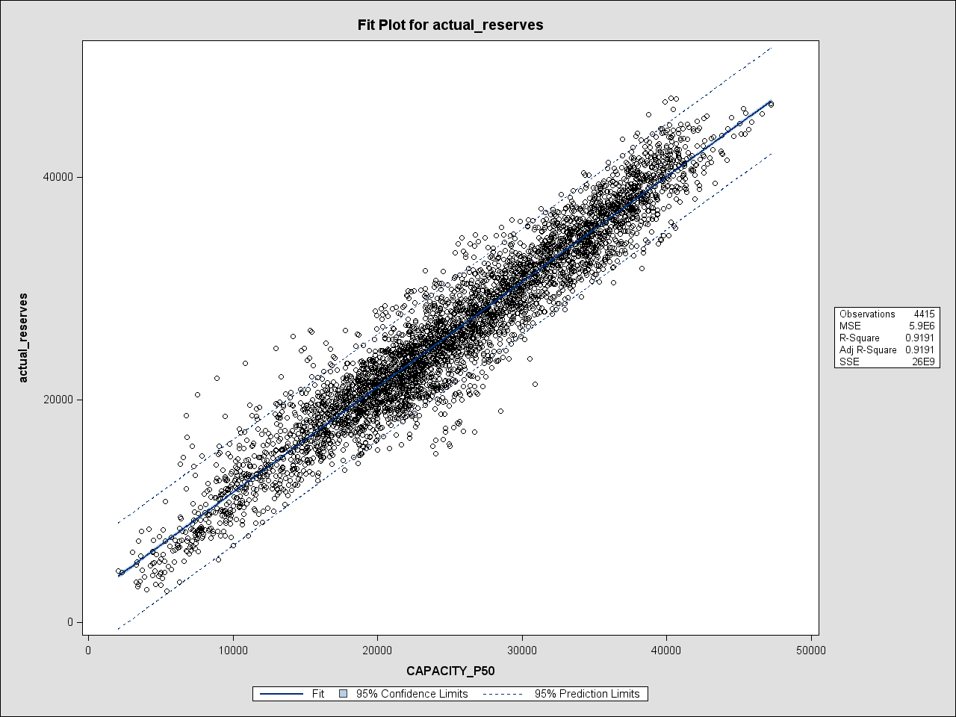
OFF1 P50 vs. Actual Reserves Correlation (MAR 2015-AUG 2015)

Slide 8
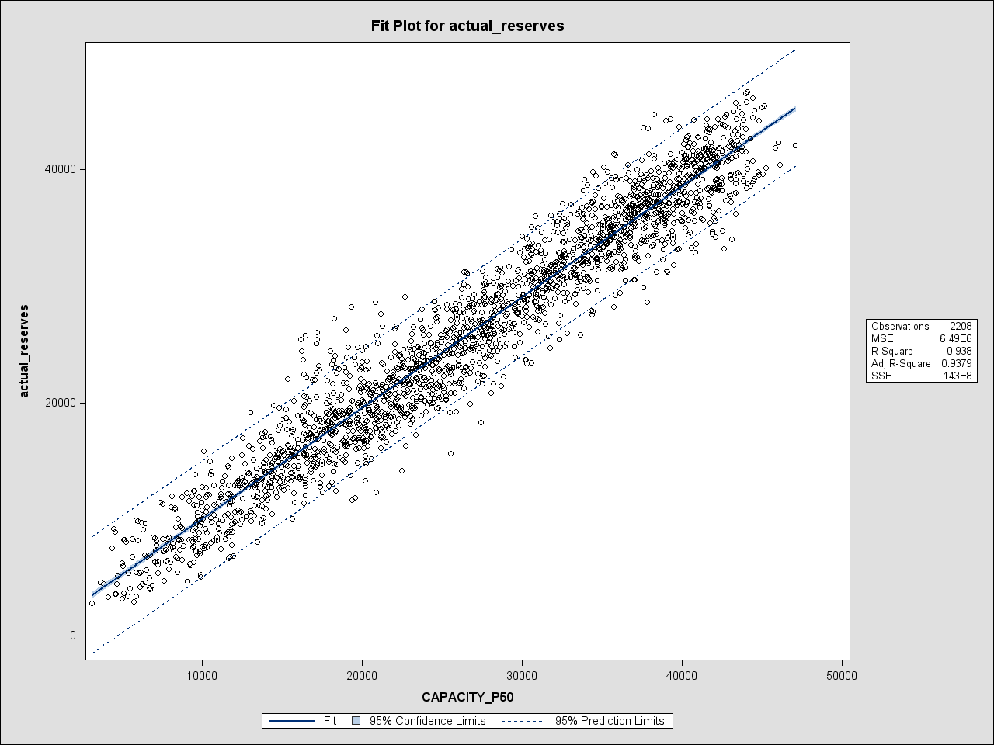
OFF4 P50 vs. Actual Reserves Correlation (Summer 2015)

Slide 9
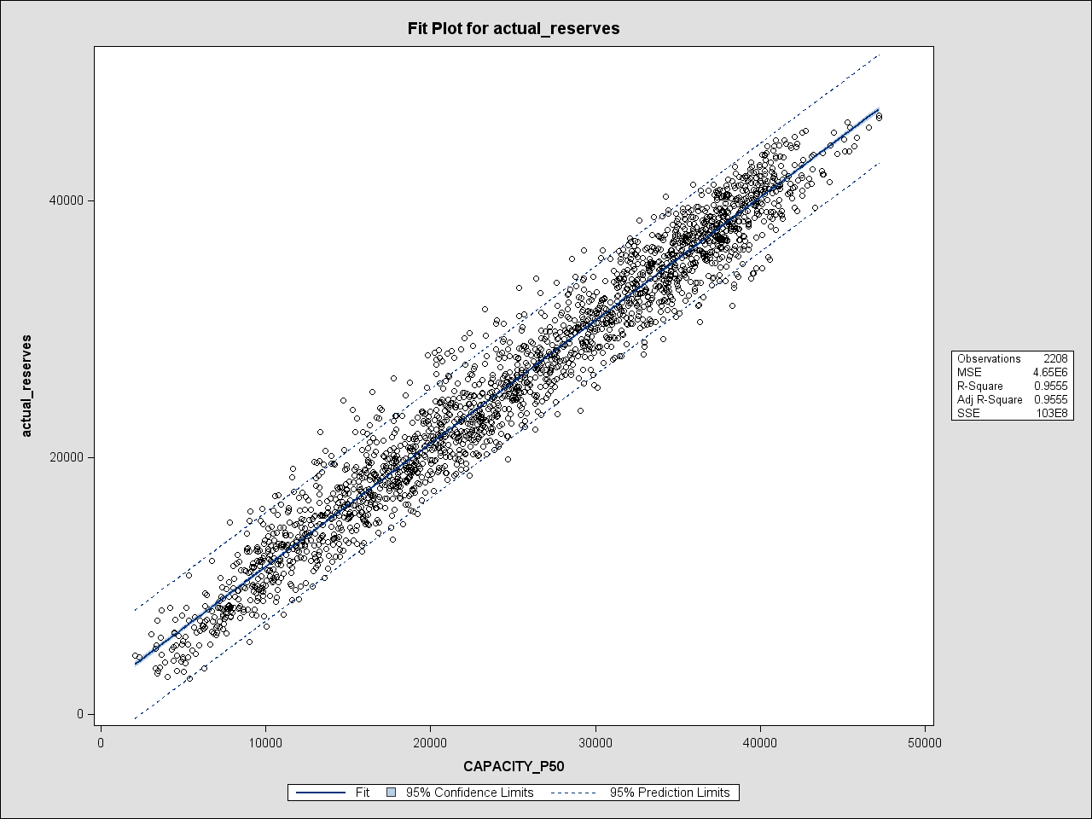
OFF1 P50 vs. Actual Reserves Correlation (Summer 2015)

Slide 10
Capacity Forecast Model – Correlation Summary
Capacity Forecast Model Excess Reserves vs Actual Results Correlation Summary:
An Exceedance Confidence Interval of P₅₀
Same Exceedance Confidence Interval is used for the corresponding reports published on MIS since late February 2015.
Period | OFF4 Correlation | OFF1 Correlation
Mar 2015-Aug 2015 | 85% | 92%
Spring 2015 | 66% | 83%
Summer 2015 | 94% | 96%
August 2015 | 95% | 96%

Slide 11
Capacity Forecast Model Reserves Error Statistics
ERCOT Public

Slide 12
Capacity Forecast Model – Error
Error = Forecast Reserves – Actual Reserves
Error < 0 means
Model predicted to have reserves lower than what they actually turned out to be
Type I Error or False Positive
Potential to ask for additional collateral but risk has not materialized
Error > 0 means
Model predicted to have reserves higher than what they actually turned out to be
Type II Error or False Negative
Potential failure to ask for additional collateral when risk has materialized
Note: Various combinations of Exceedance Confidence Interval (P50 vs P90), offsets (OFF1 vs OFF4) and Excess Reserves Thresholds (ERT MW) could be adjusted to model for desired level of risk.

Slide 13
Capacity Forecast Model OFF4 Reserves Error Statistics
(in MW) | Mar 2015 – Aug 2015 | Spring 2015 | Summer 2015 | August 2015
Mean (P50) | 536 | 272 | 800 | 555
Mean (P90) | (2,186) | (2,391) | (1,980) | (2,225)
Std. Dev. (P50) | 3,471 | 4,148 | 2,600 | 2,352
Std. Dev. (P90) | 3,544 | 4,179 | 2,752 | 2,516
Min (P50) | (13,681) | (13,681) | (9,350) | (8,273)
Min (P90) | (16,035) | (16,035) | (13,219) | (12,142)
Max (P50) | 13,946 | 13,946 | 9,884 | 6,591
Max (P90) | 10,846 | 10,846 | 7,524 | 4,090

Slide 14
Capacity Forecast Model OFF1 Reserves Error Statistics
(in MW) | Mar 2015 – Aug 2015 | Spring 2015 | Summer 2015 | August 2015
Mean (P50) | (814) | (746) | (881) | (1,307)
Mean (P90) | (2,739) | (2,528) | (2,949) | (3,376)
Std. Dev. (P50) | 2,471 | 2,715 | 2,199 | 2,279
Std. Dev. (P90) | 2,610 | 2,802 | 2,384 | 2,464
Min (P50) | (13,054) | (13,054) | (9,727) | (9,727)
Min (P90) | (14,946) | (14,946) | (12,717) | (12,717)
Max (P50) | 9,613 | 9,613 | 6,455 | 4,534
Max (P90) | 8,026 | 8,026 | 4,845 | 3,241

Slide 15
Capacity Forecast Model – Error Statistics comparison
Error comparison across Exceedance Confidence Intervals:
Mean error with P90 is higher than that of P50
Standard Deviation of error with P90 and P50 are close
Error comparison across seasons:
Standard Deviation of error is relatively higher for Spring 2015 than that of Summer 2015
Error comparison across OFFset periods:
Standard Deviation of error is relatively lower for OFF1 than that of OFF4
Note: Please note that these comparisons are only based on a very limited dataset of model run. A larger dataset may be required for statistical significance.

Slide 16
Capacity Forecast Model Reserves Error
Contributing Factors
ERCOT Public

Slide 17
Capacity Forecast Model – Error Contributing Factors
Primary Factors contributing to Model Error:
Net Load Error:
Net of Load Forecasting Error and Wind Forecasting Error
Some negative correlation is observed between Load Forecast Error and Wind Forecast
Outage Error:
Units recorded in Outage Scheduler as having outages are actually online during the same period
HSL Error:
Telemetered HSL of units is different than the forecast HSL

Slide 18
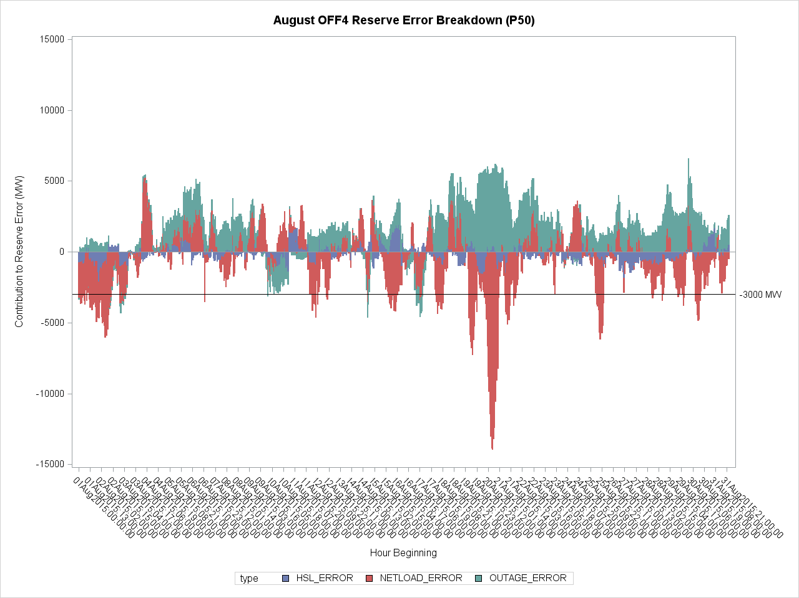

Slide 19
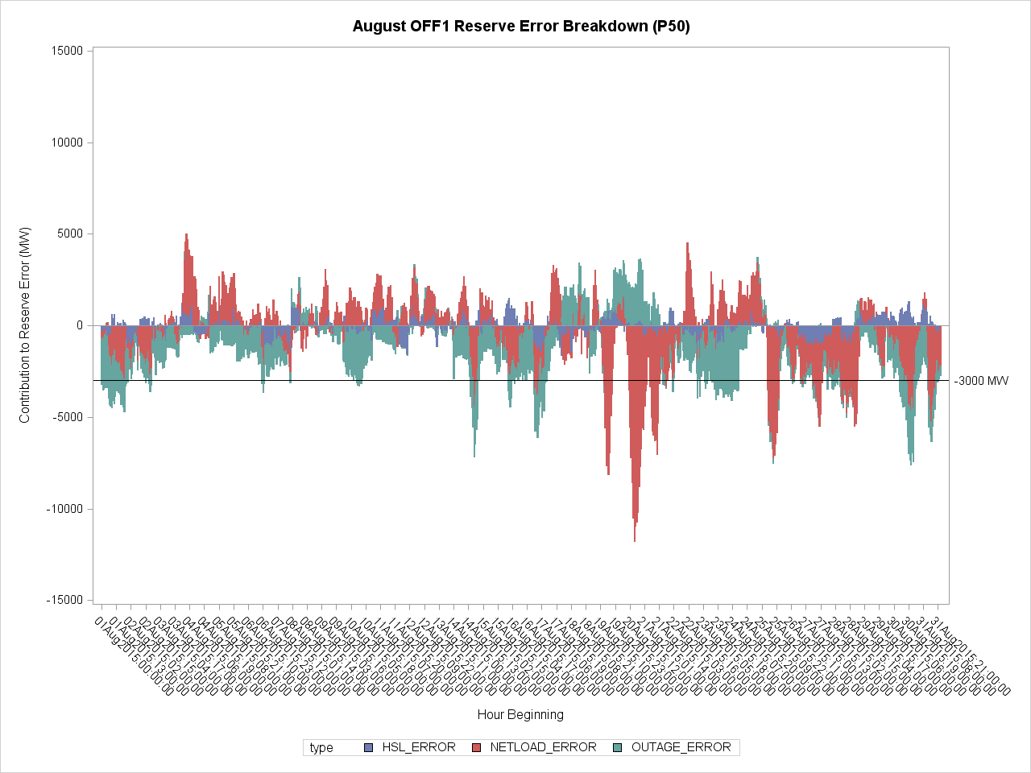

Slide 20
Capacity Forecast Model Reserves vs RTSPP Relation
ERCOT Public

Slide 21
Capacity Forecast Model – Reserves to RTSPP Correlation
log Forecasted Reserves to log RTSPP Correlation:
Period | OFF# | P_{xx} | R^2
Mar. 2015 - Aug. 2015 | OFF1 | P50 | 44.2%
 |  | P90 | 44.4%
 | OFF4 | P50 | 38.0%
 |  | P90 | 38.7%
Spring 2015 | OFF1 | P50 | 18.4%
 |  | P90 | 18.6%
 | OFF4 | P50 | 9.4%
 |  | P90 | 9.6%
Summer 2015 | OFF1 | P50 | 68.4%
 |  | P90 | 69.8%
 | OFF4 | P50 | 67.2%
 |  | P90 | 68.4%
August 2015 | OFF1 | P50 | 65.8%
 |  | P90 | 68.5%
 | OFF4 | P50 | 68.7%
 |  | P90 | 72.5%

Slide 22
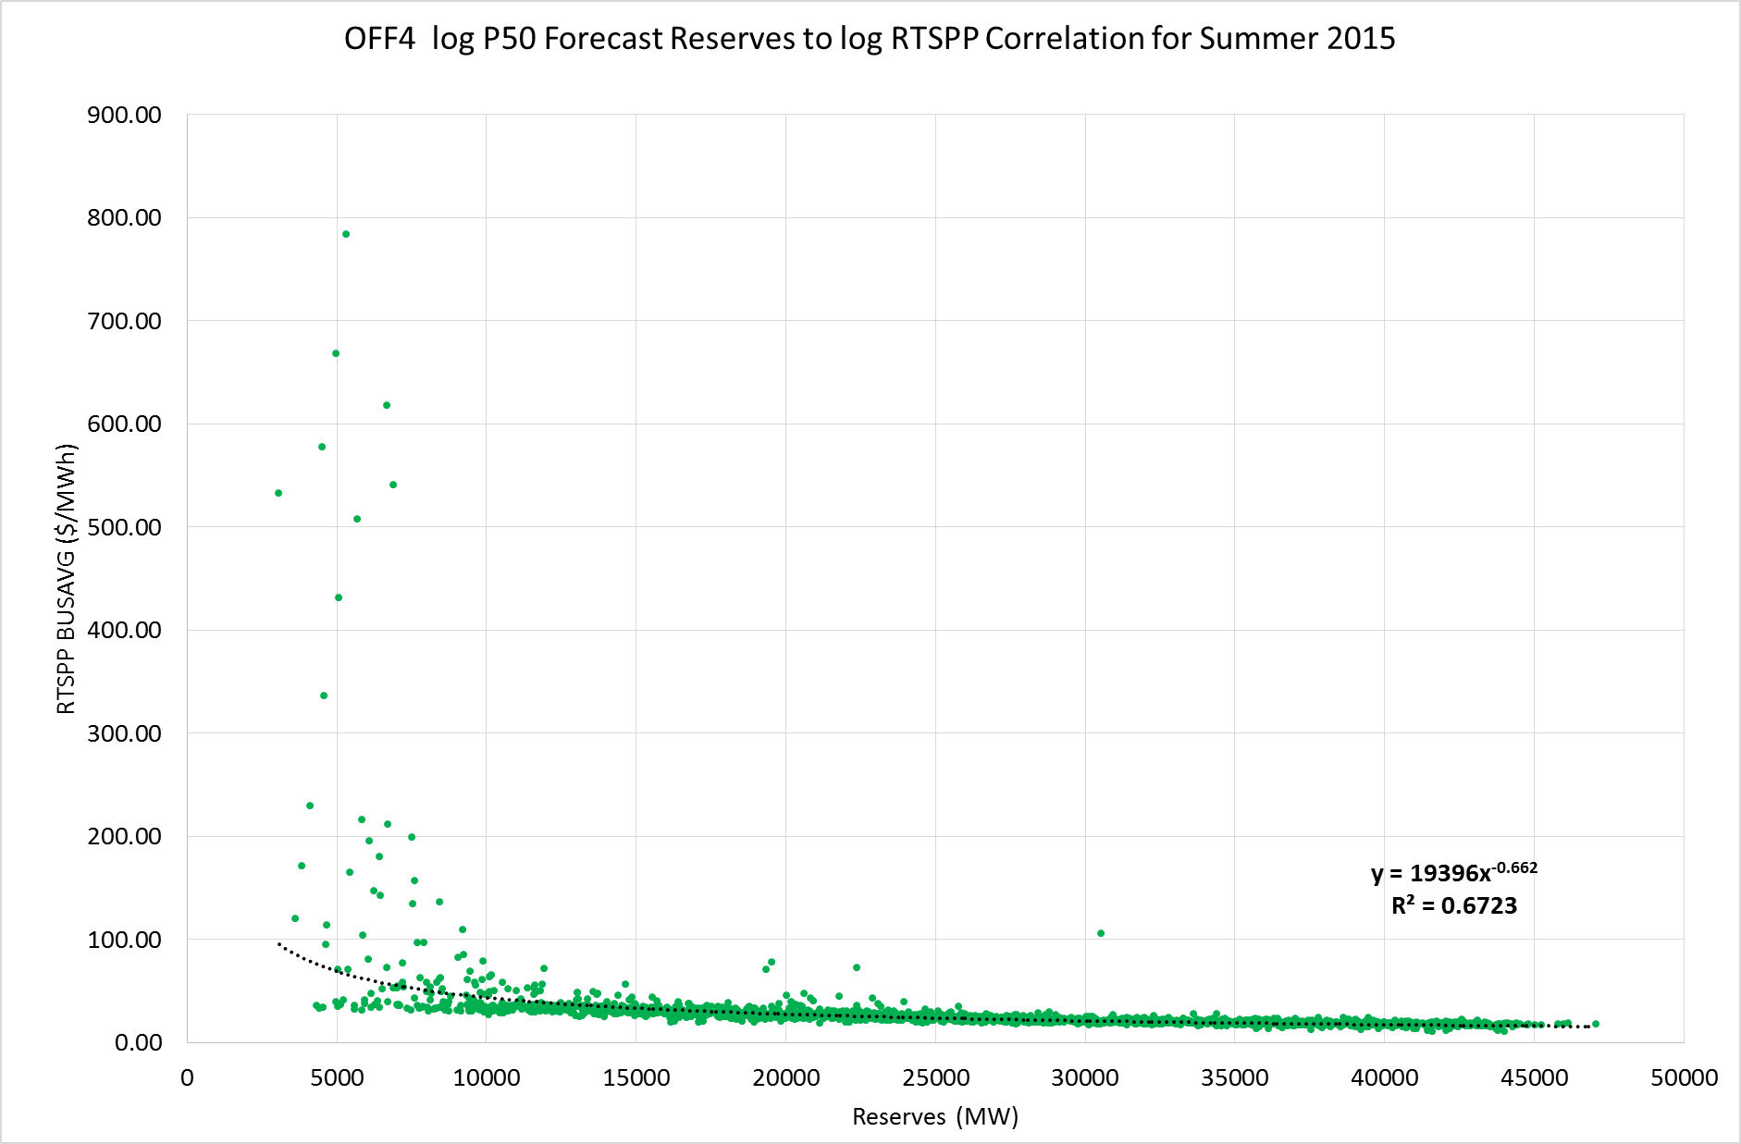
Capacity Forecast Model – Reserves to RTSPP Correlation

Slide 23
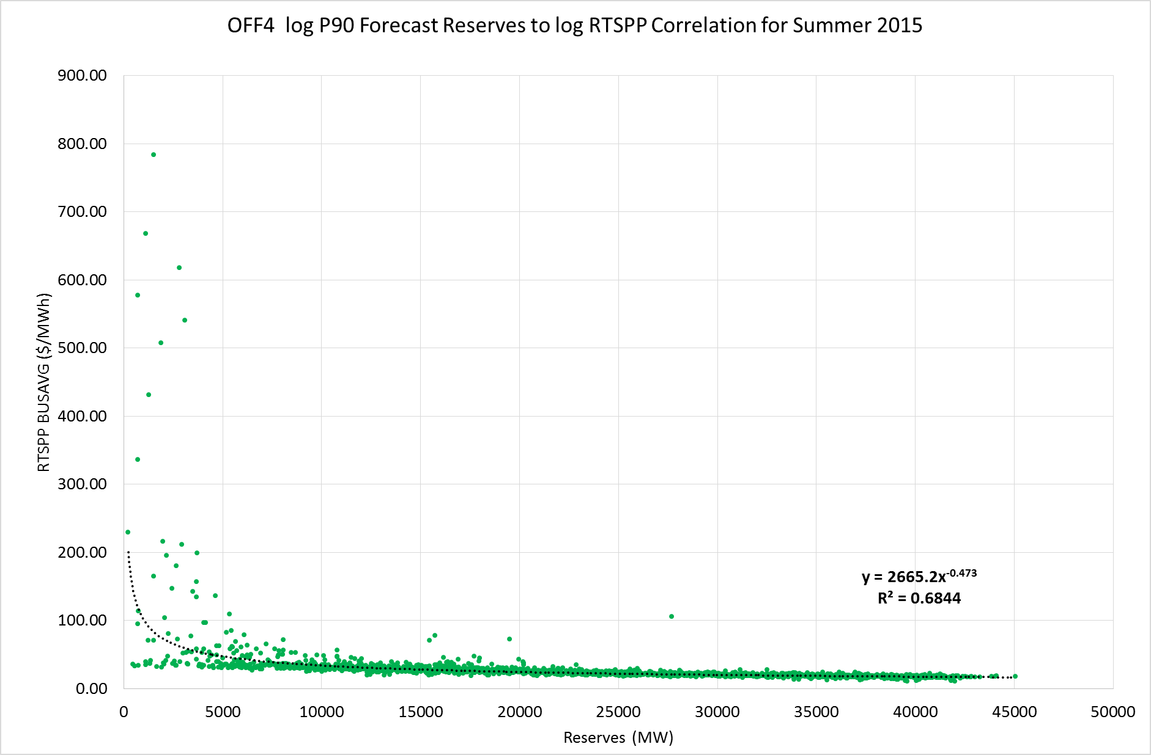
Capacity Forecast Model – Reserves to RTSPP Correlation

Slide 24
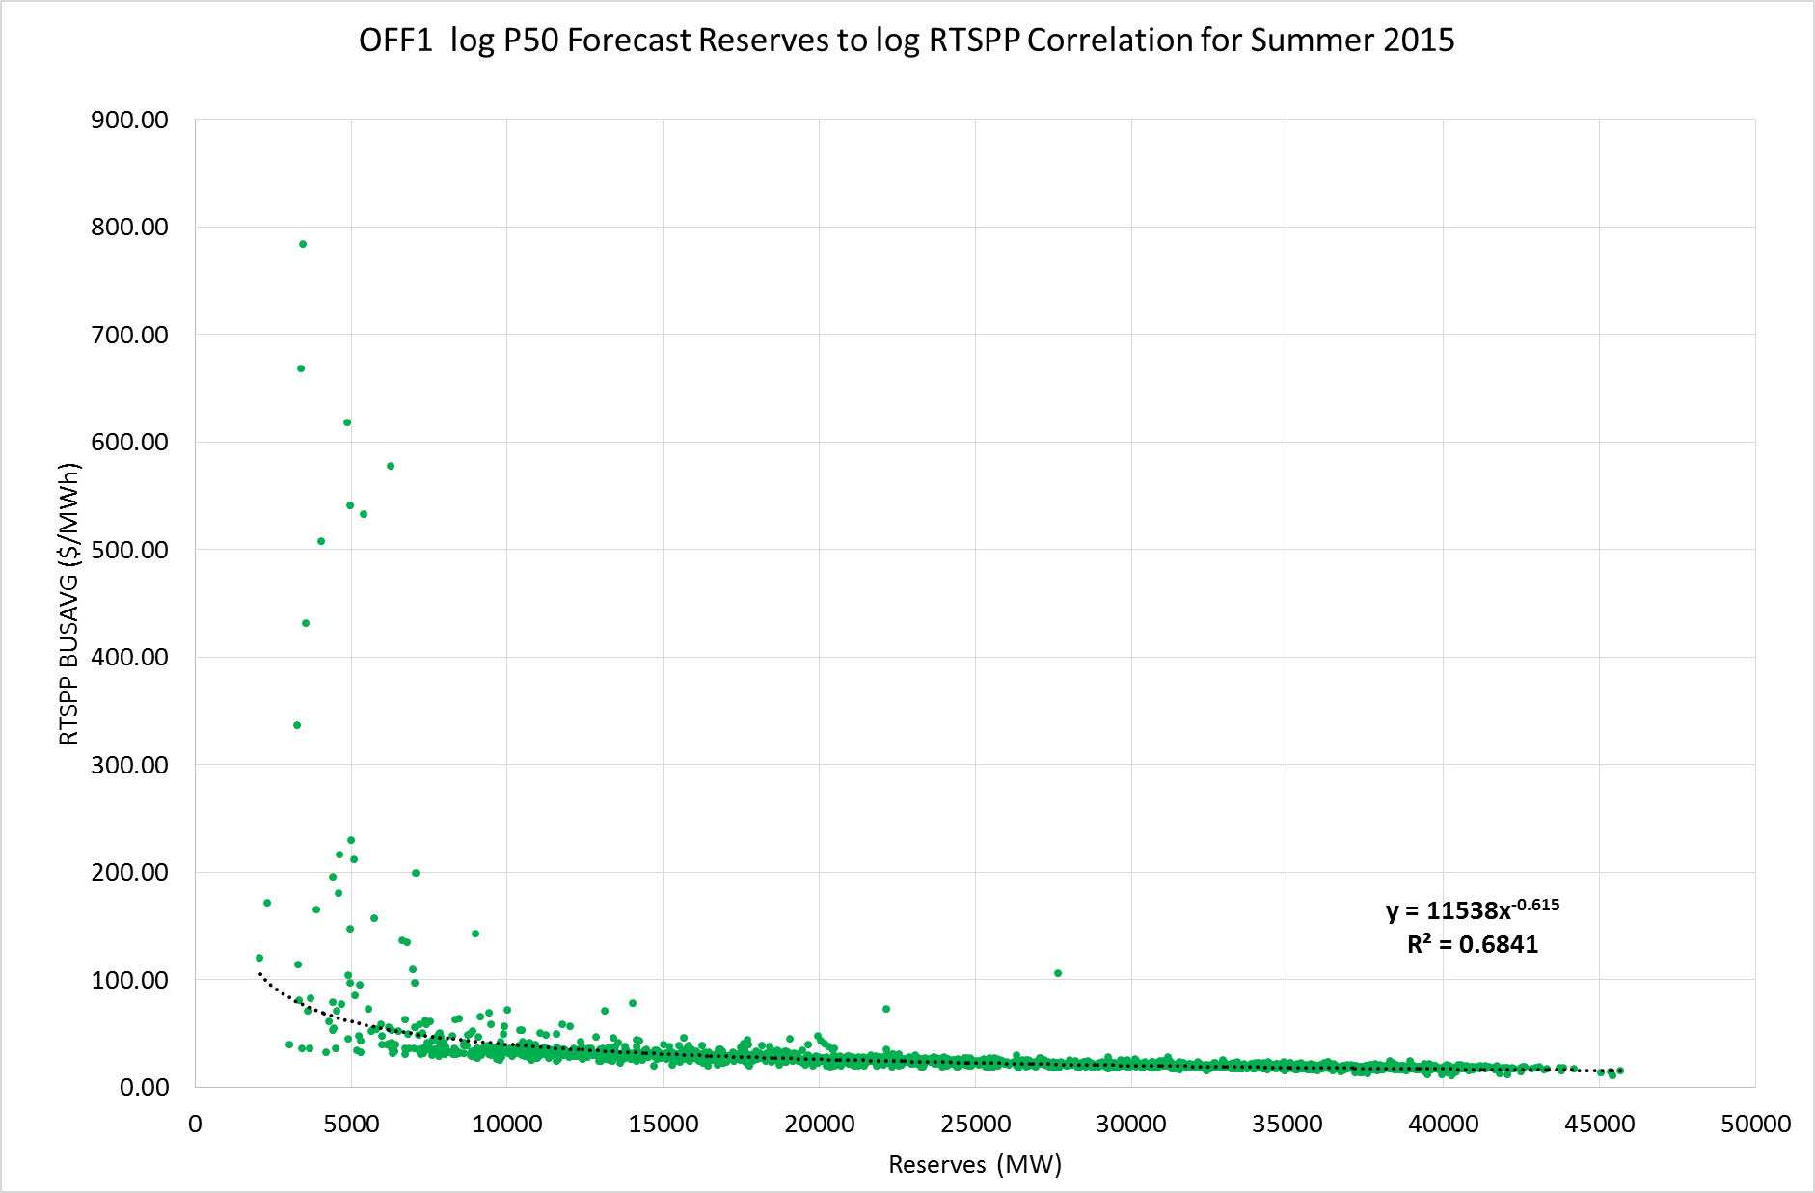
Capacity Forecast Model – Reserves to RTSPP Correlation

Slide 25
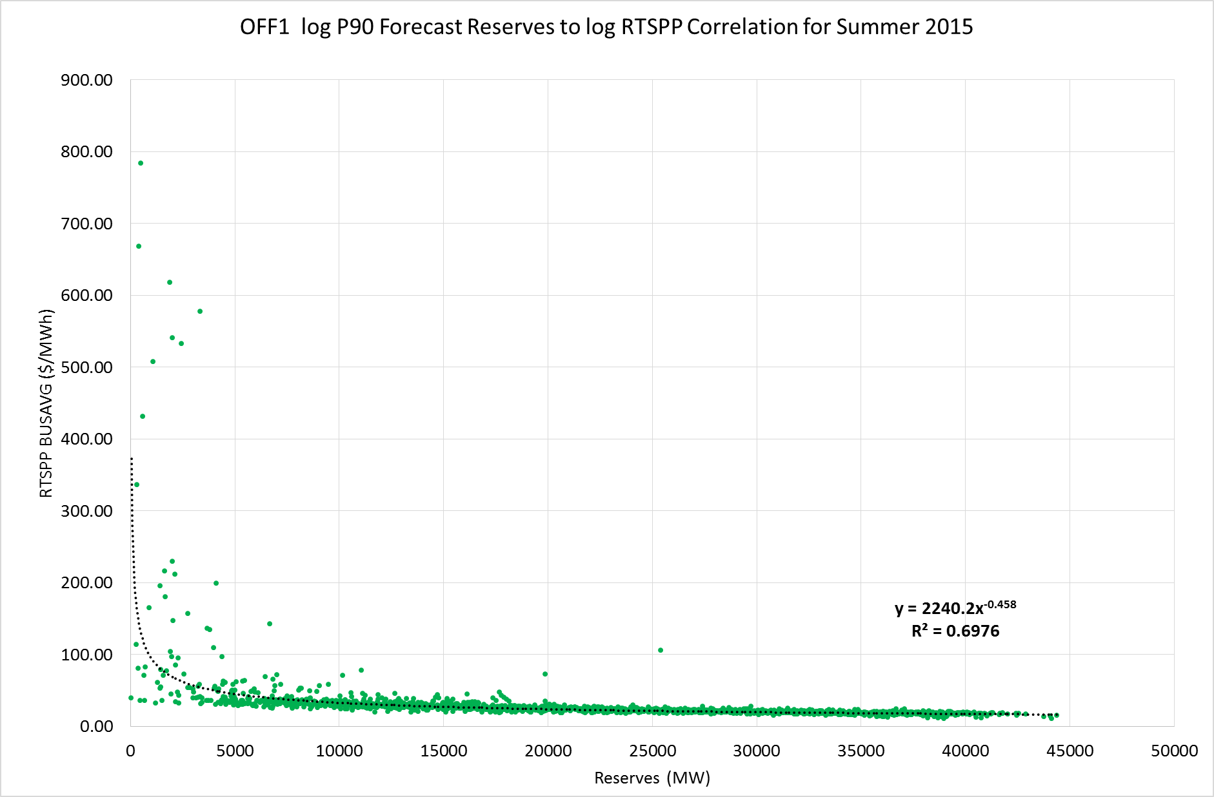
Capacity Forecast Model – Reserves to RTSPP Correlation

Slide 26
Capacity Forecast Model
Results Summary
ERCOT Public

Slide 27
Capacity Forecast Model – Results Summary
Model predictability is relatively better in Summer than Spring
A summary of effects of various model Inputs is as follows;
 | Exceedance Confidence Interval
Model Attribute | P50 | P90
Probability of False Positives | Relatively Lower | Relatively Higher
Probability of False Negatives | Relatively Higher | Relatively Lower
 | OFFset
Model Attribute | OFF4 | OFF1
Probability of False Positives | Relatively Higher | Relatively Lower
Probability of False Negatives | Relatively Higher | Relatively Lower
 | Threshold Level
Model Attribute | 3000MW | 5000MW
Probability of False Positives | Relatively Lower | Relatively Higher
Probability of False Negatives | Relatively Higher | Relatively Lower

Slide 28
Capacity Forecast Model – Results Summary continued..
Correlation of Forecast Reserves to Actual Reserves is really strong in Summer and it is relatively weak in Spring
Correlation of log Forecast Reserves to log HUBBUSAVG RTSPP is around 70%
Capacity Forecast Model could be one of the potential options for reasonably predicting price risk
Note: Supplemental graphs/charts available in APPENDIX.

Slide 29
Questions

Slide 30
Appendix
Additional Graphs/Charts

Slide 31
Correlation of
Capacity Forecast Reserves to Actual Reserves
ERCOT Public

Slide 32
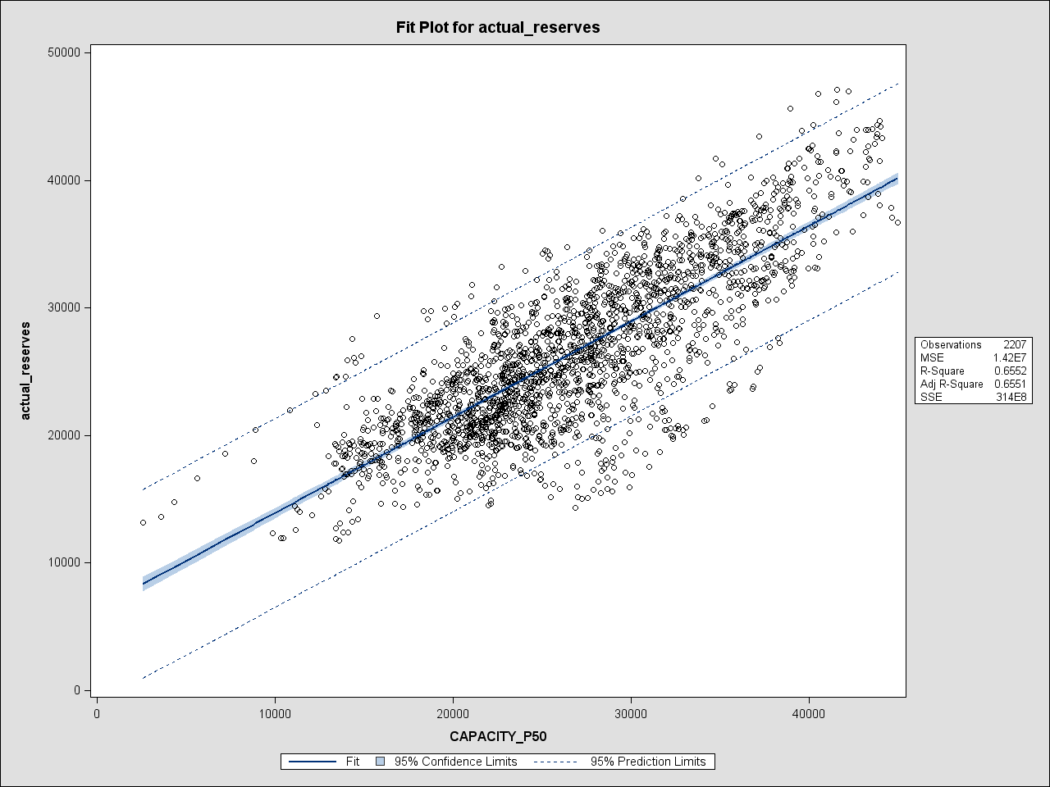
OFF4 P50 vs. Actual Reserves Correlation (Spring 2015)

Slide 33
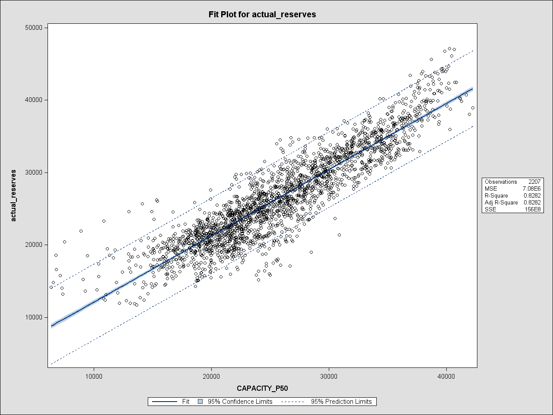
OFF1 P50 vs. Actual Reserves Correlation (Spring 2015)

Slide 34
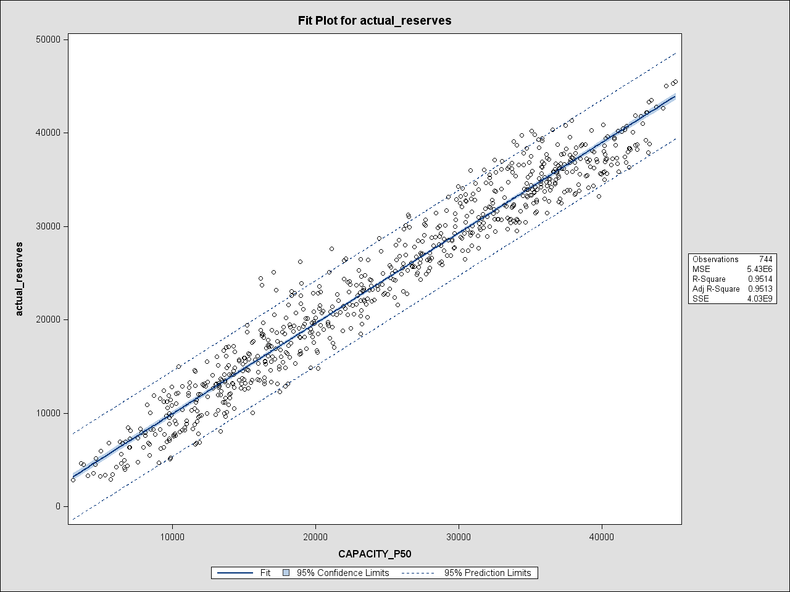
OFF4 P50 vs. Actual Reserves Correlation (August 2015)

Slide 35
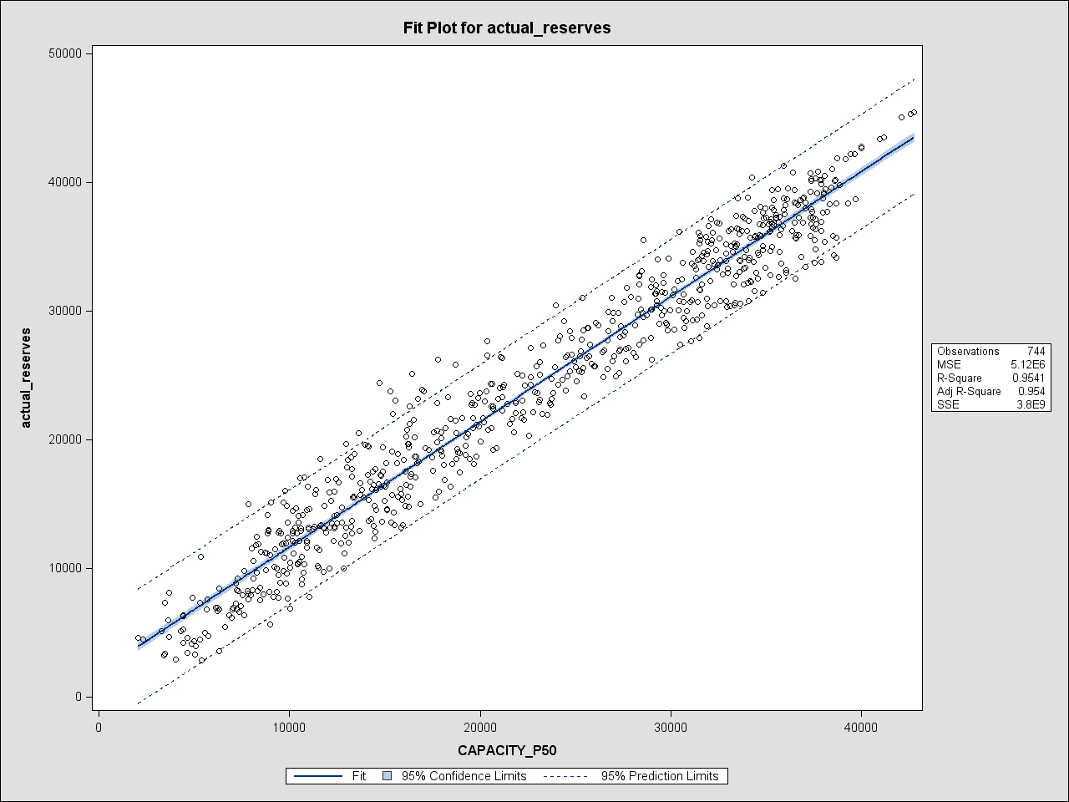
OFF1 P50 vs. Actual Reserves Correlation (August 2015)

