Slide 1
SMT Update To AMWG
AUG 2015

Slide 2
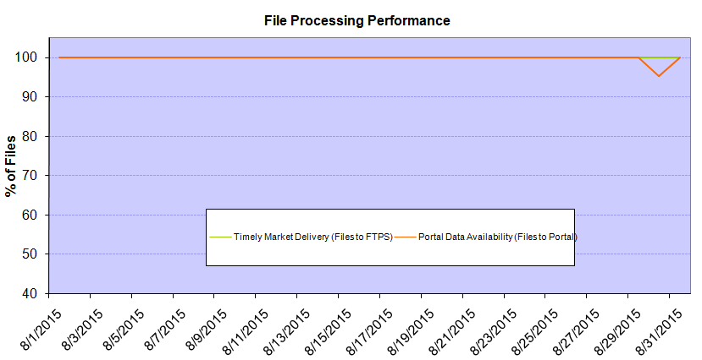
Monthly SMT Data Timelines AMWG CR 2014 002 End to End File Processing Completeness – AUG 2015
% Timely Market Delivery - % of files posted to market (FTPS) by 11:00pm out of # of files received by SMT by 11:00pm.
% Portal Data Availability - % of files loaded to the database for data availability on portal by 6:00am next day for the files received by 11:00pm
* A LSE file includes usage data for up to 50,000 ESIIDs.
Observed Anomalies:
08/30 – SMT services were down due to SMT firmware upgrade on Dallas environment
2

Slide 3
SMT API and FTPS Services Availability – AUG-2015
The service availability is measured as a percentage of number of minutes the service was available out of the total number of minutes in a month, excluding planned outages.
Observed Anomalies:
Mar-Apr 2015: SMT outage and subsequent recovery/catch-up impacted API availability. FTPS was available for most of the part except on 03/21-03/22 for 36 hours.
26 Jul 2015: Services were unavailable for 12 hours due to Flash storage issue
Notes:
3

Slide 4
SMT Number of Accounts by Type AMWG CR 2014 009 – AUG 2015
Registered Users | ONC | CNP | AEPN | AEPC | TNMP | TOTAL
Active Residential Accounts | 31397 | 20221 | 2062 | 5268 | 2228 | 61176
Active Residential English Accounts | 31252 | 20079 | 2058 | 5160 | 2221 | 60770
Active Residential Spanish Accounts | 145 | 142 | 4 | 108 | 7 | 406
Non Active Residential Accounts | 15242 | 10909 | 1223 | 2498 | 537 | 30166
Total Residential Accounts | 46639 | 31130 | 3285 | 7766 | 2765 | 91342
TDSP User | 457 | 38 | 11 | 16 | 2 | 524
TDSP Admin | 4 | 4 | 4 | 4 | 3 | 19
Small Business User | 76 | 34 | 0 | 1 | 1 | 112
Small Business Admin | 2208 | 1140 | 66 | 225 | 67 | 3792
Total Agreements | 350 | 376 | 1 | 0 | 0 | 727
Energy Data Agreements | 257 | 79 | 1 | 0 | 0 | 337
Han Device Agreements | 93 | 296 | 0 | 0 | 0 | 389
Han Service Agreements | 0 | 1 | 0 | 0 | 0 | 1
IN SMT
ESI IDs | 3445336 | 2364357 | 196897 | 850963 | 202645 | 7060198
Meters | 3374177 | 2365456 | 197741 | 851140 | 202407 | 6990921
HAN Devices | 4019 | 5186 | 149 | 262 | 35 | 9651
Acknowledgement | 0 | 0 | 0 | 0 | 0
Pending | 0 | 1 | 0 | 0 | 0
Meter Ready | 537 | 46 | 44 | 116 | 25
Provisioned | 3482 | 5139 | 105 | 146 | 10
HAN Messages (MTD) | 0 | 0 | 0 | 0 | 0 | 0
HAN Messages (YTD) | 14 | 21 | 0 | 0 | 0 | 35
HAN Messages (Cumulative) | 305 | 7385 | 0 | 0 | 0 | 7690
Simple Text Messages | 94 | 2919 | 0 | 0 | 0
Load Control Messages | 80 | 2655 | 0 | 0 | 0
Pricing Messages | 89 | 49 | 0 | 0 | 0
Cancellation Messages | 42 | 1762 | 0 | 0 | 0
Supplemental – (Friends)
Total Agreements | 1527 | 1216 | 72 | 79 | 55 | 2949
Accepted Agreements | 692 | 475 | 32 | 27 | 17 | 1243
Pending Agreements | 4 | 4 | 0 | 0 | 0 | 8
Revoked Agreements | 216 | 231 | 9 | 7 | 6 | 469
Expired Agreements | 589 | 479 | 29 | 45 | 32 | 1174
Terminated Agreements | 26 | 27 | 2 | 0 | 0 | 55
 | TDSPs | REP | NRC | Regulatory | Third Party
Registered Entities | 5 | 100 | 3694 | 2 | 59
Registered Users | 524 | 855 | 112 | 7 | 2
Registered Admins | 19 | 158 | 3706 | 3 | 61
HAN Messages Sent By | 295 | 7383

Slide 5
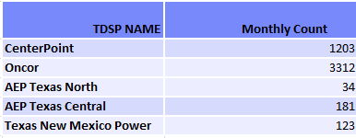
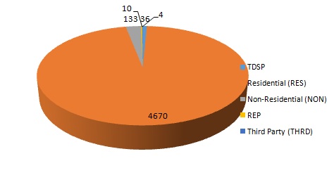
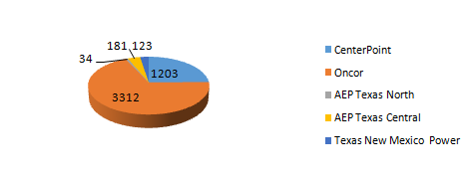
SMT ODR Details – AUG 2015
Total ODR Requests TDSP wise statistics:
Total ODR Requests User type statistics:

