Slide 1

2016 LTSA Scenario Assumptions
Doug Murray
ERCOT
Sr. Planning Analyst
September 15, 2015

Slide 2
Agenda
Data Sources
Scenario Descriptions
Load Forecasts
Capital Cost Projections
Fuel Price Projections
High Storage/Electric Vehicle Adoption Scenario
Generation Expansion Schedule

Slide 3
Data Assumptions and Sources
Assumption in this presentation are preliminary and changes are likely in the next couple months based on stakeholder comments
In general the sources for the information were obtained from:
  EIA 2015 AEO
  Lazard’s Levelized Cost of Energy Analysis - 2014
  Several reports from Lawrence Berkeley National Lab (LBNL)
  Electric Vehicle Transportation Center at Univ. of Central Florida
  Federal Highway Administration
  Electric Power Research Institute (EPRI)
  Solar Energy Industries Association (SEIA)
  American Natural Gas Association (ANGA)
  Presentations given at the scenario development workshops

Slide 4
Scenario Descriptions

Slide 5
Scenario Descriptions

Slide 6
Load Forecast – Modeling Assumptions
Scenario | Base Forecast | Energy Efficiency | Rooftop PV | Price Responsive DR | LNG Terminals
Current Trends | ERCOT Planning LTDEF¹ | 3.5% of the total demand by 2031 | Current amount of known solar | Use same amount from 2014 LTSA | Freeport + Corpus Christi
High Economic Growth | Load forecast based on Moody’s high economic data | MW savings same as Current Trends | Same as Current Trends | Same as Current Trends | Freeport + Corpus Christi + Brownsville
Environmental Mandate | Same as Current Trends | 5% of the total demand by 2031 | Increased amounts of rooftop solar | Same as Current Trends | Same as Current Trends
Texas Recession | 5% drop in total load (peak and energy) in year 2022 followed by recovery using Moody's – low economic data | No growth | No growth | Same as Current Trends | Same as Current Trends
Extended Extreme Weather | Forecast based on 2011 weather year | Same as Current Trends | Same as Current Trends | Same as Current Trends | Same as Current Trends
High EE/DG | Same as Current Trends | 15% of the total demand by 2031 | Increased amounts of rooftop solar | Increase amounts of responsive DR | Same as Current Trends
Low Sustained NG price | Same as CT with higher industrial growth in Corpus-Houston area | Same as Current Trends | Same as Current Trends | Same as Current Trends | Freeport + Corpus Christi + Brownsville
1: The 2015 ERCOT planning LTDEF (under development) will be used for the 2016 LTSA

Slide 7
Base Capital Cost Assumptions ($/kW)
Thermal plant costs increase at 2.4% annually (2015 EIA AEO)

Slide 8
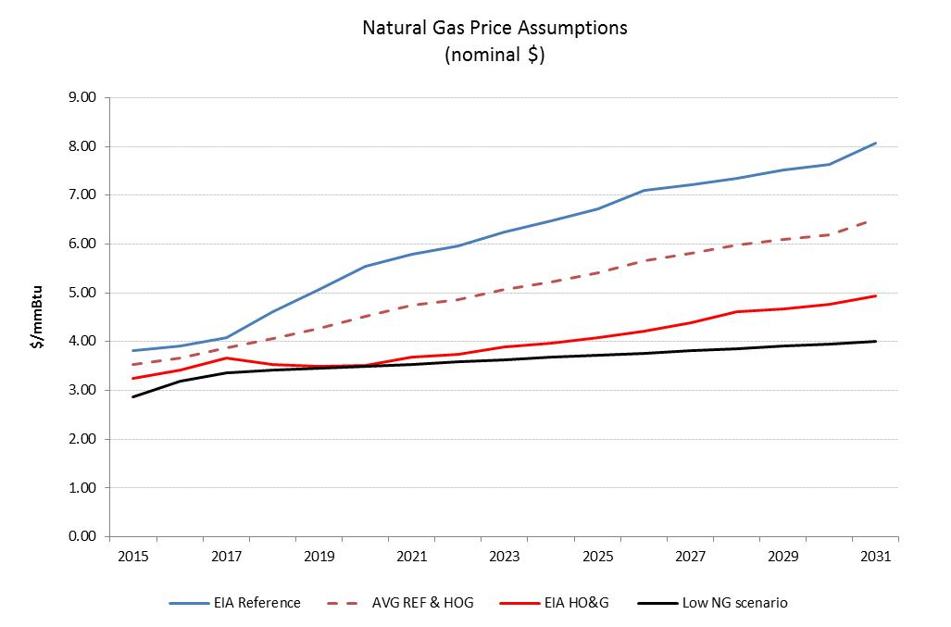
Natural Gas Price Assumptions
Average of EIA Reference and EIA High Oil & Gas production case will be used for Current Trends Scenario
For Low Natural Gas Price Scenario assumed price remained below $4/mmBtu

Slide 9
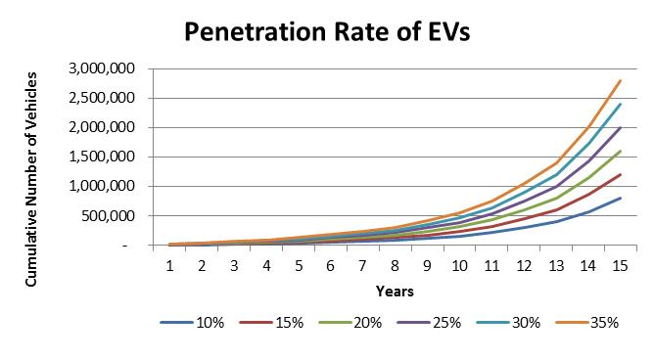
Storage/EV Scenario Assumptions
Scenario will include:
Information for batteries is still being developed
Increasing penetration on electric vehicles
Approximately 8 million passenger vehicles on Texas roads
Vehicle charging pattern will charge all day with most charging occurring off-pk hours
Average vehicle will require:
  8 hours of charging
  30 miles driven per day
  10.2 kWh needed per day
  1.275 average hourly charge rate
1,600,000 EVs by 2031 which will be 20% of total passenger vehicles in Texas today?

Slide 10
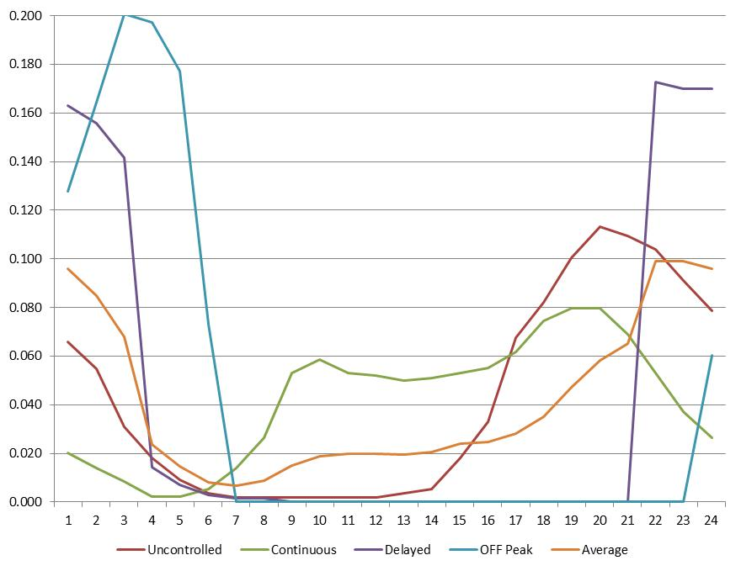
EPRI EV Charging Patterns

Slide 11
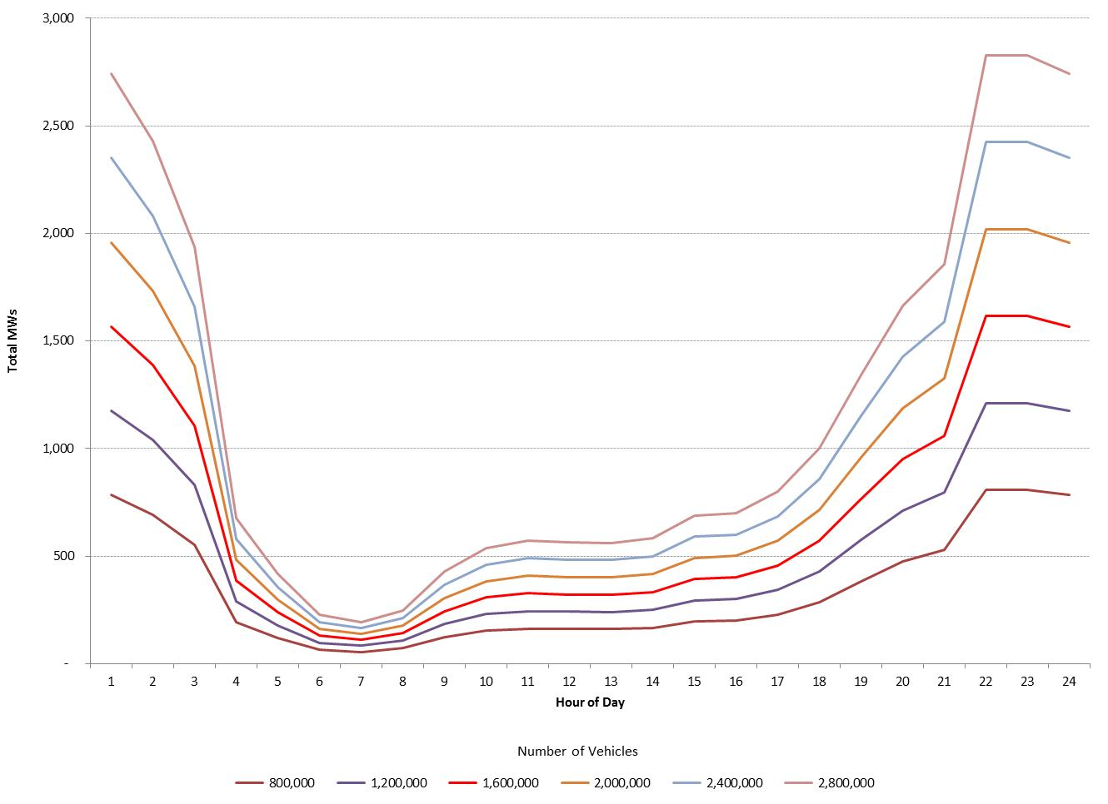
EV Average Charging Pattern

Slide 12
Schedule for Generation Expansion
Comments/changes to data completed by mid October
Final scenario data development by end of October
Model runs begin early November
Completion of generation expansion January 2016

Slide 13

Questions
Contact info:
Doug Murray Julie Jin
douglas.murray@ercot.com julie.jin@ercot.com
512.248.6908 512.248.3982
Sandeep Borkar
sandeep.borkar@ercot.com
512.248.6642

Slide 14
Appendix

Slide 15
The 2016 LTSA Scenarios
Current trends
High economic growth
Environmental mandate
Texas recession
Extended extreme weather
High energy efficiency/distributed generation
Sustained low natural gas scenarios
Storage/electric vehicle adoption scenario

Slide 16
1. Scenario: Current trends
Economic Growth
Migration to TX along I-35 corridor
Lower Growth in south and west Texas
Industrial growth in Houston, I-35
Average GDP growth in line with long-term average US GDP growth rate~1.5% load growth – high growth in near term then tapering off in long-term
LNG growth based on permits existing – may be 2 new LNG plants
Oil production rates drop to those seen in recent projections
Story:
Same old, same old. The recent population and economic growth in Texas continues in the near future, however the recent decline of the oil and gas sector has impacted growth in the west and south Texas especially in areas near the oil and gas plays. World oil prices are low enough to keep oil production low in the short-term, while also keeping domestic natural gas prices relatively low. With low gas prices, currently commissioned LNG export terminals get completed by 2019-2020 timeframe however no new LNG Terminals get added. Modest wind and solar growth continues based on economics without production tax credits. Capital costs for solar continues to decline at the current rate for 3-4 more years. No required reserve margin is set for ERCOT and the environmental regulations continues to be moderate, with no explicit federal carbon tax. However SOx/NOx limits imposed by CSPAR, and Regional Haze ruling become active by 2018.
Technology
No breakthroughs – steady modest cost improvements
New DC ties
Government policy/mandate
No reserve margin set for ERCOT
Maintain energy-only market
Economic retirements continues based on economics
Increased DC-tie capacity with neighboring region
Environmental Regulation
Impact of Regional HAZE and CSAPR are seen in the near future
CSAPR Hybrid
Greenhouse gas regulation set with flexibility
No other major changes in environmental regulations – no CPP impacts
Alternative Generation
Total wind capacity of 20K to 25K generation added by 2017
Solar capability addition limit:1000 MW/ year
Wind capacity addition limit: 3,000 MW/yr
Capacity factor wind – rely on historical data from ERCOT
Capital cost wind ~$1755/kW
Capital cost solar ~4.4% reduction/year continues for 3 to 4 years
Overall renewable growth driven by economic entry
No production tax credit beyond 2013
No change to existing investment tax credit policy
End-Use
Increased need for ancillary services
Increase penetration of demand response
Increasing distributed generation
Implications for ERCOT:
Continued modest economic and therefore load growth in Texas.
Reduction in oil production and population across the state results in slower load growth in oil and gas producing regions
Continued increased renewables especially solar may lead to reliability (inertia) issues
While EPA’s clean power plan has not been implemented in this scenario, other emissions standards may have some effect on future generation mix
Weather / Water
No drought situation, but water supply continues to be a concern to existing and new generators.
No specific increase in electricity consumption due to drought conditions.
Gas/Oil Prices
Sustained low oil prices
Moderate growth in natural gas prices

Slide 17
2. Scenario: High economic growth
Economic Conditions
High Texas GSP growth ~5%/year
High population growth (2.5%/yr)
Pro-business environment
Industrial growth concentrated in Houston, I-35 corridor, Midlands/Odessa, Lower Rio Grand Valley
Higher LNG exports than under Current Trends
Capital is available to support new generation and transmission
Story:
Texas economy continues to outpace US economic growth. Increased immigration to Texas shows continued accelerated load growth in urban centers. Higher natural gas prices increase drilling activity and lead to higher economic growth than under Current Trends. Growth occurs throughout Texas driven in large part by oil and gas sector and related upstream and downstream industries. Local natural gas price, while higher than current trends, is expected to be competitive in global LNG market, thus resulting completion of additional LNG terminals along the Texas gulf coast. Lastly, Alternative generation such as wind and solar is expected to respond to higher priced natural gas fueled generation.
Technology
Smarter appliances with an increase in efficiency and price responsive
Automated price responsive demand response is greater than Current Trends
Gen Resource Adequacy Standards
mandated reserve margin of 13.75%
Consider additional ancillary services
Environ. Regs/Energy Policy
Continued modest environmental regulations, no significant changes from assumptions under Current Trends
U.S. more focused on developing domestic energy sources
End-Use
Growth of household income however, more energy-efficient new homes
Overall efficiency gains are similar as under Current Trends
Higher distributed generation than current trends
Alt. Gen. Resources
Renewables are economic and growth occurs due to higher gas prices
More technological improvement than under Current Trends for renewables and storage
Cap on annual wind capacity growth
Implications for ERCOT:
High load growth
High urban growth
High industrial growth, concentrated through I-35 corridor, Midlands/Odessa, Lower Rio Grand Valley and oil and gas rich areas
Potential challenges with generation portfolios keeping pace with load profile changes
Weather / Water
Same as Current Trends
Oil/Gas Prices
Higher (but still relatively low) gas prices than under Current Trends (~$6/7 or use EIA’s high forecast)
Higher oil prices than under Current Trends

Slide 18
3. Scenario: Environmental mandate
Economic Conditions
Moderate economic growth
Same LNG exports than under Current Trends
Population growth same as under Current Trends Increase in industrial production of alternative energy and efficiency-related technologies
Story:
This scenario assumes a nationwide implementation of stringent environmental regulations. This implementation results in increased energy efficiency and customer-sited solar PV. In addition to the target of 32% CO2 reductions in Texas, the scenario also expects existing regulations related to Regional Haze, NAAQS and CSAPR continue to remain active. Continued drop in cost of renewable generation and retention of tax credits makes solar and wind generation more competitive. Stricter emission standards are expected to be in place to achieve the CO2 target set by these regulations, making coal generation less economical and may gradually get replaced by Natural Gas fired generation. Stricter regulations around water use result in installation of dry cooled generation.
Natural Gas Prices
Same as Current Trends
Same amount of LNG exports as under Current Trends
Technology
Same as current trends
Some improvement in efficiency of gas and renewable incorporation of storage.
Environmental Regs / Energy Policies
Ongoing Regional Haze and CSAPR related emission limits remain active
Carbon limits imposed by CPP implementation in Texas
Transmission Regs
Same as Current Trends
Implications for ERCOT:
Lower peak and overall end use
Challenge in matching generator w/ load
Reserve & integrate issues
Potential need for new ancillary services to provide faster & flexible resources
End – Use Customers / Policies
Continued stringent building code – 10% improvement every 3 years
Alt. Generation Resources
Continued PTC/ITC through 2020, reducing over time
Continued decrease capital costs for solar: 3-5% /yr
Wind capacity factors increase due to technological improvements
Cap on annual wind generation
Increased development of storage due to cost reductions for batteries & compressed air
More financing mechanism are available; e.g.: real estate investment trusts, property-assessed clean energy financing, and others
Weather & Water
Same as Current Trends

Slide 19
4. Scenario: Texas recession
Economic Conditions
Net population growth in Texas ~negative to zero
Urbanization with growth concentrated in the major cities
No industrial growth
Capital for new generation difficult to obtain
Little to no GDP growth or net load growth
Technology
Less spending one energy efficient appliances
Limited growth of new technologies that are still high costs, such as storage
Story:
Low energy prices threaten the Texas economy. Load growth is limited. Resource expansion is limited to gas-fired plants and continued subsidized renewables. Stimulus programs help create incentives for consumers to replace old appliances and increase conservation. similar to but less impactful than 1980’s recession.
Environ. Regs. / Energy Policy
Continuing modest environmental regulations, no significant changes from assumptions under Current Trends
Government incentives continue for high efficiency appliances
Same as Current Trends
Gen Resource Adequacy Standards
Retiring of coal plants due to low energy margins
System inertia issues increase
No reserve margin mandate
Alt Gen Resources
Lower oil/gas prices
Limited development of wind and solar due to low energy prices
Nuclear re-licensing
Slower solar cost decline due to reduced global demand
Implications for ERCOT:
Slow load growth
Growth in urban areas greater than in rural areas
Counties with oil and gas economies shrink at a faster rate
Limited generation development, predominantly gas-fired, subsidized renewables
Import/export issues between urban areas will need to be addressed
Stability issues continue to increase due to low system load
End - Use
Customers are more cost conscious, thus more conservation – less disposable income
Gas/Oil Prices
Lower prices (~$1/mmbtu lower than assumptions under Current Trends)
Less oil exploration and production
No LNG development
Weather / Water
Same as under Current Trends – no drought conditions, but limited water supply for new generation

Slide 20
5. Scenario: Extended extreme weather
Economic Conditions
Slow down in population and economic growth with higher impacts on localities with water intensive industry
Increased food, water and electricity prices
Productivity and job losses in agriculture
Potential negative impact on oil & gas extraction
Impact on local economy, lower economic growth than national average
Story:
In this scenario Texas undergoes extreme weather conditions for an extended period of time, this means hot summers and cold winters. The sustained water stressed drought conditions impact water-intensive generation resources (nuclear/coal/steam units), and lead to significant increase in renewables and storage, dry cooling on thermal generation], and transmission expansion over those in Current Trends. Extremes in weather result in more energy consumption per capita.
Technology
More efficient appliances, HVAC
Less water intensive generation
Gen Res Adequacy Standards
Demand response plays a larger role than in Current Trends
Increase in transmission due to policy/ regulatory changes resulting from drought
Environmental Regs / Energy Policies
Required drought management plans and water conservations
Stringent requirements on power generation water use leads to dry cooling
Tax breaks for drought resistant generation
Other environmental regs are same as Current Trends
Alt. Generation Resources
Continued investments in renewables, storage, and dry-cooling
Development of co-location desalination and power plants
Renewable costs same as Current Trends
Implications for ERCOT:
Derating units due to water resource limitations and generation retirements lead to challenges in meeting demand
Potential need for new ancillary services to meet the needs of integrating new renewable energy generation
Seriously consider more interconnections outside ERCOT.
End – Use Customer / Policies
Increase the development of demand-side management tools
increases EE penetration beyond those in the Current Trends
Greater market penetration of time-of-use rates and water smart devices
Natural Gas and Oil Prices
Moderate increase in natural gas prices relative to in Current Trends [$1 – 2/MMBtu]
Moderate impact on local oil production, but prices are set internationally. at the same price as Current Trends
Weather & Water
More drought than in the Current Trends
Extreme high and low temperatures
Hot summers
Limited water supply – water rights restricted

Slide 21
6. Scenario: High efficiency/distributed generation
Economic
Same as under Current Trends
Additional growth in clean technologies
Story:
Economic growth good enough to allow new investments in efficiency and distributed generation. Customers increase acceptance of EE/DG technologies which leads to widespread market adoption. In addition to the efficiency improvements there is higher participation in price responsive demand response.
Technology
Accelerated price reductions of solar, storage, high SEER HVAC, Lighting and Controls
Environ. Regs/Energy Policy
Increase stringency in building codes, with more net zero buildings
Government provides more incentives for building retrofits to increase efficiency
Increase in appliance standards increase
More attractive DR programs/pricing
Environmental regs same as current trends
Gen Resource Adequacy
Same as under Current Trends
No reserve margin mandate however expectations is that increased load resources participation helps meet system need
End – Use
More high efficiency homes and buildings built due to enhanced building codes
Efficiency gains are above those under Current Trends, results in 30% reduction in energy usage in homes and buildings relative to pre-2006
Increased time of use + price-responsiveness
Higher installation DG
Higher DR participation
More options for microgrids, smart appliances, etc.
Alt. Gen. Resources
Capital cost for wind and solar technologies and CHP decrease faster than under Current Trends
Improved storage technology and lower cost
Implications for ERCOT:
Lower net load (demand and energy) growth compared to under Current Trends
More market-based programs for demand response
Widespread distributed generation creates some operational challenges
Lower capital cost of renewable generation
Gas Price / Oil Price
Moderate to Higher gas prices (4$-5$/mmbtu) than under Between Current Trends and High economic growth scenario: also higher resulting wholesale electricity prices
Weather / Water
Same as Current Trends

Slide 22
7. Scenario: Sustained low natural gas prices
Story:
Improvements in extraction technology continues to create an natural gas over-supply condition. As a result, gas prices continue to stay low in the 2-4$/MMBtu range. Such sustained low natural gas prices creates an environment which stimulates growth in industrial sector. While the cost of local natural gas remains low, there continues to be a healthy global demand for US LNG, resulting in increase in development of LNG export terminals along Texas’ gulf coast
Economic Conditions
Gas sector gets impacted with sustained load natural gas prices
However, lower gas prices stimulates growth in manufacturing industry
Global demand for US LNH continues to stay robust resulting an increase in development of LNG export terminals
Technology
Efficiency improvements for gas plants and other generation types
Resource Adequacy Standards
As some plants become uneconomic, leading to pressure for market mechanisms
Environmental Regulations
Moderate regulation on oil & gas drilling activity
Other environmental regulations are same as in Current Trends
End - Use
Less likely to have EE and DG growth
Alternative Generation
Slight slowdown on renewable roll out due to reduced NG prices
PTC/ITC same as current trends
Implications for ERCOT:
The industrial sector sees strong growth
Tighter reserve margin with unit retirements
Seasonal mothballing of plants a possibility
Need for transmission due to unit retirements and load growth in the industrial sector
Natural Gas Prices
Local natural gas priced stay low $2-4/MMBtu .
Global natural gas price continue to stay higher than US natural gas prices
Weather / Water
Same as Current Trends

Slide 23
8. Scenario: High storage/electric vehicle adoption
Economic Conditions
GDP growth same as Current Trends
Population growth ~2.3%/yr
Pro-business environment
Story:
This scenario calls for increased adoption of Electric Vehicles and continued drop in the cost of . Storage. Electric vehicle developed for longer range, infrastructure for faster charging more prevalent. Proliferation of roof-top PV + Storage application results in flattening and shitting of loads. Electric vehicle charging has a potential of ‘birthday cake’ effect showing spikes of demand during the shoulder hours.
Technology
More spending on EE and energy storage
More charging infrastructures
Faster charging
Longer range Electric Vehicles
Environm. Regs/Energy Policy
Modest environmental regulation, same as in under Current Trends
Impact of Regional HAZE and CSAPR are seen in the near future
Greenhouse gas regulation set with flexibility
No other major changes in environmental regulations – no CPP impacts
Gen Res Adequacy Standards
Same as under Current Trends
No reserve mandate
Implications for ERCOT:
Flat load shape – higher energy usage but net reduction and shifting of peak load and hour
High urban growth due to growth in infrastructures used for electric vehicle charging and battery swapping centers
More residential PV with storage
End - Use
Motivate high energy efficiency at a higher rate than current trends.
Storage developed close to loads
Flat load shape at the transmission delivery site
More residential PV
Alt. Gen Resources
High penetration of storage coincident with higher penetration of wind and PV
Renewable – wind and solar growth same as current trends
Gas Prices / Oil Prices
Same as Current Trends
Weather / Water
Same as under Current Trends

