Slide 1
ERCOT MARKET EDUCATION
Retail 101

Slide 2
Retail Transaction Processing

Slide 3
Overview
  Topics in this lesson . . .
  Introduction to Retail Transactions
  Systems used by ERCOT, REPs and TDSPs for processing Retail Transactions
  Business Processes that use Retail Transactions

Slide 4



An Important Definition
Retail Transaction:
A Communication that enables and facilitates retail business processes in the deregulated Texas Electrical Market
Involves REPs, TDSPs and ERCOT
Electronic Data Interchange (EDI)
format, based on ANSI
ASC X12 Standards

Slide 5


Texas Standard Electronic Transactions (TX SET)
Retail Transactions are defined by TX SET
Developed and maintained by Stakeholders
High level description in Protocol Section 19
Detailed Implementation Guides posted on ERCOT.com

Slide 6
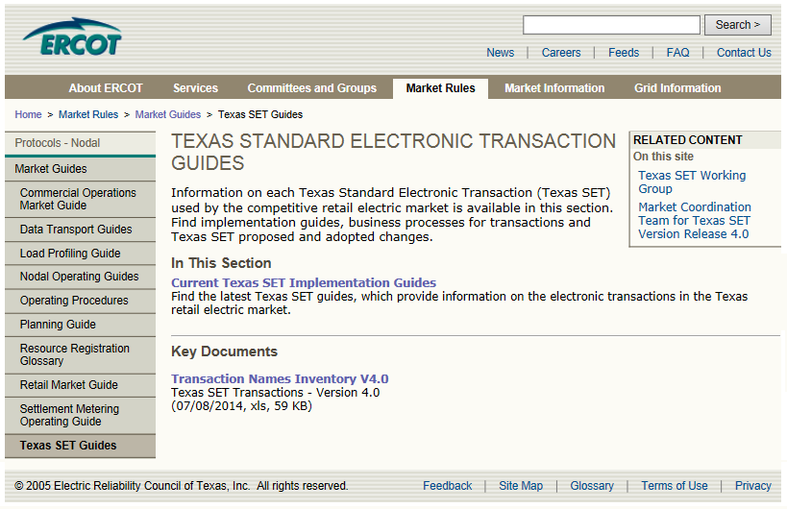
Texas Standard Electronic Transactions (TX SET)
Transaction Names Inventory and Pocket Card
Notes:
But for quick reference, there is also a Transaction Name Inventory posted on ERCOT.com, complete with a handy pocket card. We printed and laminated pocket cards to give you here today. We hope that you will find them as useful as we do. We also hope that you will use them in the upcoming class scenarios!

Slide 7
Texas Standard Electronic Transactions (TX SET)
Many transactions involve ERCOT
Transaction Type | Use
814’s – ESI ID info and Relationships (Many flavors) | Enrollments; Switch Requests; Move-Ins; Move-Outs; ESI ID Maintenance
867’s – Premise Usage | Initial Meter Read; Historical / Monthly Usage
824’s – Reject Notification | Notice of Invoice / Usage Rejection
Notes:
Instructor should point students to the pocket card for this discussion. Point out how many different 814’s there are.

Slide 8
Texas Standard Electronic Transactions (TX SET)
Some transactions do not involve ERCOT
Transaction Type | Use
810’s – TDSP Invoice | TDSP Bills the REP for Delivery Charges
820’s – Payments | REP Payments to the TDSPs
650’s – Service Order Requests | Disconnects for Non-Pay; Reconnects Switch Hold and Switch Hold Removal; Outage Notification
824’s – Reject Notification | TDSP Invoice Rejection
These are called Point-to-Point Transactions

Slide 9
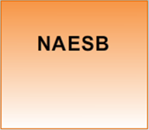
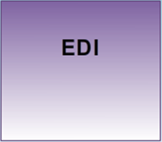
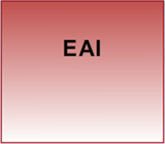
ERCOT Involved Transactions
What are the systems?
North American Energy Standards Board
Standards for data delivery
Allows standardized communication
Electronic Data Interchange
Validation
Decoding
Enterprise Application Integration
Universal translator
Integrates data across multiple applications
Notes:
Let’s spend some time looking at the transactions involving ERCOT. We want to start by looking at the systems that are involved in these transactions.

Slide 10

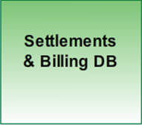
ERCOT Involved Transactions
What are the systems?
System of Record for Relationships
Currently Siebel
System of Record for ESI ID data
System of Record for usage
ERCOT-developed system
Notes:
The remaining systems are databases and serve as Systems of Record. The Registration Database, which is currently Siebel, is the system of Record for Market Relationships. The Settlement & Billing Database is then the System of Record for ESI ID data and usage. The current version of this system was developed internally by ERCOT.

Slide 11
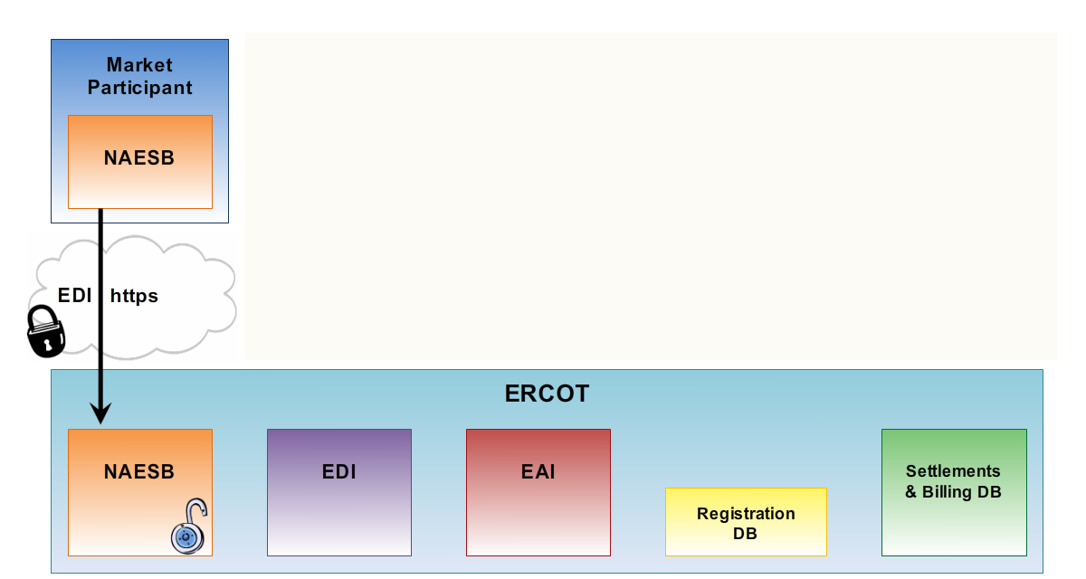
Systems for ERCOT Involved Transactions
Communication between NAESB Servers
Market Participant initiates secure communication over Secured Socket Layer (SSL)
Market Participant sends encrypted EDI package
ERCOT NAESB server identifies and decrypts EDI files

Slide 12

Systems for ERCOT Involved Transactions
Electronic Data Interchange (EDI) Server
Decrypted EDI files pushed to EDI Server
Validated against TX SET and ANSI X12
Translated from EDI into XML

Slide 13

Systems for ERCOT Involved Transactions
Enterprise Application Integration (EAI) System
Receives XML files from the EDI Server
Formats data for transfer to other ERCOT Databases

Slide 14
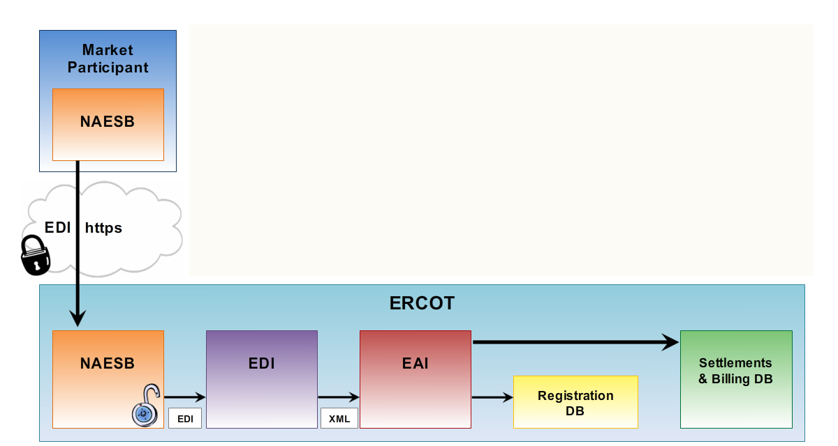
Systems for ERCOT Involved Transactions
Registration Database (Siebel)
Stores REP registration information
Manages ESI ID to REP relationships

Slide 15

Systems for ERCOT Involved Transactions
Settlements and Billing Database
Stores all ESI ID characteristics
Receives ESI ID to REP relationships through daily batch process
Incorporates relationship data into Service History for use in the settlement process

Slide 16
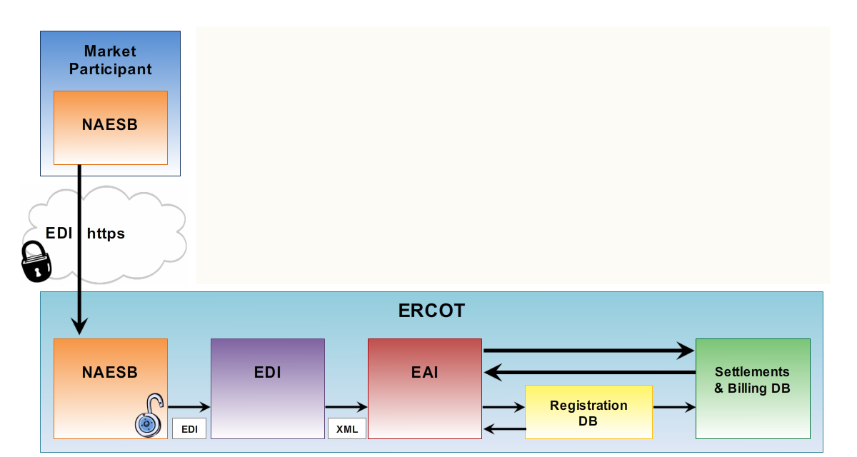
Systems for ERCOT Involved Transactions
Processed transactions sent back
through systems
Returned to EAI
EAI translates to XML

Slide 17

Systems for ERCOT Involved Transactions
Processed transactions sent back
through systems
XML passed to EDI Server
Translated back into EDI format

Slide 18

Systems for ERCOT Involved Transactions
Processed transactions sent back
through systems
EDI passed back to NAESB
EDI files encrypted once again

Slide 19
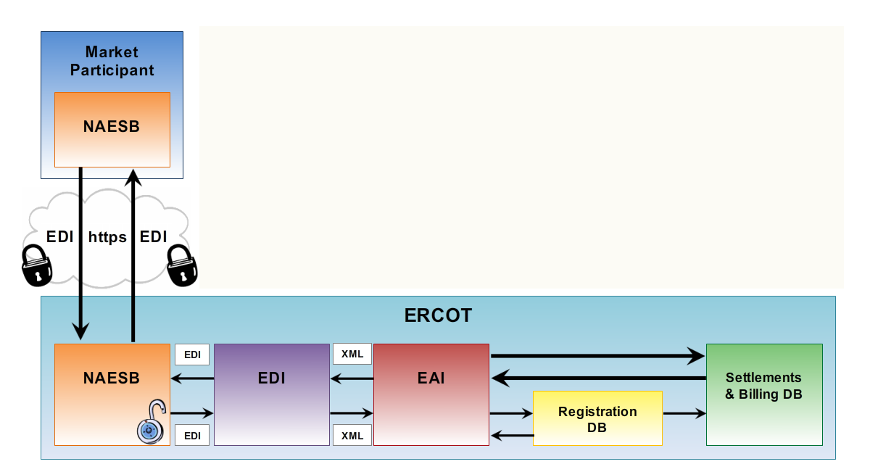
Systems for ERCOT Involved Transactions
Communication between NAESB Servers
ERCOT initiates secure communication over Secured Socket Layer (SSL)
ERCOT sends encrypted EDI package to Market Participant

Slide 20
Another Definition
Business Process:
A pre-defined package of retail transactions that must occur in a particular sequence
Developed and maintained by ERCOT and the TX SET Working Group
REP
814_16
ERCOT
814_03
TDSP
814_04

Slide 21

ERCOT Involved Transactions
Typical Retail Business Processes
Move-In
Move-Out
Switch Request
REP #1
REP #2
Others illustrated at http://www.ercot.com/mktrules/guides/txset/sw/index

Slide 22
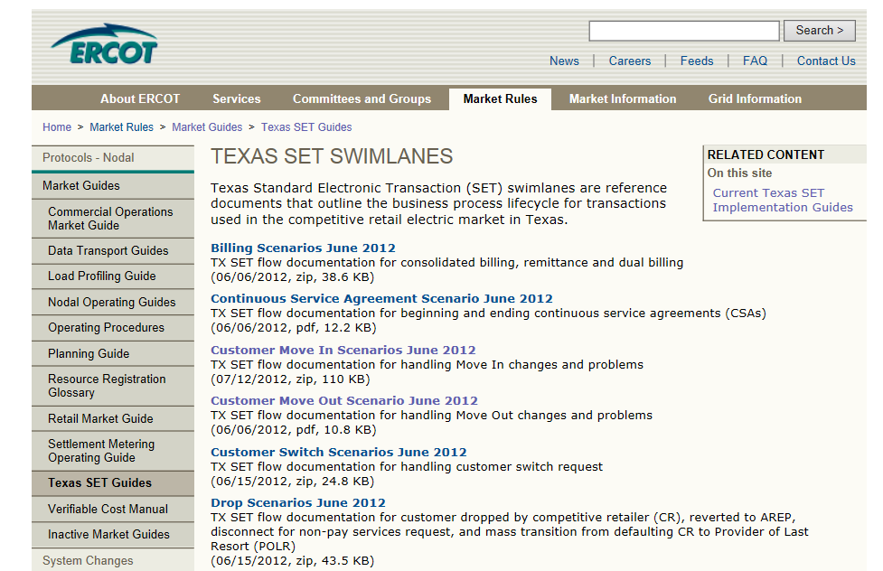
The Swimlanes!
Notes:
<Instructor should ask,> Has anyone heard of the Texas Set Swimlanes?”
If you have heard that they are scary, don’t worry, we will be using a more simplified approach for demonstrating a few Service Order Requests. However, it is important that you know where to find the Swimlanes for future reference and further exploration.

Slide 23
Customer Move-In
From
To
Transaction Type
ERCOT
TDSP
REP
ERCOT
TDSP
REP
Move In Request
814_16
Enrollment
Notification Request
814_03
Enrollment
Notification Response
814_04
CR Enrollment
Notification Response
814_05
Historical
Usage
867_02
Initial Meter
Read
867_04
Notes:
The following set of scenarios illustrate three major business process that utilize ERCOT-Involved transactions. Important: Learners must have their pocket cards (handed out earlier) to participate in this activity. These scenarios allow the instructor to walk the class through these processes step by step and encourage students to use the pocket card to begin speaking the transaction lingo.
As we can see here, the move-in process involves multiple transactions. In fact, the Move-In Business Process is a pre-defined package of transactions that must occur in a particular sequence. Notice that the sequence is initiated with the Move-In Request transaction. What follows is an ERCOT-facilitated exchange of information between ERCOT, a Competitive Retailer (REP), and the TDSP that physically connects the retail premise to the grid. Each transaction has a code number as specified in Texas SET. A transaction will always flow between at least two parties.
[Instructor should facilitate this classroom exercise as follows:]
As we have said, a Move-In Request is used to begin the Customer enrollment process for a Move-in. Using the reference cards that we handed out earlier, can someone tell me the transaction number?
Great! <Click to display number> And what parties does the transaction flow from and to?
Great! <Click to display dots> The Move-In Request is sent from the REP to ERCOT
The next transaction is the Enrollment Notification Request. What’s the number for that one? <Click to display> Who sends and receives it? <Click to display>
Great! This transaction notifies the TDSP of a Move-In, so that they can schedule meter reads.
The next transaction is the Enrollment Notification Response. What’s the number for that one? <Click to display> Who sends and receives it? <Click to display>
Great! With this transaction, the TDSP acknowledges the enrollment request and provides the Scheduled Meter Read Date.
The next transaction is the CR Enrollment Notification Response. What’s the number for that one? <Click to display> Who sends and receives it? <Click to display>
Perfect! This transaction passes the TDSP acknowledgement back to the REP, so that they will also know Scheduled Meter Read Date. This is important because it effectively marks the beginning of the REP’s service history with this customer.
The Historical Usage, if requested through the Move-in Request, provides the REP with up to 12 months of historical metered consumption at the premise. This data provides the REP with a starting point for estimating energy consumption for this customer, so that they can adequately prepare for it at the wholesale level. What’s the number for this transaction? <Click to display> Who sends and receives it? <Click to display> [Two clicks this time. Instructor may need to facilitate the two steps here]
Perfect! This transaction actually requires two steps. First the TDSP provides the Historical Usage to ERCOT, and then ERCOT passes the data on to the REP.
Lastly, the Initial Meter Read also occurs in two steps. What’s the number for this transaction? <Click to display> Who sends and receives it? <Click to display> [Two clicks again]. Great! The TDSP provides the Initial Meter Read to ERCOT, and then ERCOT passes the data on to the REP. This meter read forms the starting point for the REP’s service history with the customer. ERCOT will also use this information as the starting point for calculating wholesale energy consumption at the QSE level.

Slide 24
Customer Move-Out
From
To
Transaction Type
ERCOT
TDSP
REP
ERCOT
TDSP
REP
Move Out Request
814_24
Move Out Response
814_25
Final Meter Read
867_03
Notes:
Our next scenario, the Move-Out Business, is a little bit simpler.
[Instructor should facilitate as in previous scenario]

Slide 25
Switch Request
From
To
Transaction Type
ERCOT
Old REP
TDSP
New REP
ERCOT
Old REP
TDSP
New REP
Switch Request
814_01
Enrollment
Notification Request
814_03
Enrollment
Notification Response
814_04
CR Enrollment
Notification Response
814_05
Loss Notification
814_06
Final Usage
867_03
Initial Meter Read
867_04
Notes:
The next scenario, a Switch Request, becomes more complicated. Notice that there are simply more transactions. Plus, this type Service Order Request involves two REPs!
[Instructor should facilitate as in previous scenarios]

Slide 26
Common Transaction Timelines
Enrollment type Initiating Transaction | AMS Remote (AMSR) | AMS Manual (AMSM) | Non-AMS
Move-In 814_16 | Same Day | 2 Business Days | 2 Business Days
Standard Switch 814_01 | Same Day | Same Day | Within Next 4 Business Days
Self Selected Switch 814-01 | Same Day | Same Day | At Least 2 Business Days
For purposes of determining these minimum timelines, business hours end at 1700
Notes:
Please note the different turnaround times for AMS and Non-AMS meters. Also AMS meters with remote connect/disconnect capabilities also have different turnaround times for Move-ins (and Disconnects for non-payment, as we shall see later)

Slide 27
Point-to-Point Transactions
What are the systems?
Need some help here. I assume MP Communications occur via NAESB, but what other systems are involved?

Slide 28
Disconnect/Reconnect for Non-Payment
From
To
Transaction Type
TDSP
REP
TDSP
REP
Service Order: Request for DNP/RNP
REP must give customer at least ten days notice
650_01
Service Order: Response for completion of DNP/RNP
650_02
Timing requirements vary depending on circumstances. Details in PUCT Substantive Rules and Retail Market Guide

Slide 29
Billing and Payment
From
To
Transaction Type
ERCOT
TDSP
REP
ERCOT
TDSP
REP
Monthly Usage
867_03
From
To
Transaction Type
TDSP
REP
TDSP
REP
REP combines 810_02 with 867_03 (and
QSE charges) to bill Customer
Invoice
(Wires Charges)
810_02
REP Pays TDSP through
HACHA/Wire Transfer
Remittance Detail
820_02

