Slide 1
GTBD Bias Analysis
ERCOT Market Analysis and Design
PDCWG August 25, 2015

Slide 2
Introduction
SCR773 metrics has shown significant improvement in regulation deployment
Pricing analysis has shown significant price spikes associated with the adjustments for SCR773 and STLF errors.
Reevaluate the SCR773 metrics to determine a solution that would improve regulation deployment while maintaining prices that reflect the system conditions
  Is 15 min the right interval for the zero crossing metric?
  Would a metric of total avg hourly reg <50MW attain the desired outcome ?
  Would an ACE component be helpful ?
Notes:
Total generation is the sum of all output from units, which already includes deployed regulation.
GTBD = (total generation) should cover current load
GTBD = (total generation + K3*5 * STLF Predicted Load Ramp Rate) should cover load after 5 min when K3=1 if prediction is accurate and doesn’t have any bias
K4 term was added to recover and price constant reg deployment in one direction due to generator not following BPs
K4 > 0 does not make GTBD equal to current load or predicted load after 5 mins. It makes GTBD above or below load based on the direction of reg deployment to help recover regulation faster and reduced average regulation deployed
Average Filtered Regulation is an exponentially smoothed regulation signal using
Filter Ave Reg_{t} = Filter Ave Reg_{t-1} + k * (Reg Deployed_{t} – Filter Ave Reg _{t-1})
Weights large recent changes in deployed regulation heavily while older values drop off exponentially

Slide 3
System Lambda from SCED Rerun with Perfect GTBD
Average reduction in price over
these SCED intervals is ~$425
Notes:
SCED rerun of all intervals in past year with system lambda >$300/MWh (all high prices)

Slide 4
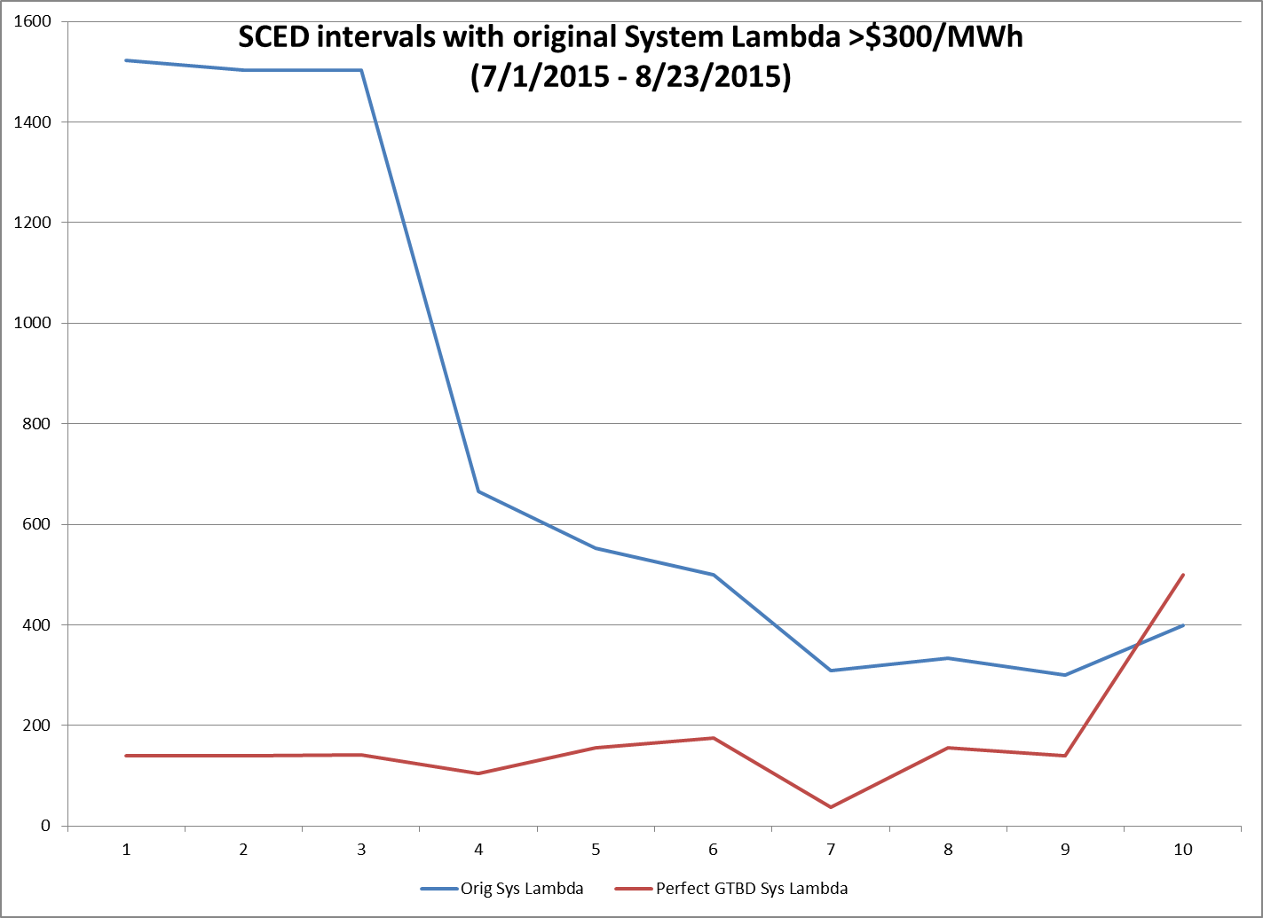
System Lambda from SCED Rerun with Perfect GTBD
Average reduction in price over
these SCED intervals is ~$590
Notes:
SCED rerun of all intervals in past year with system lambda >$300/MWh (all high prices)

Slide 5
Generation To Be Dispatched
6.5.7.3 (2) The SCED solution must monitor cumulative deployment of Regulation Services and ensure that Regulation Services deployment is minimized over time.
GTBD = Total Generation
    + K3 * 5 * STLF Predicted Load Ramp Rate
    + K4 * Average Filtered Regulation
K3 = 130% ; K4 = 50%
K4 term was added to recover and price constant reg deployment in one direction due to generator not following BPs
Notes:
Total generation is the sum of all output from units, which already includes deployed regulation.
GTBD = (total generation) should cover current load
GTBD = (total generation + K3*5 * STLF Predicted Load Ramp Rate) should cover load after 5 min when K3=1 if prediction is accurate and doesn’t have any bias
K4 term was added to recover and price constant reg deployment in one direction due to generator not following BPs
K4 > 0 does not make GTBD equal to current load or predicted load after 5 mins. It makes GTBD above or below load based on the direction of reg deployment to help recover regulation faster and reduced average regulation deployed
Average Filtered Regulation is an exponentially smoothed regulation signal using
Filter Ave Reg_{t} = Filter Ave Reg_{t-1} + k * (Reg Deployed_{t} – Filter Ave Reg _{t-1})
Weights large recent changes in deployed regulation heavily while older values drop off exponentially

Slide 6
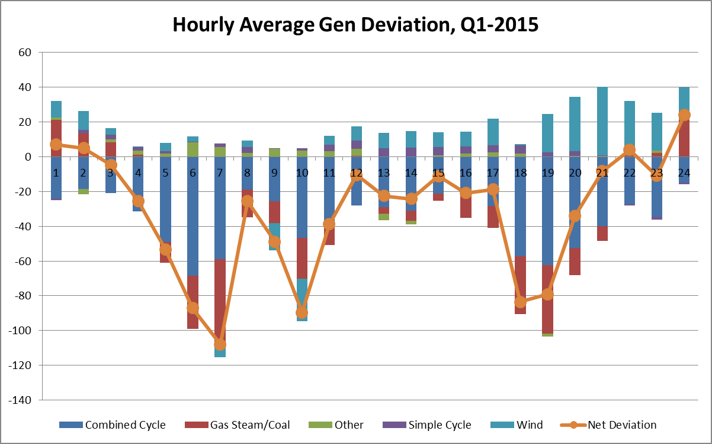
Expected Generation Deviation, Q1-2015

Slide 7
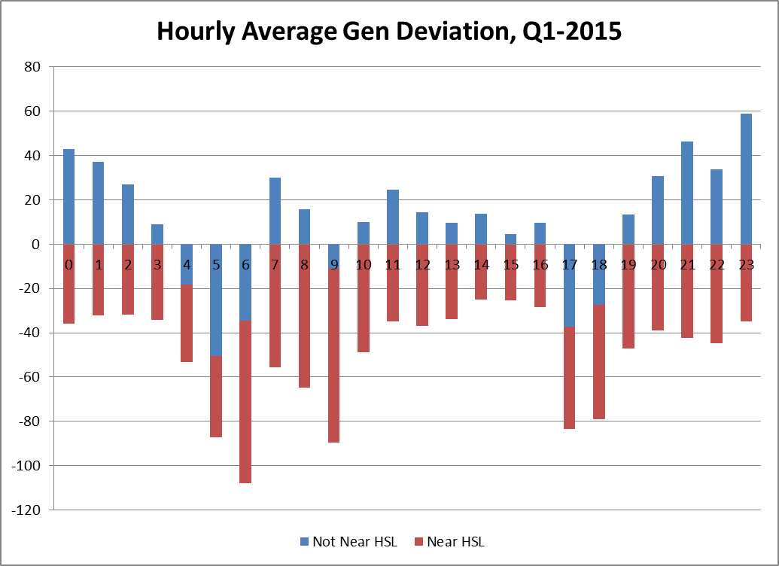
Expected Generation Deviation, Q1-2015

Slide 8
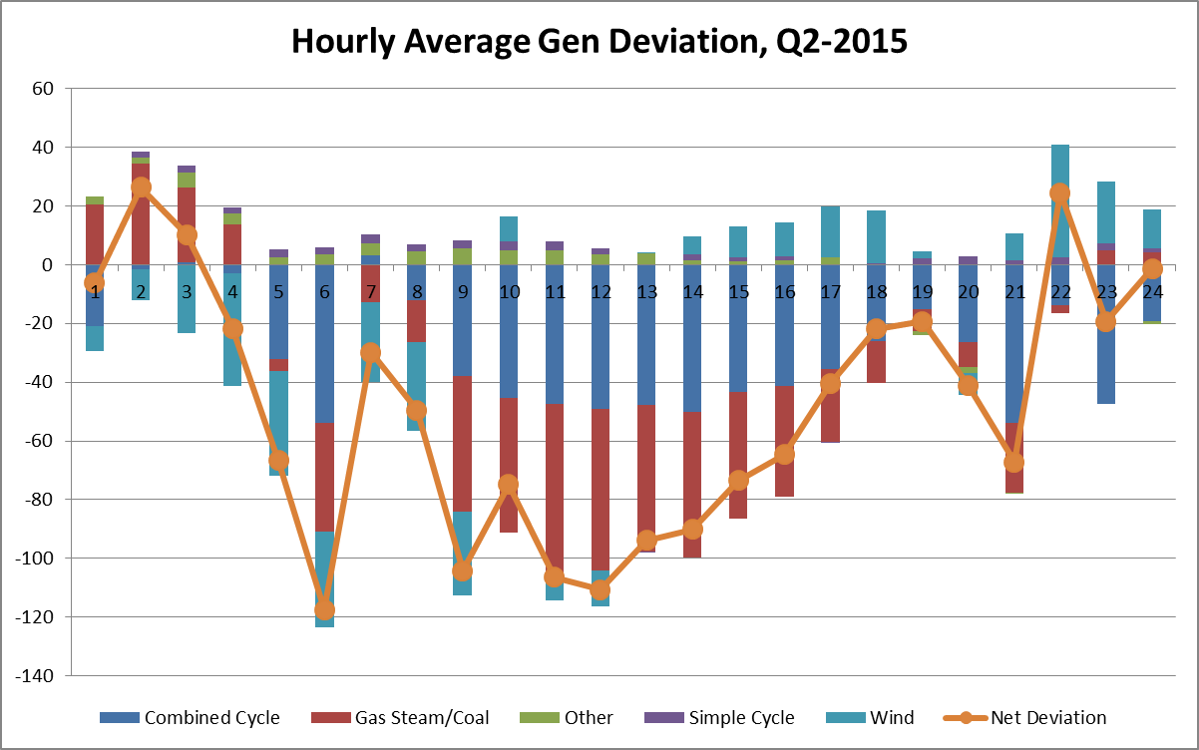
Expected Generation Deviation, Q2-2015

Slide 9
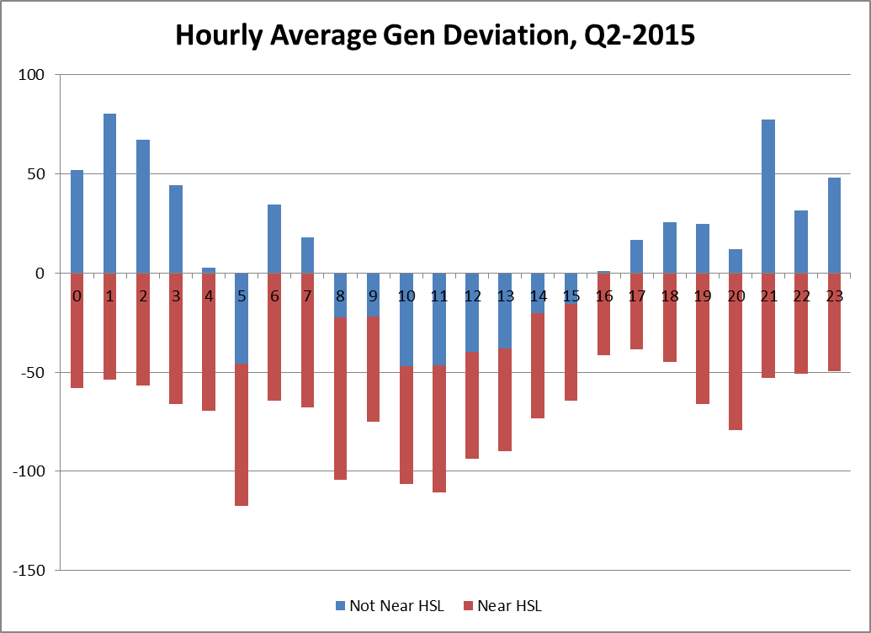
Expected Generation Deviation, Q2-2015

Slide 10
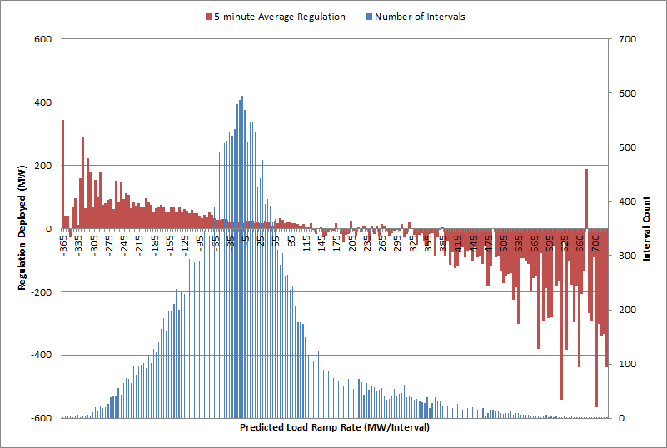
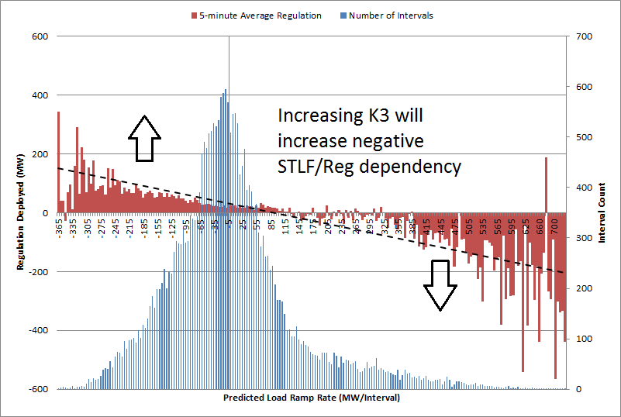
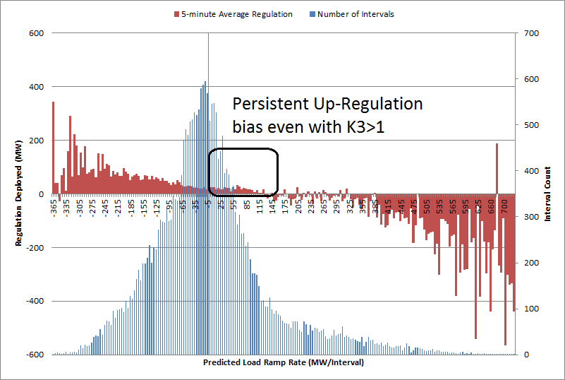
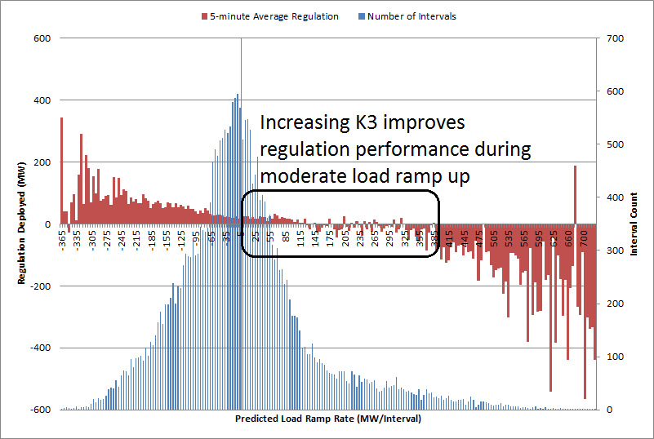
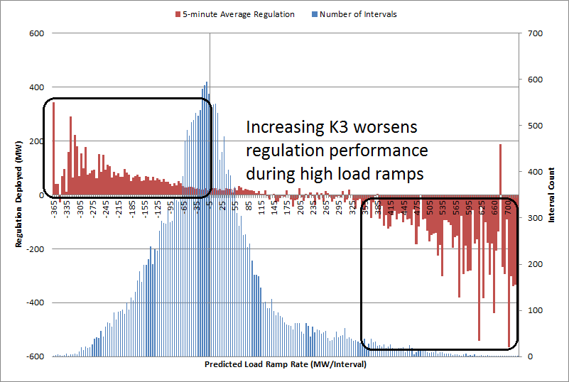
Regulation vs Load Ramp, Q1-2015
 | Load Decreasing
Average |Reg| | 104
Average Reg | 43
Upreg Bias | 64%
Downreg Bias | 36%
 | Load Increasing
Average |Reg| | 105
Average Reg | 5
Upreg Bias | 53%
Downreg Bias | 47%

Slide 11
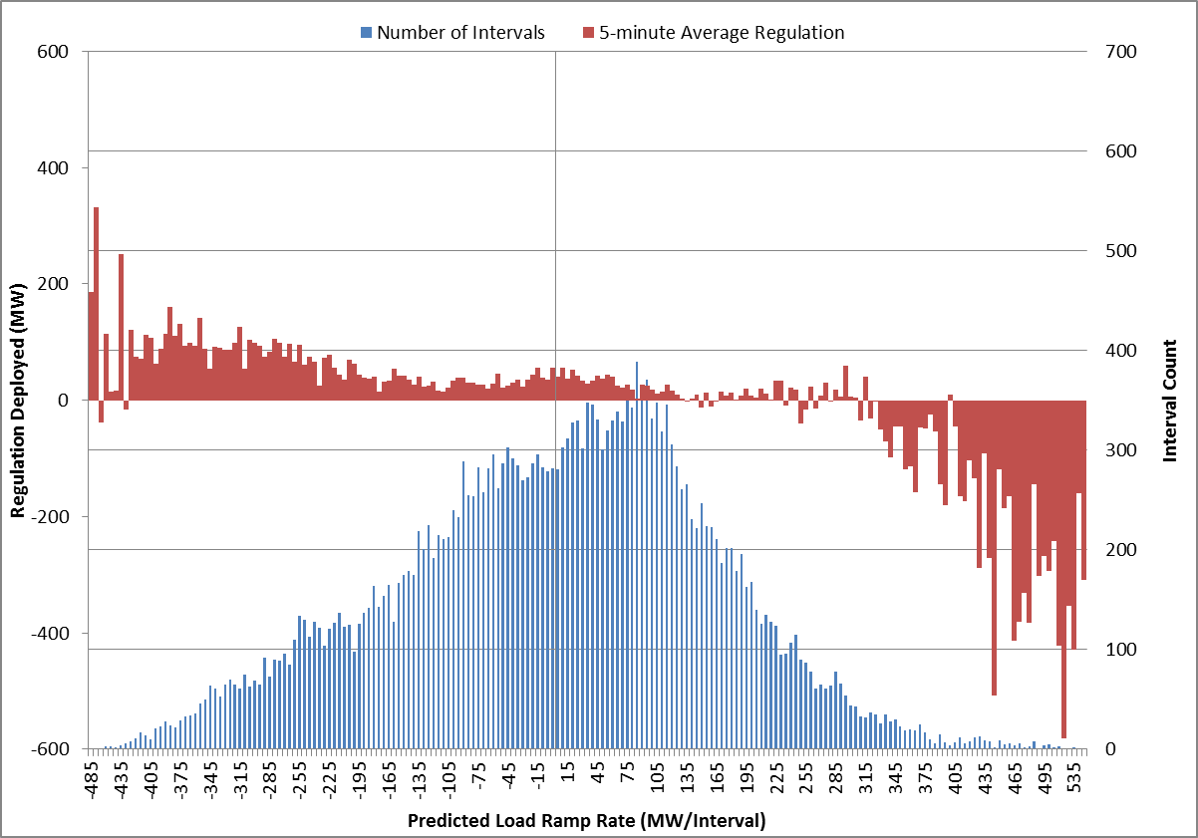
Regulation vs Load Ramp, Q2-2015

Slide 12
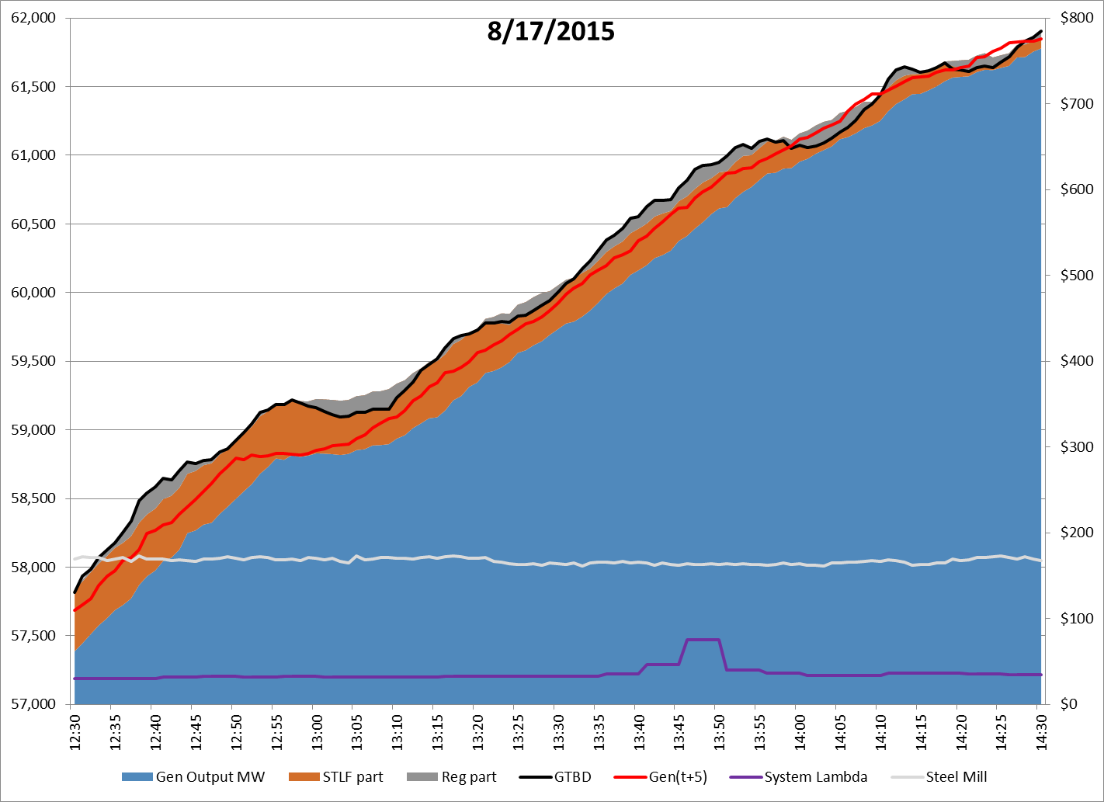
GTBD Component Analysis

Slide 13
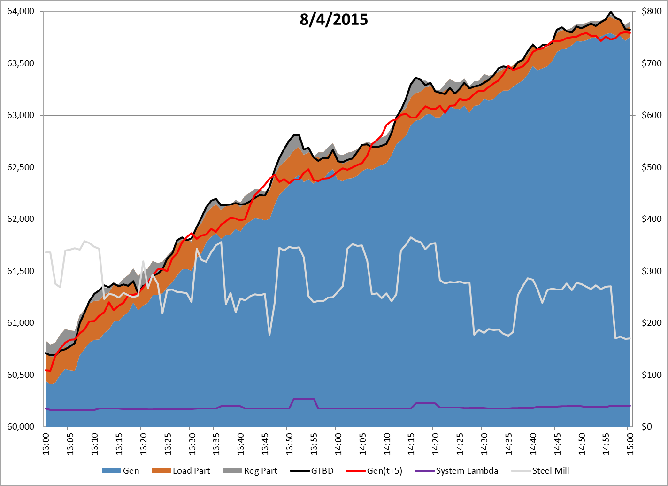
GTBD Component Analysis

Slide 14
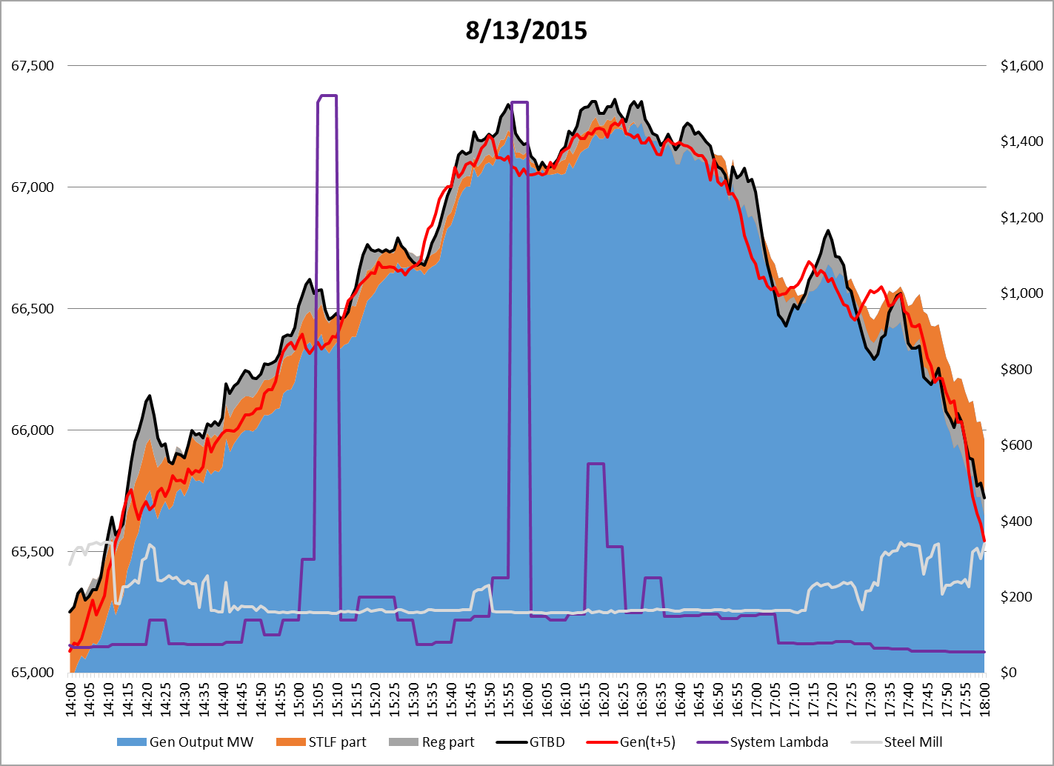
GTBD Component Analysis

Slide 15
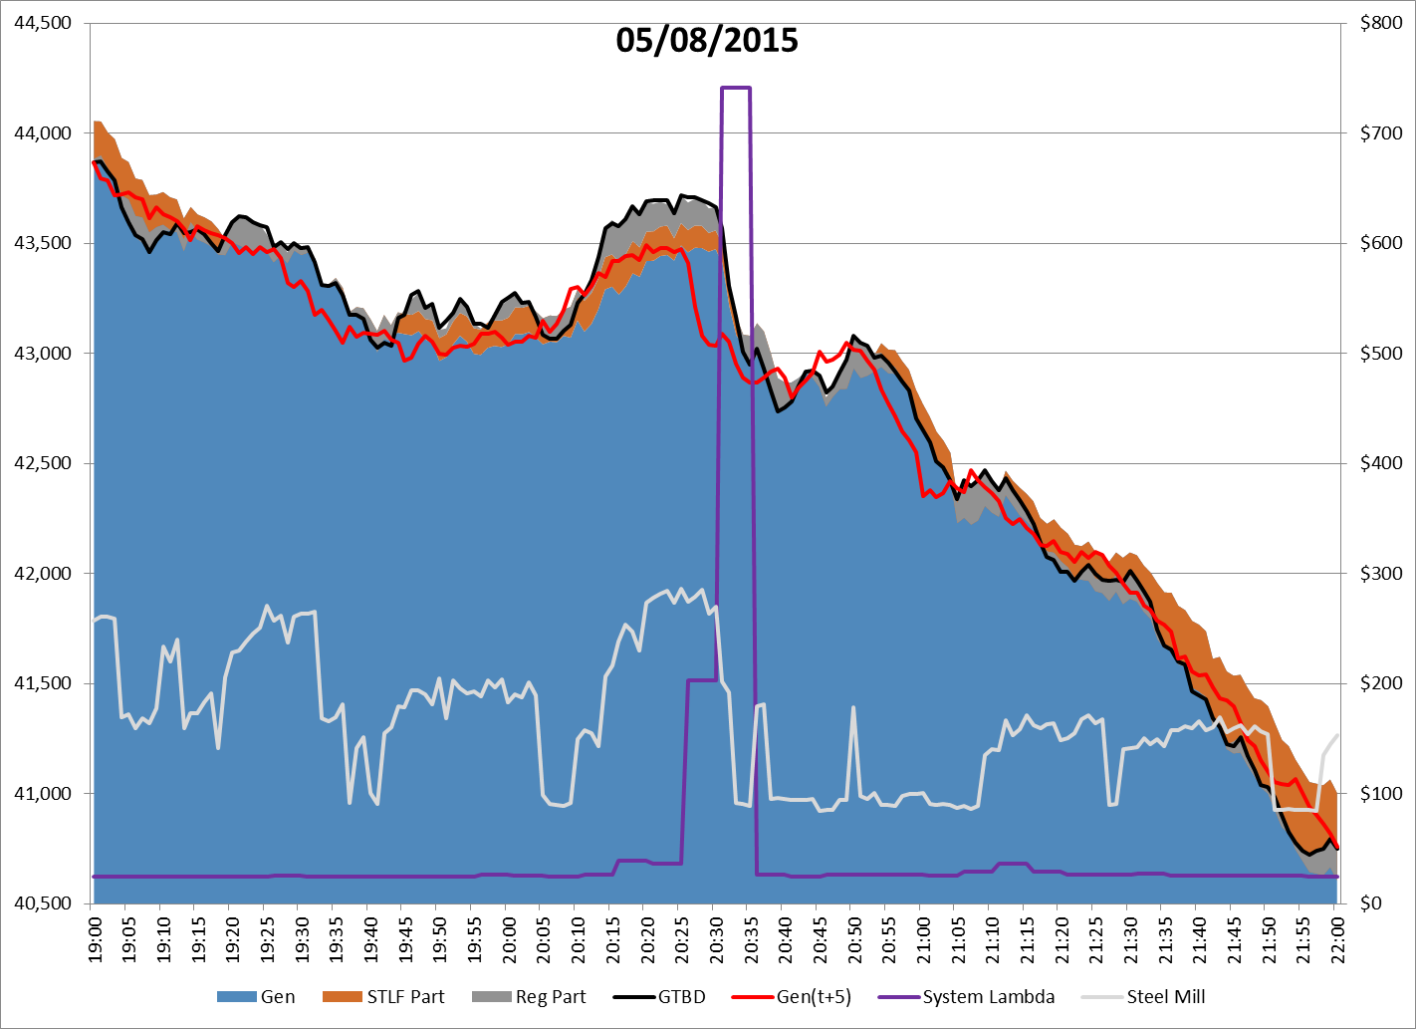
GTBD Component Analysis

Slide 16
Observations
Persistent bias towards up-regulation
  Generators are slower to ramp up than ramp down
  Generators are slow to ramp near HSL
  Correcting this bias means overshooting/undershooting actual load in GTBD and increasing GTBD ramp
Current method improves regulation deployments, but can cause excessive GTBD oscillation
  Worse with STLF error or generator lag
GTBD oscillation increases requested ramping, causing price spikes

Slide 17
Possible Improvements
Slower integral terms could help balance regulation deployments with less oscillation
  Reduce K3 and K4 while adding integrated ACE/regulation term
  Modify regulation crossover metric interval
Reduce expected generation deviation
Improve STLF to reduce impact of temporary generation/load swings

Slide 18
Summary
SCR773 metrics have shown significant improvement in regulation deployment
Pricing analysis has shown significant price spikes associated with the adjustments for SCR773 and STLF errors.
Revaluate the SCR773 metrics to determine a solution that would improve regulation deployment while maintaining prices that reflect the system conditions
  Is 15 min the right interval for the zero crossing metric?
  Would a metric of total avg hourly reg <50MW attain the desired outcome ?
  Would an ACE component be helpful ?
Notes:
Total generation is the sum of all output from units, which already includes deployed regulation.
GTBD = (total generation) should cover current load
GTBD = (total generation + K3*5 * STLF Predicted Load Ramp Rate) should cover load after 5 min when K3=1 if prediction is accurate and doesn’t have any bias
K4 term was added to recover and price constant reg deployment in one direction due to generator not following BPs
K4 > 0 does not make GTBD equal to current load or predicted load after 5 mins. It makes GTBD above or below load based on the direction of reg deployment to help recover regulation faster and reduced average regulation deployed
Average Filtered Regulation is an exponentially smoothed regulation signal using
Filter Ave Reg_{t} = Filter Ave Reg_{t-1} + k * (Reg Deployed_{t} – Filter Ave Reg _{t-1})
Weights large recent changes in deployed regulation heavily while older values drop off exponentially

