Slide 1
Regulation Bias Analysis Post SCR-773
August 2015
PDCWG Meeting 8/25/2015

Slide 2
Discussion Points
Current GTBD Parameters
Metric to measure Regulation bias and performance
Regulation Deployed comparison (June to August)
Total Regulation (net) Deployed comparison
Regulation Deployed 15-minute interval comparison by each hour for 2013, 2014 and 2015 months
Regulation Exhaustion Rate
Regulation bias for consecutive 5-min interval
Time Error & Contributing Factors
  Hourly Accumulated Time Error
  Start-Up/Shut-Down Hours
  Hourly Average 5-min STLF Error
  Hourly Average Expected Generation Deviation
Summary
Notes:
Regulation Deployed comparison (June to August)

Slide 3
Metric to measure SCR-773 performance
Trend and monitor the regulation deployed by hour
Set target of 50 MW for total regulation deployed by hour for peak hours (HE 14 to HE 18)
Set target of 85% for the number of intervals where regulation deployment was both up and down (zero crossing) for peak hours (HE 14 to HE 18)
Track the Regulation exhaustion rate for all hours (not to exceed <1.2% )
Using a 50MW filter, target 15 occurrences or less per month for regulation bias of six or more consecutive 5 minute intervals for peak hours (HE 14 to HE 18).

Slide 4
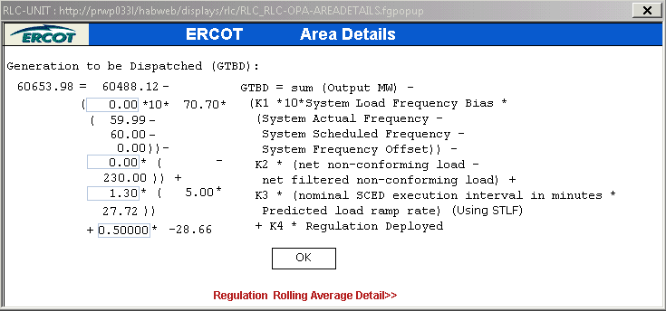
Current GTBD Parameters

Slide 5
Total Regulation Deployed Comparison
Total regulation deployed for the last three months (June, July, August)

Slide 6
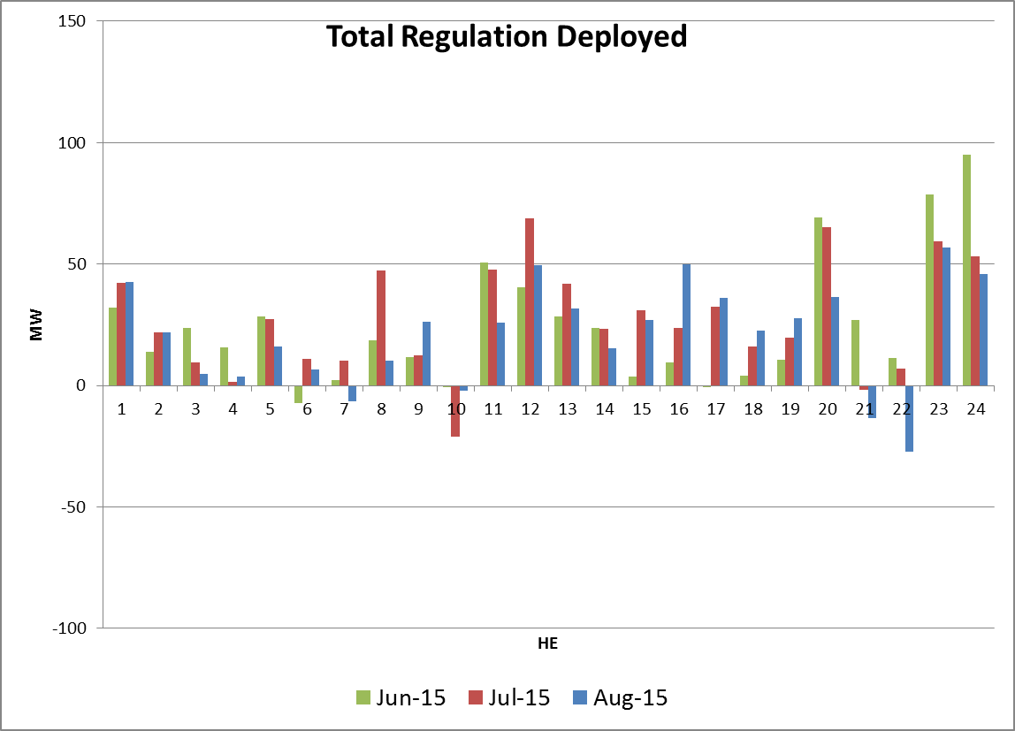
Hourly Total-Regulation Deployed Monthly Comparison (Last 3 Mo.)

Slide 7
Regulation Deployed Comparisons
Metric 1
Trend and monitor the regulation deployed by hour

Slide 8
Regulation Deployed comparison - Table

Slide 9
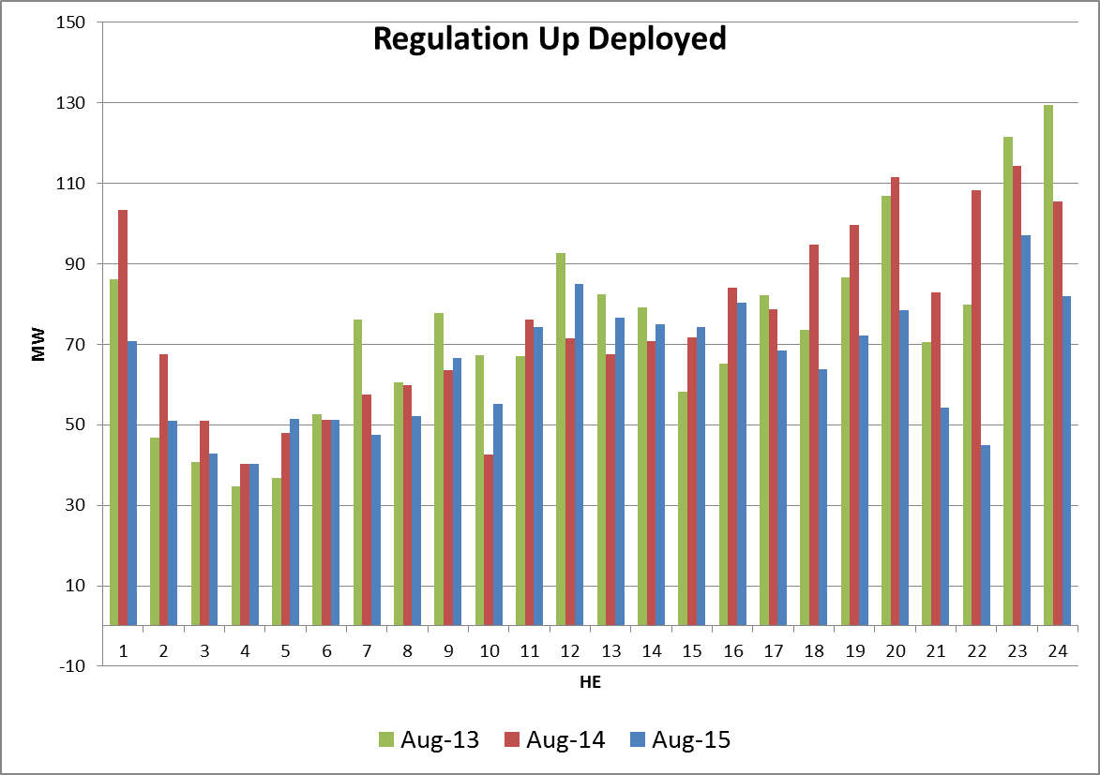
Hourly Regulation-Up Deployed Monthly comparison - Chart

Slide 10
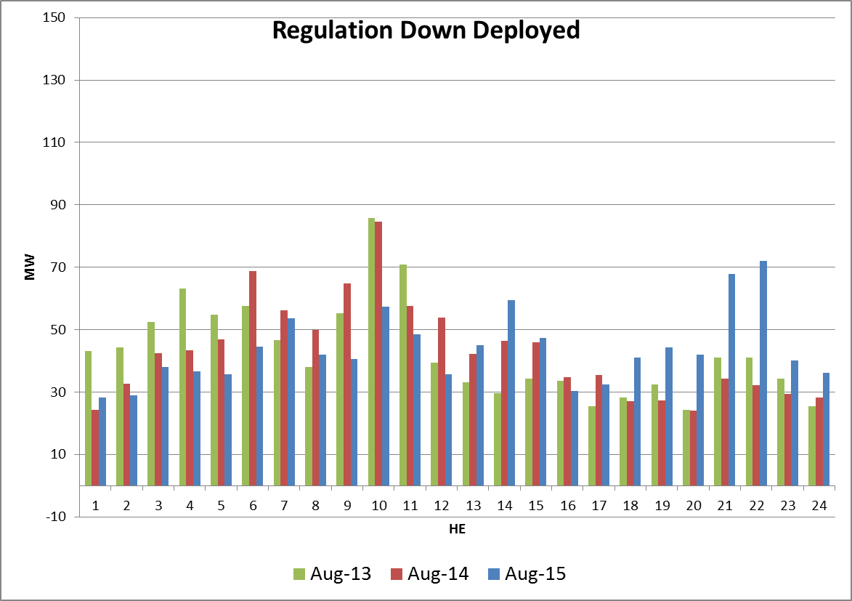
Hourly Regulation-Down Deployed Monthly comparison - Chart

Slide 11
Total Regulation Deployed Comparisons
Metric 2
Set target of 50 MW for total regulation deployed by hour for peak hours (HE 14 to HE 18)

Slide 12
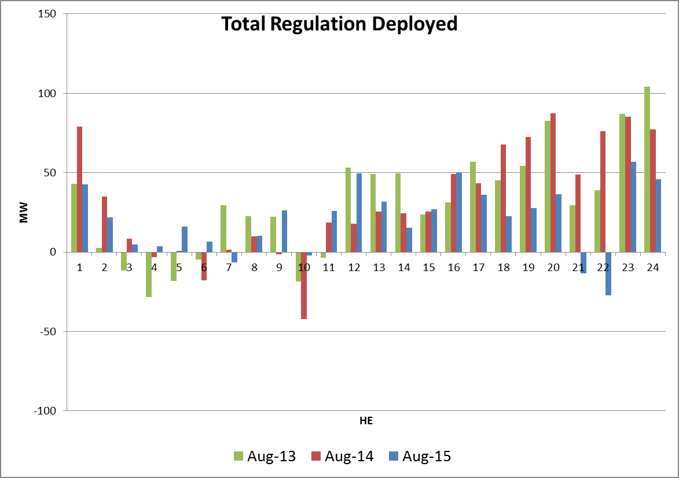
Hourly Total-Regulation Deployed Monthly comparison - Chart

Slide 13
15-Minute intervals where both Reg-Up/Down were deployed
Metric 3
Set target of 85% for the number of intervals where regulation deployment was both up and down (zero crossing) for peak hours (HE 14 to HE 18)

Slide 14
Regulation Deployed 15-Minute Interval Comparison – by hours

Slide 15
Regulation Exhaustion Rate
Metric 4
Track the Regulation exhaustion rate for all hours (not to exceed <1.2% )

Slide 16
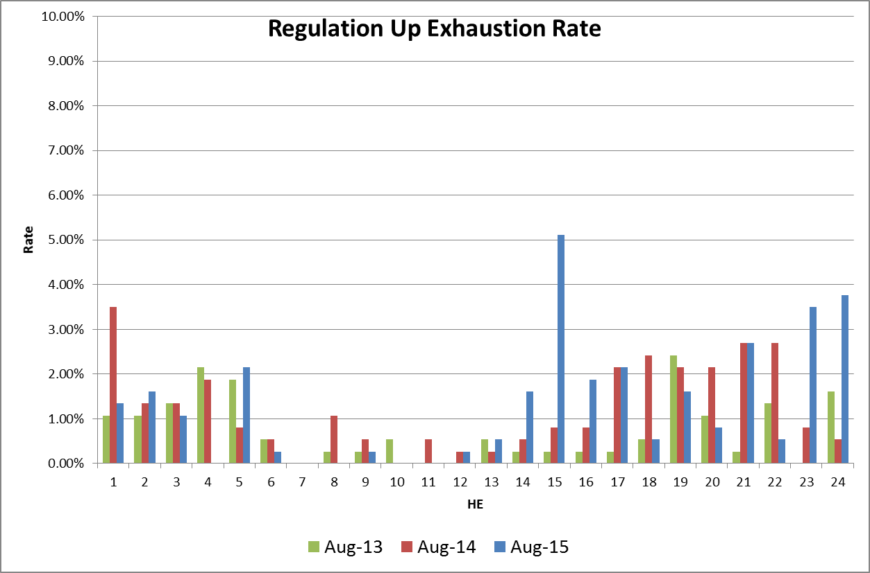
Regulation-Up Exhaustion Rate – by hours

Slide 17
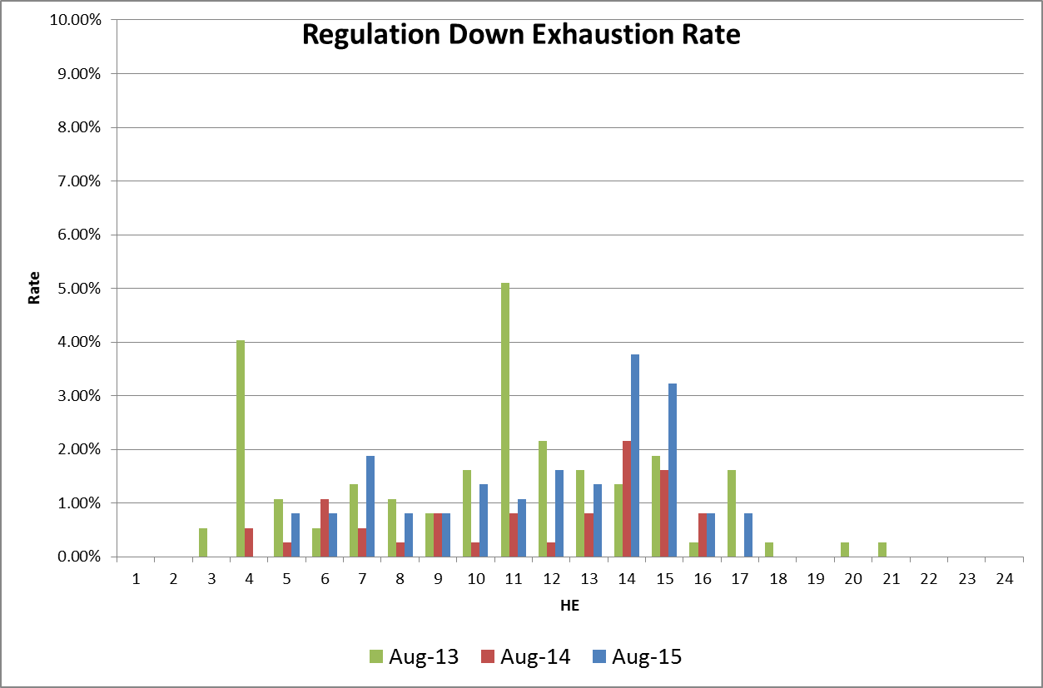
Regulation-Down Exhaustion Rate – by hours

Slide 18
Stats on Reg-Up Bias for consecutive 5-min intervals
Metric 5
Using a 50MW filter, target 15 occurrences or less per month for regulation bias of six or more consecutive 5 minute intervals for peak hours (HE 14 to HE 18*).

Slide 19
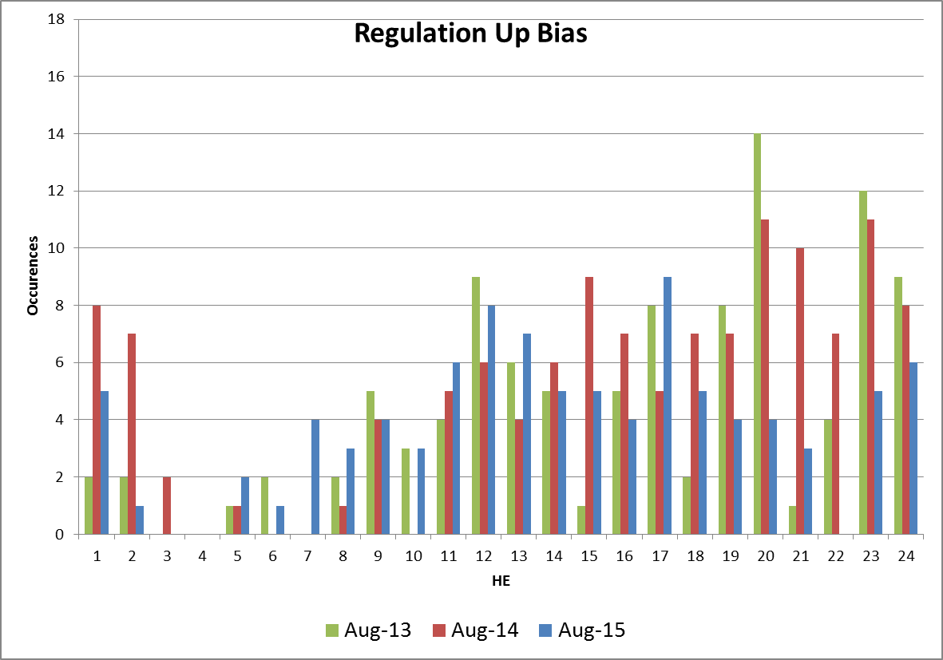
Reg-Up Bias for six Consecutive 5 min intervals (50 MW filter)

Slide 20
Time Error & Contributing Factors

Slide 21
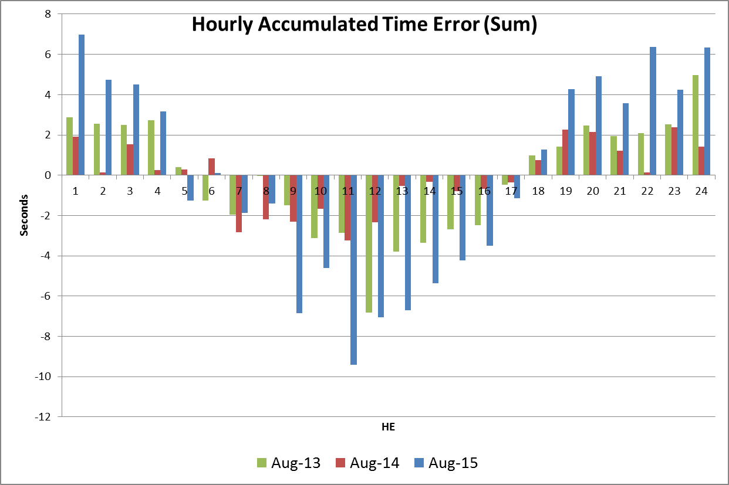
Hourly Accumulated Time Error

Slide 22
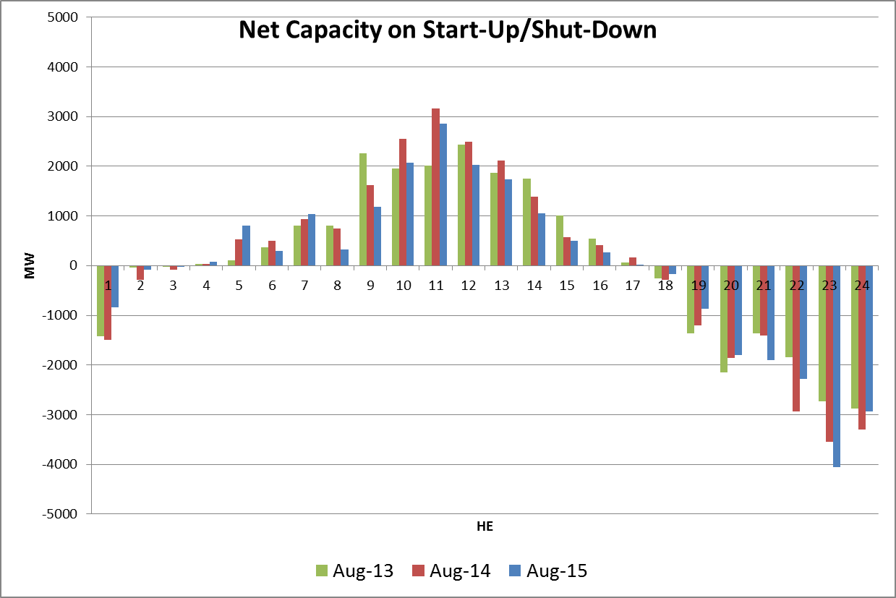
Start-Up/Shut Down Hours

Slide 23
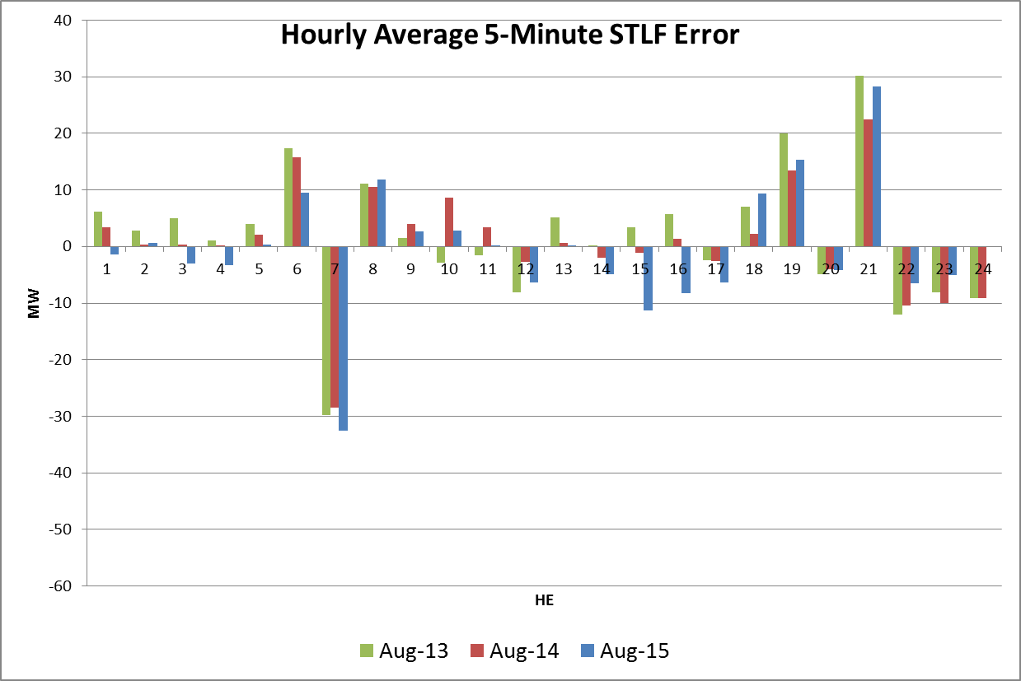
Hourly Average 5-minute STLF Error

Slide 24
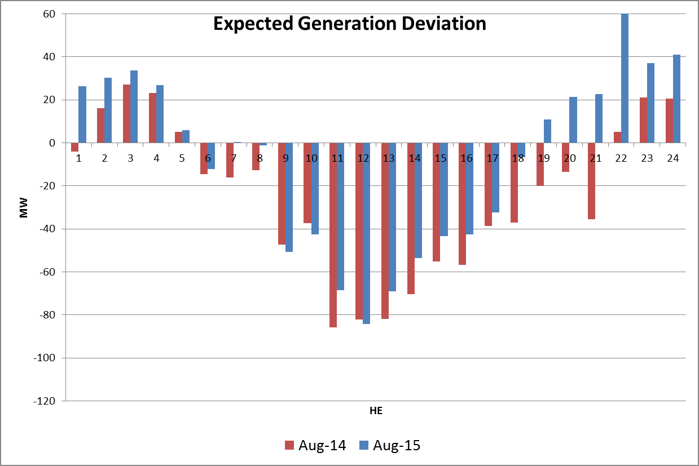
Hourly Average Expected Generation Deviation

Slide 25
Questions?

