Slide 1
Update to RMS
September 1st, 2015

Slide 2
RMGRR129 – Revision to Customer Rescission Completion Timeline
Timely execution of a customer rescission after completion of a switch transaction.
Gaining CR submits timely Rescission MT
Losing CR is provided two (2) Business Days to ‘agree’ and transition the Rescission MT
Losing CR shall submit the appropriate back-dated Move-In transaction (BDMVI) within another (2) days of the TDSP updating the MT status to “ready to receive”
UPDATE –
TAC to review for final approval
If approved, language will be grey-boxed in RMG in September with grey-box removed 10/1/2015 to align with the effective date

Slide 3
RMGRR Draft – Clarification of Inadvertent Gain Valid/Invalid Reject Reasons
Minimize confusion of valid reject reasons to improve the resolution time for Inadvertent Gain MarkeTraks.
Previous language stated “ The customer has entered in multiple, valid contracts regarding the same ESI ID(s)”
CRs are interpreting and rejecting MTs utilizing the approved valid reject/unexecutable reason (c) “Losing CR has confirmed Customer’s intent to change REPs”
This leads to various MTs being rejected and the gaining CR with balances for which they may not be able to collect.
Proposed changes will minimize “bad actor” behavior and “gaming” of the system by customers.

Slide 4
MarkeTrask TaskForce: Updates
Inadvertent Gain Reporting – Impact by REP
Reviewed current reporting metrics by ERCOT listing top 10 REPs impact by volume
Also desire visibility into percentage of IAGs & IALs to overall transactions by REP
Creating buckets by # enrollments
low, medium, and high
Accompanied with respective percentages
Represented graphically
Review and finalize format of reports

Slide 5
MarkeTrak Documentation
http://www.ercot.com/services/client_svcs/mktrk_info/index.html
http://www.ercot.com/content/meetings/rms/keydocs/2014/0110/08.__RMS_MarkeTrak_Task_Force_20140104.ppt
http://www.ercot.com/content/meetings/rms/keydocs/2014/0603/07.__RMS_MarkeTrak_Task_Force_20140603.ppt
http://www.ercot.com/content/meetings/rms/keydocs/2014/1028/07.__RMS_MarkeTrak_Task_Force_20141028.ppt
http://www.ercot.com/content/meetings/rms/keydocs/2015/0106/09.__RMS_MarkeTrak_Task_Force_20150106.ppt
http://www.ercot.com/committees/board/tac/rms/marketraktf/index.html
http://www.ercot.com/content/committees/board/tac/rms/marketraktf/keydocs/2014/PR010_03_training_FINAL.ppt
http://www.ercot.com/content/wcm/training_courses/97/MarkeTrak_Detailed_Training_102014.ppt
http://www.ercot.com/committees/board/tac/rms/marketraktf/MarkeTrak SubTypes Quick Reference 20150510 v2
Link to IAG/Rescission training: http://www.ercot.com/committees/board/tac/rms/marketraktf/index.html/MarkeTrak IAG Training
User Guide
Bulk Insert Templates
MarkeTrak Workflows
MarkeTrak Tips and Tricks
MarkeTrak API WSDL/XSD
Also direct link from MarkeTrak tool

Slide 6
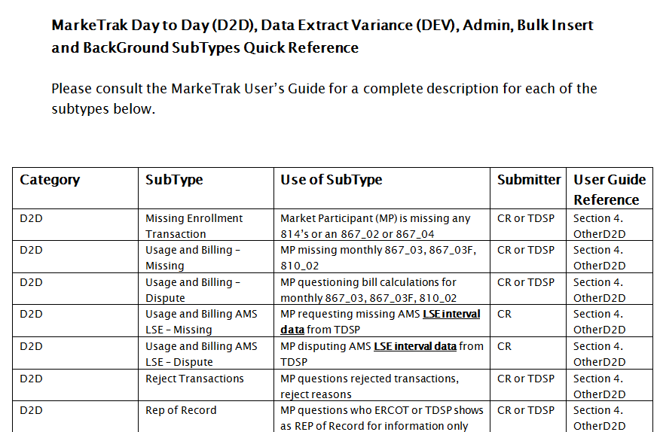
MarkeTrak Documentation
http://www.ercot.com/committees/board/tac/rms/marketraktf/MarkeTrak SubTypes Quick Reference 20150510 v2

Slide 7
Questions
Next Meeting:
Tuesday, September 15th 2:30 – 4:00 pm
After RMTTF meeting
ERCOT Met Center
Agenda Items:
RMGRR Draft – Clarification of Inadvertent Gain Valid Reject Reasons
ERCOT API SLA Metrics
Follow up on reporting for IAG statistics

