Slide 1
Emerging Technologies Working Group
Update to WMS
September 02, 2015
Contents
PVGR Forecasting Stats
Distributed Generation Outflow Report
Other Business: Requested Energy Storage Update
Next ETWG Meeting

Slide 2
I. PVGR Forecasting Stats

Slide 3
Three Hour Ahead
 | Company A STPVPF | Company A PVGRPP | Company B STPVPF | Company B PVGRPP
Average | 6.985% | 19.181% | 5.703% | 8.481%
Under | 7.321% | 20.269% | 4.253% | 9.450%
Over | -6.691% | -2.310% | -6.516% | -3.786%
Count Under | 220 | 459 | 172 | 390
Count Over | 290 | 29 | 329 | 111
Max | 26.712% | 41.647% | 30.227% | 32.349%
<10 | 2.52% | 1.56% | 0.66% | 0.68%
10<x<50 | 6.54% | 6.87% | 5.10% | 5.61%
50<x<100 | 8.92% | 17.58% | 8.84% | 9.62%
100< | 6.87% | 29.64% | 5.23% | 10.94%
120< | 6.86% | 33.34% | 3.17% | 9.28%
Company B more accurate at high and low output.
*Only forecasts where the real-time output above 0.5 MW were used.
Notes:
<10 14%
10<x<50 13%
50<x<100 23%
100< 35%
120< 14%

Slide 4
Six Hour Ahead
 | Company A STPVPF | Company A PVGRPP | Company B STPVPF | Company B PVGRPP
Average | 7.257% | 19.400% | 5.862% | 7.923%
Under | 7.583% | 20.613% | 4.052% | 8.859%
Over | -6.950% | -2.530% | -6.802% | -3.712%
Count Under | 228 | 456 | 164 | 385
Count Over | 282 | 31 | 337 | 116
Max | 26.738% | 41.300% | 26.695% | 30.120%
<10 | 2.71% | 1.75% | 0.68% | 0.65%
10<x<50 | 7.19% | 7.21% | 5.33% | 5.31%
50<x<100 | 9.43% | 18.25% | 9.13% | 9.26%
100< | 6.83% | 29.50% | 5.31% | 10.00%
120< | 6.32% | 32.88% | 3.29% | 9.07%
*Only forecasts where the real-time output above 0.5 MW were used.
Notes:
<10 14%
10<x<50 13%
50<x<100 23%
100< 35%
120< 14%

Slide 5
Day Ahead
 | Company A STPVPF | Company A PVGRPP | Company B STPVPF | Company B PVGRPP
Average | 7.281% | 19.684% | 5.671% | 8.043%
Under | 7.370% | 20.873% | 4.204% | 8.845%
Over | -7.183% | -3.113% | -6.381% | -4.117%
Count Under | 237 | 441 | 151 | 377
Count Over | 256 | 30 | 334 | 108
Max | 25.620% | 41.086% | 29.690% | 32.773%
<10 | 3.08% | 2.03% | 0.65% | 0.74%
10<x<50 | 7.23% | 7.11% | 4.74% | 5.87%
50<x<100 | 8.90% | 18.10% | 8.63% | 9.91%
100< | 7.14% | 30.02% | 5.54% | 9.66%
120< | 7.26% | 33.80% | 3.06% | 9.78%
*Only forecasts where the real-time output above 0.5 MW were used.
Notes:
<10 14%
10<x<50 13%
50<x<100 23%
100< 35%
120< 14%

Slide 6
STPVPF Comparison
All Hours
 | Three Hour | Six Hour | Day Ahead
Company A | 6.985% | 7.257% | 7.281%
Company B | 5.703% | 5.862% | 5.671%
Hours Ending 17-19
 | Three Hour | Six Hour | Day Ahead
Company A | 8.405% | 8.807% | 8.446%
Company B | 6.112% | 6.272% | 7.870%

Slide 7
Sunrise & Sunset
 | Company A | Company B
Sunrise: HE7 | 0.31% | 0.07%
Sunset: HE21 | 5.09% | 0.71%
*Three hour ahead

Slide 8
Bias
The following numbers are the percentage of forecasts that were under-forecasted.
 | Company A STPVPF | Company B STPVPF | Company A PVGRPP | Company B PVGRPP
Three Hour | 43% | 34% | 94% | 78%
Six Hour | 45% | 33% | 94% | 77%
Day Ahead | 48% | 31% | 94% | 78%

Slide 9
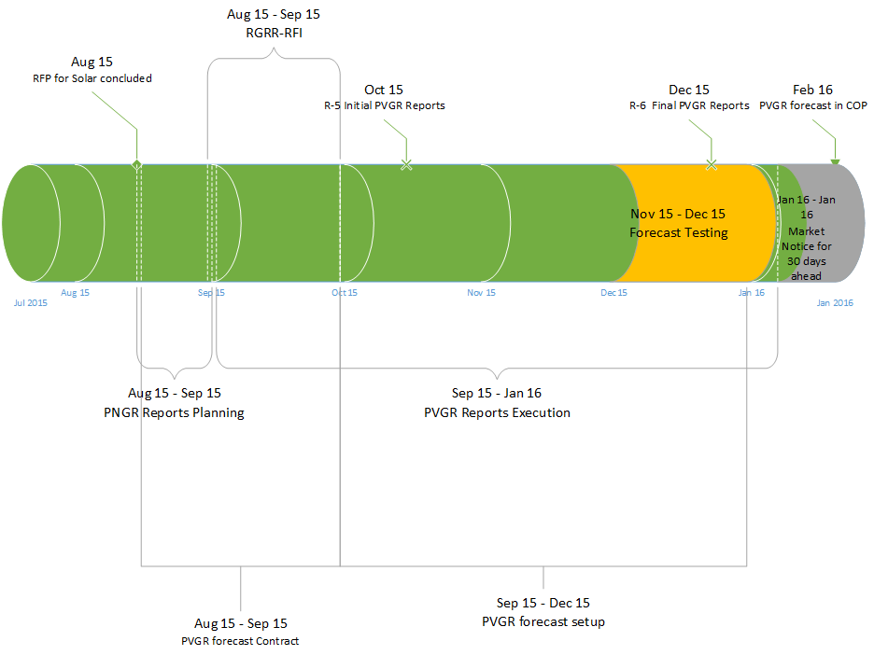
Expected timeline for PVGRR forecast

Slide 10
II. Distributed Generation Outflow Report

Slide 15
III. Other Business: Requested Energy Storage Request
Some parties have expressed an interest in having ETWG do a “score-card” review of storage issues that have been addressed over the past few years, and those remaining to be addressed
Lack of certainty expressed by some may indicate a need to update the ERCOT website under Grid Information | Emerging Technology Tracking System
ETWG will welcome market participants that want to volunteer to present on these topics

Slide 16
IV. Next ETWG Meeting September 17
Logistics
September 17, 1:00PM – 3:30PM
Room 206B
Note that this afternoon session follows the DSWG morning session
Agenda Items
Update on PVGR RFP
Energy Storage Discussion?
Other items as directed

Slide 17
APPENDICES

Slide 18
Requested WMS Motion
n/a

