Slide 1
Workshop: Reactive Power Testing:
Bill Blevins
Sandip Sharma

Slide 2
NERC Implementation of MOD-025-2
Two calendar years following approval at least 40 percent of
its applicable Facilities.
Three calendar years following approval at least 60 percent of
its applicable Facilities.
Four calendar years following approval at least 80 percent of
its applicable Facilities.
Five calendar years following approval at least 100 percent of
its applicable Facilities.

Slide 3
Requirements
Verify the Real Power and Reactive Power capability
Submit a completed test to its Transmission Planner within 90 calendar days of either (i) the date the data is recorded for a staged test; or (ii) the date the data is selected for verification using historical operational data.
It is intended that Real Power testing be performed at the same time as full load Reactive Power testing, however separate testing is allowed for this standard.

Slide 4
NERC Adds requirement for Transmission Owners
Transmission Owner that owns synchronous condenser(s)
Synchronous condenser greater than 20 MVA (gross nameplate rating) directly connected to the Bulk Electric System.
For synchronous condensers, perform only the Reactive Power capability verifications.

Slide 5
Requirements
For staged verification; verify each applicable Facility at least every five years (with no more than 66 calendar months between verifications), or within 12 calendar months of the discovery of a change that affects its Real Power or Reactive Power capability by more than 10 percent of the last reported verified capability and is expected to last more than six months.
For verification using operational data; verify each applicable Facility at least every five years (with no more than 66 calendar months between verifications), or within 12 calendar months following the discovery that its Real Power or Reactive Power capability has changed by more than 10 percent of the last reported verified capability and is expected to last more than six months.
For either verification method, verify each new applicable Facility within 12 calendar months of its commercial operation date. Existing units that have been in long term shut down and have not been tested for more than five years shall be verified within 12 calendar months.

Slide 6
Steps
For generating units of 20 MVA or less that are part of a plant greater than 75 MVA in aggregate, record data either on an individual unit basis or as a group.
Perform verification individually for every generating unit or synchronous condenser greater than 20 MVA (gross nameplate rating).
Verify with all auxiliary equipment needed for expected normal operation in service for both the Real Power and Reactive Power capability verification.
Perform verification with the automatic voltage regulator in service for the Reactive Power capability verification.

Slide 7
Notes on verification
Operational data from within the two years prior to the verification date is acceptable for the verification of either the Real Power or the Reactive Power capability, as long as
  a) that operational data meets the criteria in 2.1 through 2.4 below and
  b) the operational data demonstrates at least 90 percent of a previously staged test that demonstrated at least 50 percent of the Reactive capability shown on the associated thermal capability curve (D-curve).
If the previously staged test was unduly restricted (so that it did not demonstrate at least 50 percent of the associated thermal capability curve) by unusual generation or equipment limitations (e.g., capacitor or reactor banks out of service), then the next verification will be by another staged test, not operational data:

Slide 8
Verify Real and Reactive Lagging(synchronous generator)
Verify synchronous generating unit’s maximum real power and lagging reactive power for a minimum of one hour.

Slide 9
Verify Reactive Power capability
At the minimum Real Power output at which they are normally expected to operate collect maximum leading and lagging reactive values as soon as a limit is reached.
At maximum Real Power output collect maximum leading reactive values as soon as a limit is reached.
For hydrogen-cooled generators, perform the verification at normal operating hydrogen pressure.
Nuclear Units are not required to perform Reactive Power verification at minimum Real Power output.
Calculate the Generator Step-Up (GSU) transformer losses if the verification measurements are taken from the high side of the GSU transformer.(GSU transformer real and reactive losses may be estimated, based on the GSU
impedance, if necessary.)

Slide 10
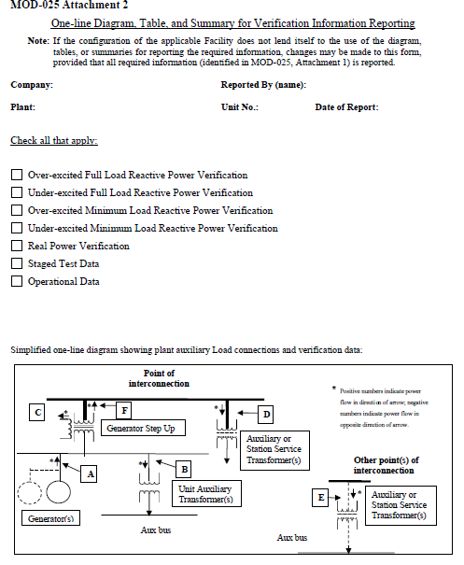
NERC form

Slide 11
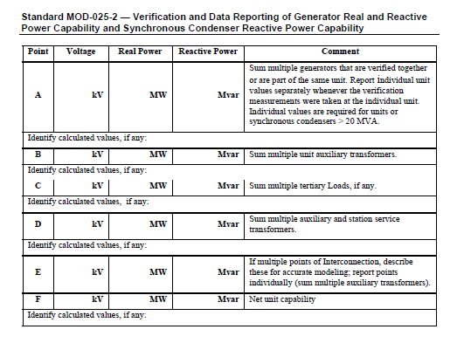
NERC Form

Slide 12
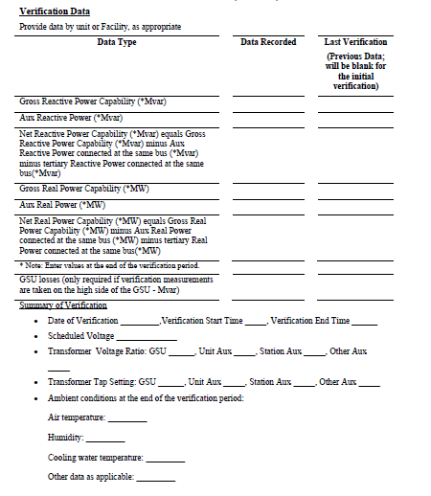
NERC form

Slide 13
Differences between MOD-025 and ERCOT testing
Every 5 years(66 months) vs 2 years
Within 12 months of commercial operations vs prior to commercial operations
Allows for staged test or operational data vs staged test
1 hour test vs 15 minute for reactive test.
  Expect that this was due to preforming the real power verification
Does not check for ERCOT VSS criteria

Slide 14
NERC-Terms Thermal capability curve (D-curve) thermal units except nuclear
Curve defined by Manufacturer (D-Curve) or CURL as updated by testing after commercial operations begins
Field
Current Constraint (Typical limit)
Test must fall within 90% of prior test and must demonstrate at least 50% of D-curve.
Test must fall within 90% of prior test and must demonstrate at least 50% of D-curve.
synchronous generating unit’s maximum real power and lagging
reactive power for a minimum of one hour
Lag +MVAR
Armature
Current Constraint
(Typical limit)
At minimum Real Power output at which they are normally expected
to operate collect maximum leading/lagging as soon as a limit is reached.
At maximum Real Power output collect maximum leading reactive values
as soon as a limit is reached.
Gross MW
Maximum Gross power output typically limited by the Turbine(Generators are typically sized greater than the Turbine)
Lead -MVAR
Test must fall within 90% of prior test and must demonstrate at least 50% of D-curve.
Test must fall within 90% of prior test and must demonstrate at least 50% of D-curve.
Under
Excitation
Constraint(Typical limit)

Slide 15
NERC-Terms Thermal capability curve (D-curve) Nuclear
Curve defined by Manufacturer (D-Curve) or CURL as updated by testing after commercial operations begins
Field
Current Constraint (Typical limit)
Test must fall within 90% of prior test and must demonstrate at least 50% of D-curve.
synchronous generating unit’s maximum real power and lagging
reactive power for a minimum of one hour
Lag +MVAR
Armature
Current Constraint
(Typical limit)
At maximum Real Power output collect maximum leading reactive values
as soon as a limit is reached.
Gross MW
Maximum Gross power output typically limited by the Turbine(Generators are typically sized greater than the Turbine)
Lead -MVAR
Test must fall within 90% of prior test and must demonstrate at least 50% of D-curve.
Under
Excitation
Constraint(Typical limit)

Slide 16
NERC-Terms Thermal capability curve (D-curve)
Variable Generation
Curve defined by Manufacturer (D-Curve) or CURL as updated by testing after commercial operations begins
Field
Current Constraint (Typical limit)
Test must fall within 90% of prior test and must demonstrate at least 50% of D-curve.
Lag +MVAR
Armature
Current Constraint
(Typical limit)
Perform verification of Reactive
Power capability of wind turbines and photovoltaic inverters with at least
90 percent of the wind turbines or photovoltaic inverters at a site on-line.
Gross MW
Maximum Gross power output typically limited by the Turbine(Generators are typically sized greater than the Turbine)
Lead -MVAR
Under
Excitation
Constraint(Typical limit)

Slide 17
NOGRR 142
Requires verification vs the RARF
Includes requirements for NERC staged test for either Coordinated or non-coordinated testing.
Includes a CURL verification (reduced from 15 minutes to 1 minute) for lagging for all units.
Includes a CURL verification (reduced from 15 minutes to 1 minute) for leading for all non NERC exempted units.

Slide 18
Comments
Comments are to include he requirement for AVR in service.
Requirements within ERCOT need to capture all units not just BES.
Include scheduled voltage for the test.
Test for lagging need to be done in summer months.
Confusion about how the 1 minute test is done vs the NERC required 1 hour test.
VSS check is not being documented.
Variable generation leading capability should be checked.
What operational data can be used?
15 minute test is needed to verify that the unit can sustain the reactive capability curve
NDCRC application form be updated to clarify certain requirements, specifically the requirements to provide net injection and power factor data with respect to the Point of Interconnection (POI) with the TSPs

Slide 19
Appendix
Information from 2013 Reactive Testing workshop

Slide 20
Outline
Clarify how Nodal Protocols for Voltage Support and Unit Reactive Test are related and dependent
Define CURL and URL
Review telemetry requirements for Unit Reactive Testing for Conventional and IRR units
Discuss Coordinated Vs. Non-Coordinated Testing
Review NDCRC Form
Demonstrate CURL data use in ERCOT ISO Grid Operations
Feedback from Market Participants
  Identify topics which still require additional clarification
  Suggested changes to NDCRC tool

Slide 21
Nodal Protocols – Reactive Capability
NP 3.15 (2): Units Required to Provide VSS
  All Generation Resources (including self-serve generating units) that have a gross generating unit rating greater than 20 MVA or those units connected at the same Point of Interconnection (POI) that have gross generating unit ratings aggregating to greater than 20 MVA, that supply power to the ERCOT Transmission Grid, shall provide Voltage Support Service (VSS).
NP 3.15 (3): Reactive Requirement (POI)
  An over-excited (lagging or producing) power factor capability of 0.95 or less determined at the generating unit's maximum net power to be supplied to the ERCOT Transmission Grid and at the transmission system Voltage Profile established by ERCOT, both measured at the POI;
  (b) An under-excited (leading or absorbing) power factor capability of 0.95 or less, determined at the generating unit's maximum net power to be supplied to the ERCOT Transmission Grid and at the transmission system Voltage Profile established by ERCOT, both measured at the POI;
Nodal Protocol 3.15
  Voltage Support Service Requirements {POI}
  +/- 0.95 power factor (lead/lag) at Maximum Net MW Output
  URL
Nodal Protocol 8.1.1.2.1.4
  Maximum Reactive Capability of the Unit
  CURL Validation {Generator Terminals/Gross}
  “How to Guide”: Nodal Operating Guide 3.3.2
NP 8.1.1.2.1.4 (2): Reactive Testing Requirement
  The Resource Entity shall conduct reactive capacity qualification tests to verify the maximum leading and lagging reactive capability of all Generation Resources required to provide VSS. Reactive capability tests are performed on initial qualification and at a minimum of once every two years. ERCOT may require additional testing if it has information indicating that current data is inaccurate. The Resource Entity is not obligated to place Generation Resources On-Line solely for the purposes of testing. The reactive capability tests must be conducted at a time agreed to in advance by the Resource Entity, its QSE, the applicable TSP, and ERCOT.
Notes:
To review please preview this slide.

Slide 22
URL and CURL Defined
Unit Reactive Limit -
URL
Corrected Unit Reactive Limits -
CURL
Nodal Protocol Definitions and Acronyms
  The maximum quantity of Reactive Power that a Generation Resource is capable of providing at a 0.95 power factor at its maximum real power capability.
Leading and lagging Net MVAR
Defined in Nodal Operating Guides 3.3.2
  The corrected reactive capability curve establishes the Corrected Unit Reactive Limits (CURL) at the unit terminals that ERCOT Planning and ERCOT Operations will use for their studies.
Leading and lagging reactive gross output

Slide 23
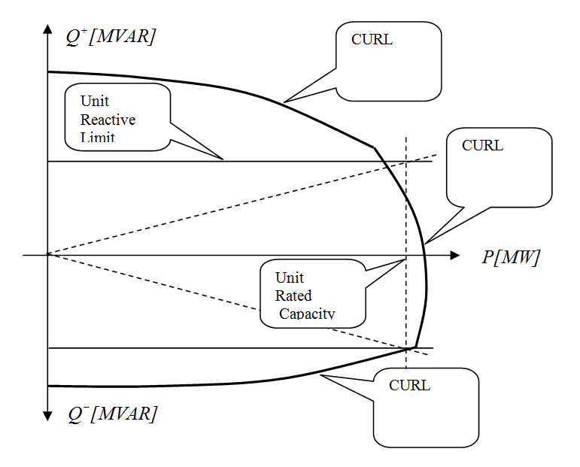
CURL and URL
Typically limited by prime mover. Generator is sized greater than turbine.

Slide 24
CURL Components
“Typical Generator Capability Curve and Operating Limits for a cylindrical rotor generator”
from IEEE PES-PSRC Paper
“COORDINATION OF GENERATOR PROTECTION WITH GENERATOR EXCITATION CONTROL AND GENERATOR CAPABILITY”

Slide 25
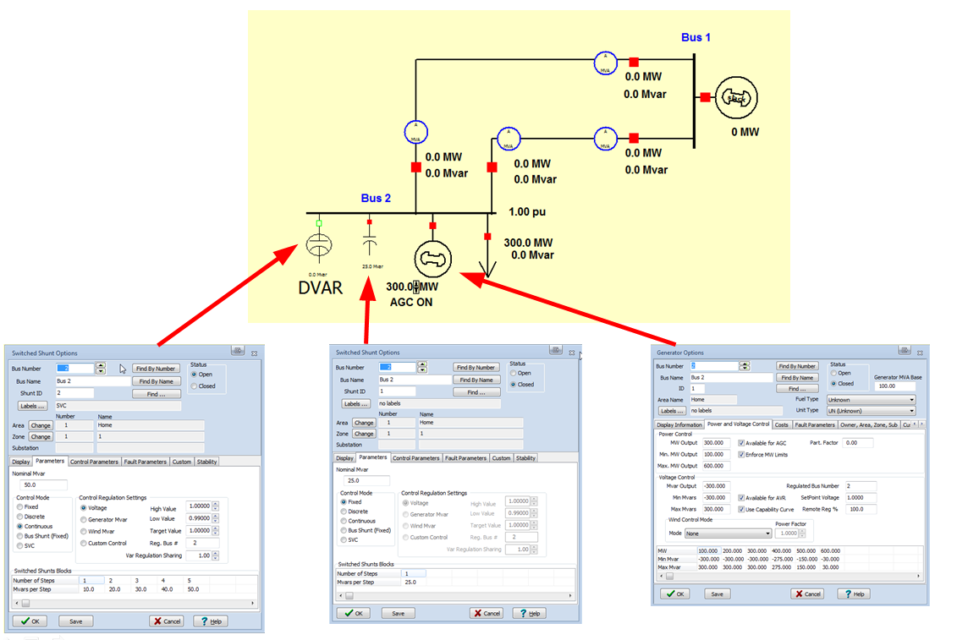
Static and Dynamic Reactive Devices
(Power World Example)
Each component is capable of providing reactive but is modeled separately.

Slide 26
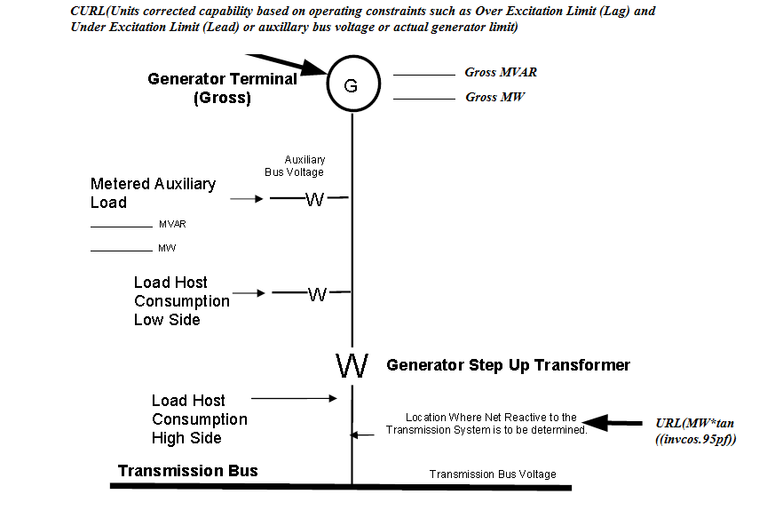
Tested Reactive Capability
Measured and Telemetered
Gross Real and Reactive Power should be Telemetered during the Reactive Capability Test.

Slide 27
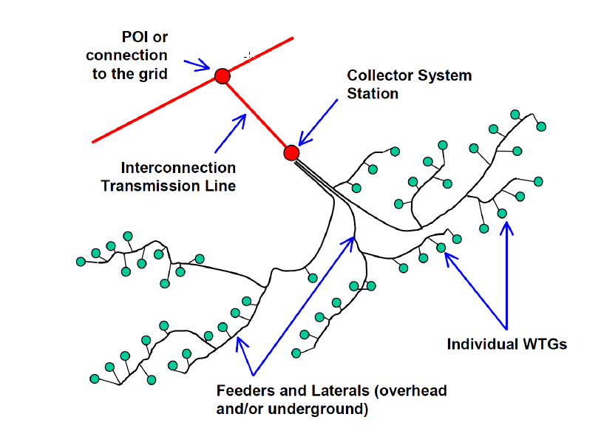
Typical IRR physical arrangement

Slide 28


Gross MW and MVAR Telemetered for IRR Testing
IRR units are modeled at the collector bus on the low side of the GSU
The gross reactive output is the measured value at the collector bus with no static reactive devices included
POI
GROSS
MW & MVAR
(CT and PTs)
GSU
138 kV/
34.5 kV
34.5 kV Collector Bus
CB
CB
Feeders
Static or Dynamic Reactive Devices

Slide 29
Coordinated Vs. Non-Coordinated Reactive Capability Tests
Non-Coordinated Test
Coordinated Test
ERCOT and TSP given a minimum of 48 hour notice of testing. ( An “ERCOT Operating Procedure Document Request for Unit Testing” should be submitted)
Included in the notice:
  Date of Testing
  Net MVAR Leading and/or Lagging that will be experienced on the TSPs transmission system during the test
  CURL
  Estimated MW output
TSP given confirmation prior to test date that system conditions can be made favorable for a specified leading or lagging reactive test on the requested test date
TSP approves reactive testing
ERCOT approves reactive testing
2 Hours Notice Required for all parties
No assistance from TSP or ERCOT needed to adjust voltage at the POI
  No Adjusting Transformer Taps
  No Switching nearby Transmission Static Reactive Devices
Not Recommended for Units testing as a requirement of Part 3 of the COD Checklist

Slide 30
When should a Resource Entity conduct a Coordinated Reactive Test?
If a RE is unable to test within 90% of the URL/CURL with a “non-coordinated” test then a “coordinated” test should be performed.
For initial testing the RE determines whether “coordinated” or “non-coordinated” reactive capability testing is appropriate. For additional information for “coordinated” and “non-coordinated” refer to Nodal Operating Guides section 3.3.2.3 and 3.3.2.2.

Slide 31
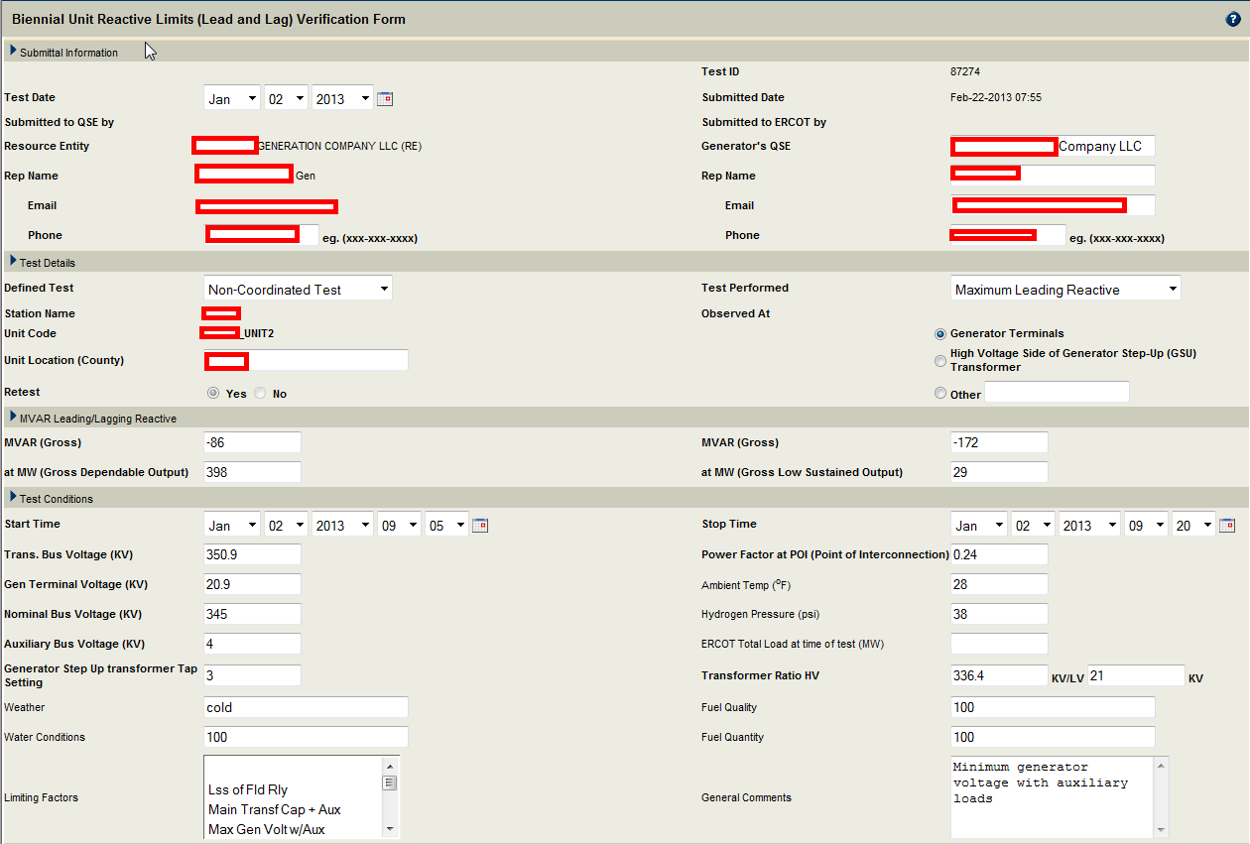
NDCRC Unit Reactive Test Form
Process & timeframe for ERCOT to review & respond
is between 2 weeks to a month

Slide 32
NDCRC Unit Reactive Test Form

Slide 33
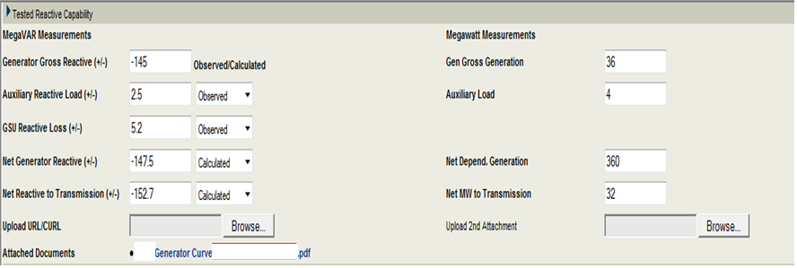
NDCRC Unit Reactive Test Form
Tested Reactive Capability Section is were Gross and Net MW and MVAR values are entered
These values must align with historical telemetered data to be considered valid

Slide 34
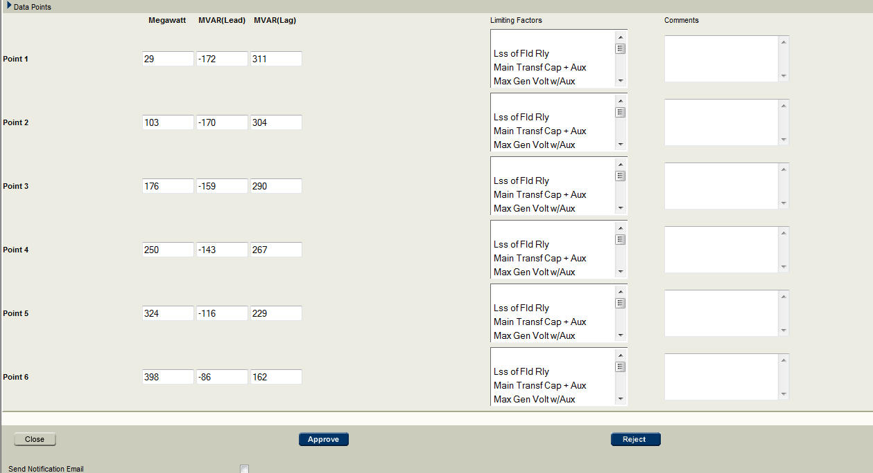
NDCRC Typical Unit Reactive Test – Data Points
6 Points which could be used to recreate the attached CURL
These values should be the remain constant for a given unit
Those entering the Test Form Should now receive automatic notifications that a review is complete whether the test is approved or rejected

Slide 35
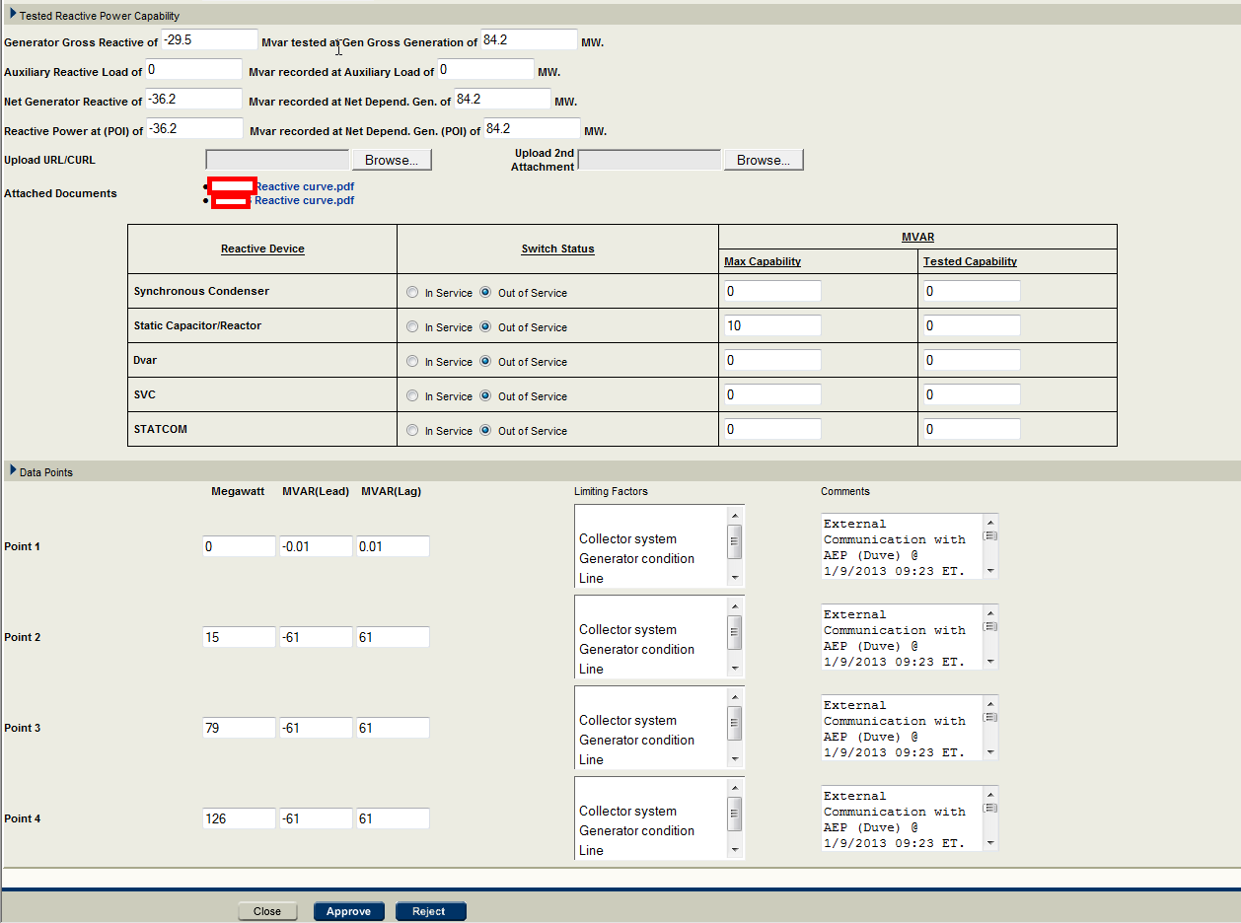
NDCRC IRR Unit Reactive Test
The Max Capability is the capacity of commissioned reactive devices at the site.
The Tested Capability is the magnitude of MVAR contributed from the commissioned reactive devices during the test.

Slide 36
NDCRC IRR Unit Reactive Test

Slide 37
CURL DATA USE
Process for CURL Data Retrieval:
  Perform Reactive Capability Test
  Submit Test Results and CURL in NDCRC
  Test Results are Reviewed
  When Approved, the RARF should be updated (as needed) to reflect the CURL which was submitted in NDCRC within 10 business days
    Nodal Protocol 3.7 (b): “
      The QSE or Resource Entity must update any Resource Parameter for a specific Resource…(b) Within ten Business Days of completion of a reactive capability test to reflect the results of the test”
Four Data Points submitted in the RARF are:
  Incorporated in EMS model
    Real Time
    VSAT
  Incorporated in Seasonal Studies
    Planning Models

Slide 38
FEEDBACK
Identify topics which still require additional clarification
  Additional Detail?
  Examples?
Suggested changes to NDCRC tool
  Changes to HELP documentation?
  Add/Remove Fields?
  More User-Friendly format?
  Point of contact. Bill Blevins bblevins@ercot.com

Slide 39
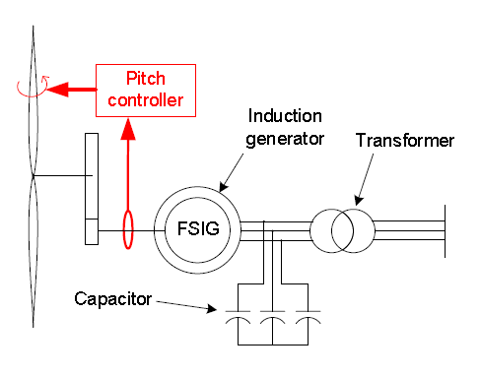
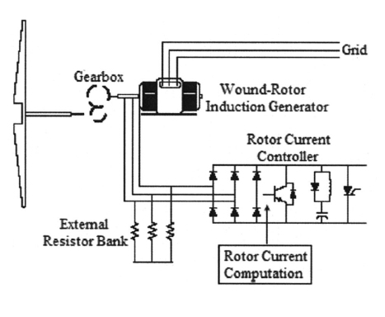
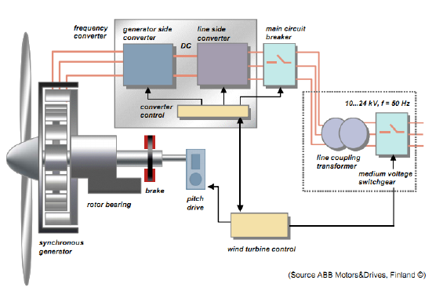
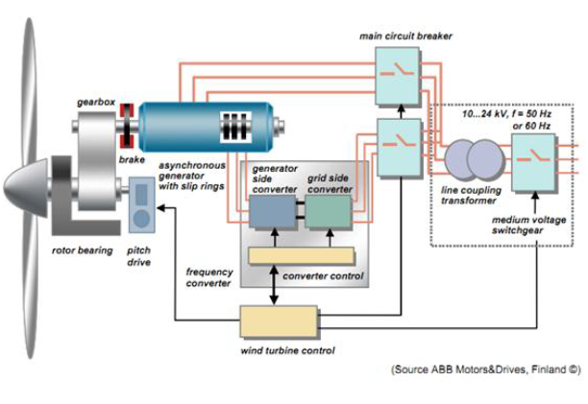
Four basic WTG types
  Type 1: Wound rotor induction generator
  Type 2: Wound rotor induction generator with variable rotor resistance
  Type 3: Doubly-fed induction generator (DFIG)
  Type 4: Full back-to-back converter interface between grid and turbine

Slide 40
Protocol Language
3.15 (4) Generation Resources required to provide VSS whose installations initially began operations on or after September 1, 1999, except as noted below, must have and maintain a URL which has an over-excited (lagging) power factor capability of 0.95 or less and an under-excited (leading) power factor capability of 0.95 or less, both determined at the generating unit's maximum net power to be supplied to the transmission grid and at the transmission system Voltage Profile established by ERCOT, and both measured at the point of interconnection to the TSP.

Slide 41
Other Protocol defined terms
High Emergency Limit (HEL) - Limit established by the QSE describing the maximum temporary unsustainable energy production capability of the Resource. This limit must be achievable for a time stated by the QSE, but not less than 30 minutes.
High Sustained Limit-(HSL for a Generation Resource)- Limit established by the QSE, continuously updated in Real Time, that describes the maximum sustained energy production capability of the Resource.
Net Dependable Capability - The maximum sustained capability of a Resource as demonstrated by performance testing.
Unit Reactive Limit - The maximum quantity of Reactive Power that a Generation Resource is capable of providing at a 0.95 power factor at its maximum real power capability.

Slide 42
URL and HSL
Curve defined by Manufacturer (D-Curve) or CURL as updated by testing after commercial operations begins
Field
Current Constraint (Typical limit)
Test must fall within 90% of the Curve provided by the Resource
Unit
Reactive Limit (URL)
Lag
Lag +MVAR
Armature
Current Constraint
(Typical limit)
.95 pf Lagging
Real Power Test loading for Leading Test done at <60% HSL for IRR or at typical loading for low load conditions for Thermal Unit
Real Power Test loading for Lagging Test done at >60% HSL for IRR or above 95% HSL for Thermal Unit
Maximum Net power output HSL typically
Net or Gross MW
Maximum Gross power output typically limited by the Turbine(Generators are typically sized greater than the Turbine)
Lead -MVAR
.95 pf Leading
Unit
Reactive Limit (URL)
Lead
Test must fall within 90% of the Curve provided by the Resource
Under
Excitation
Constraint(Typical limit)

Slide 43
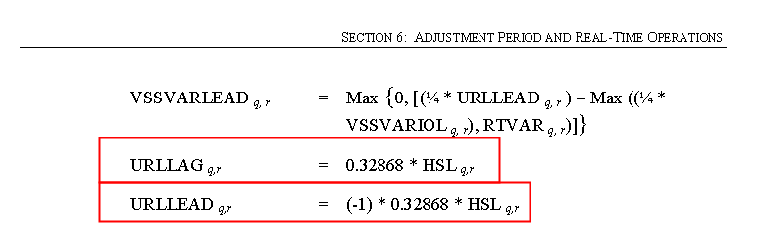
The Question
Is the “maximum net power to be supplied to the transmission grid” the HSL?

