Slide 1
ERCOT Change Request Overview to PRS
Mandy Bauld
ERCOT Project Management Office
August 13, 2015

Slide 2
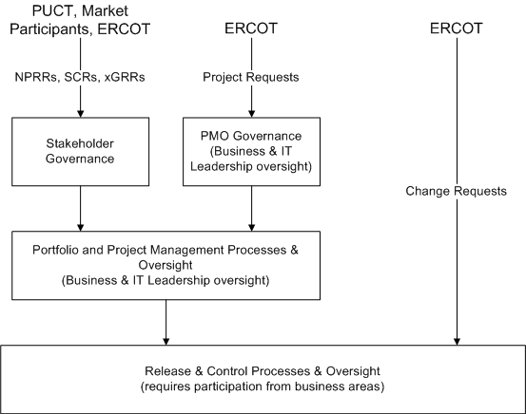
Inputs for Change

Slide 3
ERCOT Internal “Change Requests”
Upon submission the change must be flagged as “market-facing” (Y/N)
If “Y” a description for a market notice is required
The Market Notices team participates in the release planning board
Reviewed, approved, and scheduled through a standard, repeatable process
A Release Control Board (RCB) driven by our Release & Control team
The RCB requires participation from the business owner and other business owners, IT, and PMO staff
Impact assessment required (market impact, cross-impact, scheduling, etc.)
Greater impact / effort?
Not aligned with current policy?
Impact on participant systems?
If any of the above are true the change is taken through the internal process for consideration as submission as an SCR/NPRR/xGRR.
Alternatively, it may just remain pending as an internal change request but be taken for concept review to a stakeholder body
Alignment to a release typically solidifies 30-45 days out
Change request included in 30-day and 10-day market notices for a Release
Spreadsheet attached to the Market Notice

Slide 4
ERCOT Internal “Change Requests”
Process changes under consideration:
Notification prior to 30-days out (e.g., “target delivery dates”)
Useful incorporation into ERCOT PPL and project updates to PRS
Process / tool changes for additional safe-guards for assessing market-facing impacts

