Slide 1
Analysis of Reserves and Prices
July 27, 2015 – August 23, 2015: Hour Ending 17:00
Market Analysis

Slide 2
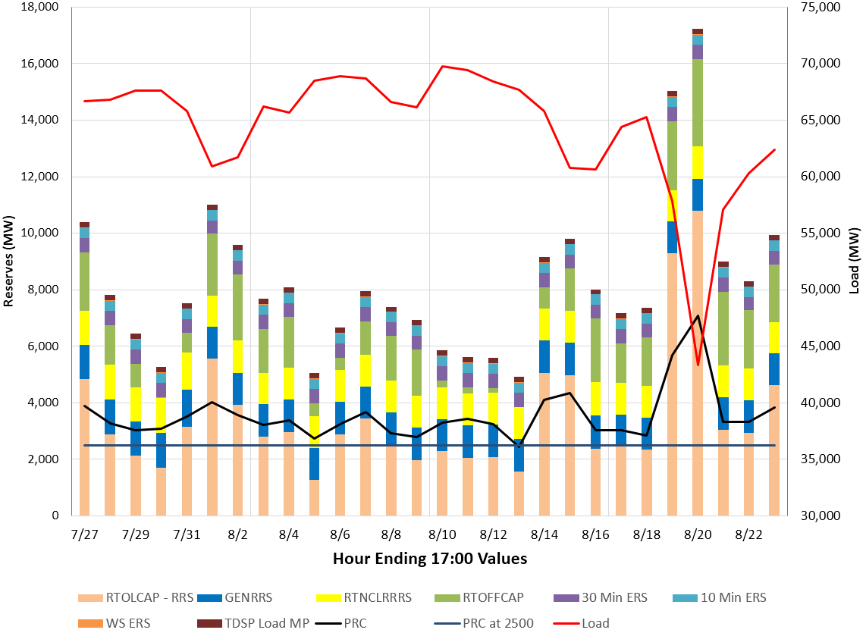
All Reserves
Notes:
In this graph RTOLCAP = (RTOLCAP – RRS)+ RTNCLRRRS+ GEN RRS

Slide 3
All Reserves
Days with lowest total reserves
Notes:
In this graph RTOLCAP = (RTOLCAP – RRS)+ RTNCLRRRS+ GEN RRS

Slide 4
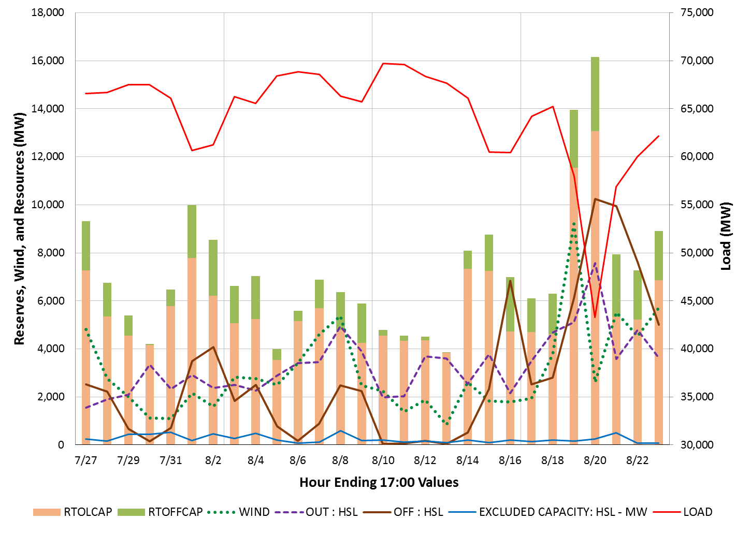
Wind, Offline HSL and Outages
Reserves are affected by wind output, unit outages, offline resources and load

Slide 5
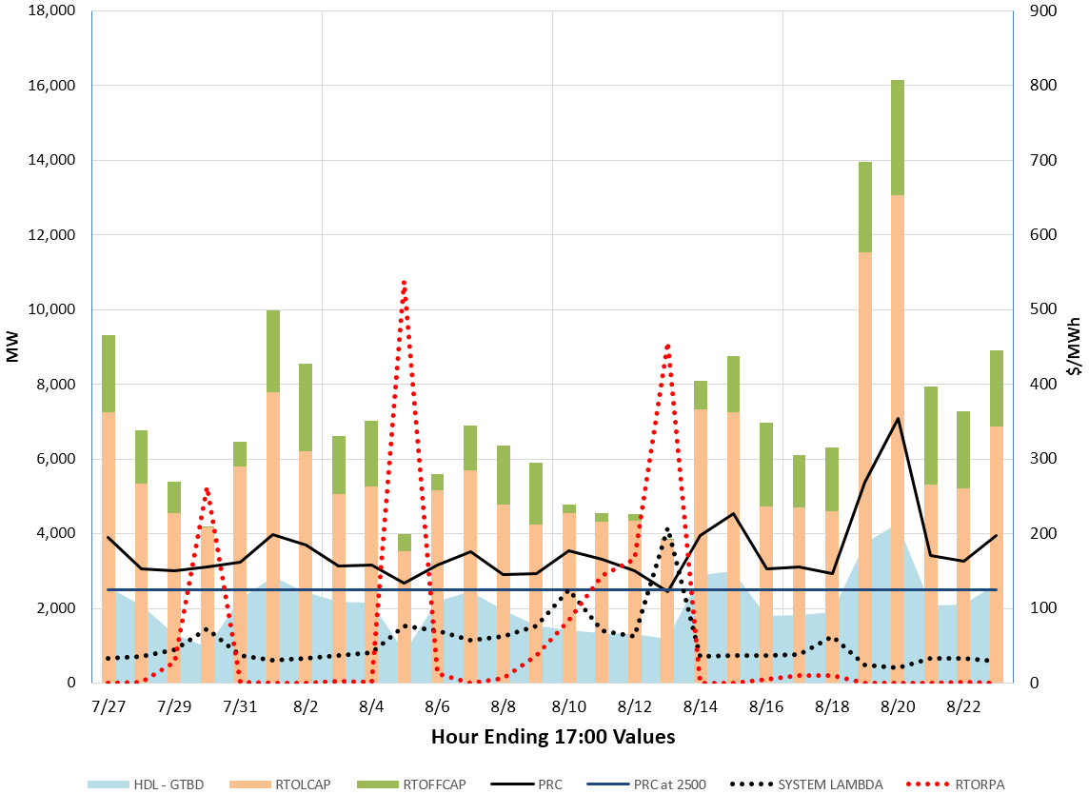
Reserves and Prices
ORDC prices reflected the scarcity of reserves

Slide 6
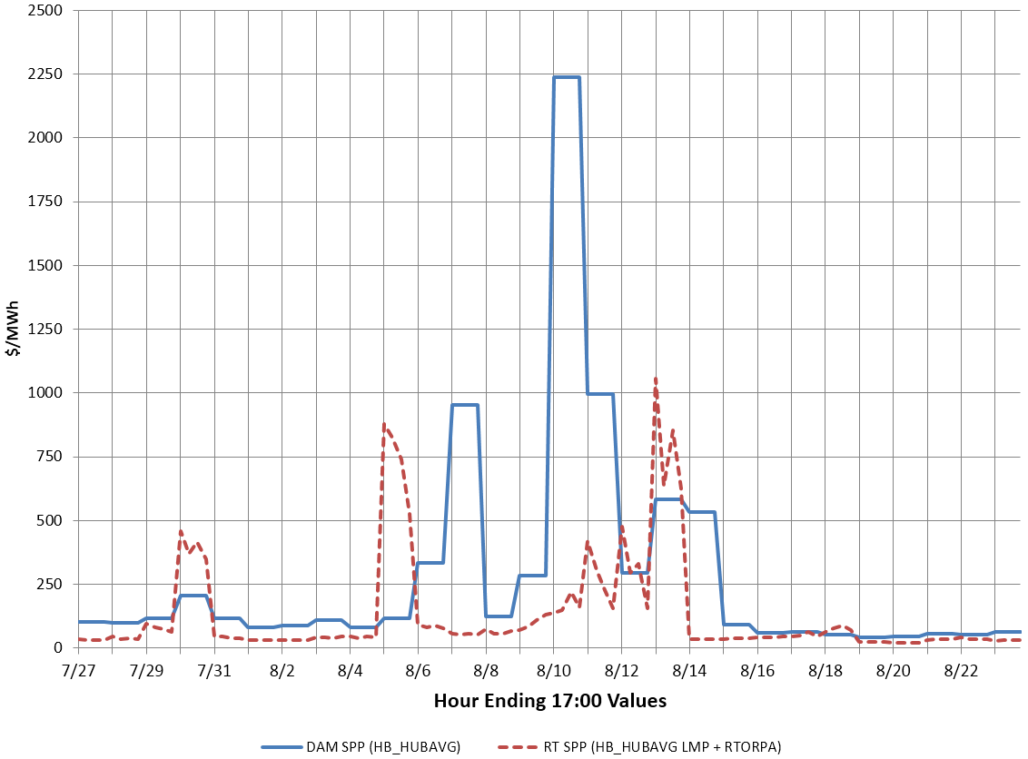
DAM vs. RTM Price Convergence

Slide 7
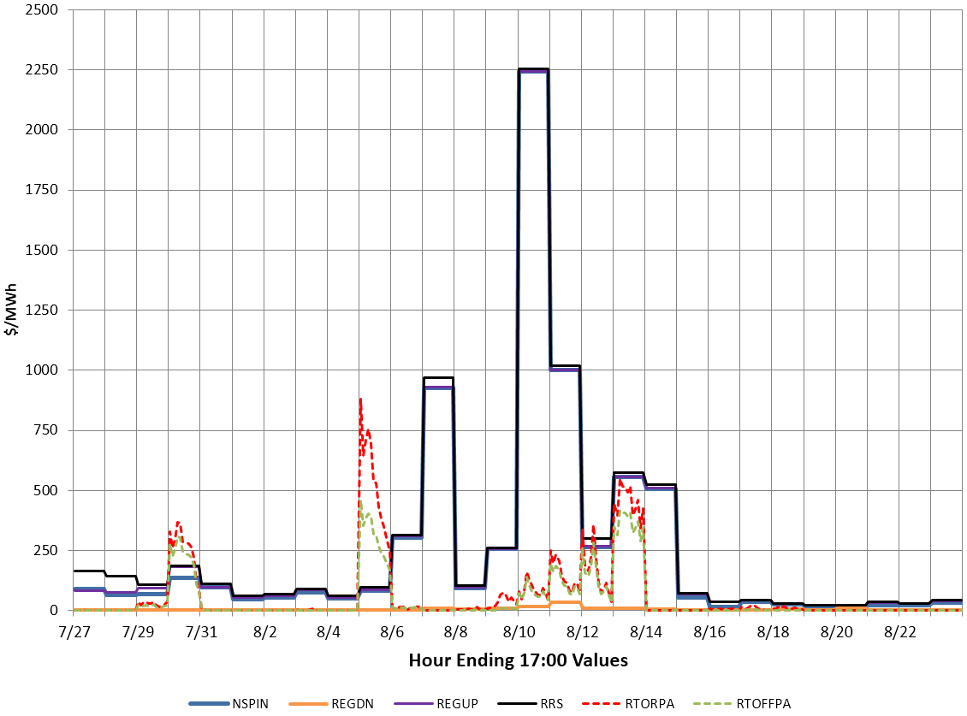
MCPC vs. ORDC Price Adder Convergence

Slide 8
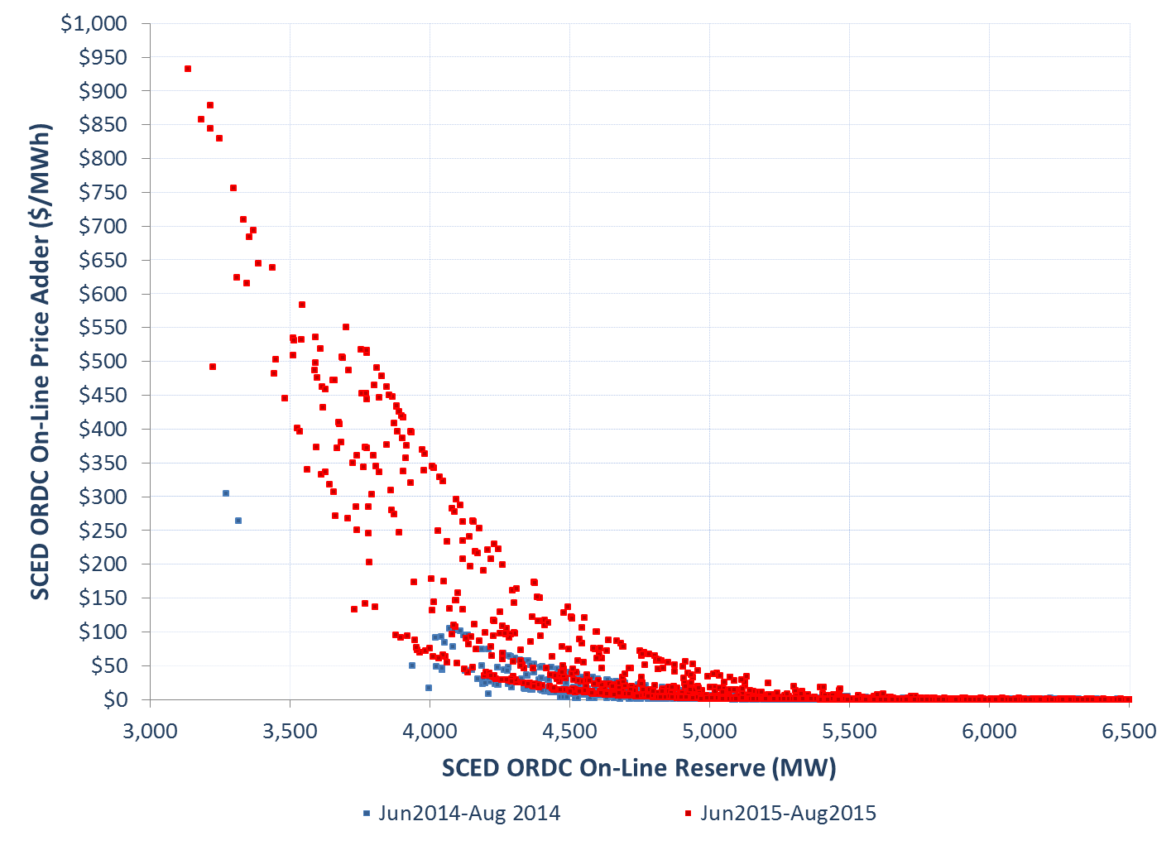
SCED ORDC On-Line Reserve and Price Adder

Slide 9
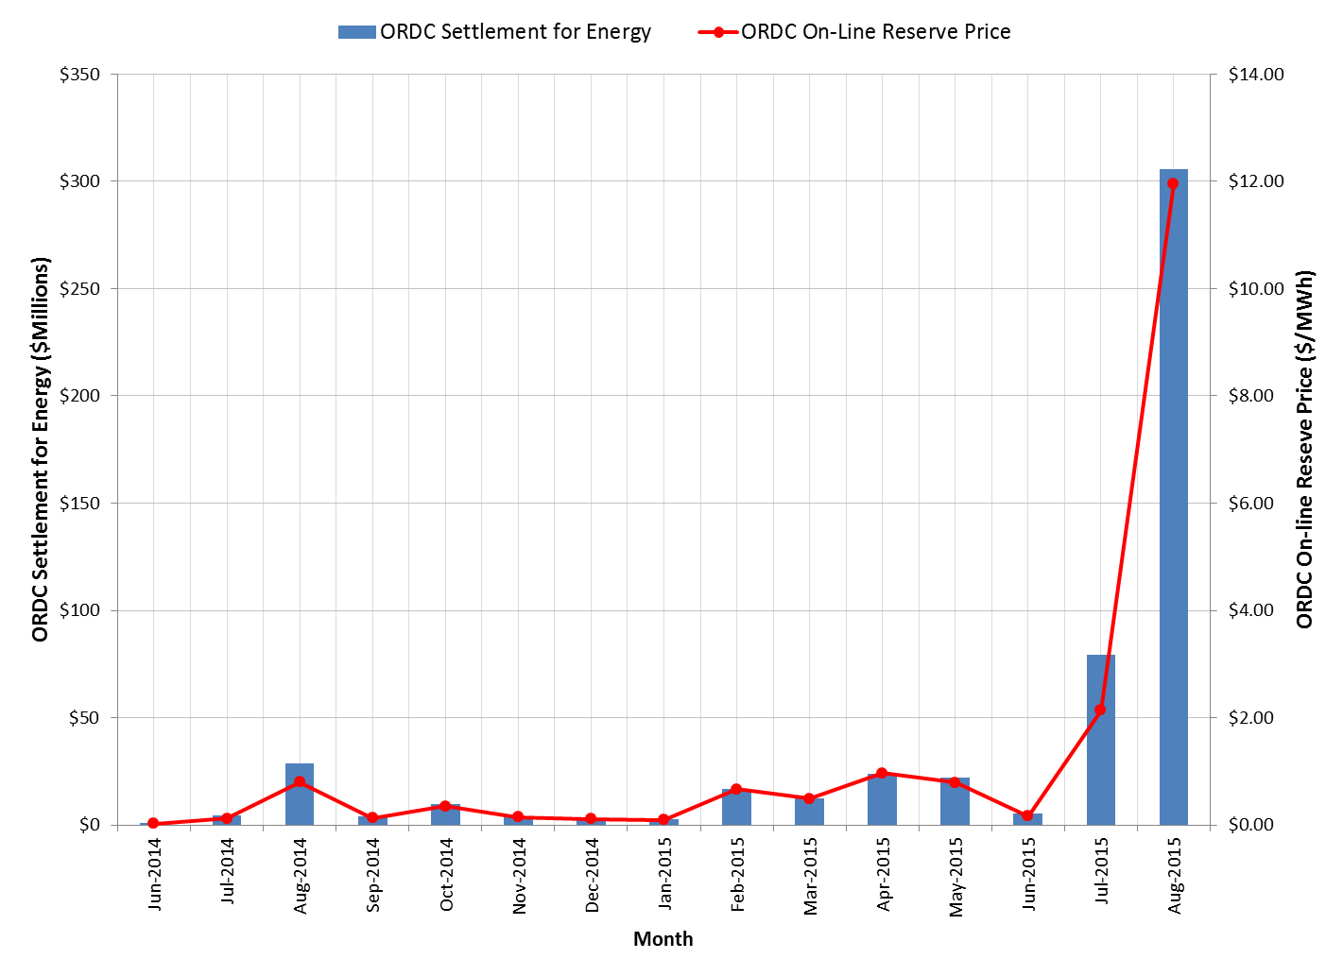
ORDC Settlement for Energy (June,2014 – Aug21st,2015)

Slide 10
SCED ORDC Impact
 | First one year | June 2015 | July 2015 | August 2015 until 21st
Settlement for Energy | $132.5 M | $5.4 M | $79.2 M | $305.7M
Settlement for Ancillary Service | $1.6 M | $0.09 M | $(0.44) M | $(0.9) M
Avg Online Reserve Price (Peak) | $0.51 | $0.25 | $3.50 | 22.6
Avg Online Reserve Price (Off Peak) | $0.26 | $0.07 | $0.53 | $0.33
Max Online Reserve Price (Peak) | $202.9 | $28.3 | $434.0 | $798.4
PNM | $29,308.0 | $738.4 | $2,945.7 | $7,574.0*
PNM from ORDC | $2,731.8 | $95.3 | $1,185.9 | $4,506.1*
Notes:
* - only until 25th

Slide 11
Questions?

