Slide 1
D.R.E.A.M Task Force
Distributed Resource Energy/Ancillary Market Task Force
August 2015 Meeting

Slide 2
Housekeeping Items
Future Meetings / Meeting Frequency
Policy Cuts for TAC in 2016
Identification of SMEs
Short-term Goals
Expansion of the Issues List / IDEAs

Slide 3
Future Meetings / Frequency
Proposal:
The DREAM task force shall meet once per month for the remainder of 2015. Each monthly meeting will have a focus area:
September: Definitions, Reporting, Distribution Awareness, and DR Aggregation Rules
October: Interconnection Procedures, Metering, and Modeling
November: Local Pricing (Nodal), Resource Optionality
December: Compliance Metrics, Review of TAC-level Policy Cuts
January: TAC Presentation: Policy Cuts
Each monthly meeting will include a review of previous meeting action items and provide an opportunity to raise new DER issues.

Slide 4
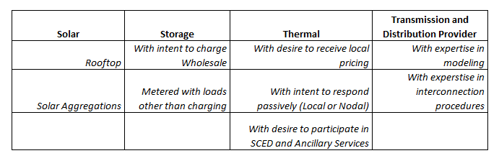
SME Identification
While DREAM is a non-voting body, it is important to verify:
Each interested market participant has a voice and is adequately represented
TAC is apprised of dissenting opinions and is aware of their respective market segment
Proposal:
Identify SMEs from

Slide 5
SME Identification
Other Categories?
Volunteers?

Slide 6
ERCOT Whitepaper
ERCOT published a whitepaper outlining a potential market framework for Distributed Resources. This comprehensive document includes:
Three varietals of DER Market involvement, including passive and active response
Extensive documentation of existing protocols and protocol changes needed to accommodate a DER marketplace
Proposed definitions
Items for stakeholder consideration
Please review the whitepaper to expand the issues list prior to the September DREAM Meeting.

Slide 7
IDEAS: Issue development, explanation and solutions
Each issue identified should have
A sponsor
A description of the issue, gaps, relevant protocols, and necessary changes
Detailed analysis and potential solutions to be considered by the DREAM TF
Consensus where achievable
TAC escalation when necessary
DREAM leadership will work with ERCOT to develop and formalize DER issues.

Slide 8
CAISO Documentation Available
The California ISO published numerous documents outlining their quest to develop a more comprehensive market structure for distributed energy resources.
Some challenges facing each ISO are different in nature. Other issues considered and resolved by CAISO may be more informative.
The most recent document released by CAISO “Expanded Metering and Telemetry Options Phase 2 – Draft Final Proposal”
Provides useful insight for the October Focus Meeting, and
Is a “significant” and “quick” step forward to improving the status quo while avoiding “major market system changes and the associated time required to implement those changes.”
http://www.caiso.com/Documents/DraftFinalProposal_ExpandedMetering_TelemetryOptionsPhase2_DistributedEnergyResourceProvider.pdf

Slide 9
Goals:
Short-term
Long-term
Review the ERCOT Whitepaper
Expand and refine the issues list (to include issues from the WP)
Host issue-specific meetings on a monthly basis. September will focus on Definitions, Reporting, Distribution Awareness, and LZ Aggregations
Establish consensus where possible
Identify and elevate key issues for TAC direction
Prepare an informative white-paper for TAC and/or PUC direction

Slide 10
Questions?
Gregory.thurnher@shell.com

